Slide 1



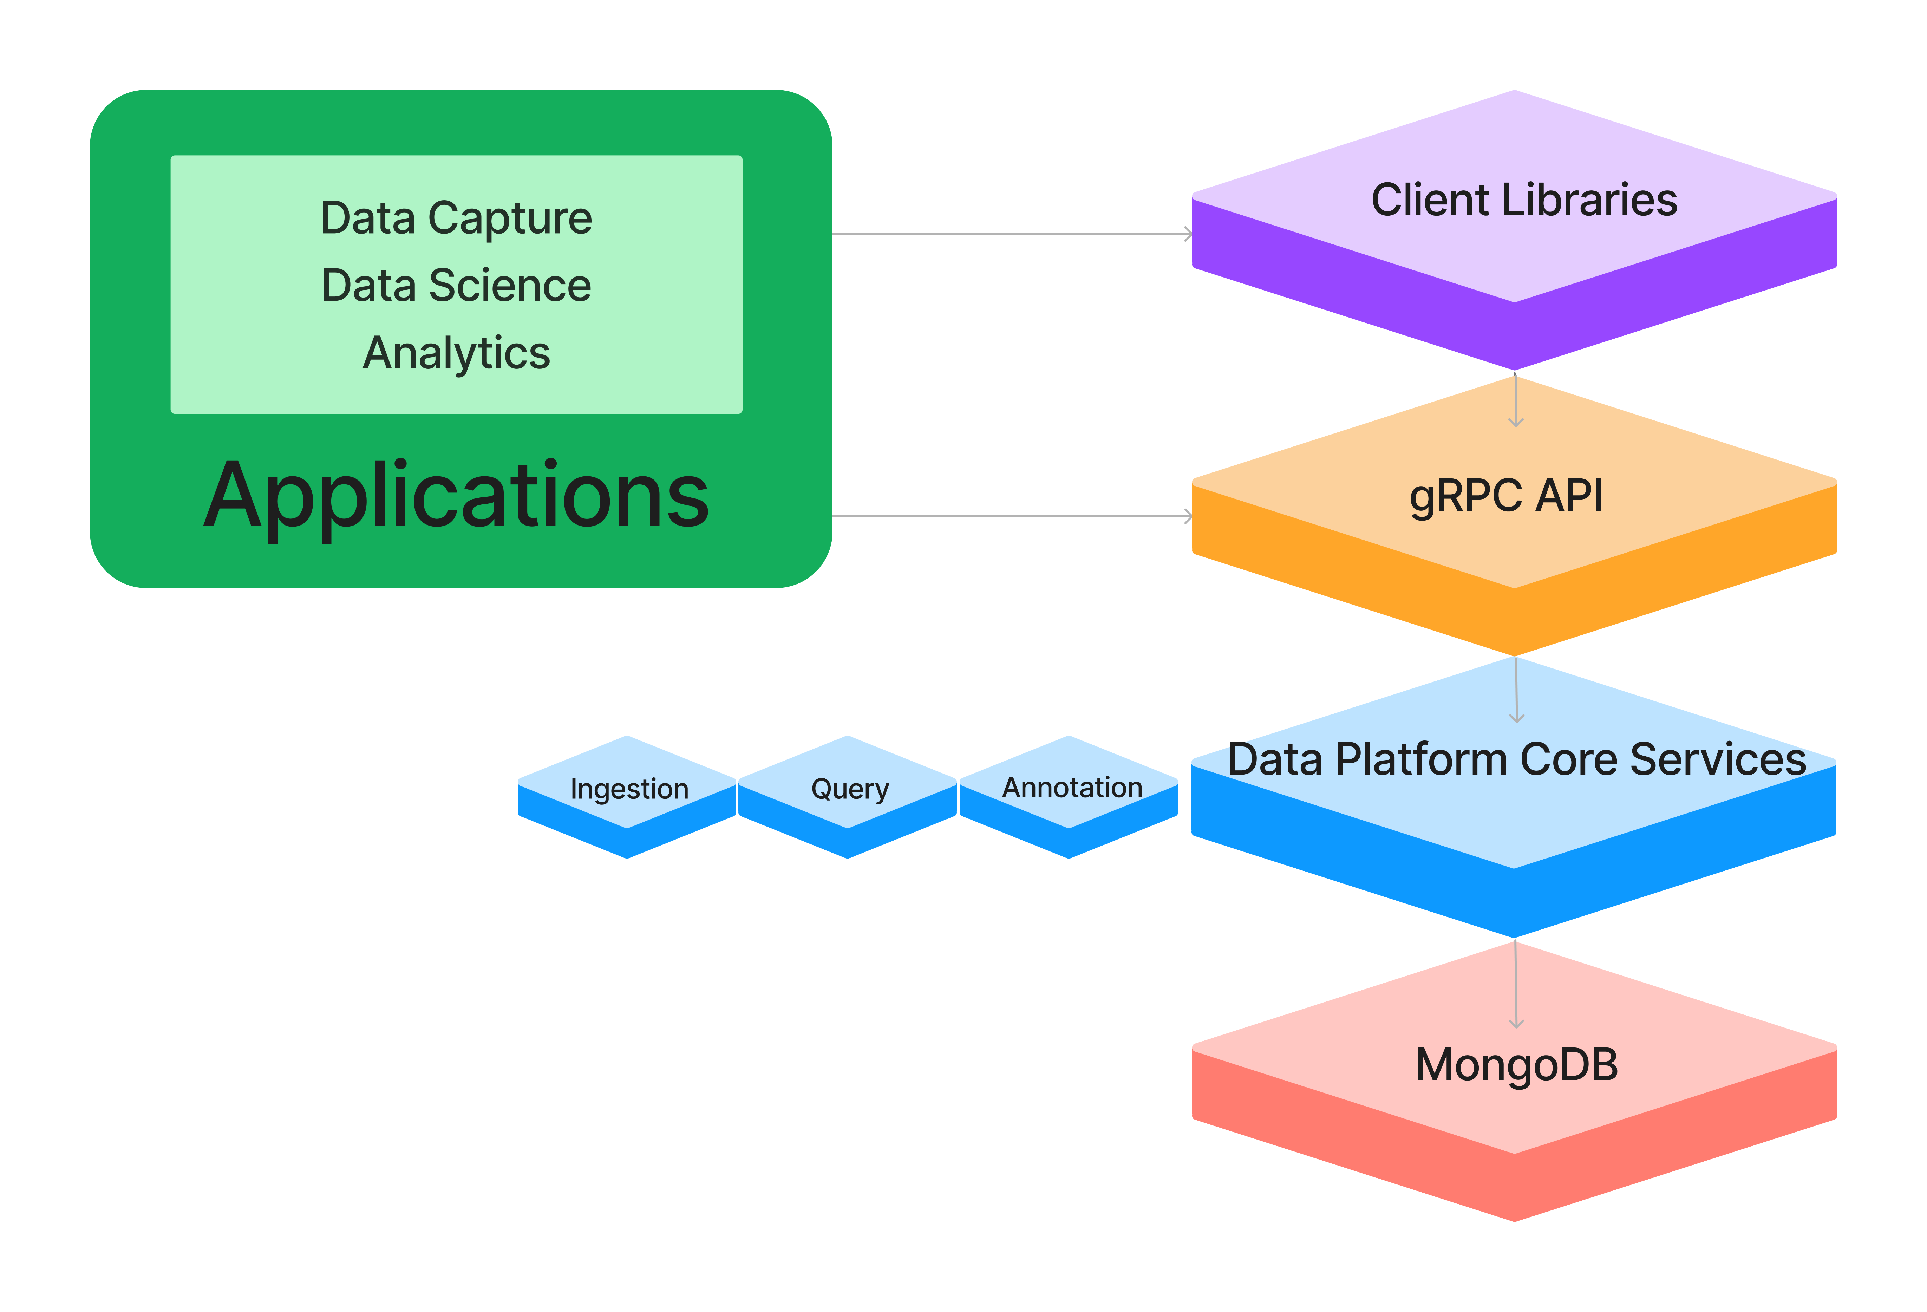
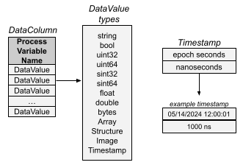
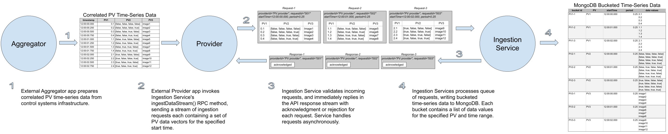
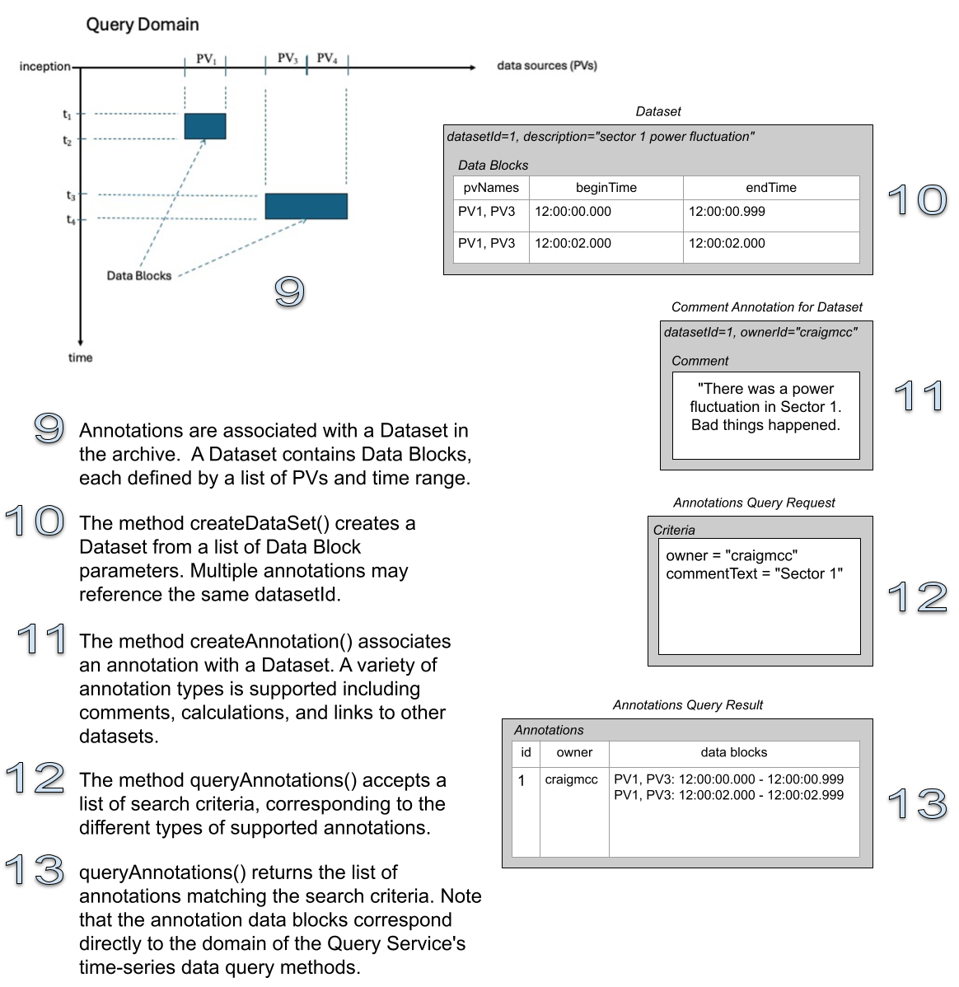

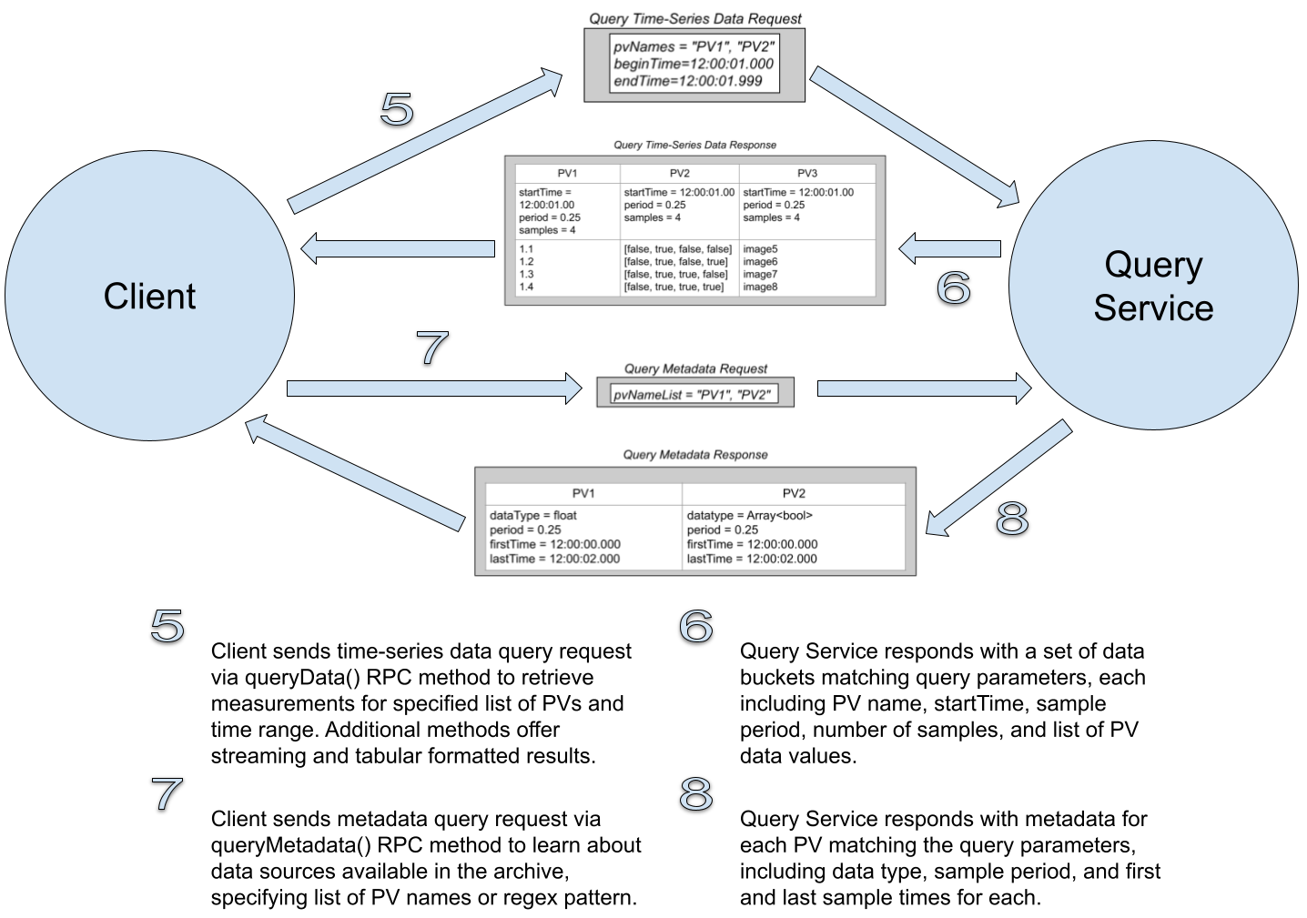
The Data Platform: An Independent System for Management of Heterogeneous, Time-Series Data to Enable Data Science Applications
C. McChesney, C. K. Allen, M. Davidsaver, B. Dalesio, Osprey DCS, Ocean City, Maryland, USA
Abstract
The Data Platform is a fully independent system for management and retrieval of heterogeneous, time-series data required for machine learning and general data science applications deployed at large particle accelerator facili-ties. It is an independent subsystem within the larger Machine Learning Data Platform (MLDP) which provides full-stack support for such facilities and applications. The Data Platform maintains the heterogeneous data archive along with all associated metadata and post-acquisition user annotations. It also facilitates all interactions between data scientists and the data archive; thus it directly sup-ports all back-end data science use cases. Accelerator facil-ities include thousands of data sources sampled at high frequencies, so ingestion performance is a key requirement and the current challenge. We describe the operation, architecture, performance, and development status of the Data Platform (DP).
Data Platform Installation and Deployment
The DP has a formal installation system available at: https://github.com/osprey-dcs/data-platform which includes instructions and additional documentation. The repository access is soon to be public as we secure the API, however, interested parties can contact Osprey DCS to obtain development releases now.
Project Background
Several objectives were stated at project initiation, for both performance and operation.
Provide an Applications Programming Interface (API) for ingestion of heterogeneous, time-series data including scalar values, arrays, structures, and images.
Handle data rates expected for an experimental research facility such as a particle accelerator (minimum. performance requirement is 4,000 scalar data sources sampled at 1 KHz, i.e., 4 million samples per second).
Provide an API for retrieval of ingested heterogeneous data.
Provide an API for exploring metadata available in the archive.
Provide mechanisms for adding post-ingestion annotations to the archive and performing queries over those annotations.
Data Platform technical components
Visible to clients are 2 primary technical components.
The DP API is built with the gRPC high-performance remote procedure call (RPC) framework. The API may be used directly by external applications, using gRPC’s many programming language bindings. Additionally, applications may use a custom Java Client Library for higher level functionality.
The DP Core Services are implemented as Java server ap-plications. There are currently 3 independent services: Ingestion, Query, and Annotation. All services utilize the MongoDB document-oriented database for persistence.
DP API Data model
The gRPC API defines the data model for the Data Platform. Key elements include Process Variables, Data Vectors, Heterogeneous Data Values, and Time.
The core data element of the DP is the process variable (PV). These are processes within the facility being monitored or controlled. Process variables are sampled within the control system to create correlated, time-series data.
The Ingestion and Query Service APIs for handling data work with vectors of PV measurements. In the APIs this aspect is reflected with data type "DataColumn", which includes a PV name and list of measurements.
The API supports heterogeneous data values in column vectors through the use of the API type “DataValue”, which allows a variety of data types for PV measurements including numerous scalar types, as well as multi-dimensional arrays, structures, and images. Both Ingestion and Query Service APIs use this data type to provide a streamlined method interface.
Time is represented with the "Timestamp" data type. It contains fields for 1) seconds since the epoch start, and 2) nanosecond offset from the epoch second. API time methods use either the data type "TimestampList" to send an explicit list of timestamps, or a "SamplingClock" message that includes the parameters of a uniform sampling clock (i.e., start time, sample period, sample count).
DP Ingestion service
DP annotation service
DP Query service

