Slide 1
A Data Platform for Machine Learning and Data Science Applications
Introduction and Overview
Craig McChesney
Christopher K. Allen
Osprey DCS

Slide 2
Outline
Motivation
Approach
Status
Development Plan
Technology Drill-Down
Installation and Deployment

Slide 3
Motivation
Our goal is to provide full stack support for machine learning and general data science applications. We will provide tools to:
capture time-correlated machine data from arbitrary data sources to a central repository
support ingestion of heterogeneous data types: scalar, array, table, structure, and image
associate machine data with important events via "snapshot" metadata
support post-ingestion annotation including comments, associations, and calculations
upload derived datasets and link datasets to show provenance and relationships
provide broad data-science oriented retrieval of heterogeneous data and annotations
minimize time required to make data available in the repository: our performance goal is to continuously capture data for 4000 PVs each sampled at 1KHz
provide a web application for exploring the data platform repository

Slide 4
Approach
create Java server applications providing data ingestion, query, and other services such as annotation and export
utilize a central database platform for storing time series data and metadata, and indexing data files created outside the database
provide a cross-platform, high-performance API that supports a wide variety of programming languages and types of applications
provide high-level libraries for building data science applications
build a JavaScript web application for retrieving, viewing, exporting, annotating, and manipulating data in the repository

Slide 5
Why use an ingestion service API instead of writing directly to the database?
This is a common question, and is understandable when the focus is on ingestion performance. Using a service API facilitates:
Changing the underlying persistence technology or database schema transparently to the clients
Capturing data from a wide variety of devices without creating a custom capture client for each of them that exposes the details of the underlying persistence mechanism and must be kept in sync with database/schema changes
Including time-correlated data for those devices in a single result set
The performance measured for the initial ingestion service implementation is in the same range as our benchmark for writing data directly to MongoDB, so using the service API doesn't seem to degrade performance significantly.

Slide 6
Status
investigated gRPC authentication/authorization approach (9/2023)
re-implemented ingestion service utilizing MongoDB to store time series data and metadata, exceeding baseline performance goal for scalar data (9/2023)
simplified API specification, eliminated InfluxDB from tech stack (8/2023)
completed performance benchmark study of technology stack alternatives (8/2023)
built prototype web application demonstrating use of query service API from JavaScript app running in the browser (1/2022)
built prototype ingestion and query services demonstrating use of gRPC API for capturing heterogeneous data types from arbitrary data sources (12/2022)

Slide 7
Road Map / Development Plan
documentation and build process for new data platform implementation (10/2023)
build query service that reflects API changes and new repository structure, focusing initially on scalar data (10/2023)
add handling to ingestion and query services for arrays, tables, structures, and images (12/2023)
add authentication/authorization mechanism
add support for post-ingestion annotation of data
add support for exporting data
add support for uploading and linking datasets, data provenance
revamp web application to reflect API changes and add new features
deployment, prodictionization, configuration, and scaling

Slide 8
Technology Drill Down

Slide 9
Data Platform Technology Drill Down
Architecture Diagrams
Technology Stack
Data Flow
Technology Stack Elements
Communication Layer
Service Layer
Persistence Layer
Application Layer
Toolbox

Slide 10
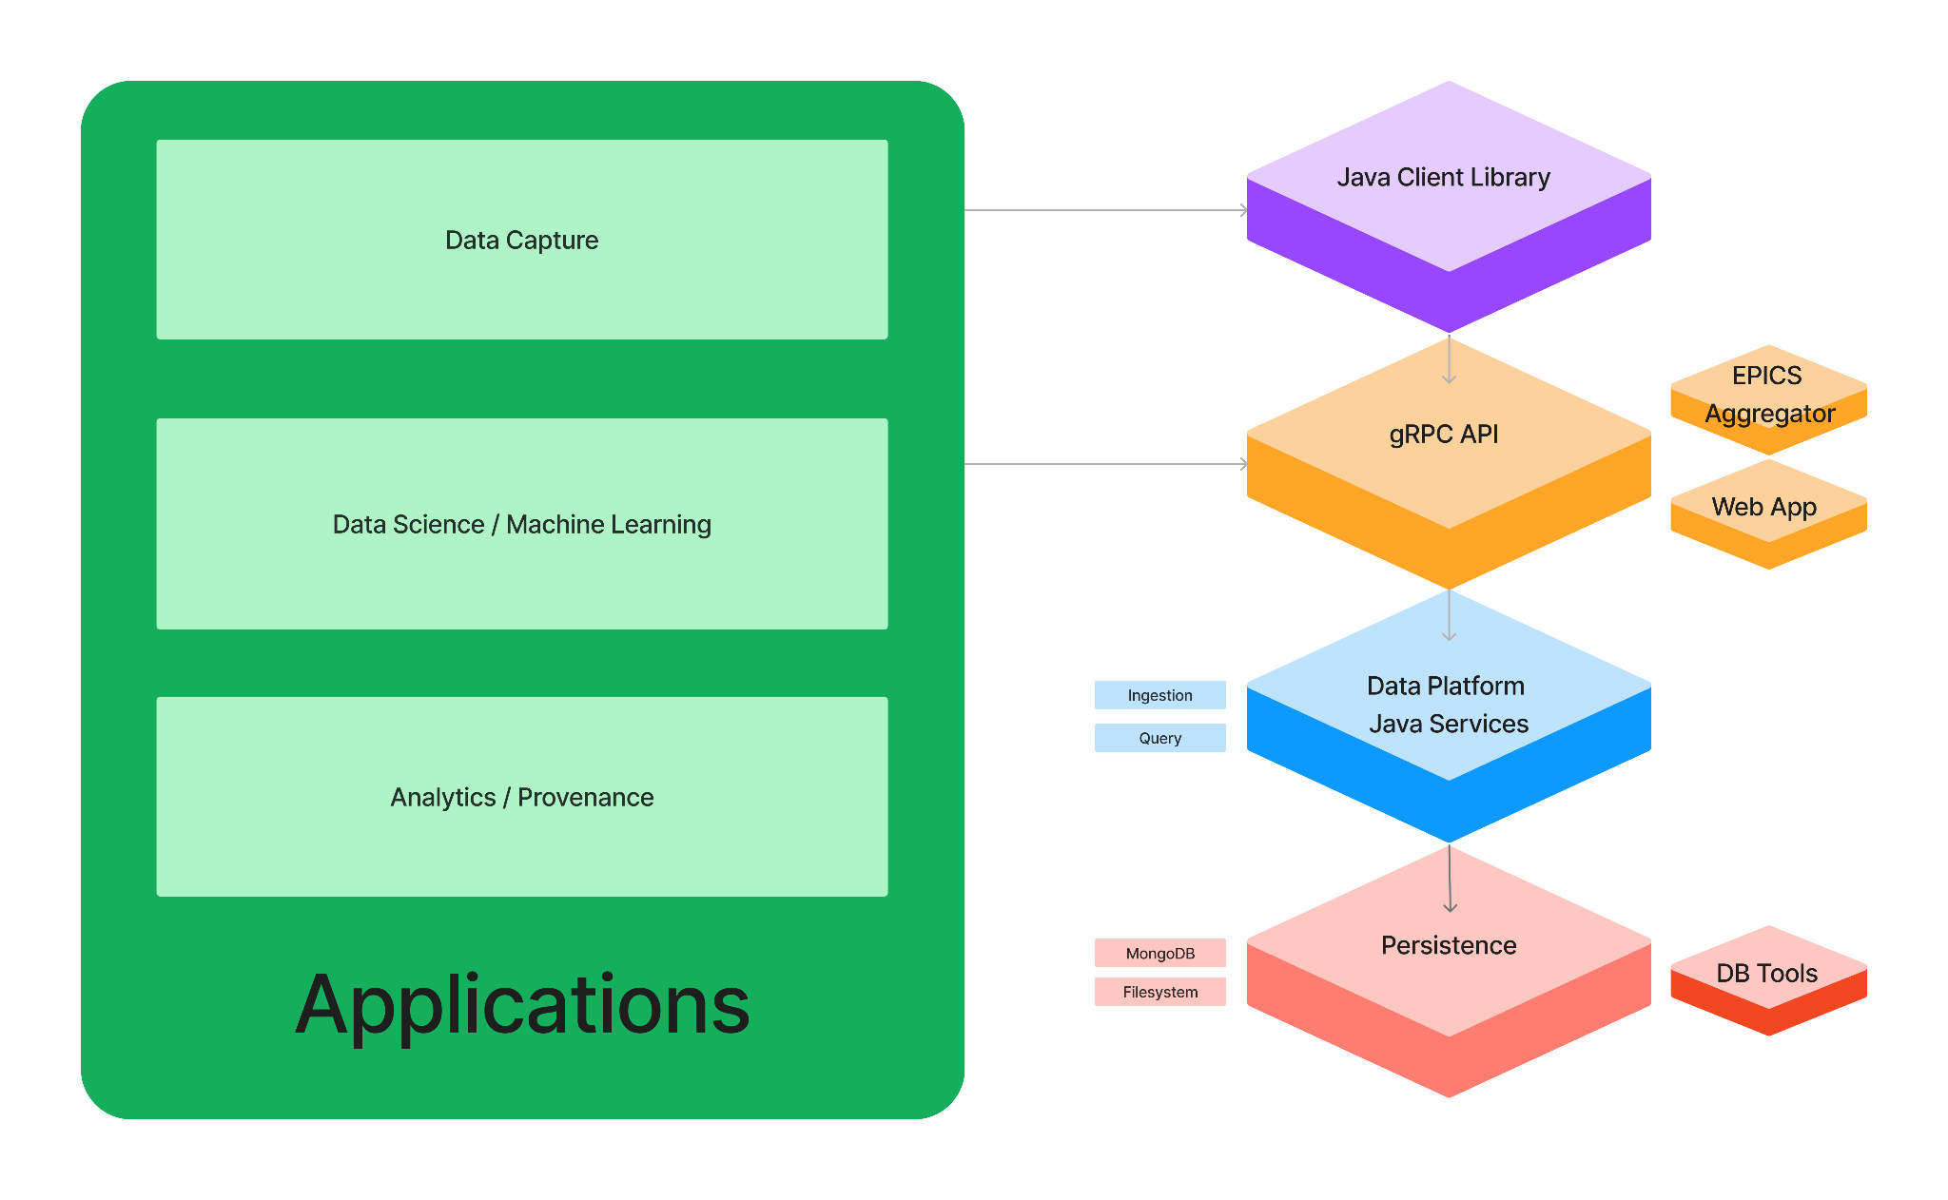
Data Platform Technology Stack
The Data Platform provides full stack support for building machine learning and data science applications.

Slide 11
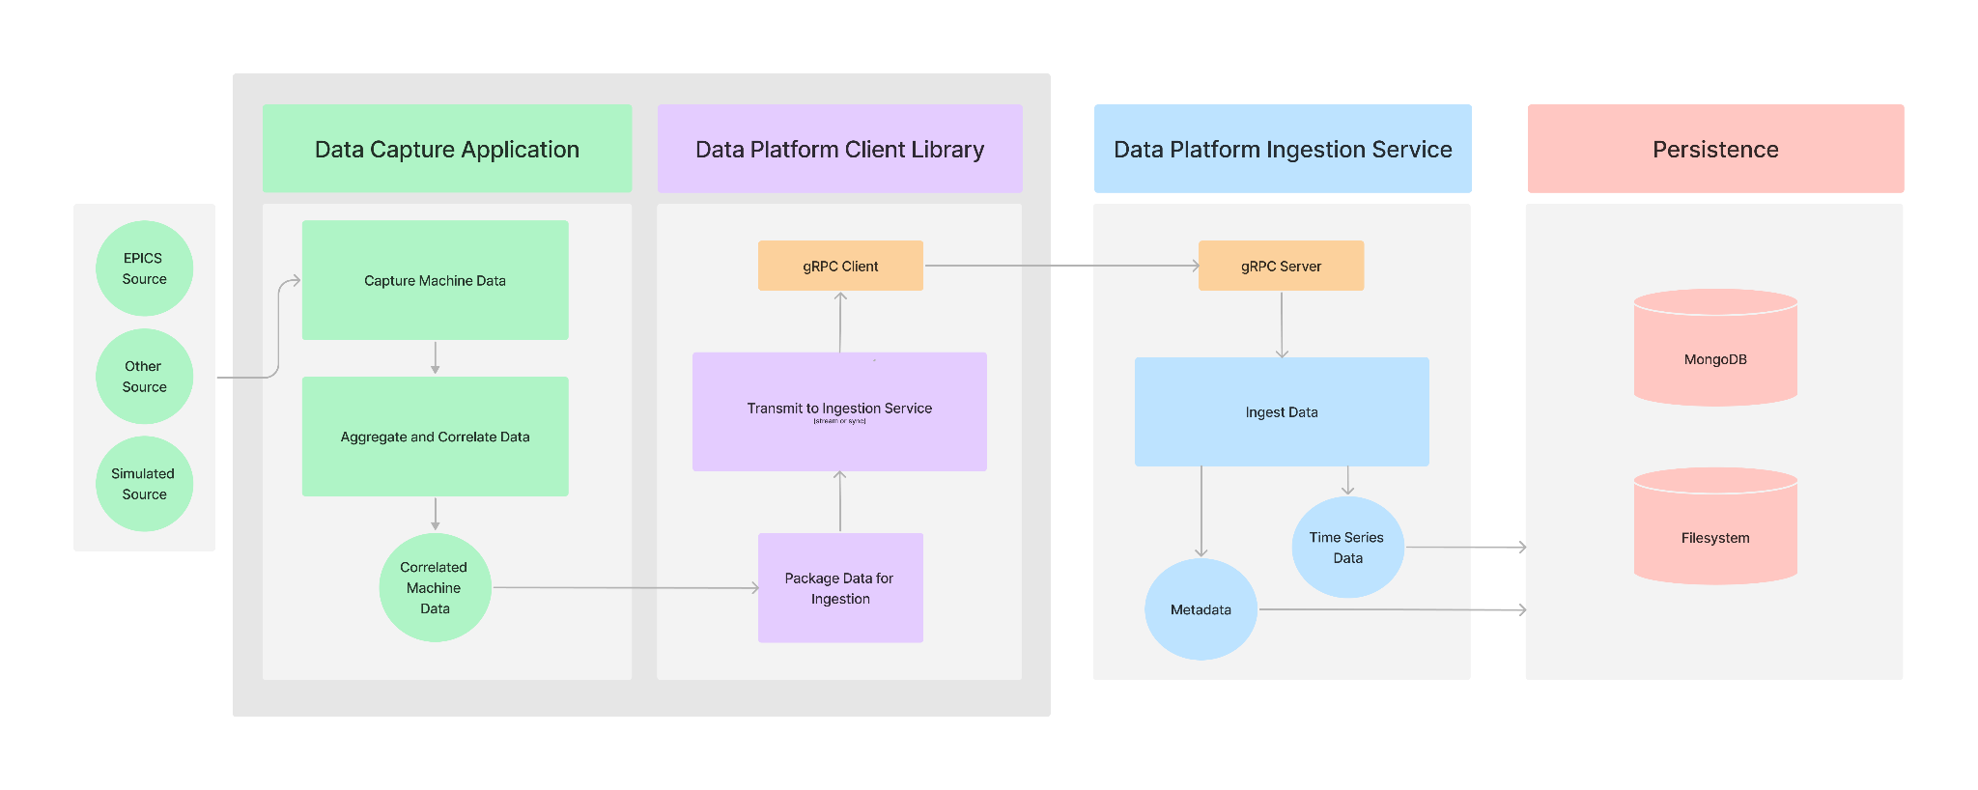
Data Platform Ingestion Data Flow

Slide 12
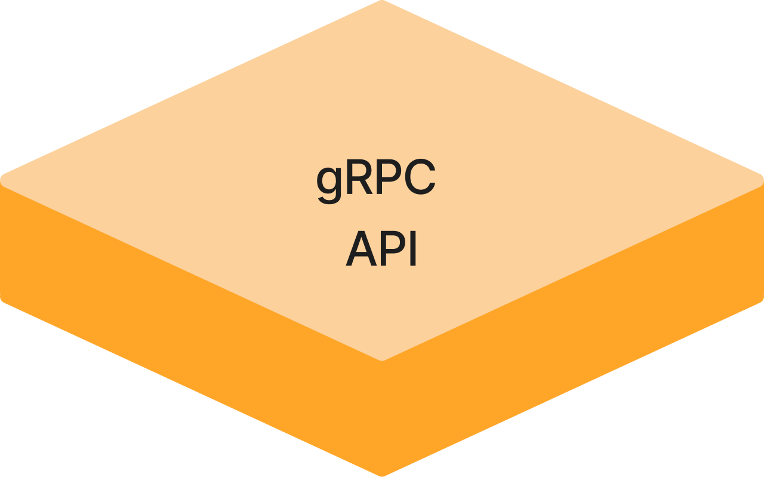
Communication Layer: gRPC
gRPC is a high-performance, cross-platform communication framework.
gRPC support is provided for pretty much every programming language.
"proto" files are used to specify the API for a service along with supporting data structures.
The protoc compiler generates programming language specific code for using the API and data structures.
gRPC supports bidirectional streaming of data between client and server.

Slide 13
Communication Layer: gRPC Service Definition "proto" files
service DpIngestionService {
rpc registerProvider (RegisterProviderRequest) returns (RegisterProviderResponse);
rpc streamingIngestion (stream IngestionRequest) returns (stream IngestionResponse);
rpc unaryIngestion (IngestionRequest) returns (IngestionResponse);
}
service DpQueryServiceService {
rpc queryDataByTime (QueryDataByTimeRequest) returns (stream QueryDataResponse);
}

Slide 14
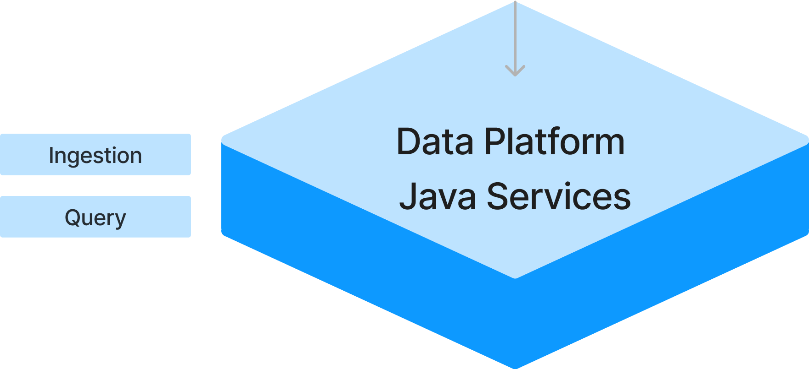
Service Layer: Ingestion and Query Services
The Data Platform provides Java server implementations of the Ingestion and Query service APIs as defined in the gRPC "proto" files.
The Ingestion Service uses MongoDB and the filesystem to build a repository of machine data, metadata, and annotations.
The Query Service provides broad data-science oriented access to that repository.
Client applications communicate with the services via the gRPC communication framework.

Slide 15
Service Layer: Authentication/Authorization
Assumption is that ingestion clients run behind firewall and that authentication is not required (e.g., similar to EPICS infrastructure components). Authentication is required for query clients. Initial thoughts about how we will handle authentication and authorization in the gRPC service:
Enable server authentication and secure transport via built in gRPC support for SSL/TLS.
Create a new "login" gRPC API method in the ingestion (and query) services. The login method will use the infrastructure LDAP service to authenticate the user credentials. It will return a JSON web token (JWT) to the caller.
In subsequent gRPC API calls, the client will attach the JWT token as metadata to the request header.
Investigate use of API token authentication for infrastructure applications (not tied to a specific user).

Slide 16

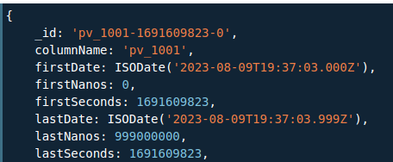
Persistence Layer: MongoDB
MongoDB is a document-oriented "NoSQL" database platform.
We are using the "Community Edition" which can be used without a licensing fee.
JSON-like documents are used to store data.

Slide 17

Persistence Layer: Filesystem
Data files are used to store image data and possibly other complex data types.
Elements stored in MongoDB reference those data files via indexes.
We are evaluating the use of HDF5 files for longer term storage of infrequently accessed data.

Slide 18
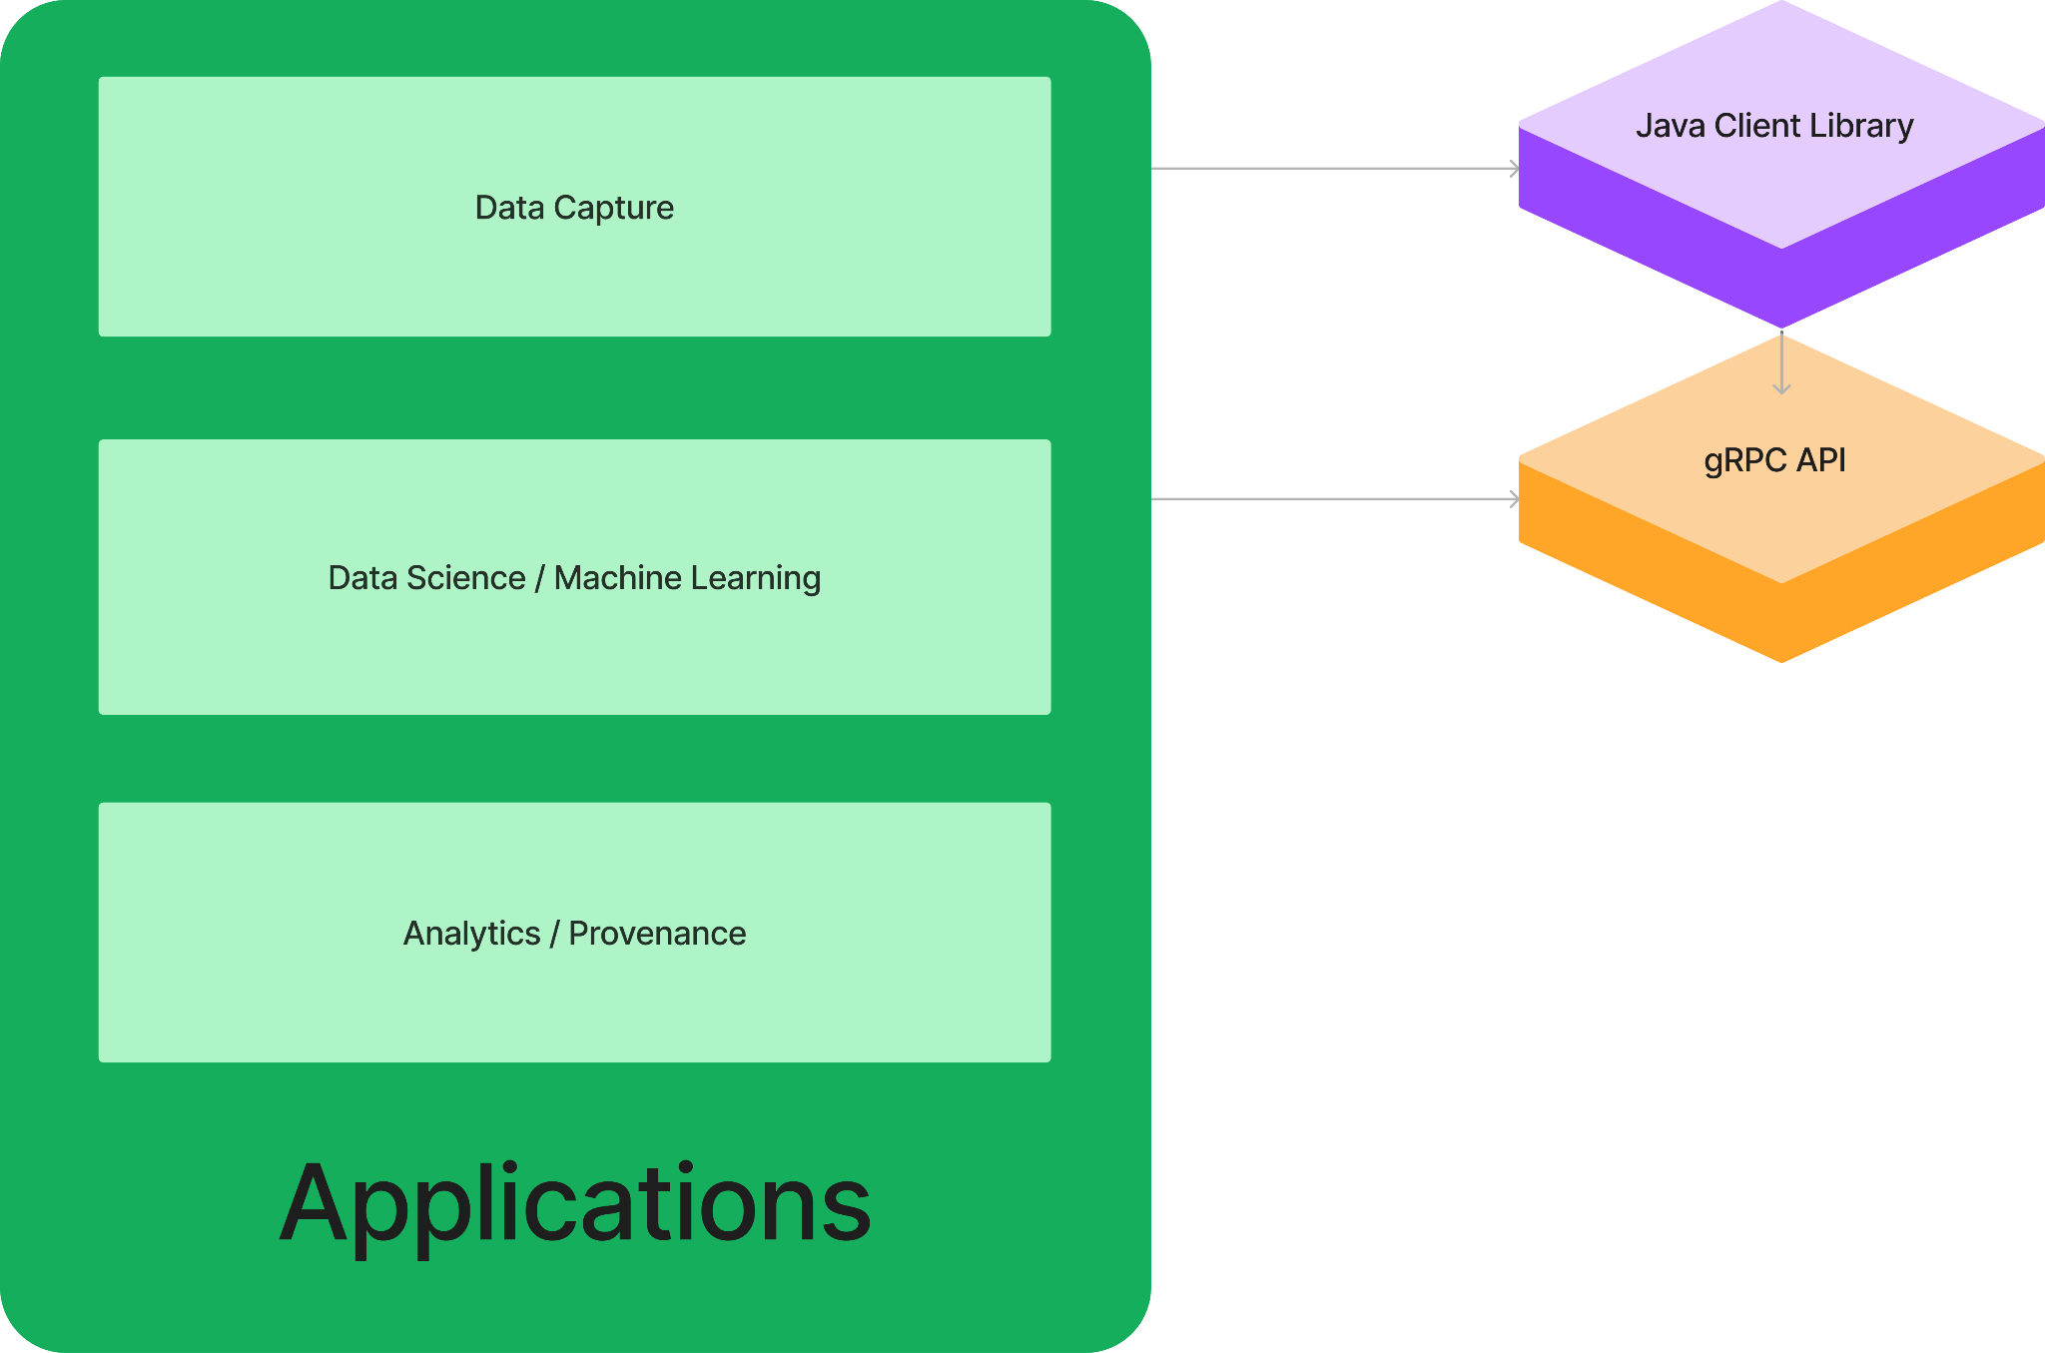
Application Layer: Low-Level API vs. High-Level Library
Applications can be built at two levels, either using the lower-level gRPC API directly or using the higher-level Java client library.

Slide 19
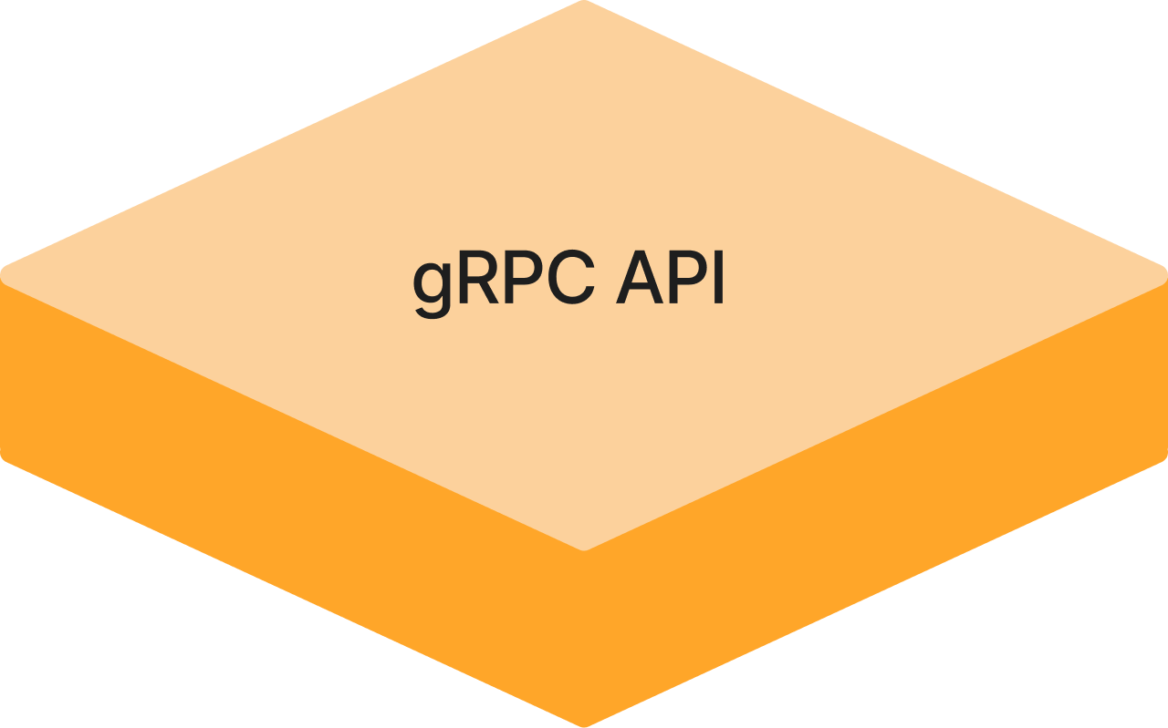
Application Layer: gRPC API Clients
The low-level gRPC Ingestion and Query Service APIs can be used from a wide variety of programming languages to build applications.
The "protoc" compiler generates appropriate code for using the data structures and invoking procedures defined in the service "proto" API files.
IngestionRequest.Builder requestBuilder = IngestionRequest.newBuilder();
Timestamp.Builder snapshotTimestampBuilder = Timestamp.newBuilder();
snapshotTimestampBuilder.setEpochSeconds(params.snapshotTimestampSeconds);
snapshotTimestampBuilder.setNanoseconds(params.snapshotTimestampNanos);
snapshotTimestampBuilder.build();
requestBuilder.setSnapshotTimestamp(snapshotTimestampBuilder);
requestBuilder.build();
IngestionResponse = blockingStub.unaryIngestion(requestBuilder);

Slide 20
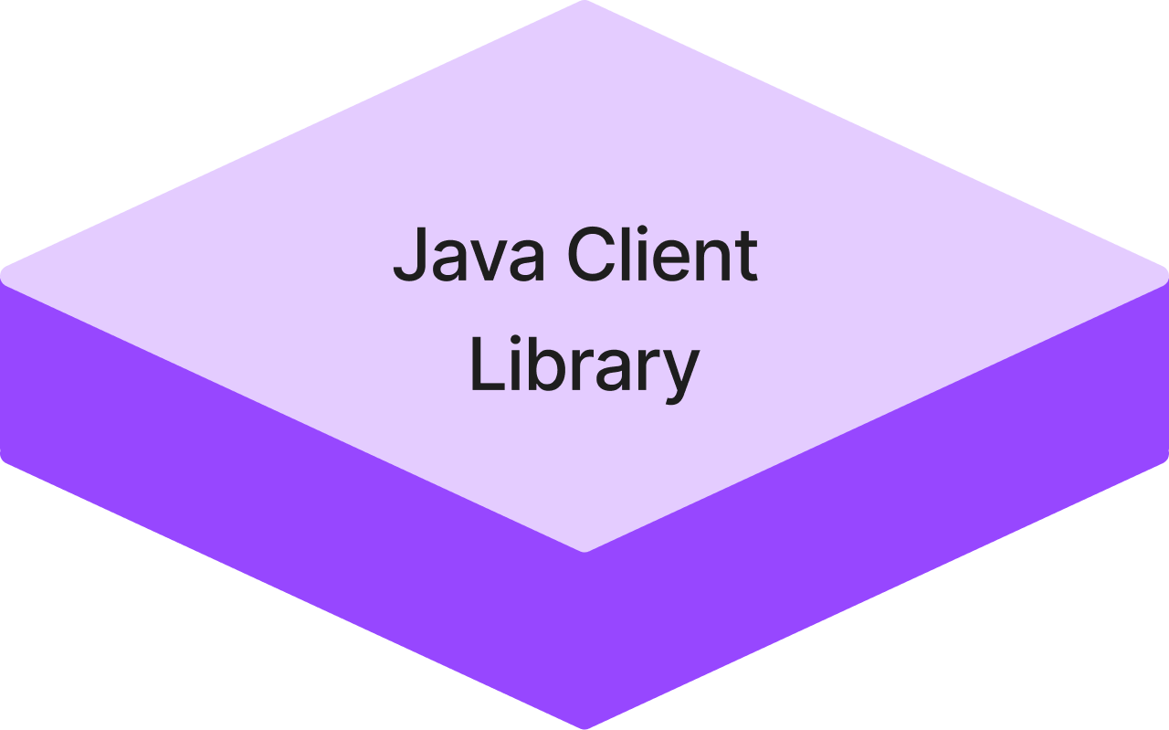
Application Layer: Java Client Library
A Java client library provides a high-level data science oriented interface to the data platform.
It hides the gRPC API implementation from developers, allowing them to focus on the application instead of communication details.

Slide 21
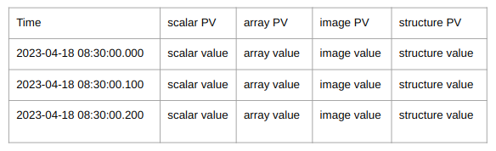
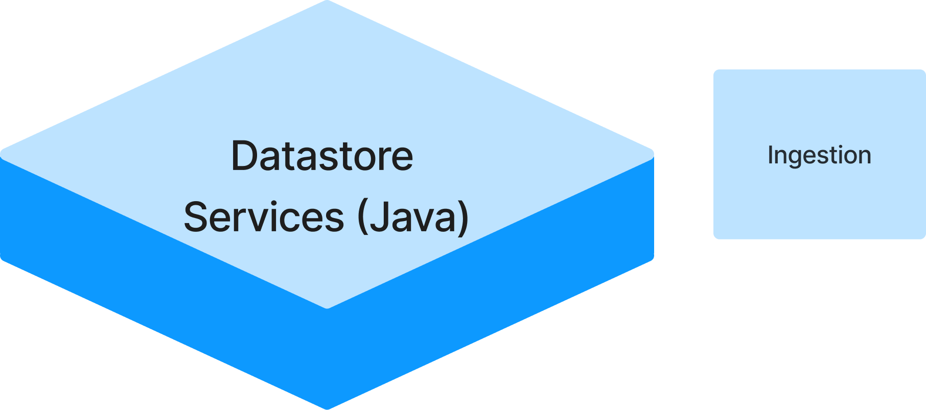
Application Layer: Java Client Library Ingestion Example
Example: Open streaming connection to Datastore Ingestion Service, create data frame for current interval, send to service.
// Create interface to streaming ingestion service.
IIngestionStream ingStream = DsIngestionServiceFactory.connectStream();
// Open stream for PV data provider registration.
ingStream.openStream(pvProviderRegistration);
// Create DataFrame from PV table for current interval.
DataFrame dataFrameCurrentInterval = DataFrame.from(pvValueTable);
// Send data frame to ingestion service in current stream.
ingStream.streamData(dataFrameCurrentInterval);

Slide 22
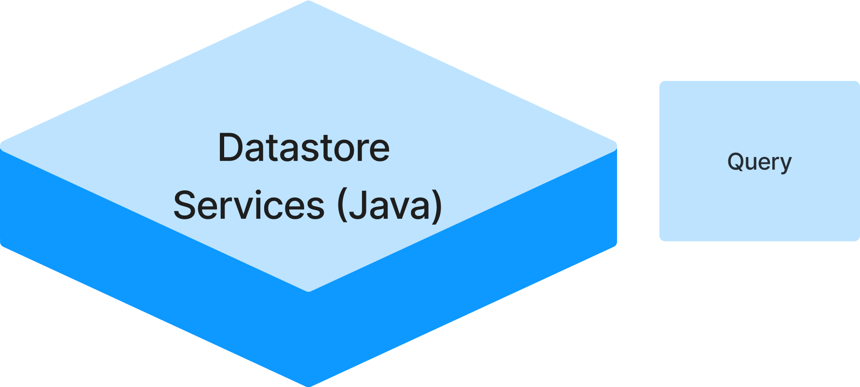
Application Layer: Java Client Library Data Science Example
Objective: Retrieve PV data from Datastore Repository to train a machine learning model, or feed data to predictive ML model embedded in a control application.
Approach: Use Datastore streaming query API to retrieve latest BPM values for relevant PVs and feed them to ML model.
/ Create interface to query service.
IQueryServiceData qrySvc = DsQueryServiceFactory.connectData();
// Create query request for relevant PVs starting from now.
qryRequest = qrySvc.newRequest();
qryRequest.rangeAfter(Instant.now()); // or use "rangeBetween" to specify time range
qryRequest.selectPvs("scalar_PV", "array_PV", "image_PV", "structure_PV");
// Send query request and invoke callbackFunction with query results as they are available.
IDataTableDynamic tblResult = qrySvc.requestDataAsync(qryRequest, callbackFunction);

Slide 23
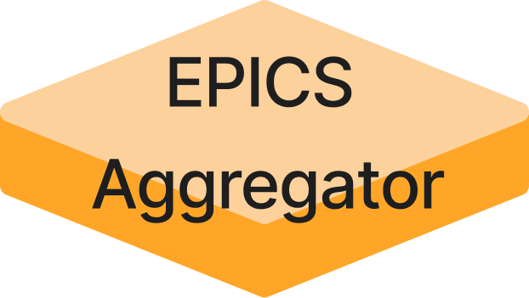
Toolbox: Feeding EPICS Data to the Ingestion Service
There is work in progress to enhance the EPICS Aggregator so that it can feed the Data Platform Ingestion Service.
It subscribes to EPICS data for a configured set of PVs, and pushes data to Ingestion Service using the gRPC API.

Slide 24
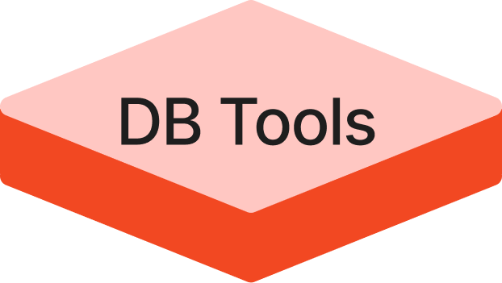
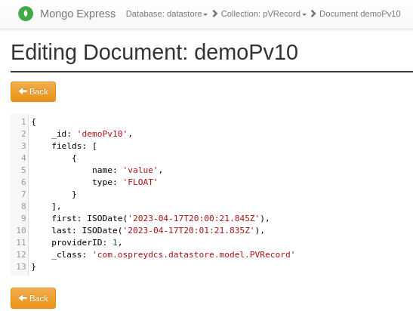
Toolbox: DB Tools for Data Access
MongoDB provides a command shell and web portal for direct database access and data manipulation.
MongoDB Portal

Slide 25
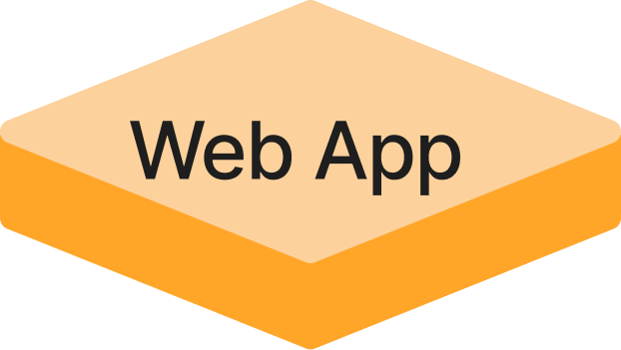
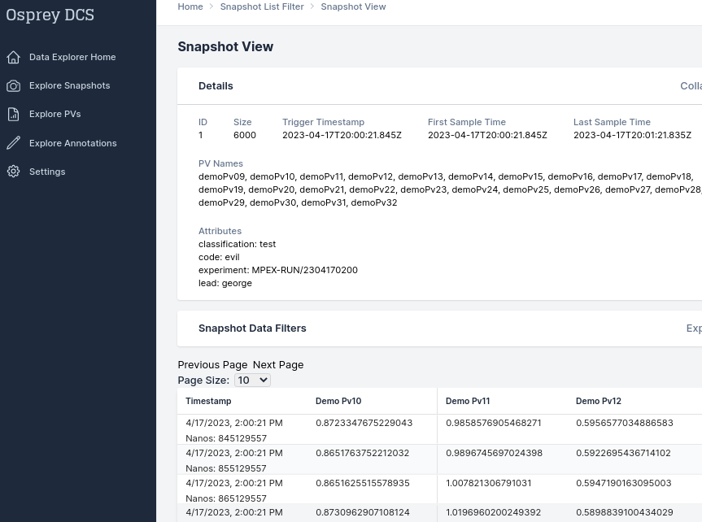
Toolbox: Web Application
JavaScript web application uses gRPC Query API to navigate Data Platform repository.

Slide 26
Installation and Deployment

Slide 27
Data Platform Installation Process
install MongoDB database package
install repos for Java data platform server applications
optionally install repos for Java client library
optionally install repo for JavaScript web application
install support repo for managing data platform ecosystem (building apps, managing services and applications, etc)

