Slide 1
UX9343 - Travel guide redesign
High bounce rate
No clear ‘next steps’ or calls to action
Doesn’t ‘sell’ the Hotels.com brand and service
Not much of a looker

Slide 2
Early exploration
How do the Travel guides fit within the HCOM Ecosystem?
What information are people looking for?
What content do we have to work with?

Slide 3
Travel guides place in the HCOM Ecosystem
HCOM core flow
Trip lifecycle
Plan
Find
Book
Prepare
Go
Return
Travel guides
Landing pages
Purpose of these tools
Relevant communication with customers throughout the trip life-cycle
Facebook app / social marketing
SEO / SEM
Guide people into the core flow
Email Marketing

Slide 4




What information are people looking for*
*Based on analysis of the personas, user journeys and assumptions database
“I want to feel like I’m in the know about what to do and where to go so I need lots of local information before I book a hotel”
When to go
Climate | Price | Popularity | Events
Where to stay
“I want to make sure the location is safe and family-friendly”
Neighbourhood | Hotel | Landmark proximity
“I want to know about the things we can do as a family”
What to do
Activities | Landmarks | Experiences
“I want to impress my colleagues by finding a great restaurant near the hotel”
What to expect
Customs | Local transport | Weather | Currency
“I want to find out about restaurants and points of interest near the hotel”
Trip Type
Family | City Break | Business
Although everyone has information needs across all the content themes the differentiating element is Trip Type

Slide 5
What content are we working with?
What we have
600+ editorially (externally) produced articles
Other potential sources
HCOM staff articles (content team)
Customers (social curation - individual or collective)
Internal data
Customer travel habits (time of year, length of stay, type of trip)
Popularity (most booked / searched for)
Customer opinions (guest ratings / reviews)
Hotel data (price, star rating, themes, amenities)
Location data (neighbourhood, landmark)

Slide 6
Other considerations
No budget for additional editorial resource which impacts scale and maintainability
No existing editorial strategy to direct us
Impact of any design work on SEO

Slide 7
Approach
Reduce bounce rate by:
Improving discoverability of other Travel Guide content
Creating relevant and contextual cross over points into the core shopping flow
Giving an inspirational feel to the design
Use a data-led content approach to aid scalability and maintenance
Focus additional content elements around the customers ‘Where to stay’ information needs
Recommend that future editorial focussed on Type of Trip and Where to Stay

Slide 8
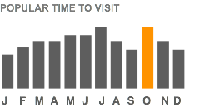
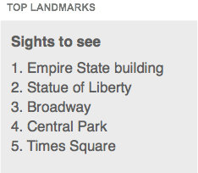
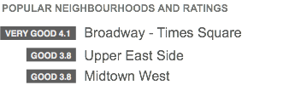
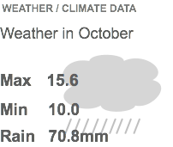
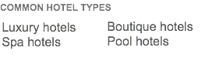
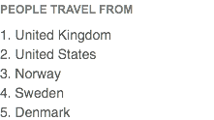



What data is available - some examples

Slide 9
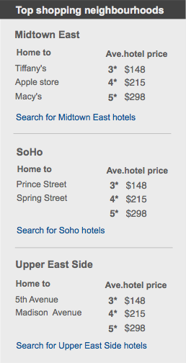
Info box
Added to existing articles to create contextual crossover points into the core shopping flow
In this example we:
list the best neighbourhoods for shopping based on landmark density and significance
display average prices for hotels under each star rating

Slide 10
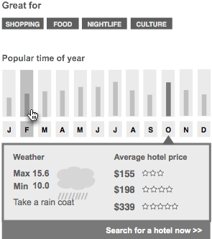
Destination snap-shot
Added to a destination hub page
Made up of:
Destination characteristics
Popular visiting times
Climate data by month
Ave hotel price by month

Slide 11
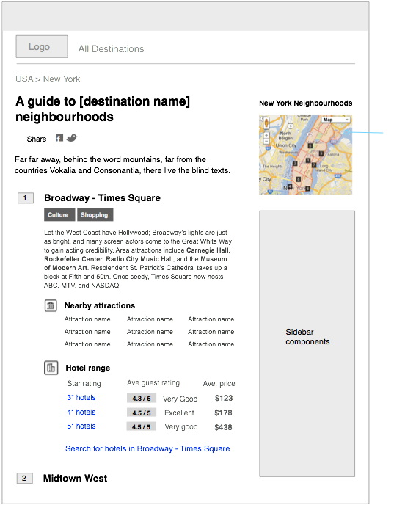
Neighbourhood guides
Allows users to learn about and compare different neighbourhoods in a city
All the information displayed here is extracted and aggregated from data that currently exists and includes:
Neighbourhood popularity
Neighbourhood name
Neigbourhood characteristics
Neighbourhood description
Nearby landmarks
Hotel prices and rating

Slide 12
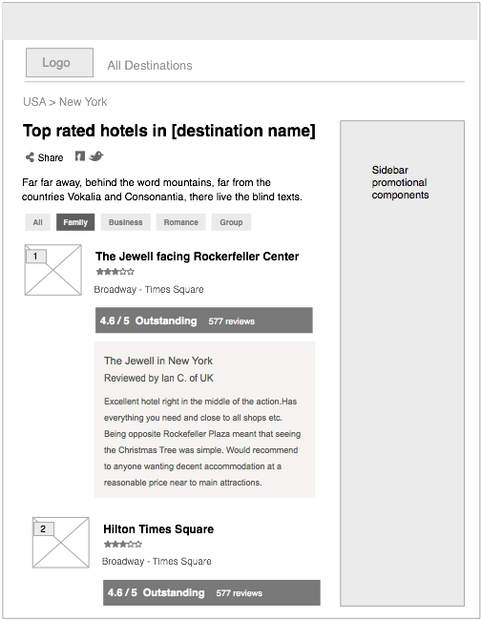
Top rated hotels
Gives us the opportunity to showcase hotels that are highly rated by hotels.com customers
Multiple lists can be created by cutting the data in a variety of ways
Trip type (family, business, etc...)
Price range (Luxury, Budget, etc...)
Amenities/Theme (Spa, Beach, etc...)

Slide 13
On the Wiki
http://wiki.hotels.com/display/HUX/UX9343+-+Travel+guides+redesign

