Slide 1

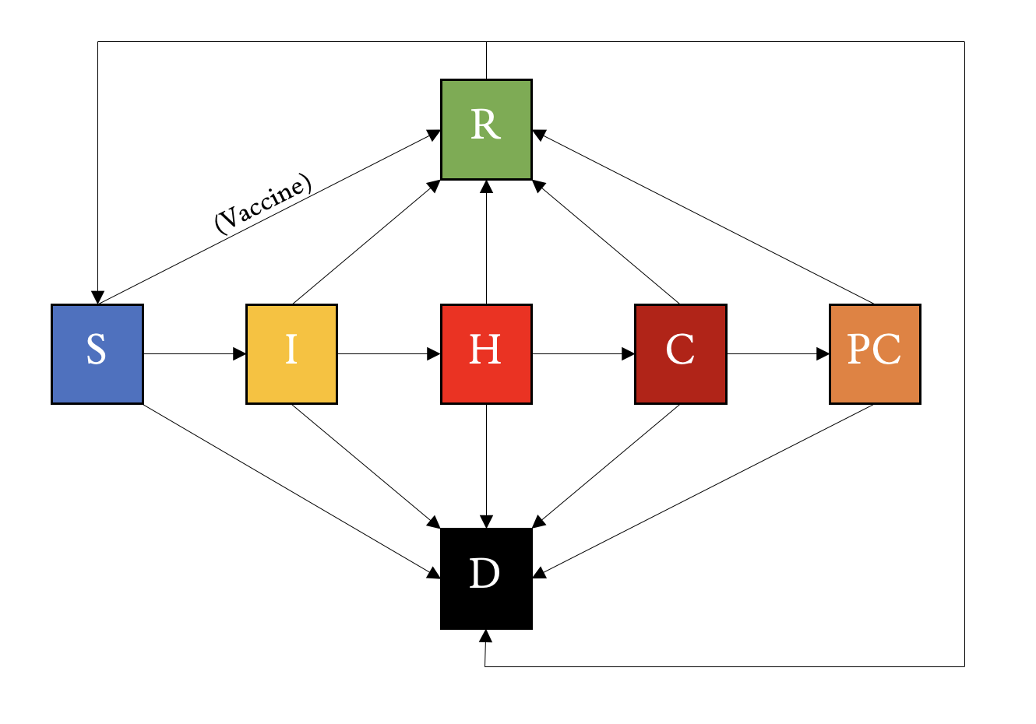
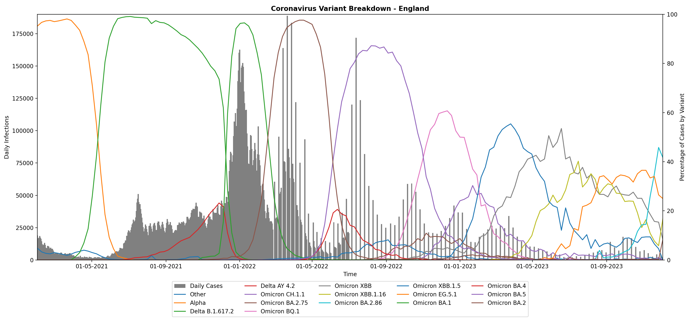
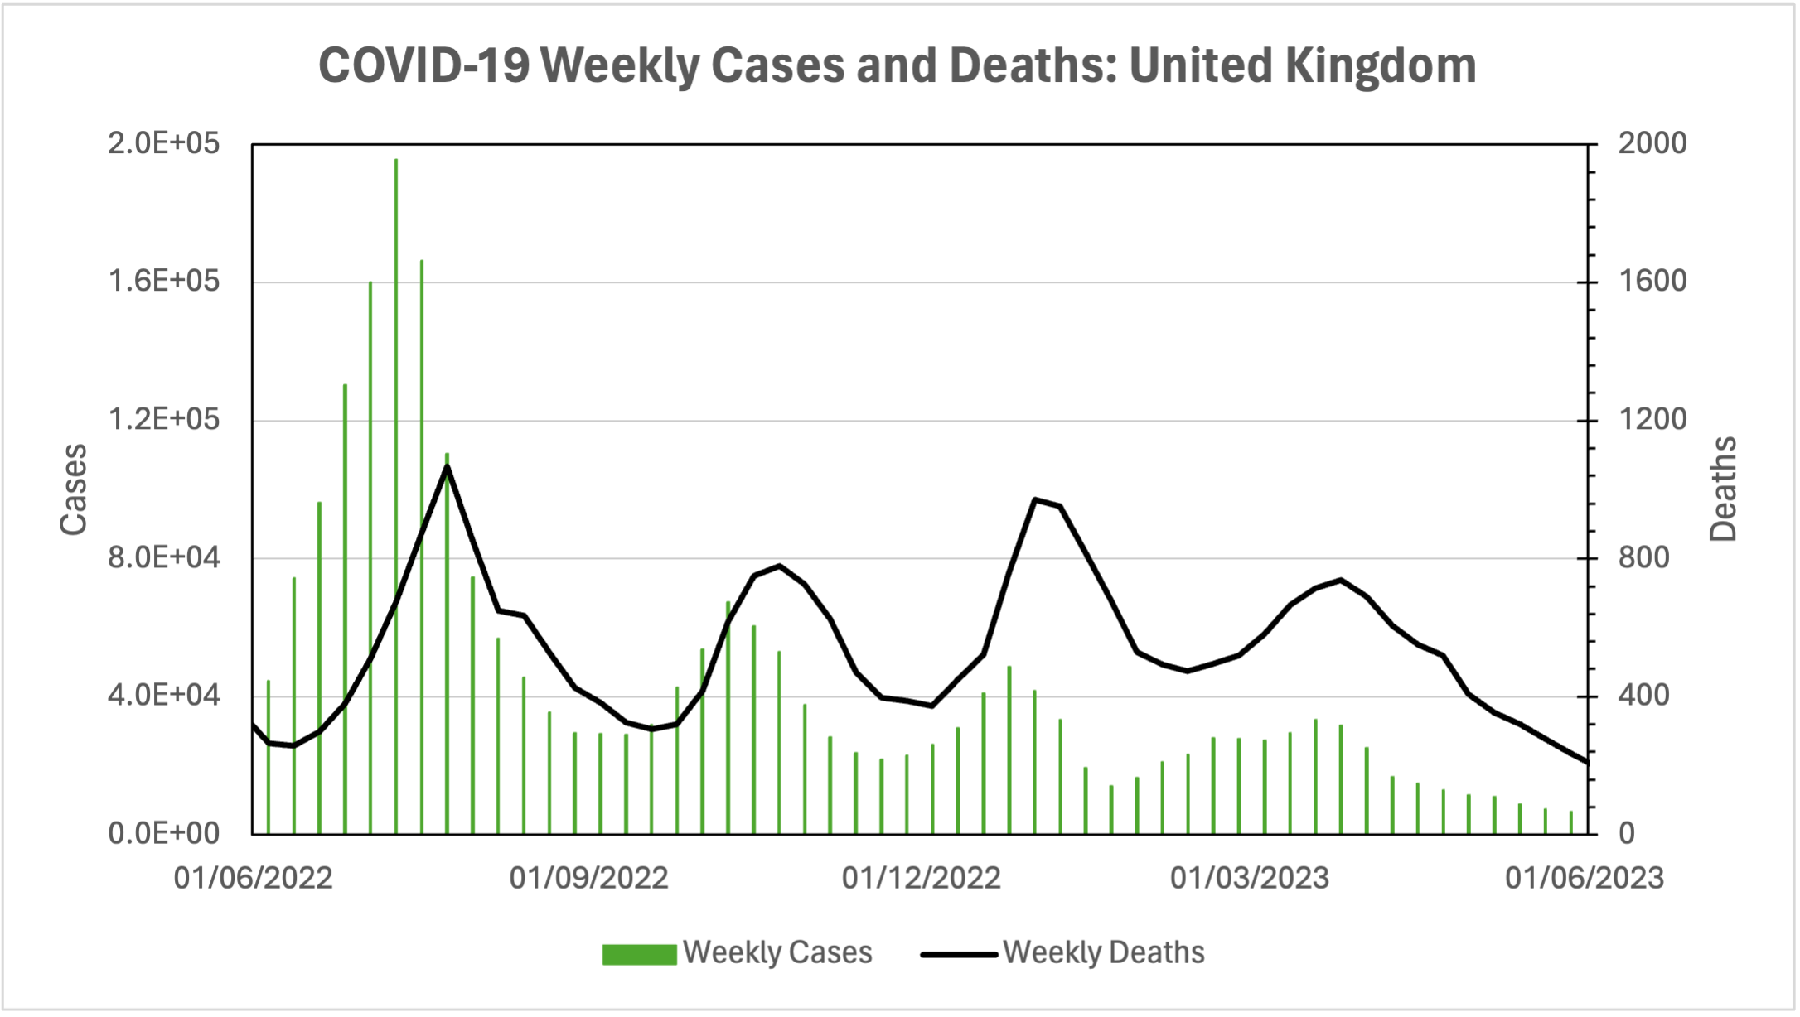
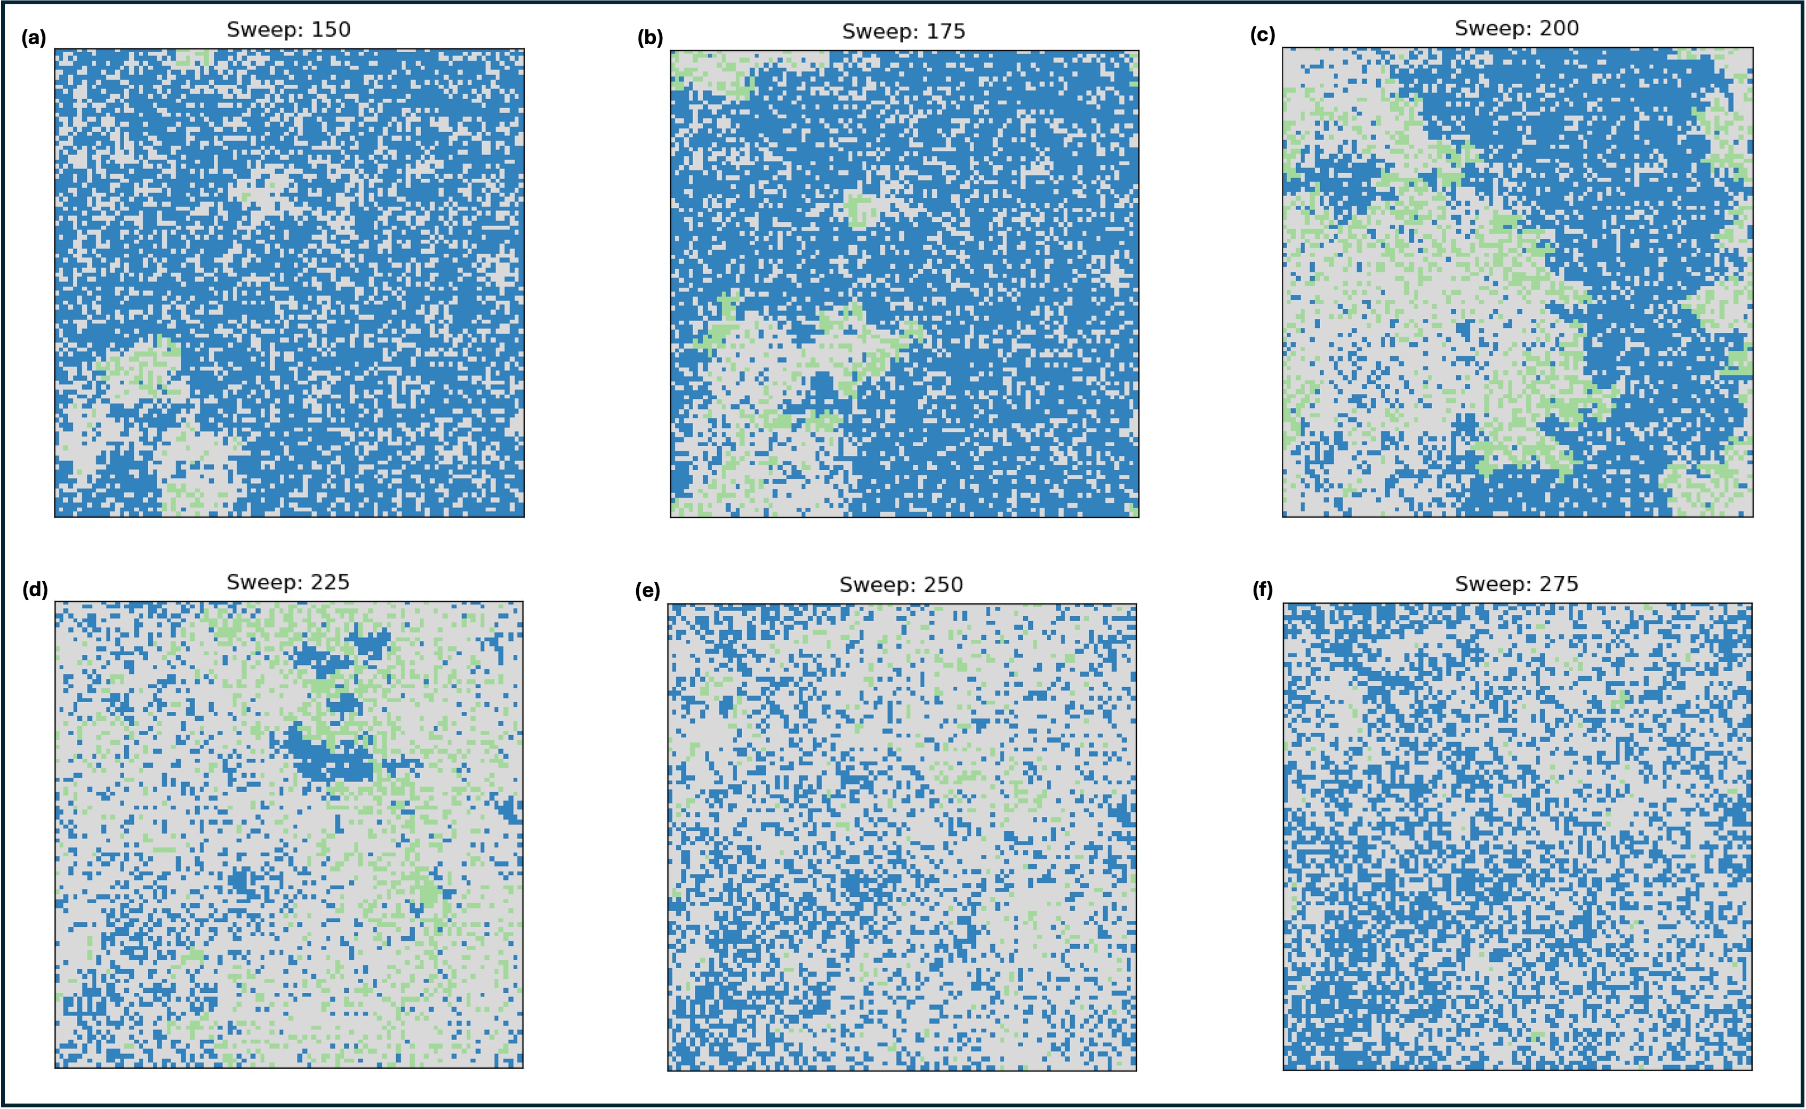
Exploring the Effectiveness of Compartmental Models to Predict Epidemiological Trends
Craig Miller (s2049878)
Supervisor: Graeme Ackland
Implementation
The Coronavirus Pandemic
Compartmental Models
Results
Senior Honours Project 2023/24
Computational Physics BSc
Photo Credit: WHO

Slide 2
Exploring the Effectiveness of Compartmental Models to Predict Epidemiological Trends
The Coronavirus Pandemic
Compartmental Models
Implementation
Results
Craig Miller (s2049878)
Senior Honours Project 23/24
Supervisor: Graeme Ackland
Photo Credit: WHO

