Slide 1
Life and Loading of Transformers

Slide 2
Contents
1) Transformer Aging
2) Allowable Loading
3) Transformer Sizing
4) Estimating Transformer Loading

Slide 3
Transformer Aging
Transformer age is determined by the tensile strength of the paper insulation
The typical life for a transformer is 20.55 years
This can vary depending on the type of insulation – wet vs. dry
There are three main causes for the paper insulation to deteriorate
1) Heat – Every 6°C increase in Temp above rated hot spot temperature will half the transformer life.
2) Water – Every doubling of moisture content in the paper insulation above 0.5% by weight will result in half the transformer life
3) Air – High oxygen environments will age 2.5x faster than in low oxygen environments.
How it’s made: Transformers
https://www.youtube.com/watch?v=r1TrQgQpSvY

Slide 4
Transformer Aging
A liquid filled transformer has an expected design life of 180,000 hours. While operating continuously with a hot spot of 110°C, the insulation life is aged by 1-hour.
Transformer temperatures fluctuate throughout the year/seasons.
If the hot spot is below 37°C, then effectively zero hours of insulation life are consumed.
If the hotspot is 66°C for a week, only one hour of life is consumed.
If the hotspot is 117°C, for every hour, two hours of life is consumed.

Slide 5
Transformer Aging
Different kinds of Insulating Fluid
Mineral Oil – Petroleum based, with flash point > 140 °C
High Fire Point Fluids – Flash point 170 to 300°C, PCB
Natural Ester Based Fluids – Environmentally Friendly, High Flash point at 330 °C
Aging Test conducted with Insulation paper in Mineral Oil and Ester Fluid
Criteria: Same materials, in same proportions found in a 225 kVA Pad mounted transformer.
Samples heated to 130, 150, 170°C for 250, 500, 700, 1000, 1500, 3000, and 4000 hours. Separate vessels were used for each test duration.
The tensile strength of the paper is then tested

Slide 6
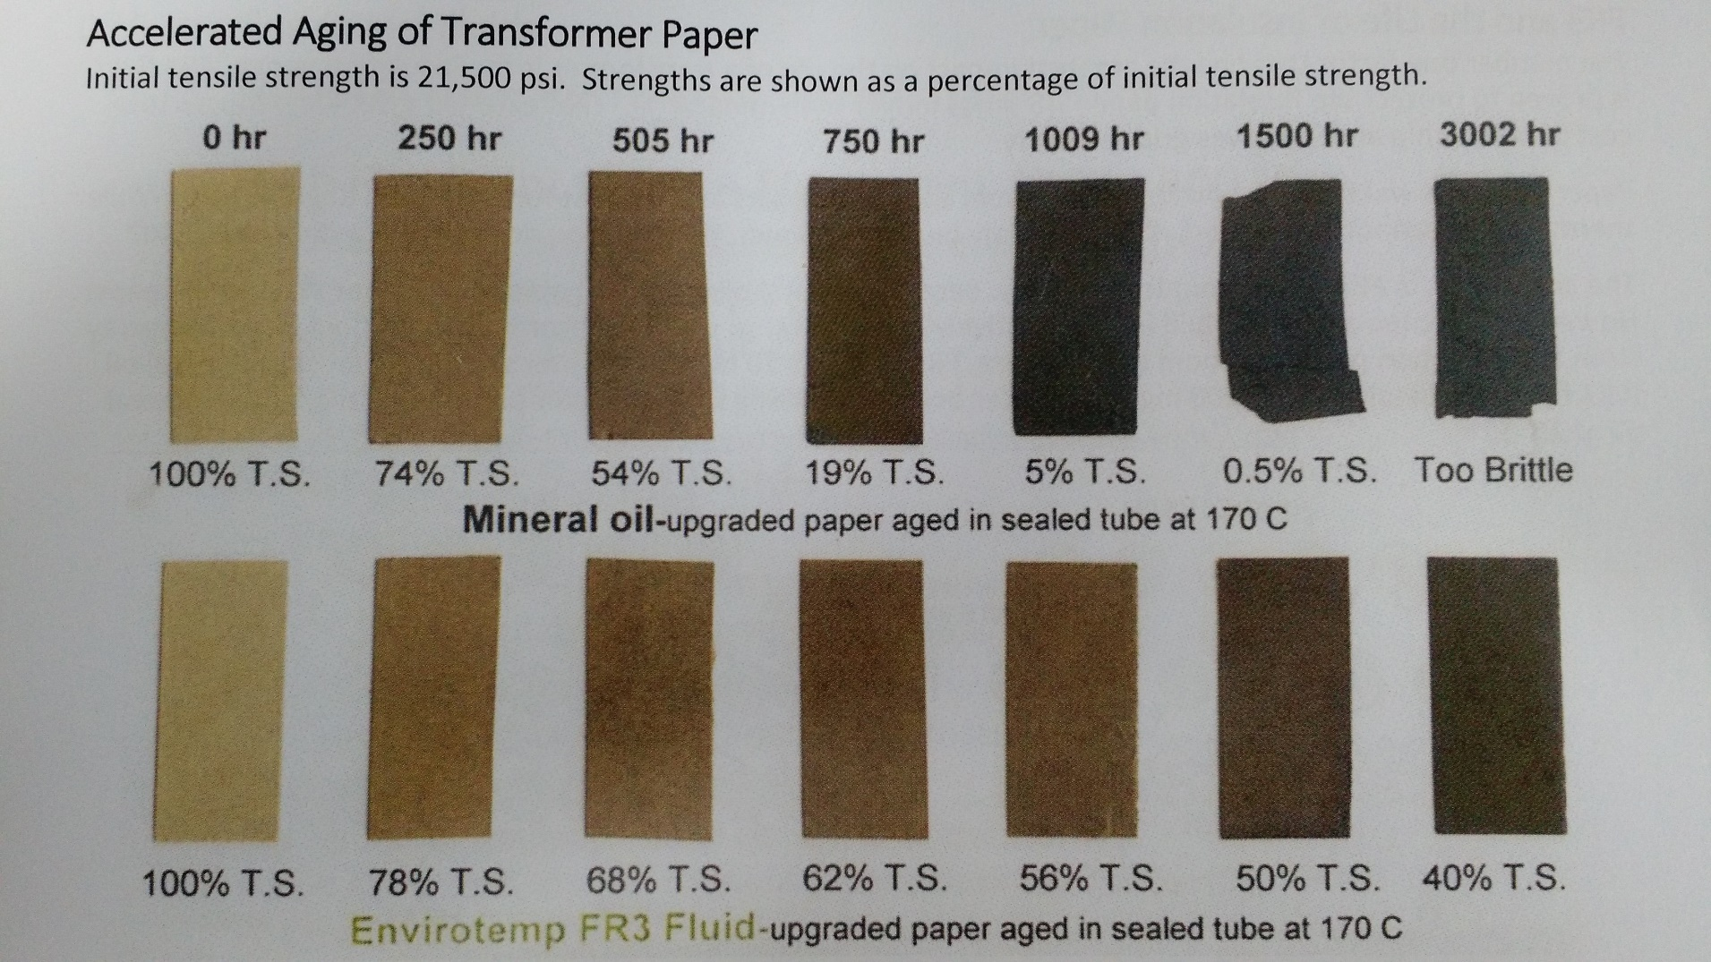
Transformer Aging

Slide 7
Transformer Aging
Results of aging tests on Insulation Paper in Transformers
°C | Age Factor
< 37 | 0.0000
40 | 0.0002
50 | 0.0007
60 | 0.0028
70 | 0.0104
80 | 0.0358
90 | 0.1156
100 | 0.3499
105 | 0.5957
°C | Age Factor
110 | 1.0000
114 | 1.4990
117 | 2.0197
124 | 3.9793
136 | 12.0573
144 | 24.3679
168 | 172.5817
188 | 754.8617
198 | 1506.2220

Slide 8
Allowable Loading
C57.91 is the IEEE Standard for Insulation Life. Based on this standard, ABB (Transformer manufacturer) created a chart for Peak Loading Capability for Normal Life Expectancy for transformers.
Based on ambient temperature at 30°C, highest peak load seen by the transformer in the data, and Continuous Preloading conditions.
Depending on how long the duration of the peak load will determine if the size of the transformer is correct.

Slide 9
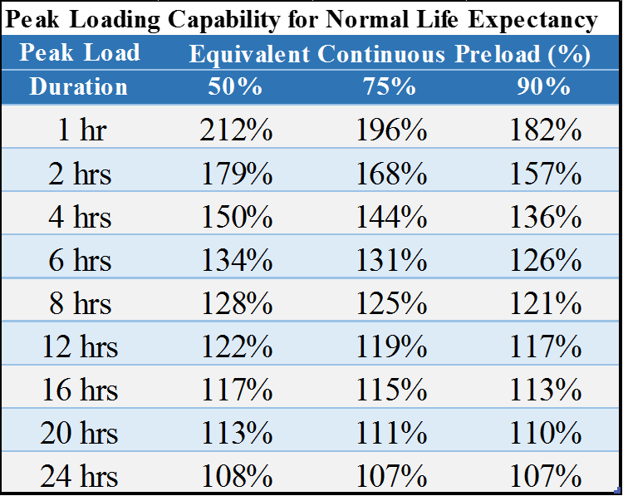
Allowable Loading
Adjustments for Chart:
-1.5% for each degree above 30°C
+1.0% for each degree below 30°C
Valid for altitudes up to 3000 meters
Above 3000 meters
-.4% for every 100m above 3000m for ONAN
-0.5% for every 100m above 3000m for ONAF

Slide 10
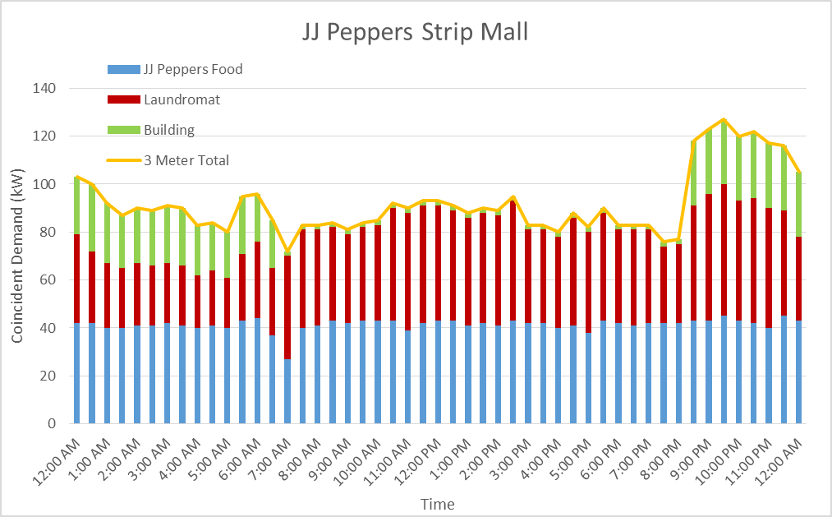
Transformer Sizing
Example #1 – The demand for Two commercial customers and a building meter for parking lot lightning is shown below. The Highest peak is 127 kW at 9:30 PM, the service voltage is 120/208V, 3Ø, 4-wire.

Slide 11
Transformer Sizing
Example #1 continued –
Assumptions
Overall power factor is 0.85 lagging
Ambient temperature is 30°C.
Peak Loading is 4-hours.
Pre-load Conditions are 90%.
Solution
127 kW ÷ 0.85 = 149 kVA
The next smaller transformer is 112.5 kVA
149 kVA ÷ 112.5 kVA = 132%
Can I live with 132% loading of nameplate?
Yes.

Slide 12
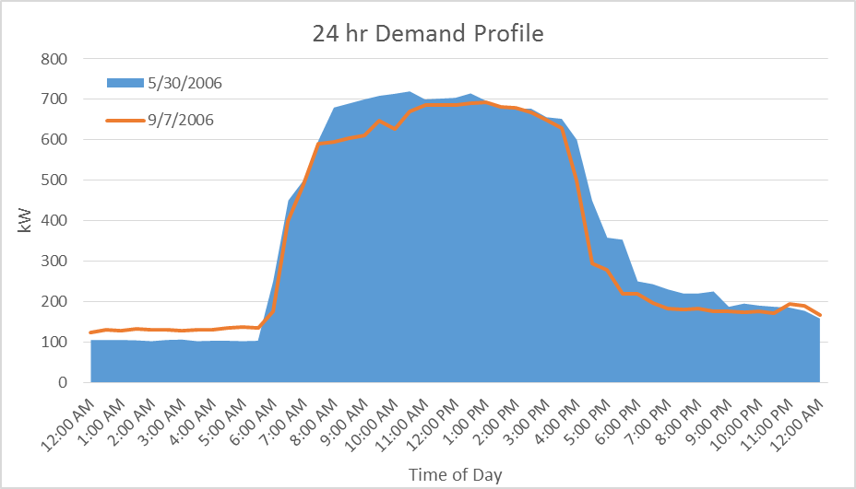
Transformer Sizing
Example #2 – Two peaks are shown in the graph below for two separate days. The highest peak is 720 kW, and the Service voltage is 277/480 V, 3Ø, 4-wire.

Slide 13
Transformer Sizing
Example #2 continued –
Assumptions
Overall power factor is 0.85 lagging
Ambient temperature is 30°C.
Peak load is 8-hours
Pre-load Conditions are less than 50%
Solutions
720 kW ÷ 0.85 = 847 kVA
The next smaller transformer is 750 kVA
847 kVA ÷ 750 kVA = 113%
Can I live with 113% loading of nameplate?
Yes.

Slide 14
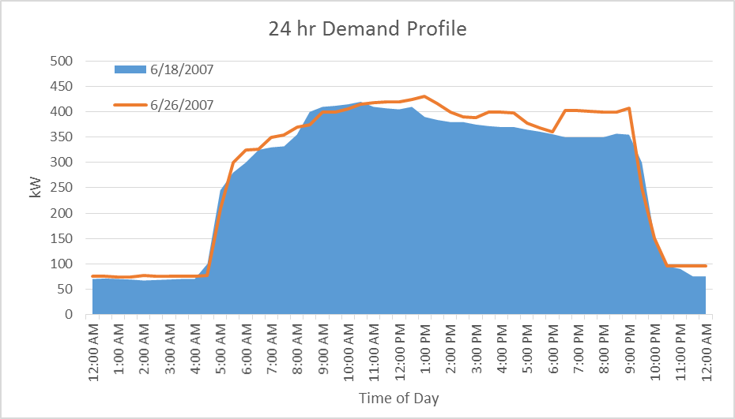
Transformer Sizing
Example #3 - Two peaks are shown in the graph below for two separate days. The highest peak is 431 kW, and the Service voltage is 120/208 V, 3Ø, 4-wire.

Slide 15
Transformer Sizing
Example #3 continued –
Assumptions
Overall power factor is 0.85 lagging
Ambient temperature is 30°C.
Peak load is 16-hours
Pre-load Conditions are less than 50%
Solutions
431 kW ÷ 0.85 = 507 kVA
The next smaller transformer is 300 kVA
507 kVA ÷ 300 kVA = 169%
Can I live with 169% loading of nameplate?
No.

Slide 16
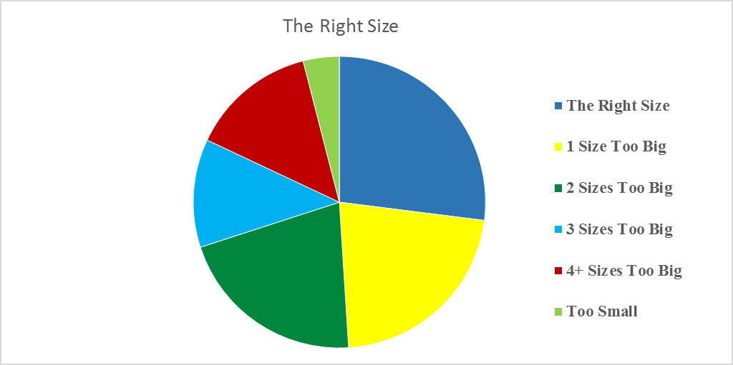
Estimating Transformer Loading
Based on one Utility’s experience (ComEd) with estimating loading of transformers.
Utilities can only size a transformer appropriately depending on the sizes in stock. Some Utilities will not carry all sizes.
The following chart shows and
example of ComEd oversizing
transformers prior to changing
methodology.

Slide 17
Estimating Transformer Loading
An example of an oversized transformer:
A 100 kVA transformer was installed in the field. The actual loading was determined to be 87 kVA. The allowable thermal loading for the customer class was to be 140% of nameplate.
87 kVA ÷ 140% = 62 kVA - Since 62 kVA is not a transformer size, the next size below 100 kVA is 75 kVA.
In this case, the 75 kVA transformer would have been the “The Right Size” instead of the 100 kVA.
The engineers learned to ask, “Would the next smaller size transformer have been adequate to serve the load?”

Slide 18
Estimating Transformer Loading
Sometimes installing a transformer for a particular load does not offer many options
A few examples:
Servicing one small house, the right size 1Ø transformer is a 25 kVA
If the smallest 3Ø URD transformer stocked by your utility is 75 kVA, then that was the right size transformer regardless if the customer’s load was 15 kW
For other transformer options, there are smaller options available.
Select the transformer where the next smaller size was “One size too small.”
Based on Estimations, ComEd’s overhead and URD transformer usage, incremental cost amounted to $2.5M a year. If assumed 20% of the sites are “one size too big”, that would be $500,000 in potential savings.

Slide 19
Estimating Transformer Loading
Causes of Oversizing Transformers?
Never hear about transformers that are too big.
If a 50 kVA is good, then a 75 kVA must be better!
Afraid to undersize transformers
30+ year old engineering guidelines
Inflated “Watts / Ft²” estimates across all sizes of buildings
Used overly conservative “allowable thermal loadings”
Data based on early 70’s building construction
Designed for unrealistic “worst case scenario”
No Feedback loop to compare initial design to actual billing loads.

Slide 20
Estimating Transformer Loading
What did ComEd do differently after changing methodology?
Identified common mistakes on load letters
Developed tools to allow engineers to easily harness their billing data by meter
Actively used their Transformer Load Management System
Analyzed billing on more than 7000 accounts of 120 national chains.
Tracked New Installations based on Customer Name/Address, Engineer’s load estimate, transformer size installed, transformer location number, and other details.
Analyze chain accounts such as grocery stores, retail stores, strip malls, etc.
ComEd nearly doubled their accuracy for “The Right Size” transformer. This result was also credited to designer turn-over with ~25+ new designers/year. Allowed for new designers to adopted the newer methodology.

Slide 21
Estimating Transformer Loading
Early Findings
Motels: ComEd previously served business travel motels with 750, 1000, and even 1500 kVA transformers. ComEd now uses 300 and 500 kVA transformers depending on number of rooms.
Auto Parts: Auto parts chain wanted to build multiple stores in ComEd’s territory. A study of existing locations found that they were served with 150, 225, and 300 kVA transformers. Based on Billing data, the right size transformer for these stores was a 112 kVA transformer.
Lessons Learned
Parade of Homes – A 25 kVA URD transformer was serving 5 homes failed on a summer Saturday morning. The replacement transformer lasted 8 hours before failing. The site was investigated on Monday found these were model homes. Each home was 4500+ ft² with every light on, front/back doors open, and AC running continuously. One house’s demand was measured at 15.5 kW. At 85% power factor, the load was 18.2 kVA for one house.

Slide 22
End
Questions?

