Slide 1
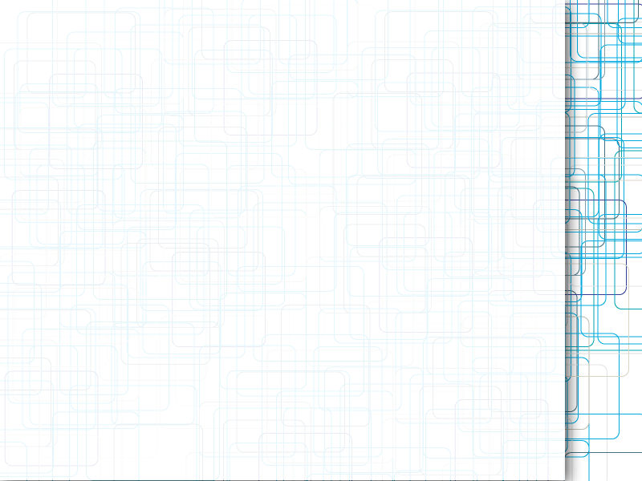
Primordial Soup
The building blocks of Genetic Algorithms in 20 minutes
Craig Nicol
Notes:
I will be discussing the theory of genetic algorithms rather than the practice, which contains far too many subtleties for a 20 minute talk. I have written a C++ library based on what I will be discussing, so I'm happy to answer any questions at the end, or afterwards.

Slide 2
Introduction
Why genetic algorithms?
Chromosomes
Populations
When and where to use them
Genetic Programming
Notes:
Genetic algorithms are inspired by the biological processes that drive evolution.
They use randomness to explore the space of all possible solutions and a series of biologically-inspired filtering to focus on the solutions that show the greatest promise : the survival of the fittest.
Genetic algorithms are constructed from a series of Chromosomes that are collected into one or more Populations allowing multiple searches to be conducted in parallel.
The Chromosomes can be defined so that they represent an executable pattern, such as an abstract syntax tree. This is Genetic Programming.

Slide 3
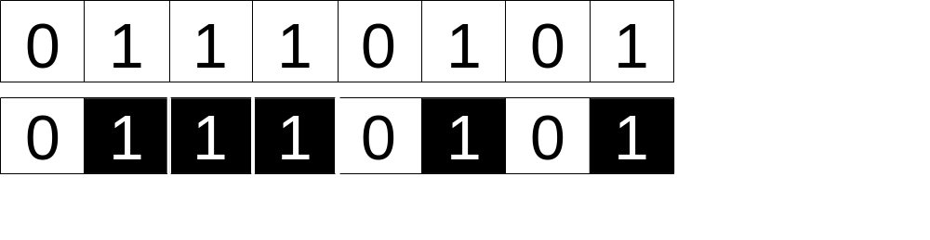
Chromosome
Looks like:
Bool, int, Whatever you like
Notes:
A Chromosome is a collection of genes. In this example, these genes are bits, but the genes can be integers, strings, tree nodes or any other type, so long as the operations discussed in the following slides are valid.
For each gene, the possible values are known as alleles. For binary genes, these values are 0 and 1, for integer genes, these values can be constrained by one or more ranges.
For simplicity in the rest of this talk, I will mainly focus on binary chromosomes like those shown. For clarity, I will be using the colour coding shown here so that the structure of the chromosome is easy to see from a distance.

Slide 4
Population
Single or multiple
Notes:
Chromosomes are contained in one or more populations. One instance of a genetic algorithm will have many chromosomes and one or more populations. Each chromosome will represent one possible solution to the overall problem.
Where chromosomes are contained in more than one population, there will be a chance of chromosomes migrating between populations to share solutions.

Slide 5
Breeding
Selection
  Fitness
  Selection of Parents
Crossover
Mutation
Migration (for multiple populations)
Notes:
The breeding process consists of three steps:
The selection process rates the fitness of each chromosome to solve the given problem, so that the fittest chromosomes have the greatest chance of reproducing. Two chromosomes are then chosen as parents.
The two parents get combined into a new child chromosome by crossing over their genes
There is a chance that before or after the crossover some genes may be mutated to have different values.
For multiple populations, the child may migrate to another population to breed with it.

Slide 6
Selection
Fitness
Selection method
  Ranking
  Stochastic Universal Sampling
Notes:
The first part of selection is to define the fitness of a chromosome to solve the given problem. Finding the right encoding and fitness function is usually the hardest part of writing a genetic algorithm. For this example, the problem is to find a chromosome that is all ones, so the fitness function simply counts the number of ones in the chromosome. The higher the fitness, the closer the chromosome is to the solution.
Once the fitness of all the chromosomes is known, the parents are selected. In Ranking, the chromosomes are sorted and selected with weighting towards the top, (give e.g.) ; in Stochastic Universal Sampling, the selection is balanced so that when chromosome A has a fitness twice that of chromosome B, it is twice as likely to be picked.

Slide 7
Crossover
Single point
2-point
Notes:
Crossover is the process of turning 2 parent chromosomes into 1 child.
The 2 most common types are single point crossover and 2-point crossover.

Slide 8
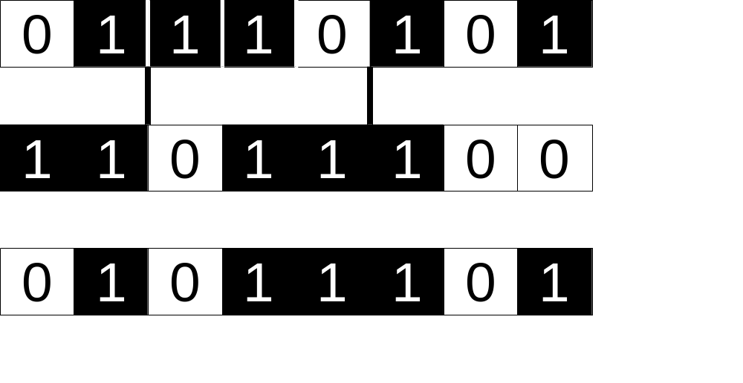
Two-Point Crossover
Notes:
In 2 point crossover, the start and end of one parent is joined with the middle of the other parent to create a child. In this example, the parents have been split at the vertical lines shown.

Slide 9
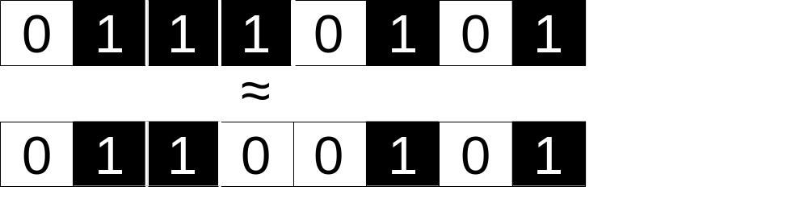
Mutation
Notes:
The mutation step may happen to the parents before crossover or the child after crossover.
In this example, the 4th gene has been mutated by flipping the bit.

Slide 10
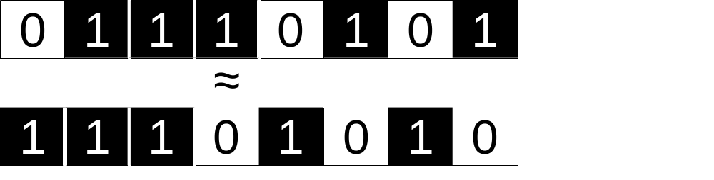
Permutation
Notes:
Another type of mutation is to permute the chromosome. In this case, the chromosome has been mutated by bit-shifting it one to the left.
For some problems, mutation by flipping makes most sense, for others, mutation by permutation makes most sense. Each problem will have its own ideal set of operations and encodings.

Slide 11
Genetic Programming
+
-
5
4
3
2
Notes:
In Genetic Programming, the Chromosome is usually represented as an abstract syntax tree, as shown here. The crossover will transplant the node of one tree (e.g. the 3 – 2 branch) onto the other.
The diagram here shows 2 possible mutations in Genetic Programming. In one mutation, the nodes are swapped, in this case the + and – nodes. In the other mutation, the value of a node is changed into a different value.

Slide 12
When to use them
Large search space
Hard to predict where answer is
Easy to calculate fitness function
Notes:
Genetic algorithms are useful when there is a large search space.
A large search space means there are lots of possible solutions to the given problem.
Another characteristic that indicates GAs are a good solution is when it is hard to predict where the answer lies within the search space.
Ideally, Genetic Algorithms should have a quick to calculate fitness function as it will be calculated several times in each generation.

Slide 13
Things to watch
Randomness & Seeding
Defining the right chromosomes
Setting the parameters correctly
  Mutation Rate
  Crossover Method
  Selection Method
Notes:
Because a genetic algorithm relies heavily on randomness, it is important to consider two things : if you want repeatability you will need to be able to define a seed. If you want proper randomness, you will need to consider which random library you use.
The chromosomes, operators, and parameters defining the probabilities of mutation and selection all need to be chosen, either by experiment or analysis.

Slide 14
Summary
Short introduction to Genetic Algorithms
Biological theory
Pros and cons
  Large search space
  Sensitive to how they are set up
Genetic Programming
Lots of libraries available, and on-line demos, C++ library on next slide…

Slide 15
Thanks
http://code.google.com/p/geneticalgorithmtemplates
http://craignicol.wordpress.com
http://www.twitter.com/craignicol
craig.nicol@gmail.com
Thank you for listening

