Slide 1
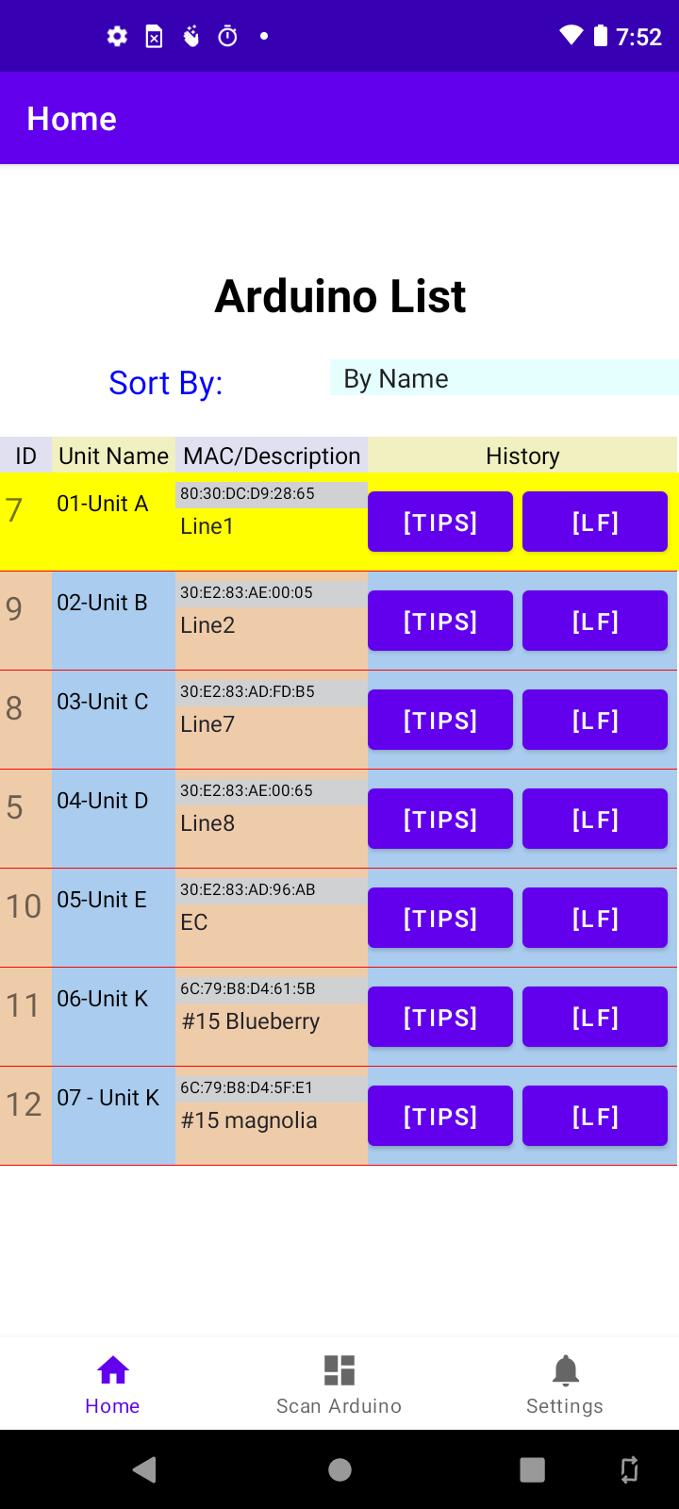
Tap to view tip or LF history
Tap to scan for Arduino units within range

Slide 2
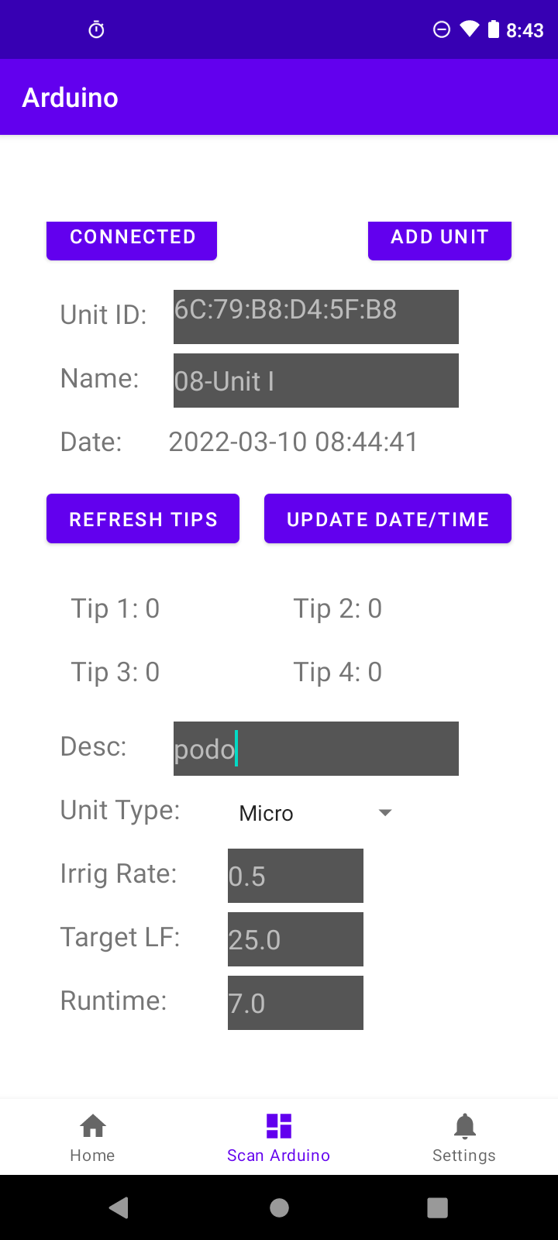
Tap to add unit with initial values
Enter initial values

Slide 3
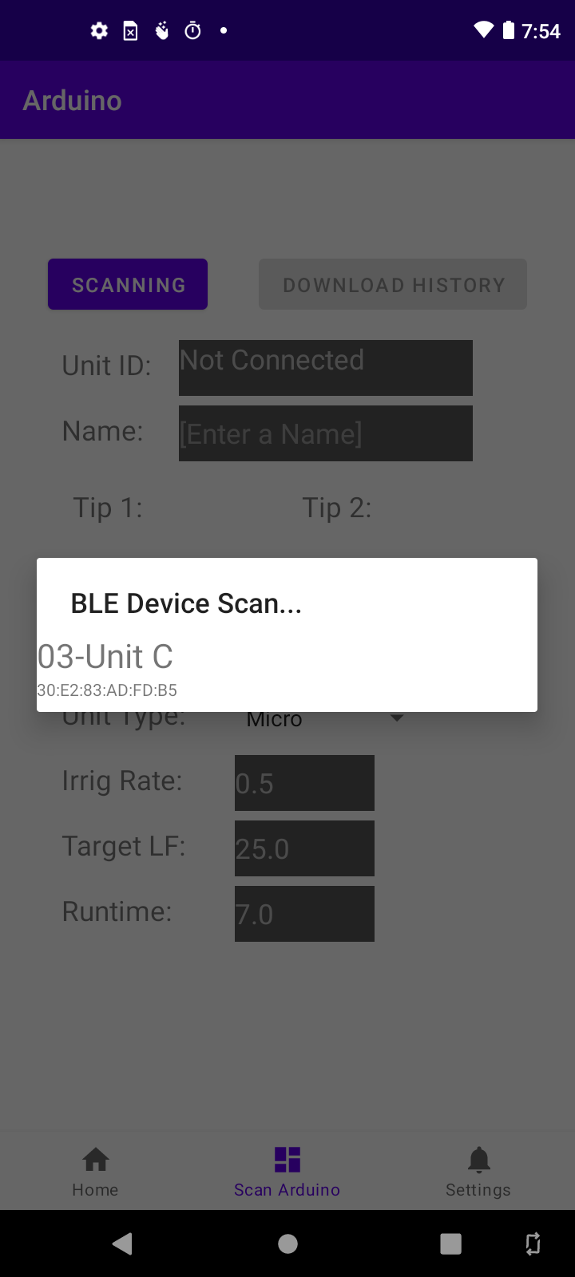

Slide 4
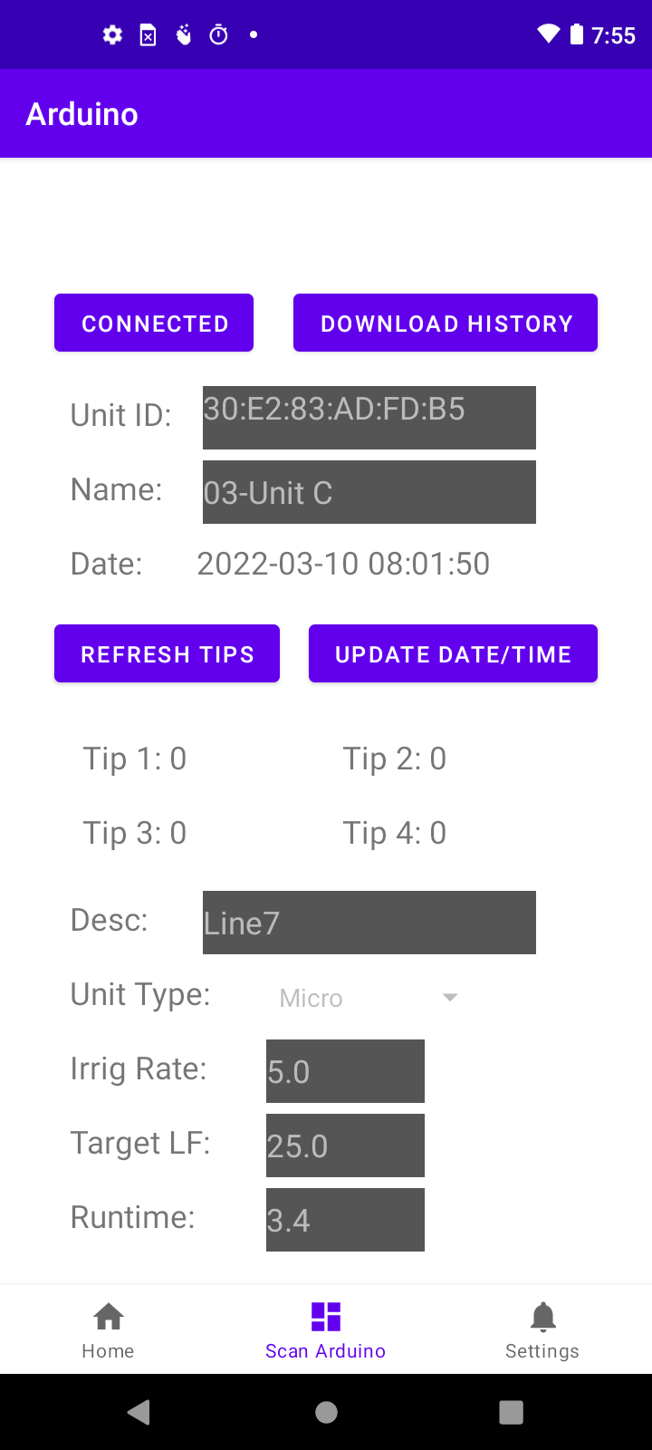
Tap to download history
Current tip count

Slide 5
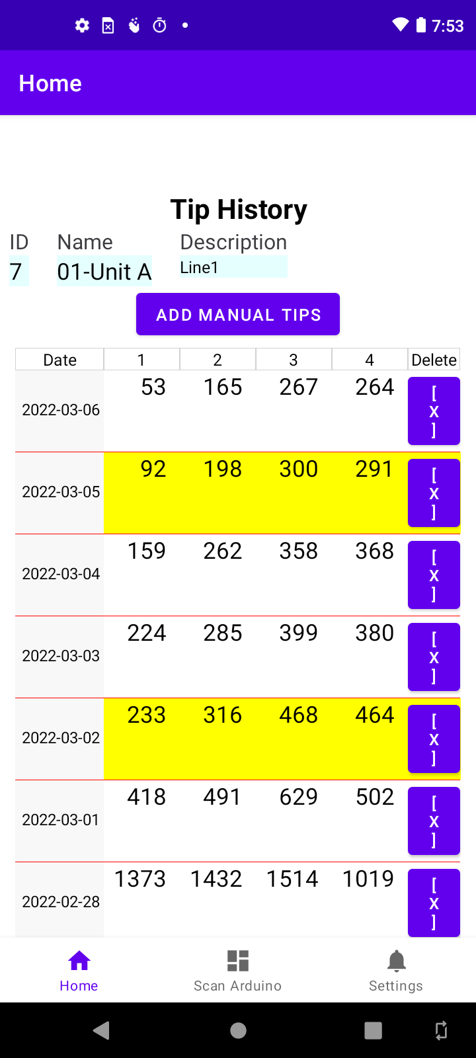
Tap date to view LF results
Last saved LF highlighted in yellow

Slide 6
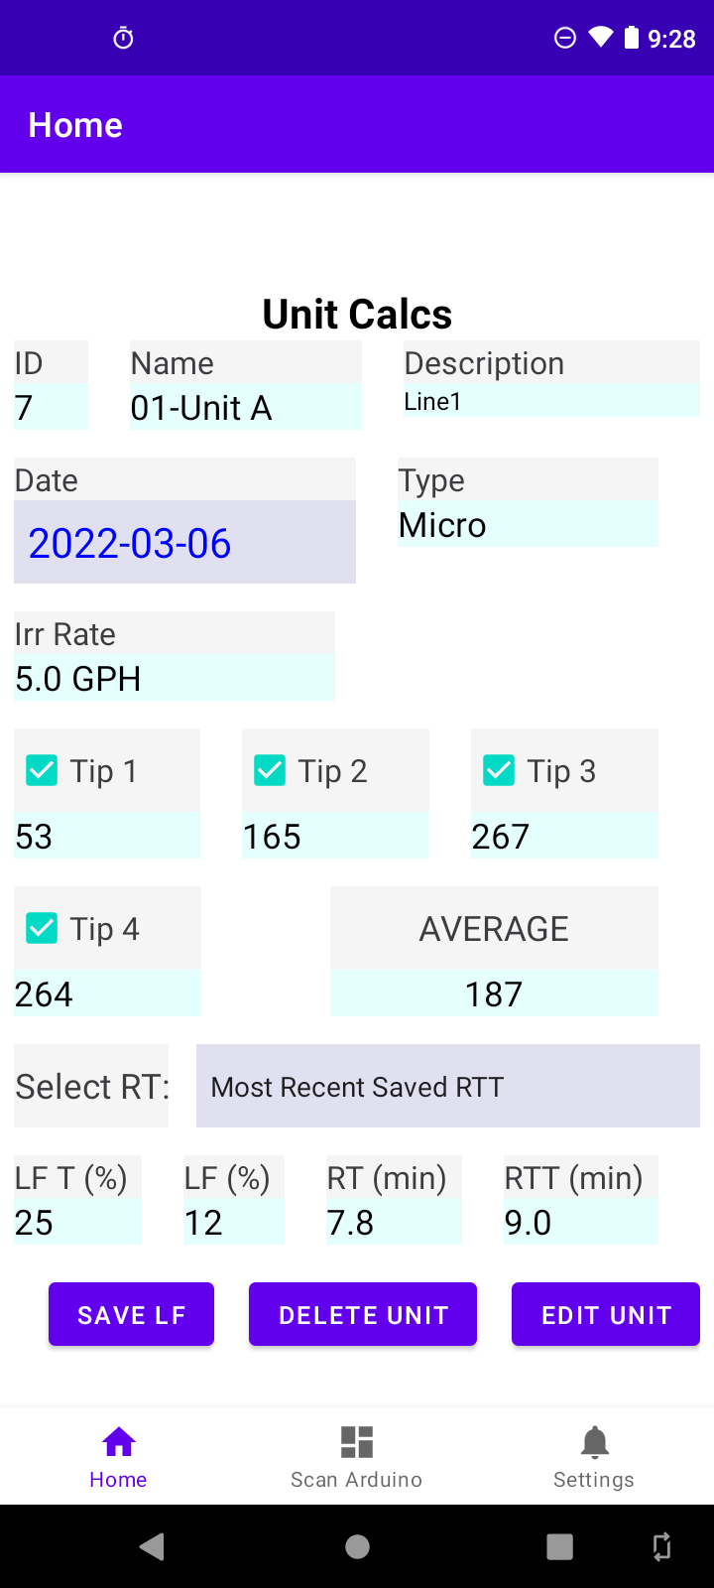
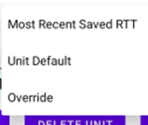
Uncheck tipper if bad
If RT was different, tap to enter an override value
If all values are correct, tap to save to LF history

Slide 7
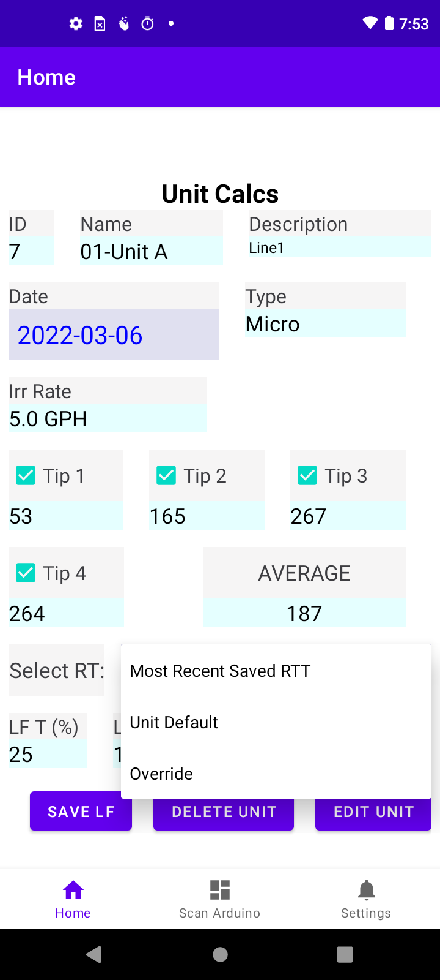

Slide 8
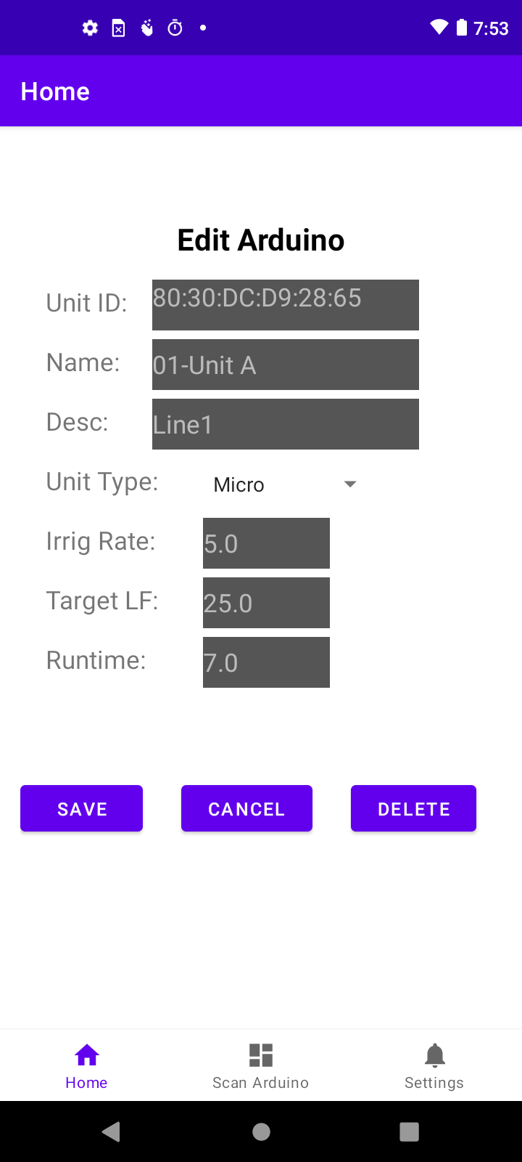

Slide 9
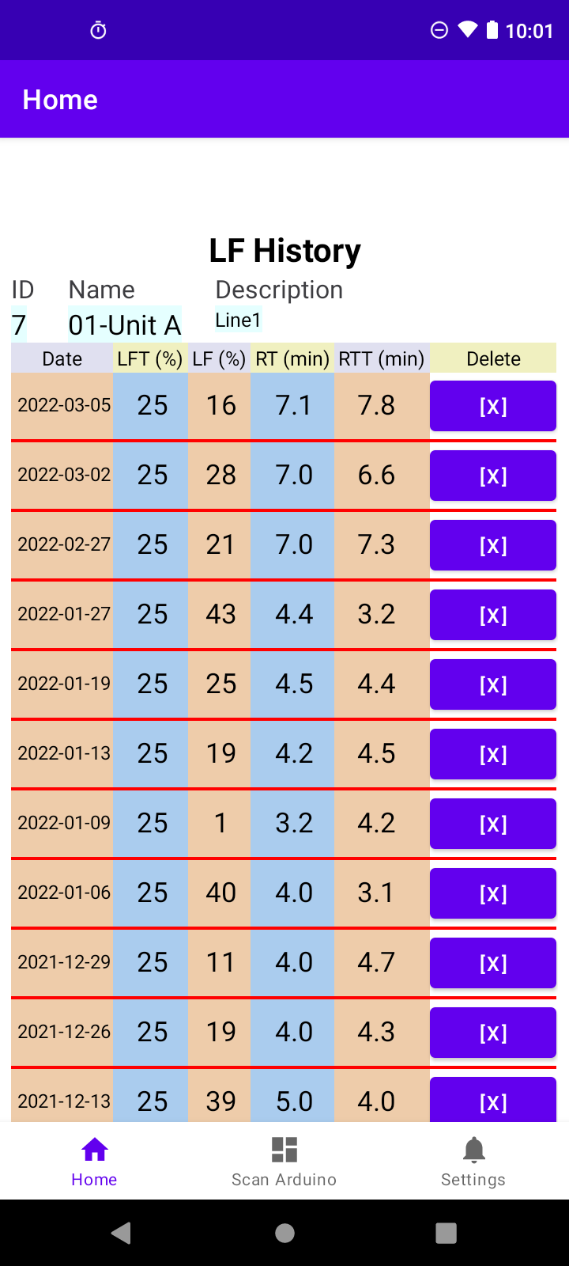

Slide 10
