Slide 1





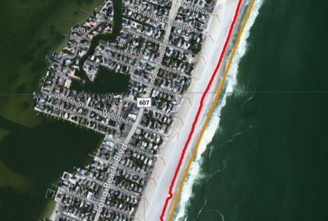

ڕ Beachfront original design
Scene Metadata
Planet Labs API
This is what was published in the SSP but it is now obsolete
Dirty
Clean
Imagery Archive
Cloud-Managed
Amazon S3
Bucket
Amazon S3
Bucket
AWS Redis API
Admin
NoSQL
Harvest
pzsvc-image-catalog
Discover
Redis
Analyst
Scene Tiles
bf-ui
bf-TidePrediction
Execute
Browser
bf-handle
piazza
Metadata Injection
OGC API
Detected
Shoreline(s)
Base Map Server
Ingest
PostGIS
PostGIS
Dirty
Clean
pzsvc-exec
Amazon EFS
LandSAT
Amazon S3
Bucket
Amazon S3
Bucket
pzsvc-ossim
Band Images
IdAM
Amazon S3

Slide 2
ڕ Beachfront Use Case 2
Planet Labs API
Cloud-Managed
Imagery Archive
AWS Redis API
Admin
NoSQL
Harvest
pzsvc-image-catalog
Discover
Redis
Analyst
Scene Tiles
bf-ui
bf-TidePrediction
Execute
Browser
bf-handle / bf-api
piazza
Execute
OGC API
Detected
Shoreline(s)
Publish
Base Map Server
Ingest
PostGIS
pzsvc-exec
PostGIS
pzsvc-exec
pzsvc-exec
OSSIM
Amazon EFS
IdAM

