Slide 1
Warehouse TRIP planner
Ubiquitous Computing
Catherine Rakama, Matteo Zavagno

Slide 2
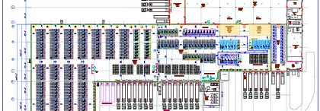
Goal of the project
Optimize the operator trip to pick the goods in a given layout context-aware warehouse
Improve user’s working experience
Save money for the company

Slide 3
What we need
Forklift operator
1
Plant layout
2
RFID location systems
3
Central processing system
4

Slide 4
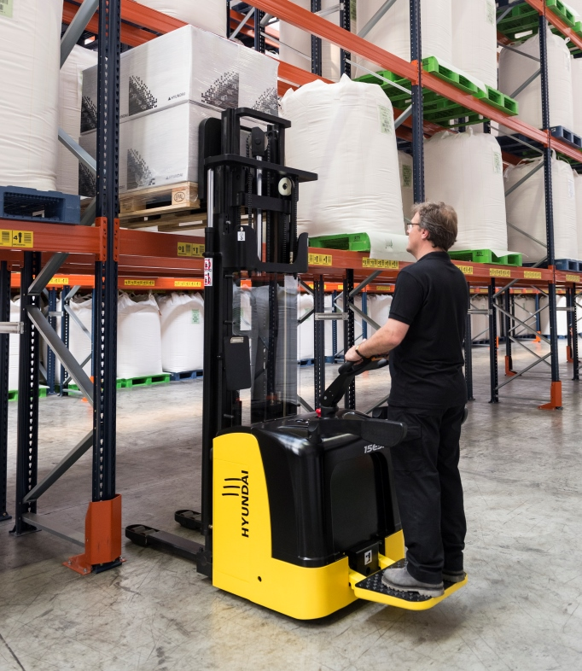
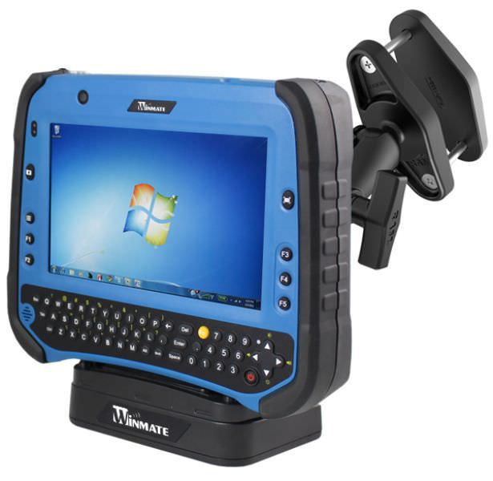
1. Forklift operator
The Forklift operator is the user that benefits from this service.
He has a tablet installed in his forklift that tells him the fastest (not shortest) way to the type of product he is looking for
The Forklift always starts its path from a fixed point in the warehouse

Slide 5
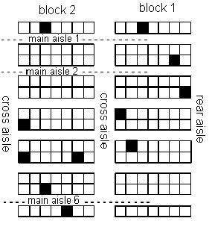
2. Our plant layout
Two main blocks
Elements stored in shelf racks
Every square is same-sized
Possible paths are fixed
Main assumption: picking products at high levels costs extra-time (penalty factor)
Trade-off between minimizing horizontal distance and vertical distance
: Forklift starting position
: Possible paths

Slide 6
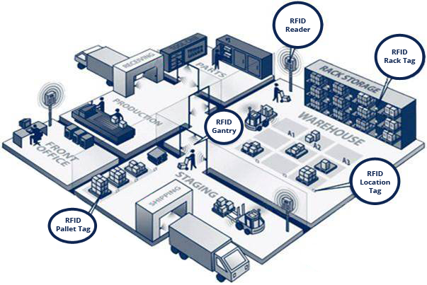
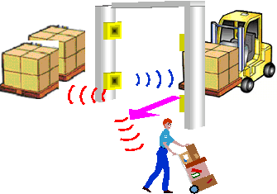
3. RFID LOCATION SYSTEM
Different solution discussed and already available in the market.
We assume that the goods position in the warehouse is constantly monitored via this RFID sensor system.
The information exchanged with the RFID tag is the product ID. The context infers the position of that box through triangulation of the antennas.
The warehouse is context-aware in the sense that it knows what and where it contains with no extra human input, every input and output of goods is automatic.

Slide 7
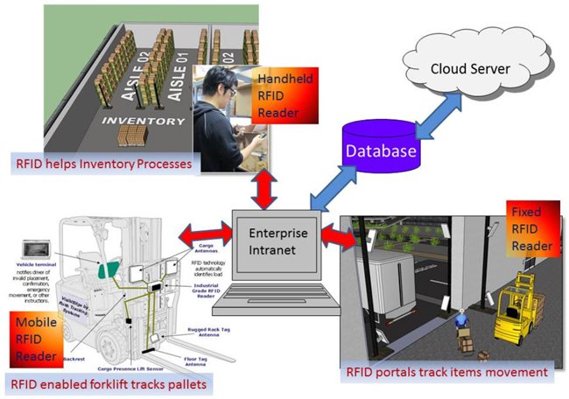
4. Central processing system
This environment needs a central processing system with a database to keep track of all changes. This is accessible through the Enterprise Intranet in the reality.
For our purposes we neglected this ulterior element of complexity.
The system pre-calculates all the possible paths to reach a product type and when one operator request for one product it shows how to get it in the format:
Go straight for 2 aisle
Turn on your right aisle
Go straight for 3 box slots
Pick on level 3 at your left.

Slide 8
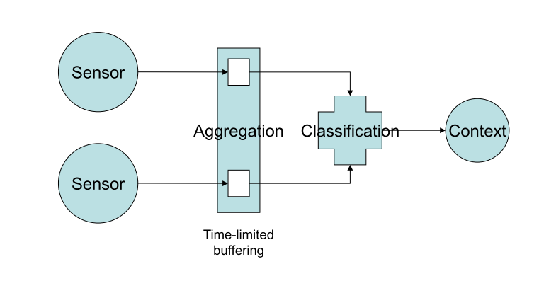
Ubiquitous computing analysis
B1 is given by the ERP software
Locations of B1 products
List of computed paths
The fastest product to pick is in location (3,5,6).
Sensors
Classification model
Context
Location of the forklift worker
Location is given by the RFID system

Slide 9
Context-awareness
Sensible to modifications of:
Turn left!
Locations of boxes
Location of the forklift worker
Number of forklift workers
Dynamic routing indications

Slide 11
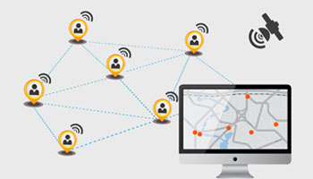
For the future: Expanding the routing system to everything
Tracking, through RFID, not only goods but also:
Important working tools
People (responsibles)
Everything useful
From the system’s login page people could access only the location and directions of the resource of their competency.
Less waste of time and better work experience

