Slide 1
Determine Best Model for Diabetes Prediction using Feature and Model Selection
Chinmayee Raman
MET CS 677
Spring 2024

Slide 2
Methodology
Dataset Overview
Hyperparameter Tuning
All Features
Logistic Regression
Analyze recall f1_score and Accuracy
EDA
KNN Classifier
Data Imputation
SVM
Feature Selection
Selected Features
Best Model
Best lassifer
Random Forest
Feature Scaling

Slide 3
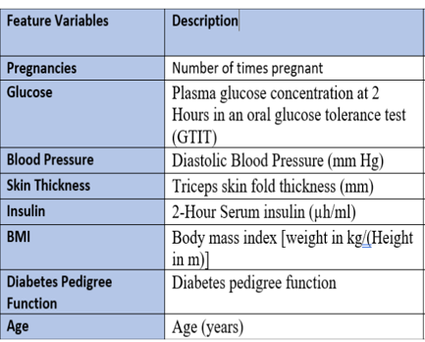
Dataset Overview
Class Label: Outcome
Outcome = 0 (negative for diabetes)
Outcome = 1 (positive for diabetes)
8 numerical features
Size : 768 rows and 9 columns
No null values

Slide 4
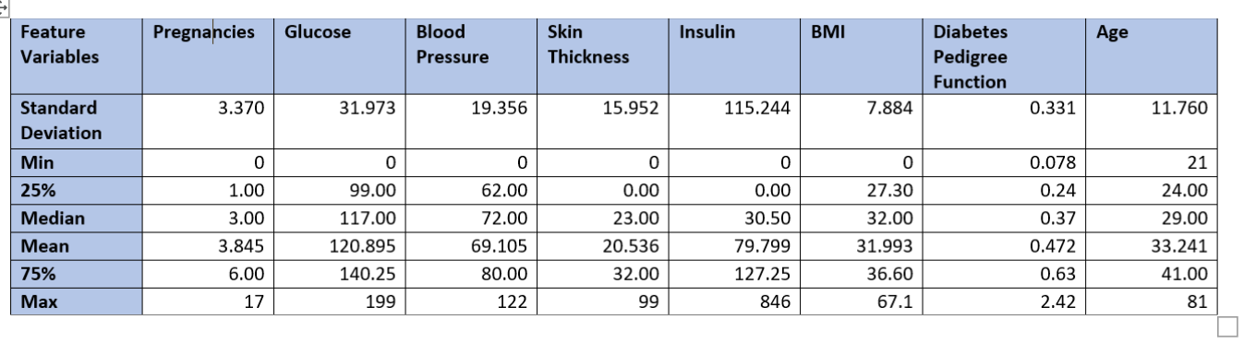
EDA – Statistical Summary and Inference
Has 0 values for all features except age and diabetes pedigree function
Okay to have 0 value for pregnancies
Insulin mean and median far apart indicating likely skewed distribution
Need scaling as data ranges are varied

Slide 5
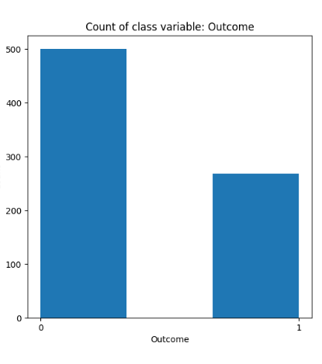
EDA: Class Label Imbalance
Count of class Labels: Outcome
0 500
1 268
Negative labels almost double that of positive
May lead to decrease accuracy in positive prediction
Balancing class weight via model parameters wherever feasible

Slide 6
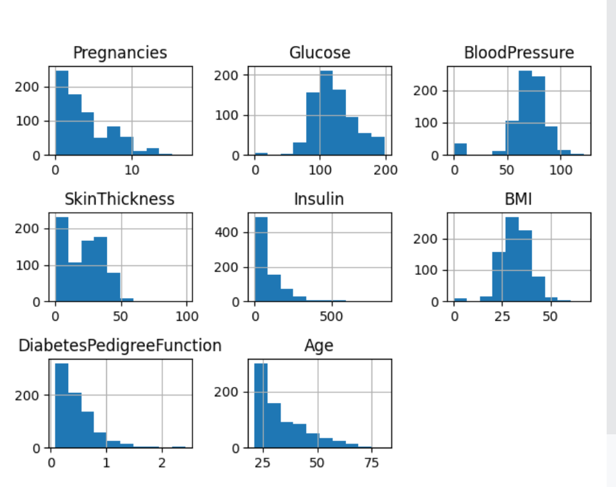
EDA: Univariate Analysis – Imputing Zero Values
Count of zeros values by column:
----------------------------------------------
Pregnancies : 111
Glucose : 5
Blood Pressure : 35
Skin Thickness : 227
Insulin : 374
BMI : 11
Diabetes Pedigree Function : 0
Age: 0

Slide 7
Methodology for Imputation zero values
dataset was split into train and test - 75/25 ratio
scaled the data using Standard Scaler
imputed Train and Test separately
imputed the to median for features with skewed distribution:
Insulin, and Skin Thickness
imputed to mean for feature with normal distribution:
'Glucose', 'Blood Pressure', 'BMI’
pregnancies not imputed as a person can have 0 pregnancies
repeated above steps: for all features and for selected features

Slide 8
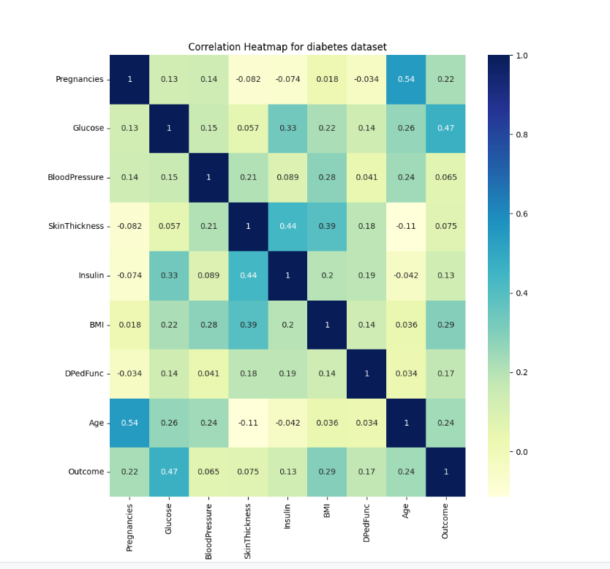
EDA: Feature Correlation
Highest Correlation of Outcome:
Glucose: 0.47
BMI: 0.29
Age: 0.24
Pregnancies: 0.22
Diabetes Pedigree Function: 0.17
Insulin: 0.13
Blood Pressure: 0.065
Skin Thickness: 0.075
Highest Correlation among features:
Pregnancies and age: 0.54
Skin Thickness and Insulin: 0.44
Skin Thickness and BMI: 0.39

Slide 9
Feature Selection
Following Features with highest correlation to class label(‘Outcome’) were chosen:
Glucose
Above normal Glucose in blood indicates diabetes
BMI
Higher BMI indicates higher weight of the person
Age
Age of the person
Diabetes Prediction Function
Numerical value of the effect of genetics on getting diabetes
Even though Pregnancies had a high correlation to ‘Outcome’ it was not chosen as:
It has a high correlation with another input feature Age
It has values of very high pregnancies like 15,16,17 which may be unwanted outliers

Slide 10
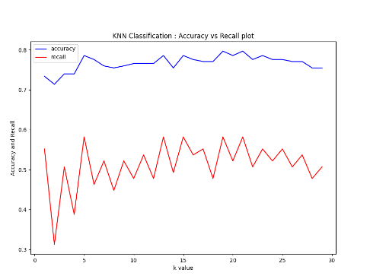
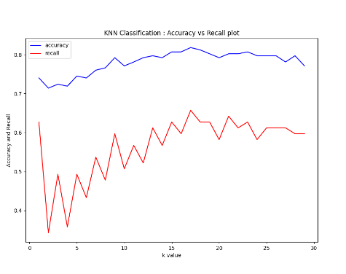
kNN Classifier: Tuning Hyperparameter k iteratively (n neighbors)
All Features : best k = 19 ( for max recall and accuracy)
Selected Features : best k = 17 ( for max recall and accuracy)

Slide 11
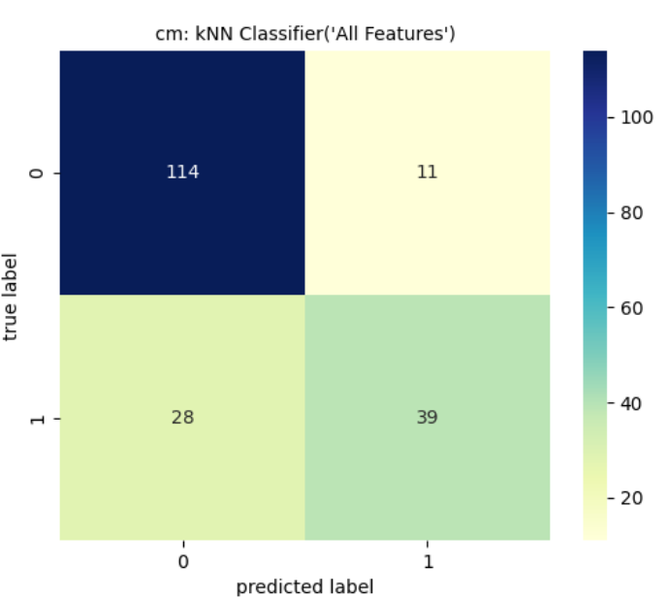
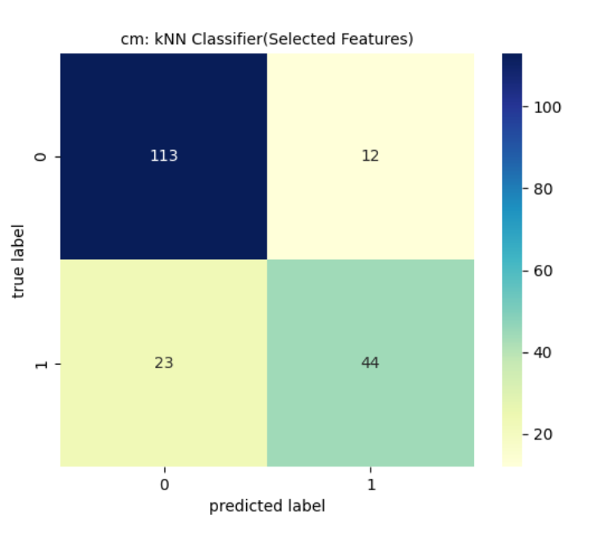
kNN Classifier: Performance Metrics
Features | Accuracy | Precision | Recall | f1_score | TNR | TN | FP | FN | TP
ALL | 0.7969 | 0.78 | 0.5821 | 0.6667 | 0.912 | 114 | 11 | 28 | 39
Selected | 0.8177 | 0.7857 | 0.6567 | 0.7154 | 0.904 | 113 | 12 | 23 | 44
Accuracy,Recall,f1_score improved after feature selection

Slide 12
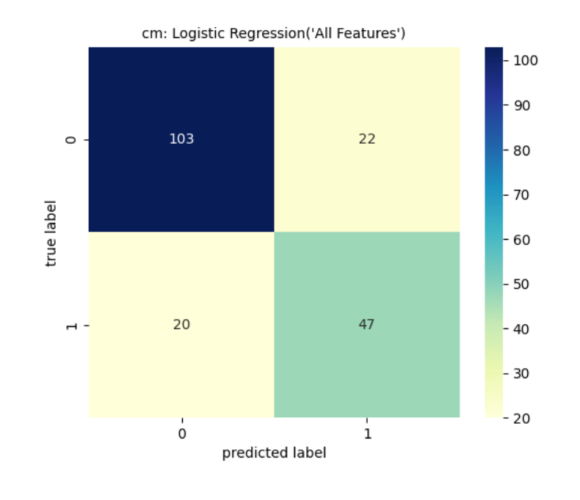
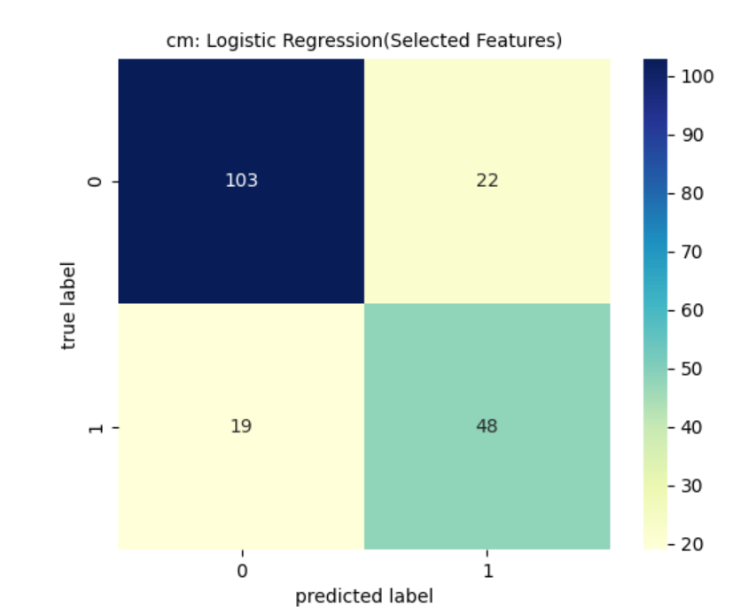
Logistic Regression: Tuning hyperparameter C iteratively (Inverse of regularization strength)
Features | Tuning C for Best Accuracy | Accuracy | Precision | Recall | f1_score | TNR | TN | FP | FN | TP
ALL | best C: 1 | 0.7812 | 0.6812 | 0.7015 | 0.6912 | 0.82 | 103 | 22 | 20 | 47
Selected | best C: 0.001 | 0.7865 | 0.6857 | 0.7164 | 0.7007 | 0.82 | 103 | 22 | 19 | 48
Accuracy, Recall,f1_score improved by around 1% after feature selection
To balance the class imbalance used parameter class_weights = ‘balanced’

Slide 13
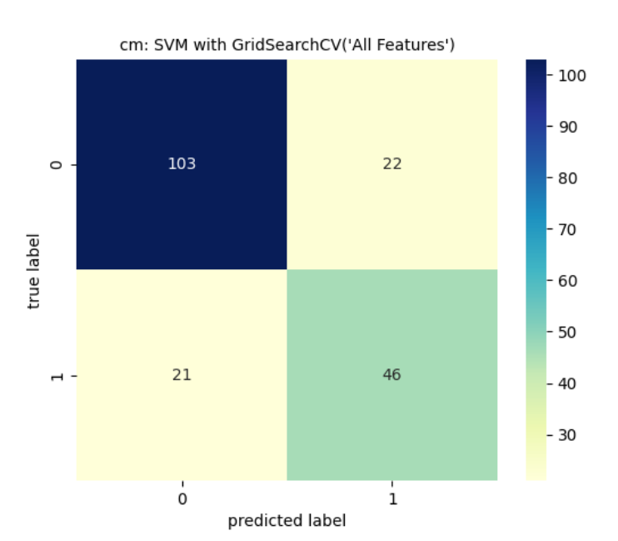
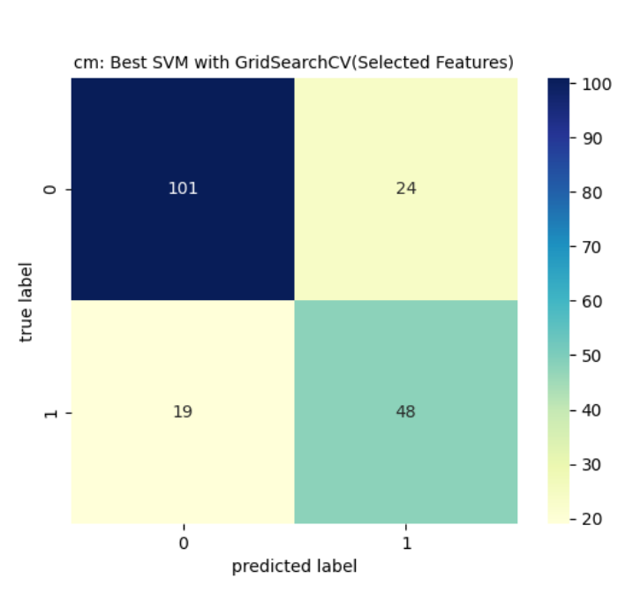
SVC: Hyperparameter Tuning for best C and gamma using GridSearchCV
param_grid = {'C': [0.1,1, 10, 100, 1000], 'gamma': [ 1, 0.1, 0.01, 0.001, 0.0001] }
All features: best params : C =100,gamma= 0.001,class_weight = 'balanced',kernel = 'rbf’
Selected features: best params: C=10, gamma=0.01,class_weight='balanced',kernel = 'rbf'
Features | Accuracy | Precision | Recall | f1_score | TNR | TN | FP | FN | TP
ALL | 0.776 | 0.6765 | 0.6866 | 0.6815 | 0.824 | 103 | 22 | 21 | 46
Selected | 0.776 | 0.6667 | 0.7164 | 0.6906 | 0.808 | 101 | 24 | 19 | 48
Recall improved by 3 % and f1_score improved by around 1% slightly after feature selection. No change in accuracy with feature selection.

Slide 14
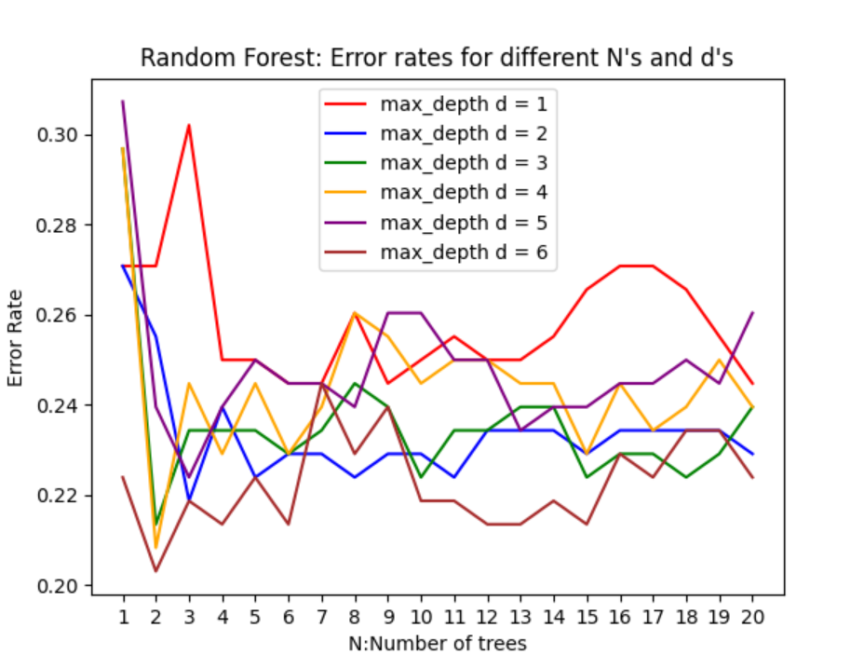
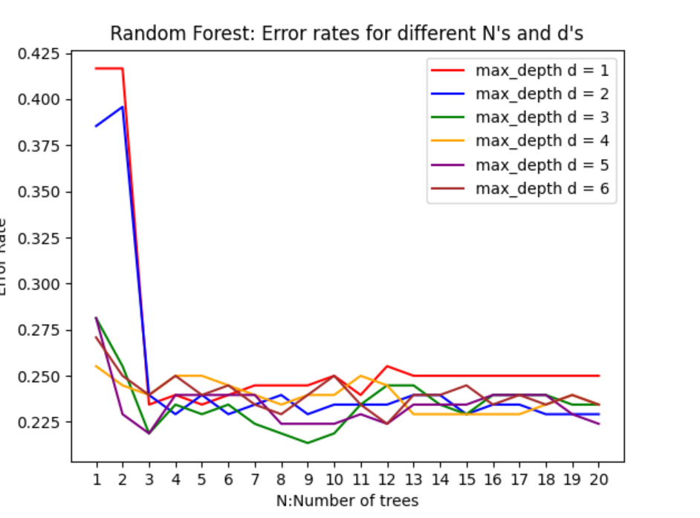
Random Forest: Hyperparameter tuning iteratively for N (number of trees) and d(max depth )
All Features : Best N: 2 Best d: 6 ( for maximum accuracy)
Selected Features : Best N: 9 Best d: 3 ( for maximum accuracy)

Slide 15
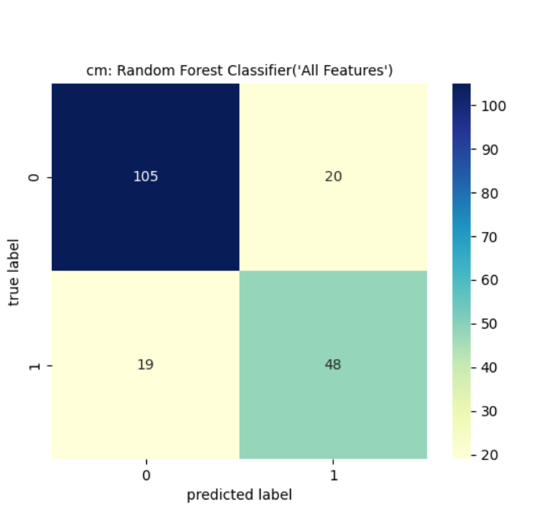
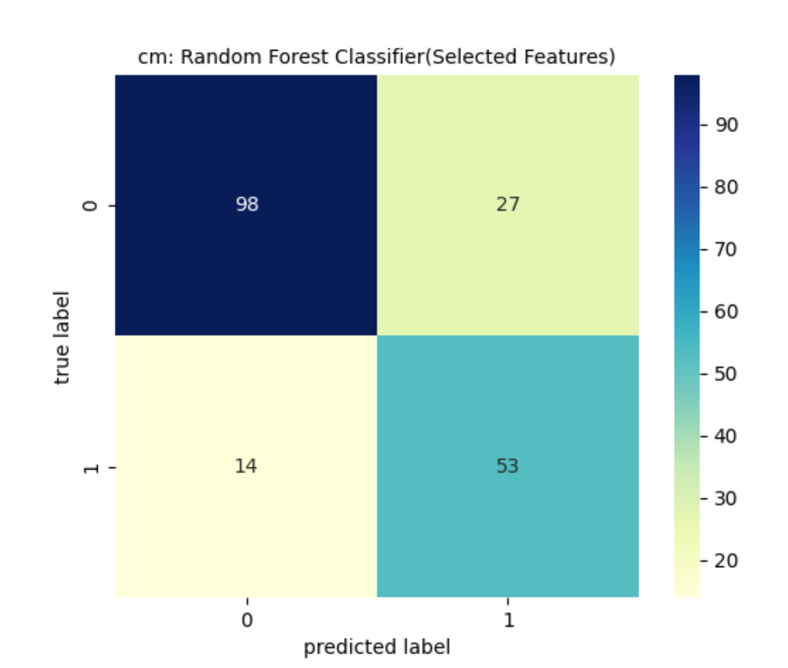
Random Forest Performance Metrics
Features | Accuracy | Precision | Recall | f1_score | TNR | TN | FP | FN | TP
ALL | 0.7969 | 0.7059 | 0.7164 | 0.7111 | 0.84 | 105 | 20 | 19 | 48
Selected | 0.7865 | 0.6625 | 0.791 | 0.7211 | 0.784 | 98 | 27 | 14 | 53
Recall improved significantly to 79.1 percent after feature selection
Accuracy decreased by 1% and f1_score increased by 1%

Slide 16
Result Analysis
Model | Features | Accuracy | Precision | Recall | f1_score | TNR | TN | FP | FN | TP
kNN | ALL | 0.7969 | 0.7800 | 0.5821 | 0.6667 | 0.9120 | 114 | 11 | 28 | 39
kNN | Selected | 0.8177 | 0.7857 | 0.6567 | 0.7154 | 0.9040 | 113 | 12 | 23 | 44
Logisitc Regression | ALL | 0.7812 | 0.6812 | 0.7015 | 0.6912 | 0.8240 | 103 | 22 | 20 | 47
Logisitc Regression | Selected | 0.7865 | 0.6857 | 0.7164 | 0.7007 | 0.8240 | 103 | 22 | 19 | 48
SVC(GridSearch) | ALL | 0.7760 | 0.6765 | 0.6866 | 0.6815 | 0.8240 | 103 | 22 | 21 | 46
SVC(GridSearch) | Selected | 0.7760 | 0.6667 | 0.7164 | 0.6906 | 0.8080 | 101 | 24 | 19 | 48
Random Forest | ALL | 0.7969 | 0.7059 | 0.7164 | 0.7111 | 0.8400 | 105 | 20 | 19 | 48
Random Forest | Selected | 0.7865 | 0.6625 | 0.7910 | 0.7211 | 0.7840 | 98 | 27 | 14 | 53
Ran all models individually for ‘All Feature’ and ‘Selected Features’ of Glucose, BMI, Age and Diabetes Pedigree Function
kNN with selected features has the highest accuracy at 81.77 % and highest precision 78.57% with lower recall 65.7 % and f1_score of 71.54%. This could be because I could not use a parameter(knn has no class_weight) to offset the class imbalance.
Random forest with selected features has the best recall at 79.1 percent and best f1_score of 72.11%, but lower accuracy 78.65% and lower precision 66.25%.
Overall Random forest showed the maximum improvement with ‘Selected Features’ while Logistic Regression showed marginal improvement.

Slide 17
Conclusion and Next Steps
Best Model: Random Forest Classifier
The Random Forest Model has the best recall at 79.1 % and best f1_score at 72.11%
Hence it is the best model to predict accurately whether a person has diabetes or is likely to get diabetic
Using an ensemble model, the random forest helped to get best recall and f1 score over the individual models
Next Steps: Though a recall of 79.1% and f1_score of 72.11% is not bad I feel we could improve on the performance metrics by:
Trying out other models(specially ensemble)
Trying to impute data in with other imputation methods like kNN impute
Trying to reduce class imbalance by resampling

