Slide 1
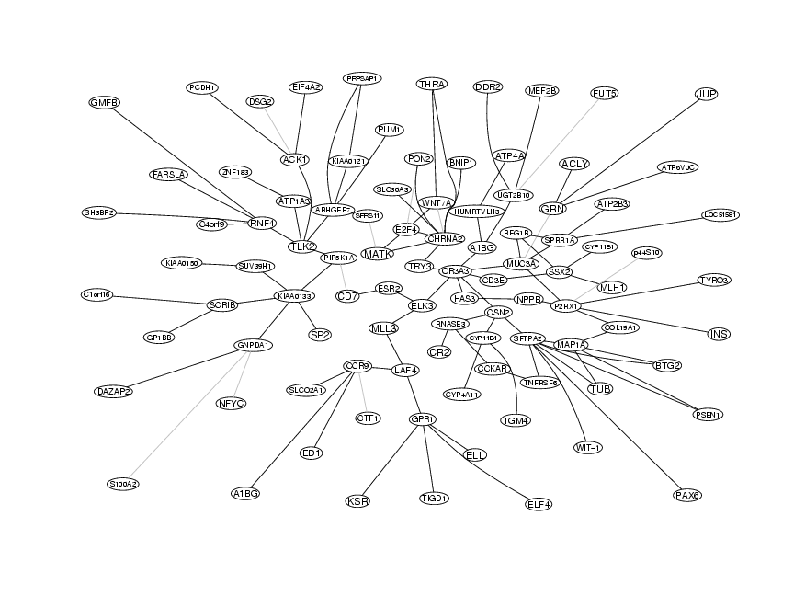
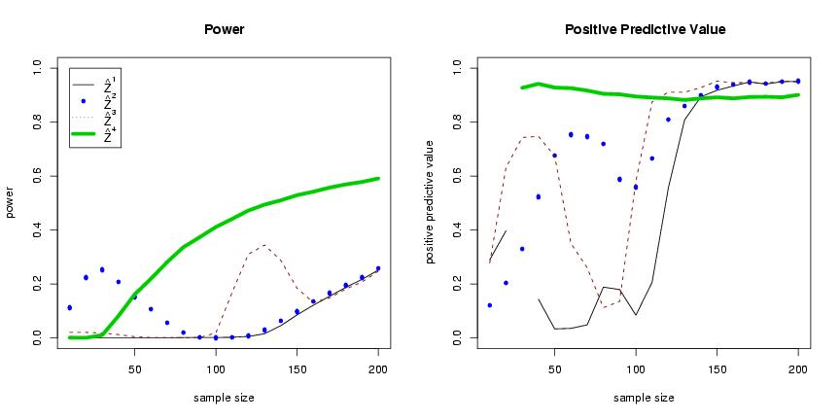
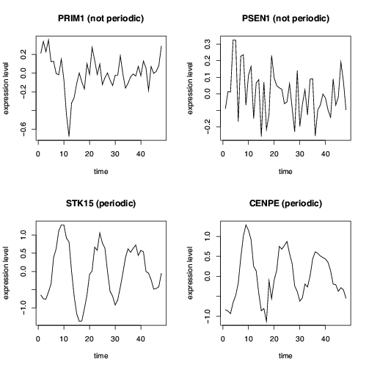


GeneTS: Microarray Time Series and Network Analysis
GeneTS focuses on the analysis of genomic
time series data (e.g. periodicity testing) and
on the inference of large-scale gene association
and gene relevance networks.
References:
Wichert et al. Bioinformatics (2004)
Schäfer and Strimmer. Bioinformatics (2005)
Additional packages needed:
corpcor, locfdr (required)
graph, Rgraphviz (optional)
Contact: korbinian.strimmer@lmu.de
Website: http://www.statistik.lmu.de/~strimmer/software/genets/

