Slide 1
Introduction to PKNCA Automation of Noncompartmental Analysis in R (or Scripted NCA Made Easy)
25-May-2016
Bill Denney Human Predictions, LLC

Slide 2
NCA in 5(+3) Lines of R
library(PKNCA)
## Load the PK concentration data
d.conc <- read.csv("concentration.csv", stringsAsFactors=FALSE)
## Load the dosing data
d.dose <- read.csv("dose.csv", stringsAsFactors=FALSE)
## Create a concentration object. (Note that any number of grouping
## levels is supporting; you are not restricted to this list.)
my.conc <- PKNCAconc(d.conc, concentration~time|treatment+subject)
## Create a dosing object.
my.dose <- PKNCAdose(d.dose, dose~time|treatment+subject)
## Combine the concentration and dosing information to automatically
## define the intervals for NCA calculation and provide doses for
## calculations requiring dose.
my.data <- PKNCAdata(my.conc, my.dose)
## Calculate the NCA parameters
my.results <- pk.nca(my.data)
## Summarize the results
summary(my.results)

Slide 3
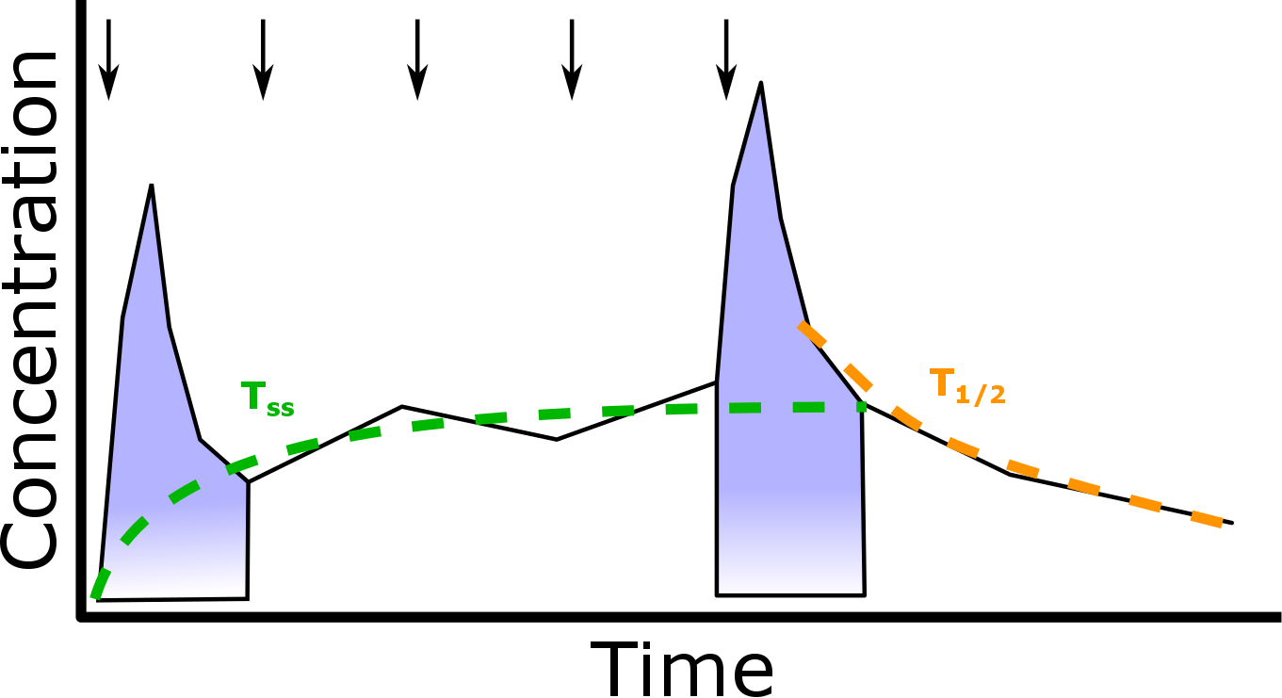
Any Questions?
?
?

Slide 4
The Right Time for Open-Source NCA
NCA consortium drafting suggested NCA validation requirements
Data standards are becoming more prevalent
FDA requirement that studies run in CDISC/SDTM by 18-Dec-2016*
CDISC ADaM working group is standardizing NCA data set (ADNCA)
Based on ADaM Basic Data Structure
Internal draft complete; goal to deliver public draft in 2016
CDISC SDTM pharmacokinetic concentration (PC) and pharmacokinetic parameter (PP) domains have been standardized
NCA calculation methods are becoming better defined
FDA/PhUSE CSS 2014 whitepaper on NCA calculations and recommended reporting†
* http://www.fda.gov/forindustry/datastandards/studydatastandards/default.htm and http://www.fda.gov/downloads/Drugs/Guidances/UCM384686.pdf
† http://www.phusewiki.org/wiki/images/e/ed/PhUSE_CSS_WhitePaper_PK_final_25March2014.pdf

Slide 5
What does PKNCA do (and not do)?
Organizes concentration/time and dose/time data
Predicts what you most likely need from NCA parameters from the concentration and dosing data.
Allows user control of all NCA parameter and summary calculations
If you want a type of control that it doesn’t allow, please make a feature request.
Does everything according to your business rules
Calculates all (standard) NCA parameters
Targeting the SDTM PK parameter terms
Summarizes the parameters
But it doesn’t…
Calculate statistics of your parameters (but, it’s a simple next step)
Have a graphical interface (yet)

Slide 6
Specific Features of PKNCA and Roadmap
Current (Version 0.7)
Future (by Version 1.0)
Calculate NCA parameters
C_{max}, T_{max}, AUC_{last}, AUC_{inf}, AUMC, half-life, …
Only calculates the requested and required parameters
NCA-related calculations
Superposition
Concentration interpolation/extrapolation (with AUC methods)
Time to steady-state
Accept any input data, SDTM PP-ready output
Track PKNCA inputs to outputs
Tested and internally-validated
>800 test cases
Version 0.7 features plus…
Clean concentration/time and dosing data
E.g. missing concentrations and time deviations
Track file read, data manipulations to tabular outputs
Improved prediction of desired parameters

Slide 7
What to do after the tutorial?
Get the development copy of PKNCA from GitHub:
https://github.com/billdenney/pknca/
All development happens on GitHub
Get the released version of PKNCA from CRAN:
https://cran.r-project.org/web/packages/PKNCA/
Ask a question now or later
wdenney@humanpredictions.com
Read the vignettes for how to use PKNCA
Presentations: https://cran.r-project.org/web/packages/PKNCA/vignettes/
Examples of code: https://github.com/billdenney/pknca/tree/master/vignettes
Contribute: It’s open source!
Data, code, test cases, documentation, requests…

