Slide 1
PKNCA: Scripted NCA Made Easy
31-March-2016
Bill Denney

Slide 2
NCA in 5(+3) Lines of R
library(PKNCA)
## Load the PK concentration data
d.conc <- read.csv("concentration.csv", stringsAsFactors=FALSE)
## Load the dosing data
d.dose <- read.csv("dose.csv", stringsAsFactors=FALSE)
## Create a concentration object. (Note that any number of grouping
## levels is supporting; you are not restricted to this list.)
my.conc <- PKNCAconc(d.conc, concentration~time|treatment+subject)
## Create a dosing object.
my.dose <- PKNCAdose(d.dose, dose~time|treatment+subject)
## Combine the concentration and dosing information to automatically
## define the intervals for NCA calculation and provide doses for
## calculations requiring dose.
my.data <- PKNCAdata(my.conc, my.dose)
## Calculate the NCA parameters
my.results <- pk.nca(my.data)
## Summarize the results
summary(my.results)

Slide 3
Any Questions?
?

Slide 4
What does PKNCA do (and not do)?
Organizes concentration/time and dose/time data
Predicts what you most likely need from NCA parameters from the concentration and dosing data.
Allows user control of all NCA parameter and summary calculations
If you want a type of control that it doesn’t allow, please make a feature request.
Does everything according to your business rules
Calculates all (standard) NCA parameters
Targeting almost all of the SDTM PK parameter terms
Summarizes the parameters
But it doesn’t…
Calculate statistics of your parameters (but, it’s a simple next step)
Have a graphical interface (yet)

Slide 5
A Bit More Explanation…
Data are arranged similarly to SDTM, but PKNCA doesn’t require SDTM
The PKNCAconc object is like SDTM PC.
The PKNCAdose object is like SDTM EX.
The PKNCAdata object is like ADaM ADPC.
The PKNCAresults object is like SDTM PP.

Slide 6
PKNCA Follows Your Rules
The PKNCA.options function lets you set all calculation options.
When combining concentration and dosing data, PKNCA automatically determines the intervals to use and which parameters to calculate.
You can override those intervals either before or after they are generated.
Only the parameters requested and dependencies are calculated; it doesn’t calculate every parameter for every subject in every interval.
PKNCA ensures reproducibility by storing the inputs, outputs, and decisions made by the user along with the computational environment details.

Slide 7
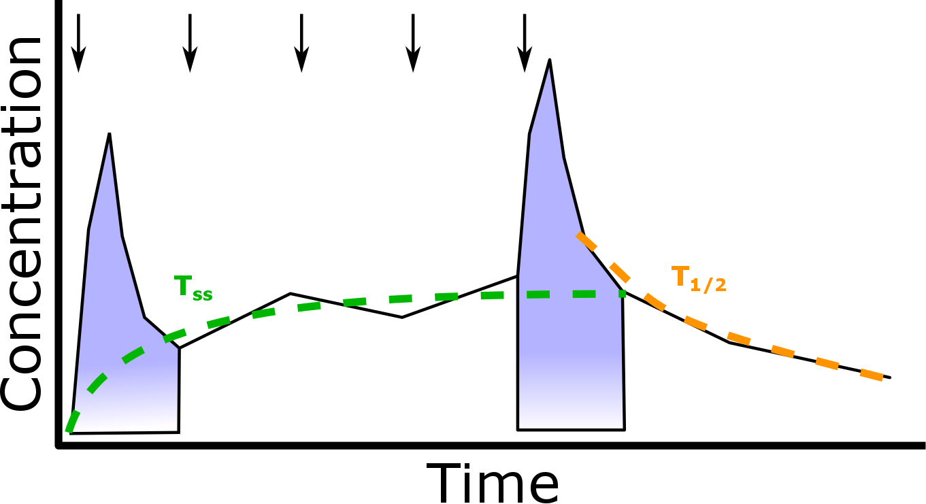
Automatic Interval Selection

Slide 8
Putting Concentration Data into PKNCA
Read in your data however makes sense for you (load a .csv file, connect to a database, read from a webserver, …)
d.conc <- read.csv("concentration.csv", stringsAsFactors=FALSE)
Make a PKNCAconc object specifying the columns for concentration, time, and grouping factors.
my.conc <- PKNCAconc(d.conc, concentration~time|treatment+subject)
Subject is automatically detected as the last grouping factor before a /
my.conc <- PKNCAconc(d.conc, concentration~time|treatment+subject/analyte)

Slide 9
Putting Dosing Data into PKNCA
As for PKNCAconc, read the data in however works in your environment.
d.dose <- read.csv("dose.csv", stringsAsFactors=FALSE)
Indicate the dose amount, dosing time, and grouping factors.
my.dose <- PKNCAdose(d.dose, dose~time|treatment+subject)
The amount and time columns can be named anything, but the grouping factors must be a subset of the groups for PKNCAconc.
my.conc <- PKNCAconc(d.conc, concentration~time|treatment+subject/analyte) my.dose <- PKNCAdose(d.dose, dose~time|treatment+subject)
my.dose <- PKNCAdose(d.dose, dose~time|study+treatment+subject)

Slide 10
Combining Concentration and Dose Data
When combined, intervals can be automatically determined from concentration and dosing objects.
my.data <- PKNCAdata(my.conc, my.dose)
… or you can specify the intervals
my.intervals <-
data.frame(start=0, end=c(24, Inf),
cmax=c(FALSE, TRUE),
tmax=c(FALSE, TRUE),
auclast=TRUE,
aucinf=c(FALSE, TRUE))
my.data <- PKNCAdata(my.conc, my.dose,
intervals=my.intervals)
And when combined, this is the time to set any non-default options
my.data <- PKNCAdata(my.conc, my.dose, options=list(first.tmax=TRUE))

Slide 11
You’ve done all the work– Get results!
One command does all the calculations,
my.results <- pk.nca(my.data)
You can extract the individual measurements
head(my.results$result)
And summarize them.
summary(my.results)
start | end | Subject | PPTESTCD | PPORRES
0 | Inf | 1 | auclast | 147.2347
0 | Inf | 1 | cmax | 10.5
0 | Inf | 1 | tmax | 1.12
0 | Inf | 1 | tlast | 24.37
0 | Inf | 1 | lambda.z | 0.048457
0 | Inf | 1 | r.squared | 1
… | … | … | … | …
start | end | auclast | cmax | tmax | half.life | aucinf
0 | 24 | 74.6 [24.3] | . | . | . | .
0 | Inf | . | 8.65 [17.0] | 1.14 [0.630, 3.55] | 8.18 [2.12] | 115 [28.4]

Slide 12
Where to go from here?
GitHub
https://github.com/billdenney/pknca/
Development happens on GitHub
CRAN:
https://cran.r-project.org/web/packages/PKNCA/
Ask a question now or later
Contribute: It’s open source!
Data, code, test cases, documentation, requests…

Slide 13
Any Questions?
?

