Slide 1
CSTR_demo in Matlab & R

Slide 2
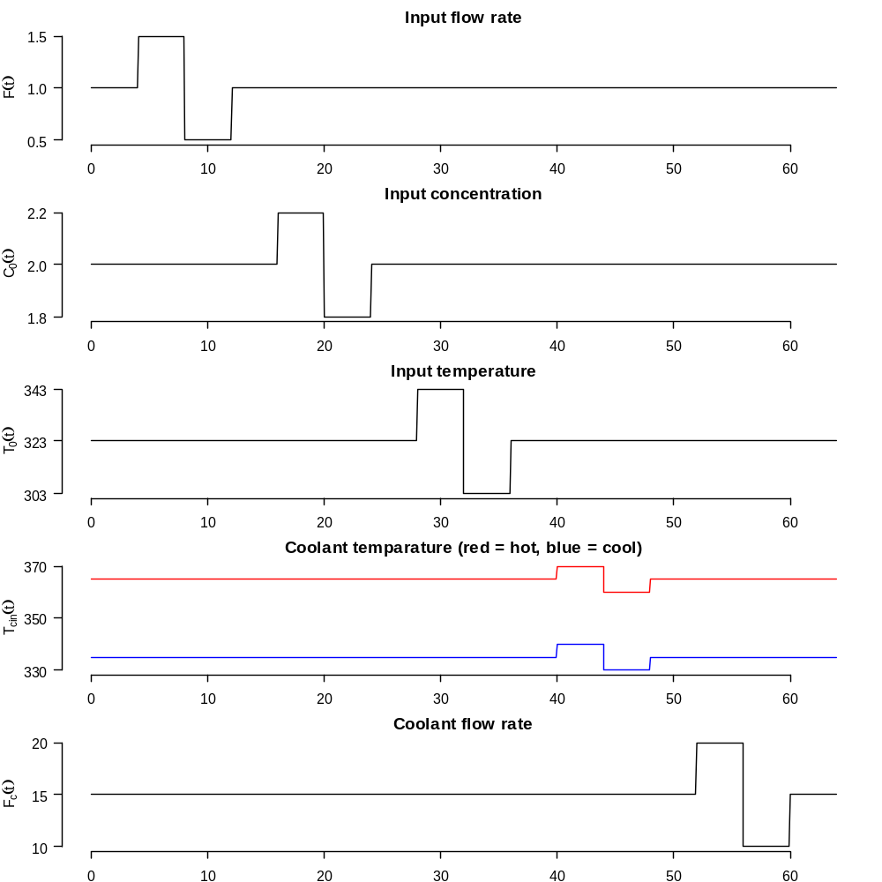
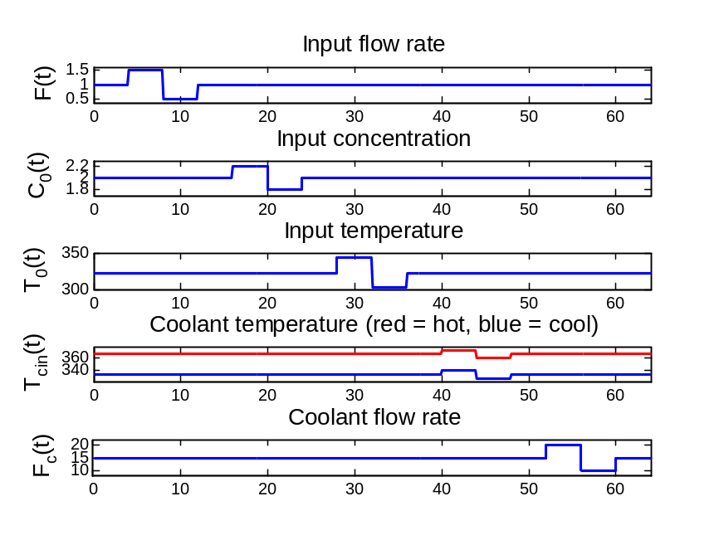
figure(1)
save CSTR_fig1Matlab -v6;

Slide 3
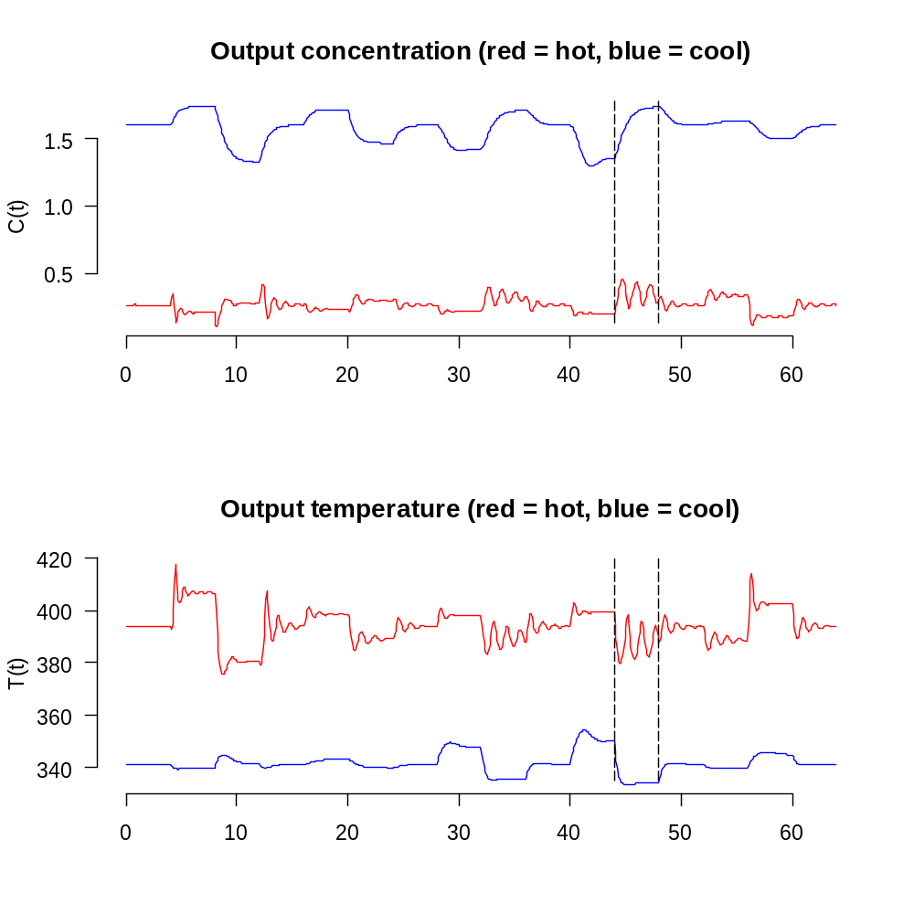
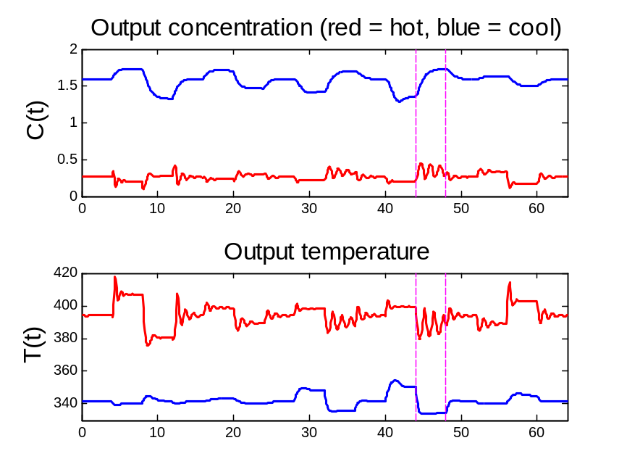
figure(2)
save CSTR_fig2Matlab -v6;

Slide 4
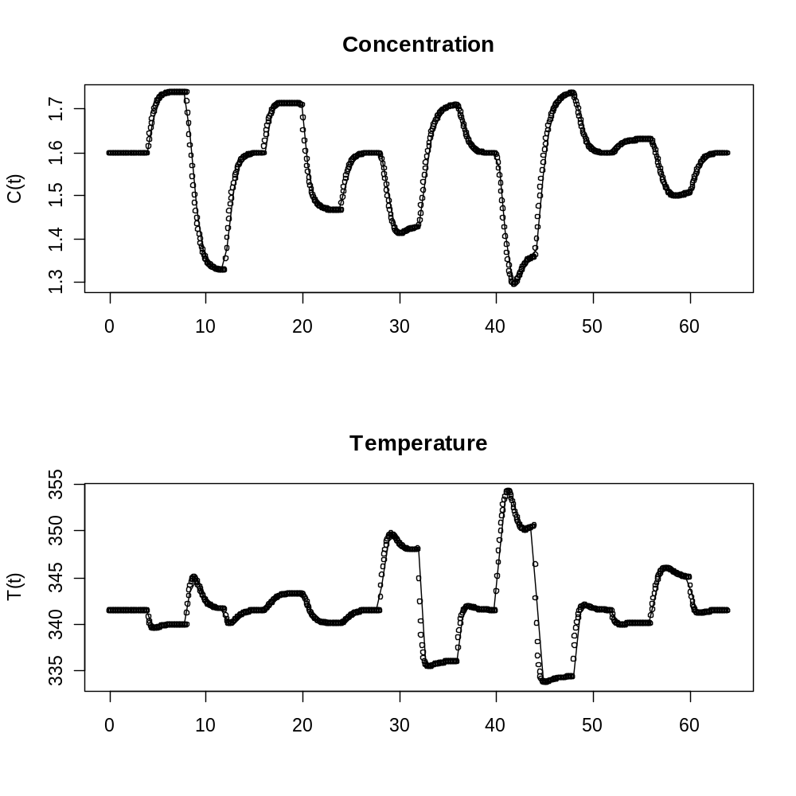
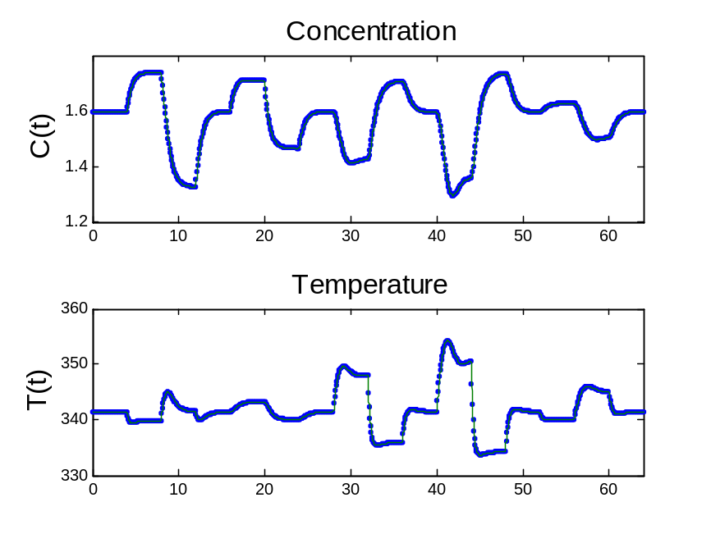
figure(3)
save CSTR_fig3Matlab -v6;

Slide 5
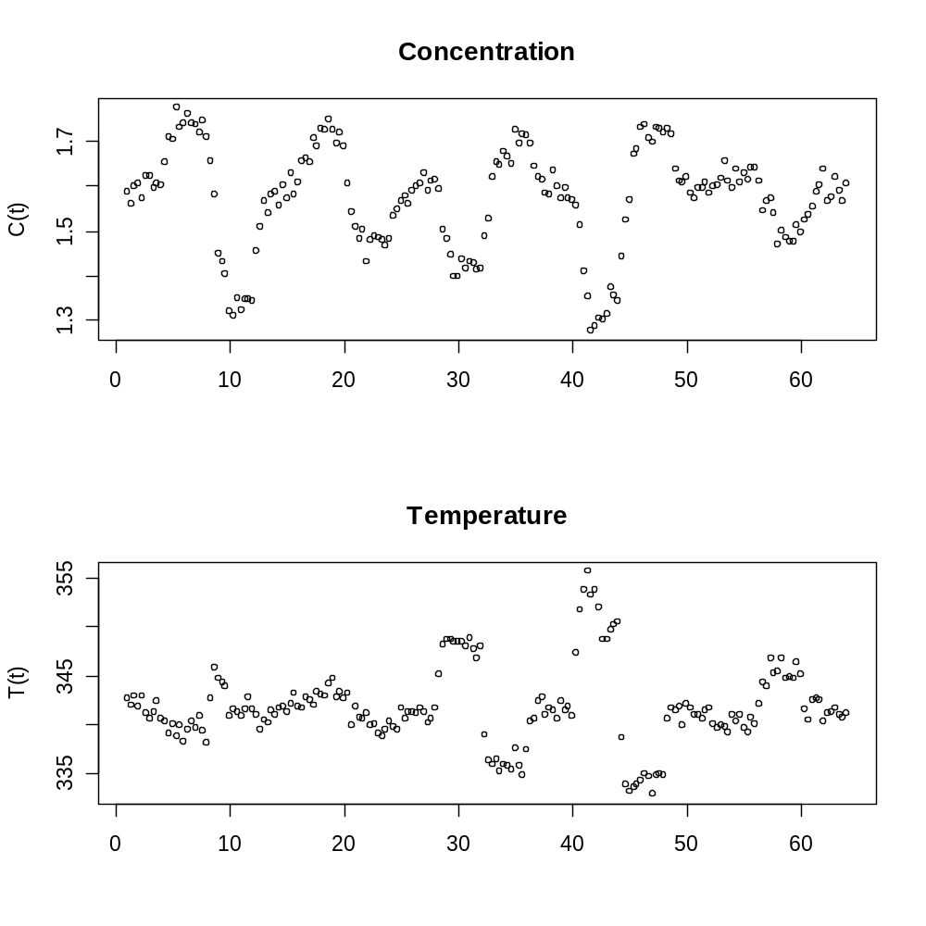
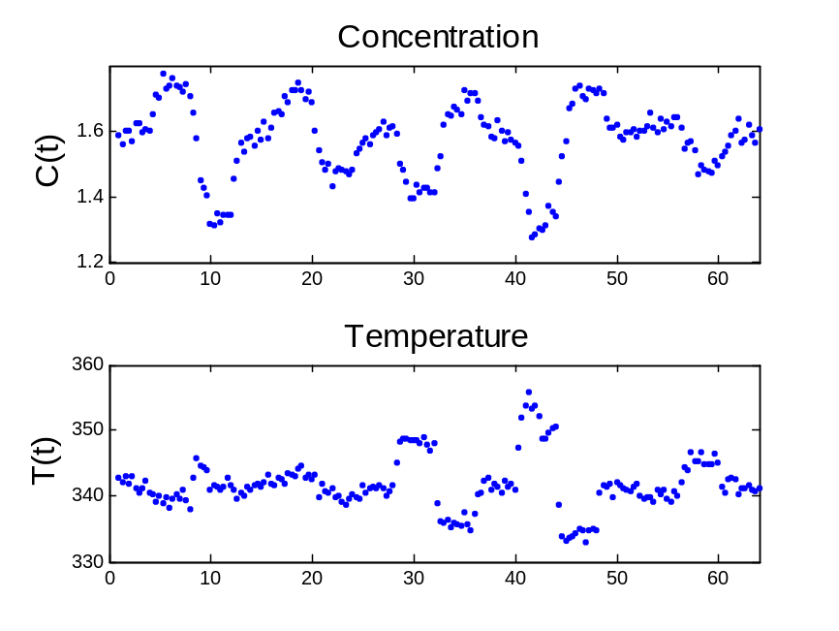
figure(4)
save CSTR_fig4Matlab -v6;
save(CSTR_fig4.Rdata)

Slide 6
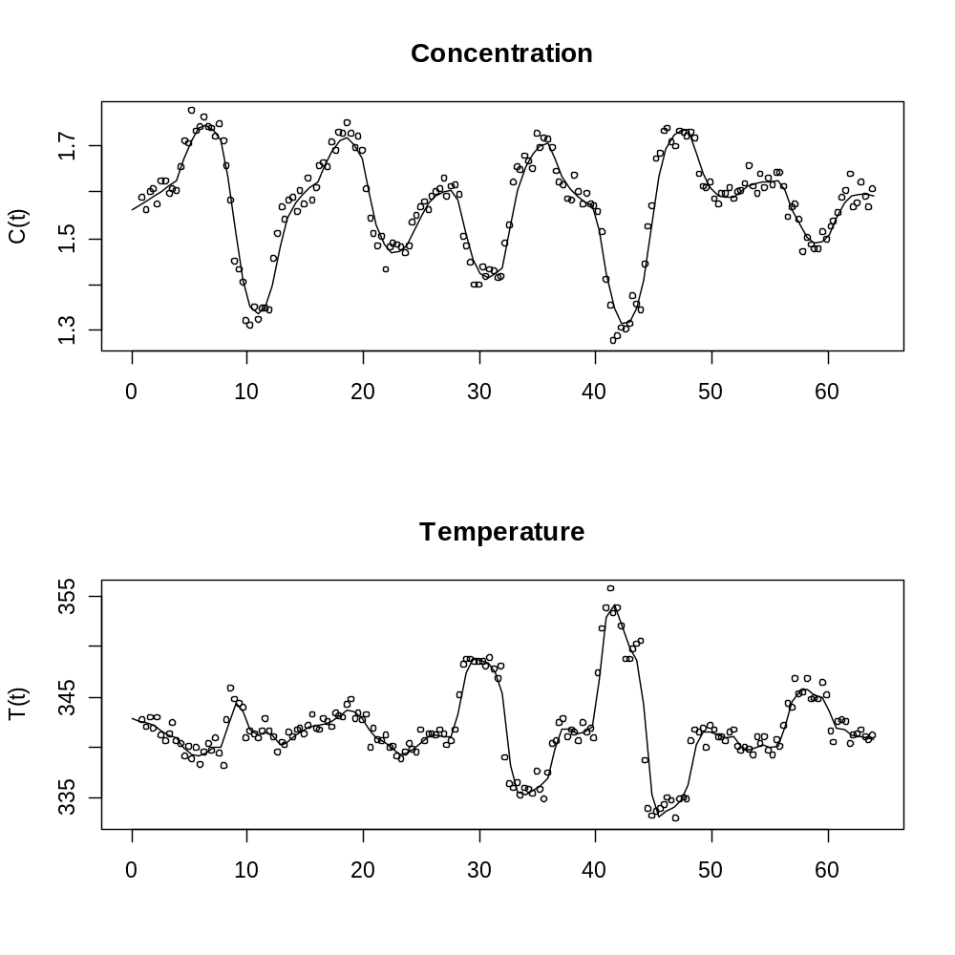
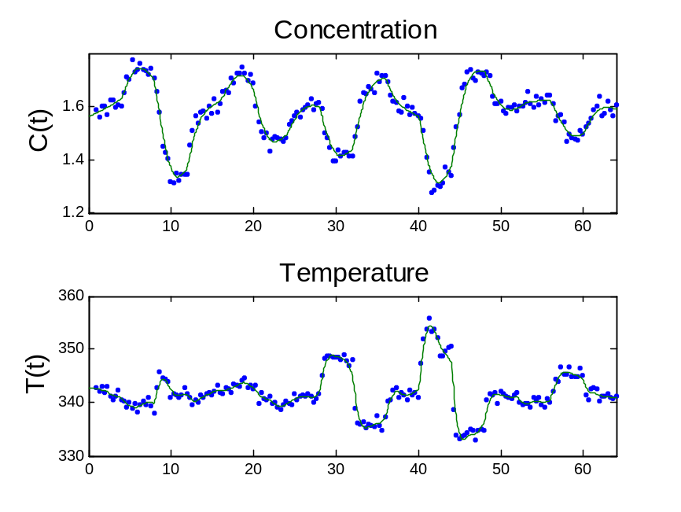
figure(5)
save CSTR_fig5Matlab -v6;

Slide 7
log10(s(1)/s(4)) = 3.019
log10(s12(1)/s12(2)) = 0.8261
log10(s13(1)/s13(2)) = 1.1789
log10(s34(1)/s34(2)) = 2.12
log10(s123(1)/s123(3)) = 1.2357
log10(s[1]/s[4]) = 3.019016
log10(s12[1]/s12[2]) = 0.8260689
log10(s13[1]/s13[2]) = 1.178939
log10(s34[1]/s34[2]) = 2.11998
log10(s123[1]/s123[3]) = 1.235720

Slide 8
lsqnonlin ...
log10(s1234(1)/s1234(4)) = 3.0146
kref EoverR a b
Initial values: 0.4 0.8 1.7 0.5
Estimated values: 0.46617 0.83961 1.7014 0.50021
True values: 0.461 0.83301 1.678 0.5
Cerrpct1234o = 0.114910
Terrpct1234o = 0.026436
nls ...
log10(s1234[1]/s1234[4]) = 3.017296
kref EoverR a b
Initial values 0.4000000 0.8000000 1.700000 0.5000000
Estimated values 0.4661415 0.8397917 1.718248 0.4963714
True valules 0.4610000 0.8330100 1.678000 0.5000000
Cerrpct1234o = 0.1145141
Terrpct1234o = 0.02635538

Slide 9
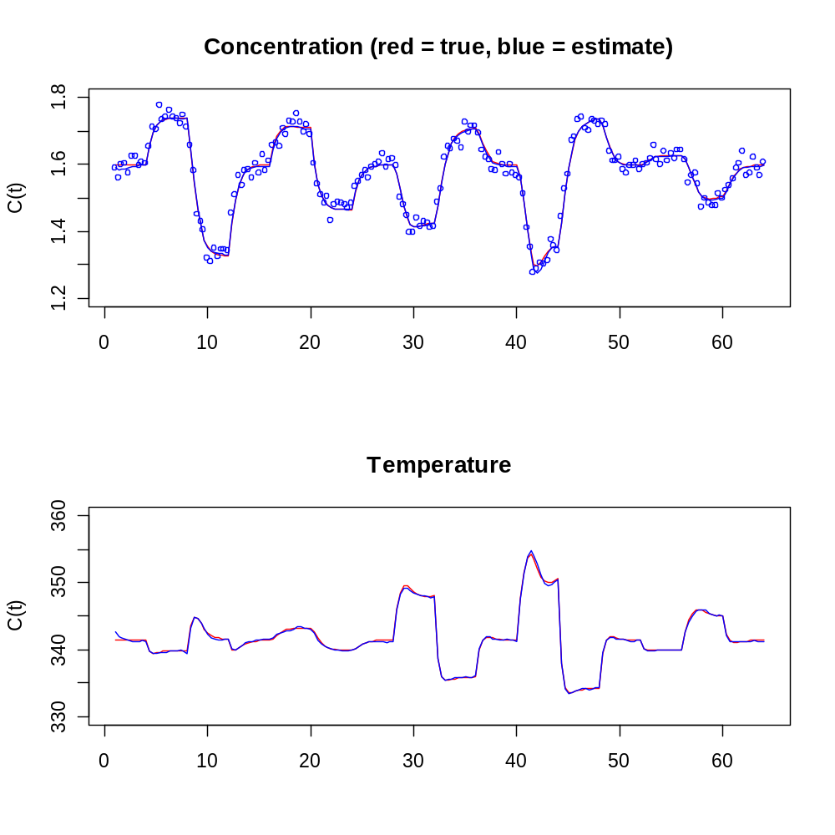
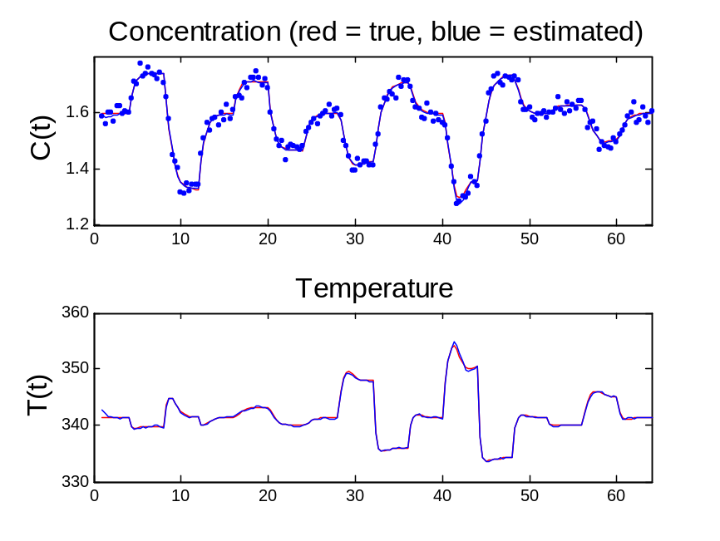
figure(6)
save CSTR_fig6Matlab -v6;

Slide 10
CerrpctHC = 1.712750
TerrpctHC = 0.060908
CerrpctHC = 1.832445
TerrpctHC = 0.05692276

Slide 11
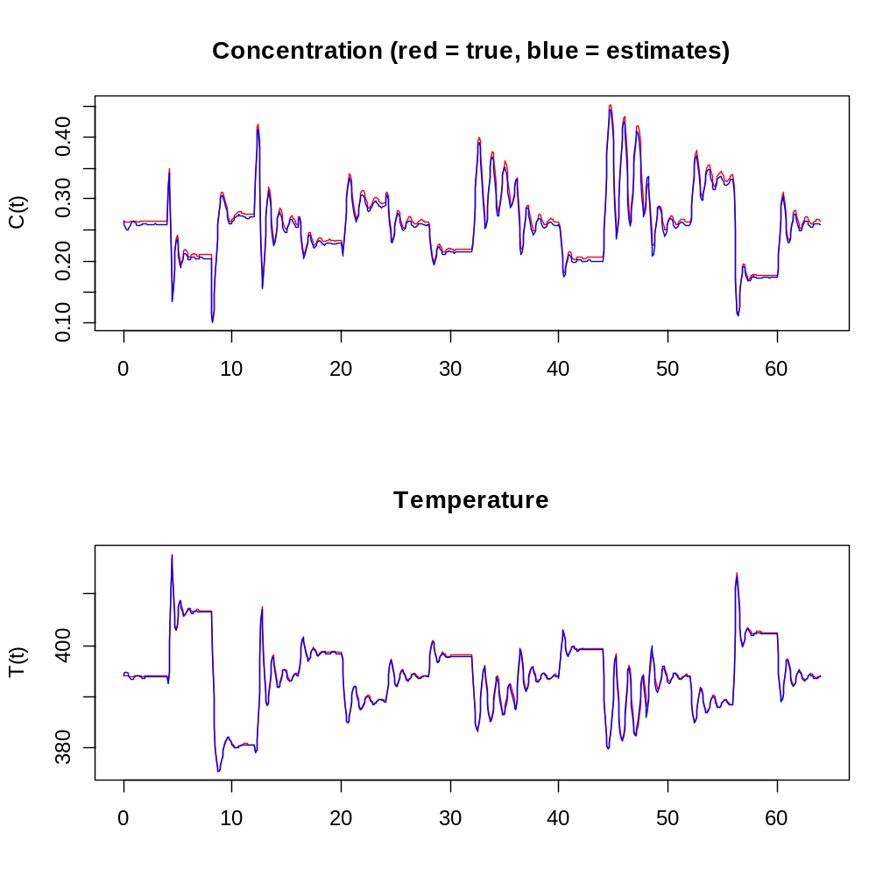
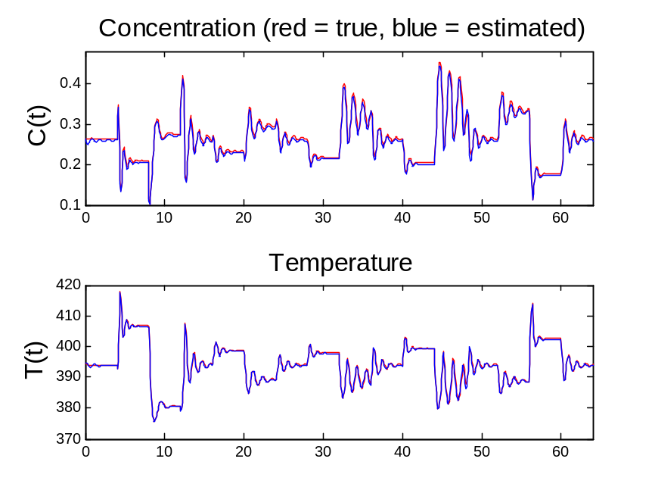
figure(8) [no figure(7)]
save CSTR_fig8Matlab -v6;

Slide 12
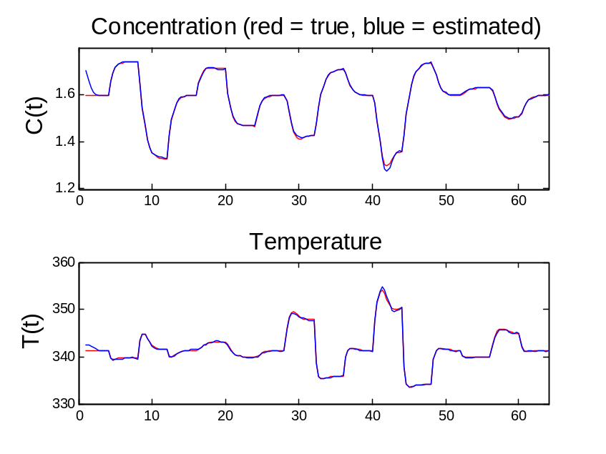
Estimated from Temperature Only
CerrpctHTemp = 0.097899
TerrpctHTemp = 0.025902
R failed to solve the problem
nls: stepsize < min
optim(Nelder-Mead, BFGS, CG) NAs
nlminb: claimed convergence too close to starting values

Slide 13
kref EoverR a b
Initial values: 0.4 0.8 1.7 0.5
Estimated values: 0.45767 0.83001 1.7108 0.48561
True values: 0.461 0.83301 1.678 0.5
CerrpctHConc = 0.097041
TerrpctHConc = 0.028031
kref EoverR a b
Initial values 0.4000000 0.8000000 1.700000 0.500000
Estimated values 0.4629777 0.8369693 1.623520 0.512704
True valules 0.4610000 0.8330100 1.678000 0.500000
CerrpctHConc = 0.093428
TerrpctHConc = 0.01241975

Slide 14
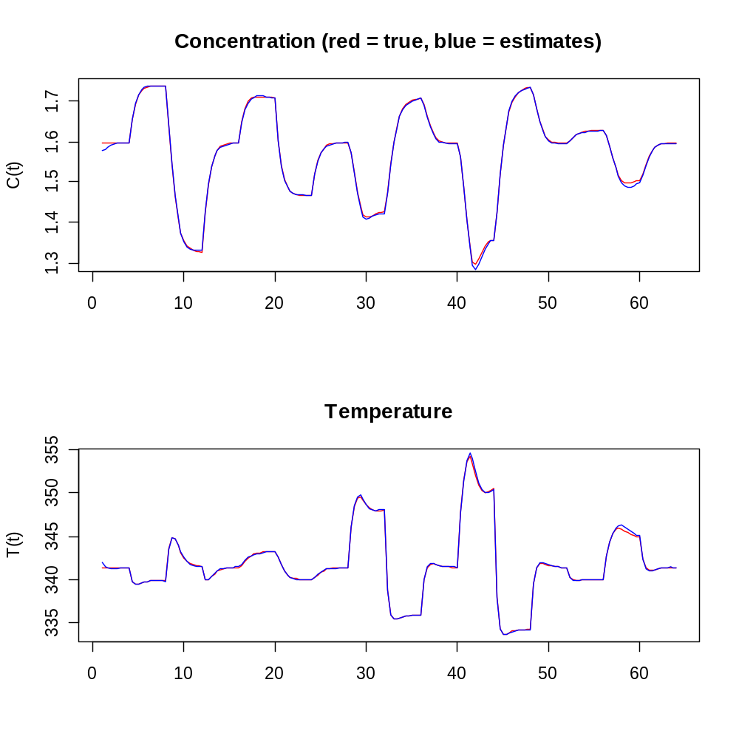
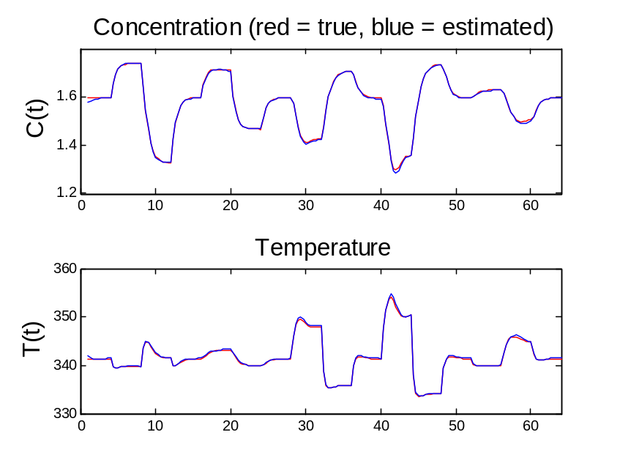
Estimated from Concentration Only
save CSTR_fig10Matlab -v6;

Slide 15
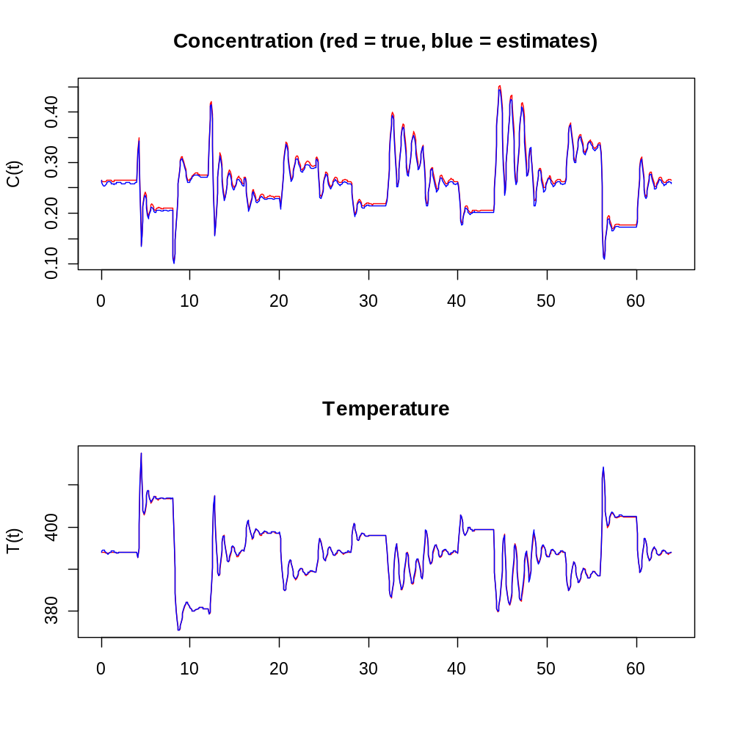
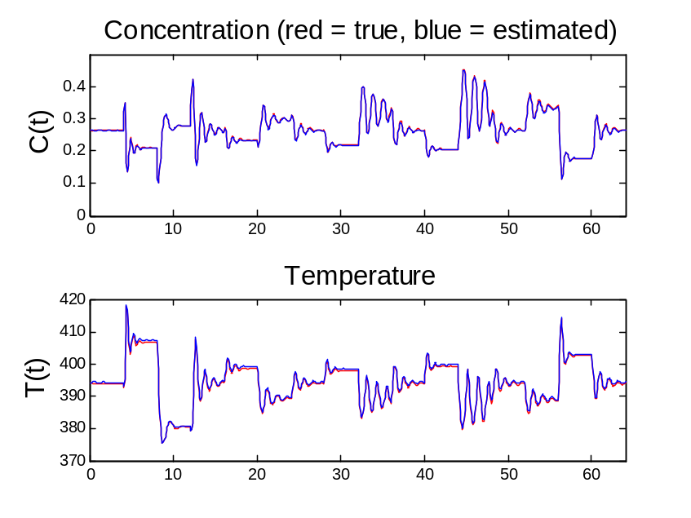
last figure
Conc: better fit from Matlab than R
figure(11)
save CSTR_fig11Matlab -v6;

