Slide 1
Functional Data Analysis in Matlab and R
James Ramsay, Professor, McGill U., Montreal
Hadley Wickham, Grad student, Iowa State, Ames, IA
Spencer Graves, Statistician, PDF Solutions, San José, CA

Slide 2
Outline
What is Functional Data Analysis?
FDA and Differential Equations
Examples:
  Squid Neurons
  Continuously Stirred Tank Reactor (CSTR)
Conclusions
References

Slide 3
What is FDA?
Functional data analysis is a collection of techniques to model data from dynamic systems
  possibly governed by differential equations
  in terms of some set of basis functions
The ‘fda’ package supports the use of 8 different types of basis functions: constant, monomial, polynomial, polygonal, B-splines, power, exponential, and Fourier.

Slide 4
Observations of different lengths
Observation vectors of different lengths can be mapped to coordinates of a fixed basis set
All examples in the ‘fda’ package have the same numbers of observations
No conceptual obstacles to handling observation vectors of different lengths

Slide 5
Time Warping
“start” and “stop” are sometimes determined by certain transitions
Example: growth spurts in the life cycle of various species do not occur at exactly the same ages in different individuals (even within the same species)

Slide 6
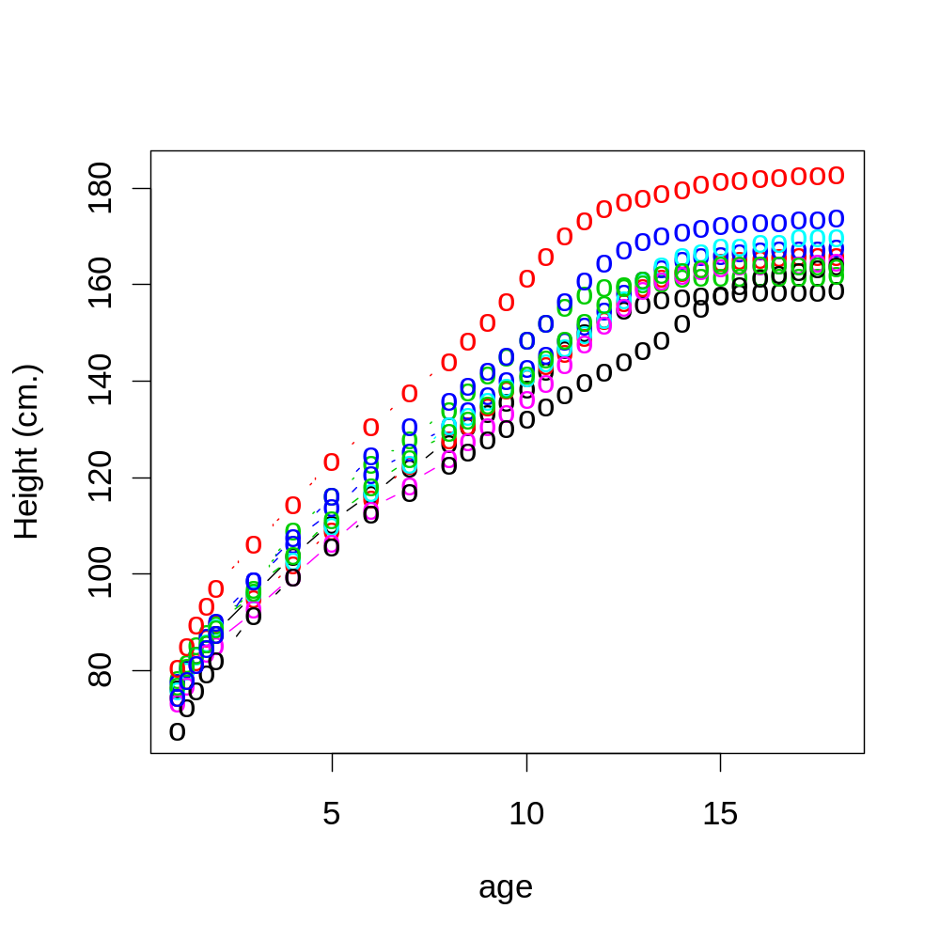
10 Girls: Berkeley Growth Study
Tuddenham, R. D., and Snyder, M. M. (1954) "Physical growth of California boys and girls from birth to age 18", _University of California Publications in Child Development_, 1, 183-364.

Slide 7
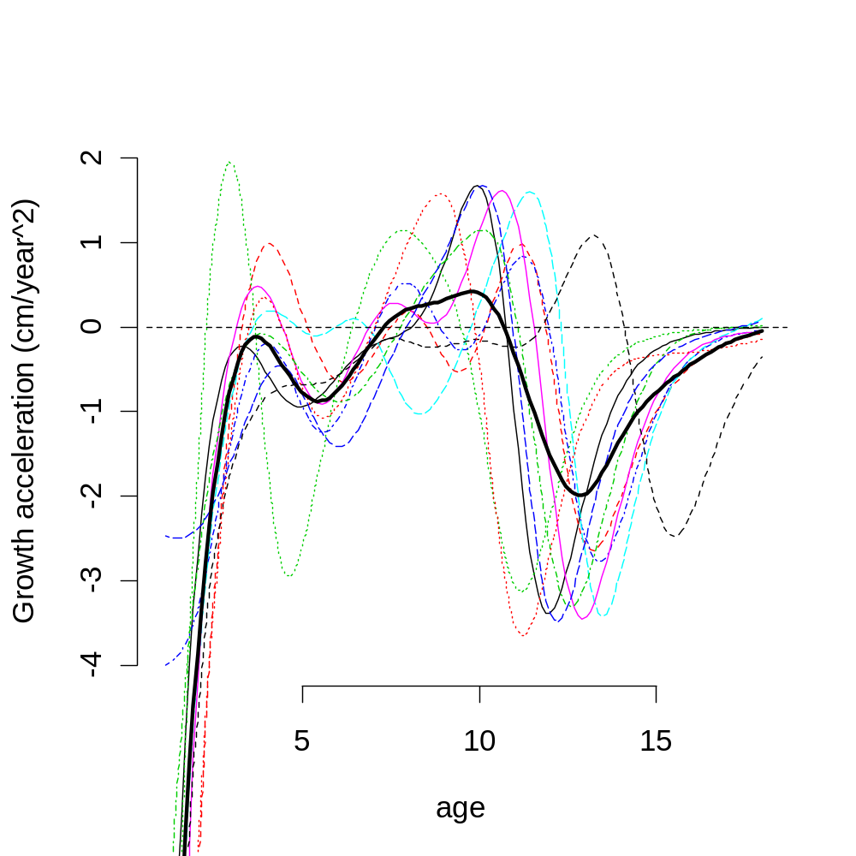
Acceleration
Growth spurts occur at different ages
Average shows the basic trend, but features are damped by improper registration

Slide 8
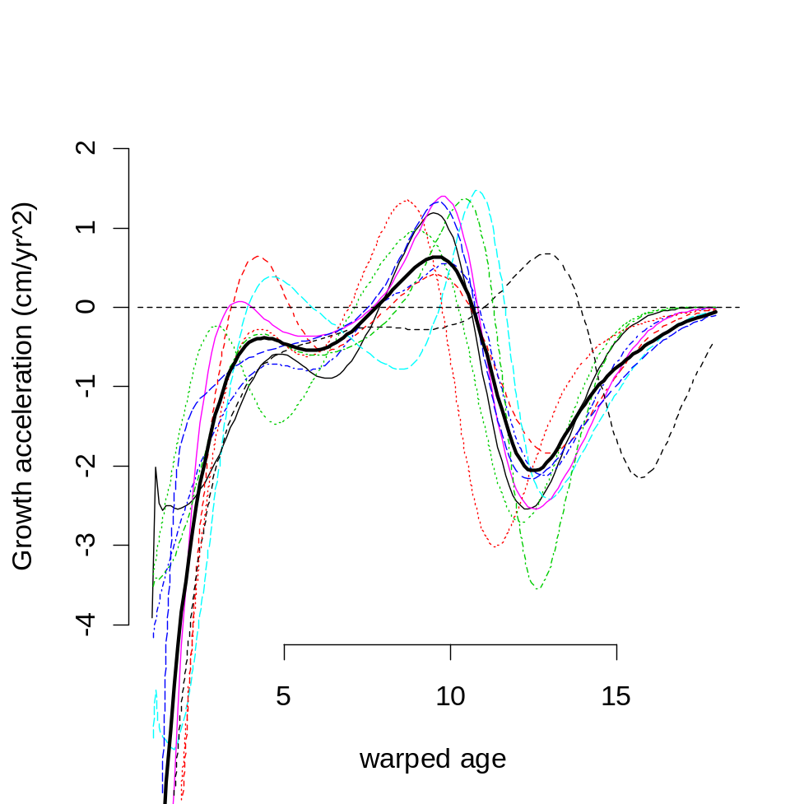
Registration
register.fd all to the mean
Not perfect, but better

Slide 9
A Stroll Along the Beach
Light intensity over 365 days at each of 190*143 = 27140 pixels was
  smoothed
  functional principal components
http://www.stat.berkeley.edu/~wickham/userposter.pdf

Slide 10
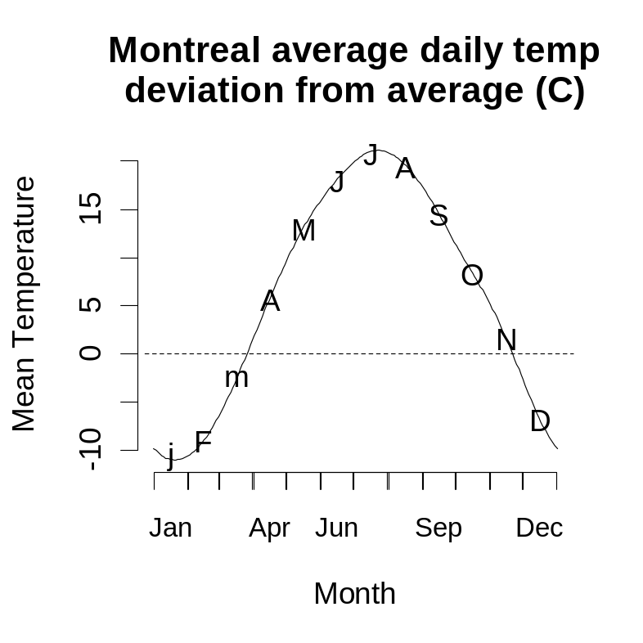
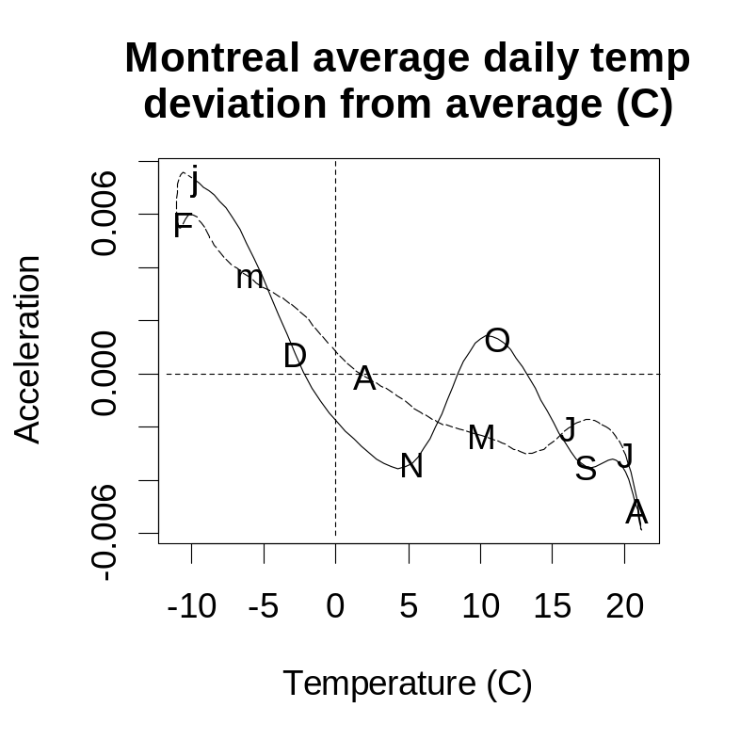
Other fda capabilities
Correlations
  even with series of different lengths!
Phase plane plots
  good estimates of derivatives
afda-ch03.R
fda-ch01.R
fda-ch02.R

Slide 11
Script files for fda books
Ramsay and Silverman
  (2002) Applied Functional Data Analysis (Springer)
  (2006) Functional Data Analysis, 2nd ed. (Springer)
~R\library\fda\scripts
  Some but not all data sets discussed in the books are in the ‘fda’ package
  Script files are available to reproduce some but not all of the analyses in the books.
  plus CSTR demo

Slide 12
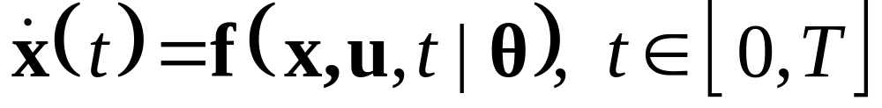
FDA and Differential Equations
Many dynamic systems are believed to follow processes where output changes are a function of the outputs, x, and inputs, u (and unknown parameters θ):
Matlab was designed in part for these types of models

Slide 13
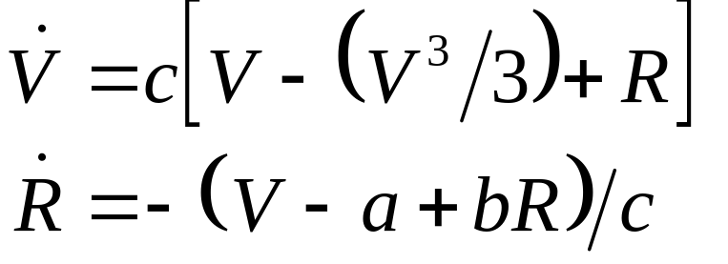
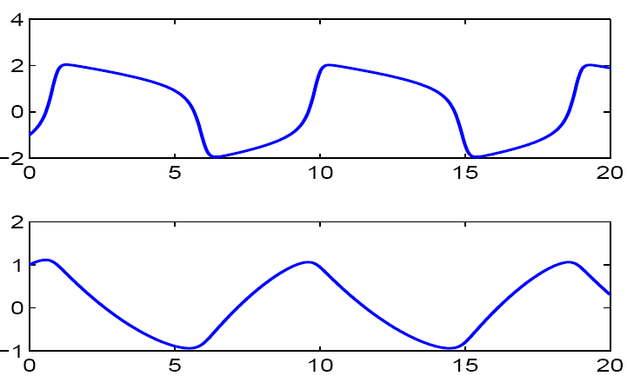
Squid Neurons
FitzHugh (1961) - Nagumo et al. (1962) Equations: Estimate a, b and c in:
Voltage across
Axon Membrane
V
Recovery via
Outward Currents
R

Slide 14
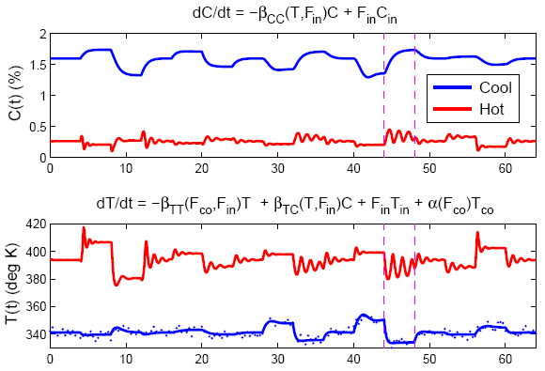
Tank Reactions
Continuously Stirred Tank Reactor (CSTR)
Temperature Concentration

Slide 15
Functional Data Analysis Process
Select Basis Set
Select Smoothing Operator
  e.g., differential equation
  equivalent to a Bayesian prior over coefficients to estimate
Estimate coefficients to optimize some objective function
Model criticism, residual plots, etc.
Hypothesis testing

Slide 16
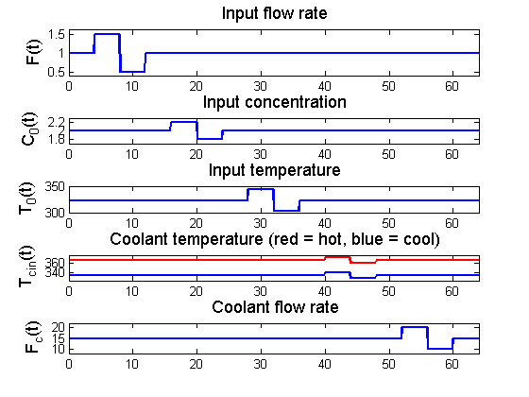
Inputs to Tank Reaction Simulation

Slide 17
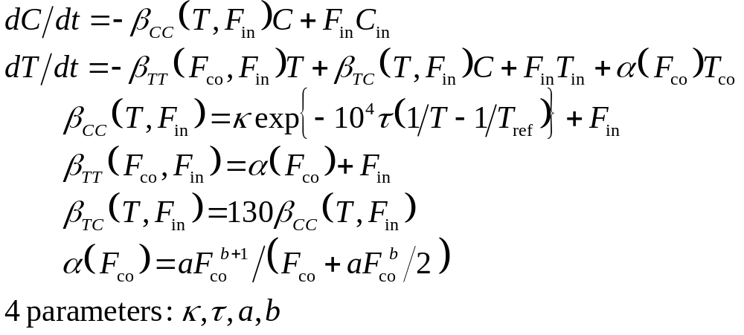
Computations: Nonlinear ODE
estimate parameters (κ, τ, a, b)
Compute Input vectors
Define functions
Call differential equation solver
Summarize, plot
Temperature Concentration

Slide 18
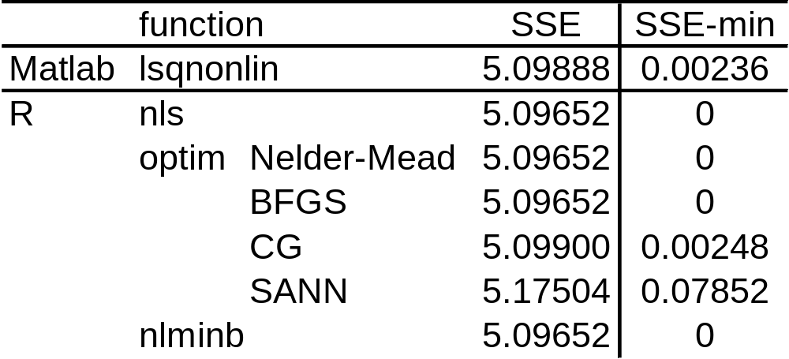
Three problems
Estimate (κ, τ, a, b) to minimize SSE in Temperature only

Slide 19
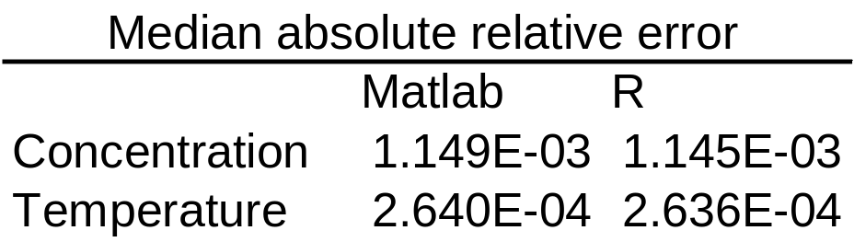
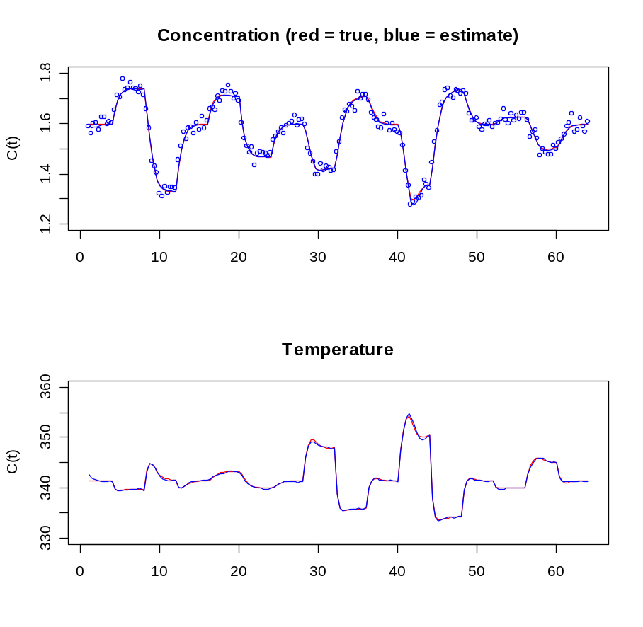
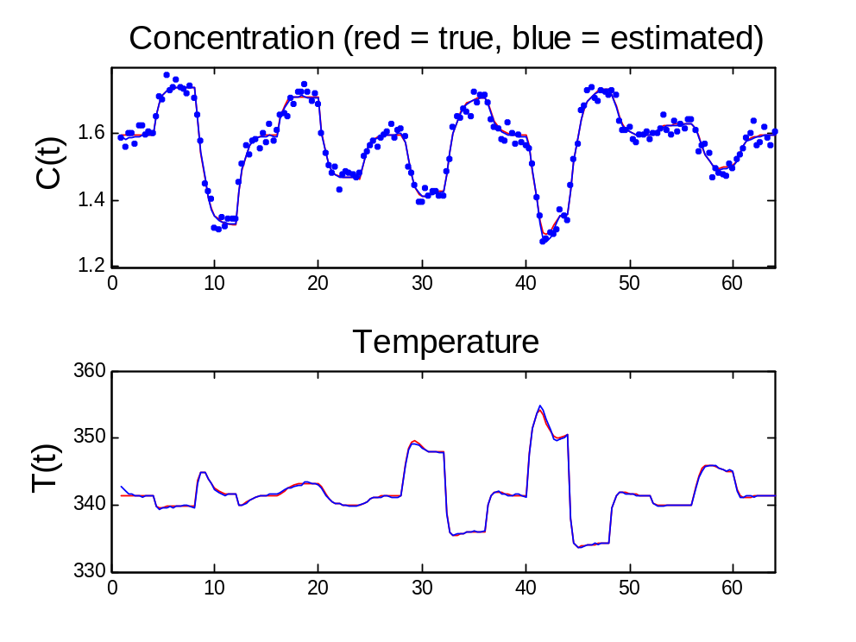
SSE(Temp, Conc)
Matlab: lsqnonlin
R: nls

Slide 20
R vs. Matlab
Gave comparable answers
R code for CSTR slightly more accurate but requires much more compute time
  coded by different people
R has helper functions not so easily replicated in Matlab
  summary.nls
  confint.nls
  profile.nls
Estimate StdErr t Pr(>|t|)
kref 0.466 0.004 113.0 < 2e-16 ***
EoverR 0.840 0.009 94.7 < 2e-16 ***
a 1.720 0.232 7.4 8.2e-13 ***
b 0.496 0.050 10.0 < 2e-16 ***

Slide 21
confint.nls
Likelihood-based confidence intervals: generally more accurate than Wald intervals
  Wald subject to parameter effects curvature
  Likelihood: only affected by intrinsic curvature
> confintNlsFit
2.5% 97.5%
kref 0.458 0.474
EoverR 0.823 0.858
a 1.300 2.222
b 0.401 0.599

Slide 22
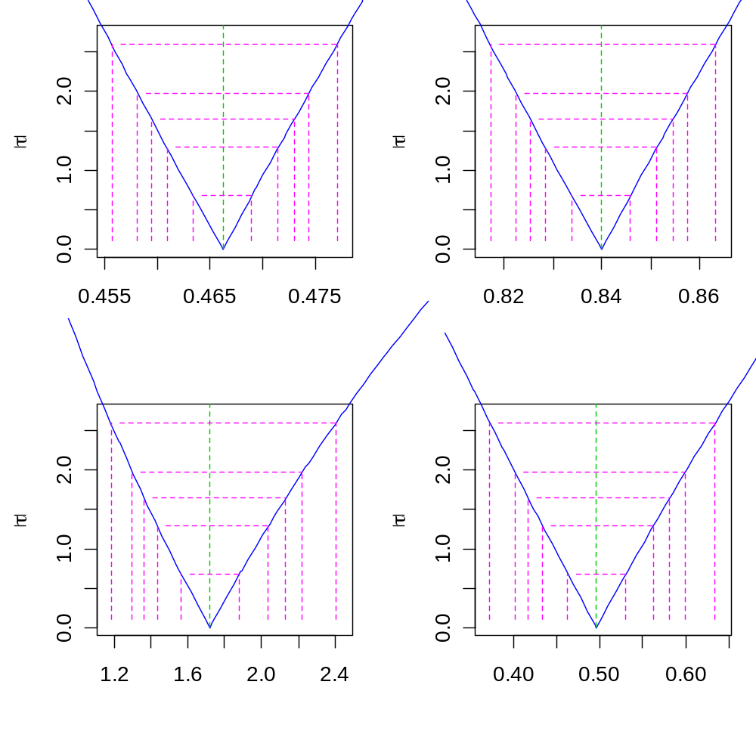
plot.profile.nls
99
for a plot showing the sqrt(log(LR))
80
50
kref
EoverR
95
90
a
b

Slide 23
Conclusions
R and Matlab give comparable answers
R:nls has helper functions absent from Matlab:lsqnonlin
Functional data analysis tools are key for
  estimating derivatives and
  working with differential operators

Slide 24
References
www.functionaldata.org
Ramsay and Silverman (2006) Functional Data Analysis, 2nd ed. (Springer)
________(2002) Applied Functional Data Analysis (Springer)
Ramsay, J. O., Hooker, G., Cao, J. and Campbell, D. (2007) Parameter estimation for differential equations: A generalized smoothing approach (with discussion). Journal of the Royal Statistical Society, Series B. To appear.

Slide 25
NOT free-knot splines
For this, see
  DierckxSpline package
  Companion to Dierckx, P. (1993). Curve and Surface Fitting with Splines. Oxford Science Publications, New York.
R package by Sundar Dorai-Raj
  links to Fortran code by Dierckx available from www.netlib.org/dierckx
soon to appear on CRAN

