Slide 1

Anime Wav2Lip
JAMA
Jen Kaplan, Aparna Natarajan, Maliha Islam, Ashley Chung

Slide 2
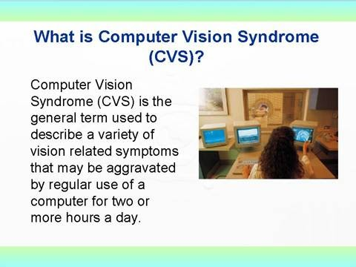
Do anything you like here.
Maybe even change the background and text.
CSCI 1430
Notes:
Src: http://pkkindia.blogspot.com/2011/02/computer-vision-syndrome.html

Slide 3
Guidelines
Tell us about your project! We know it will be work in progress still.
Each group has two minutes. We will clap you off after 2 minutes.
One speaker per group is recommended for smoothness.
Brevity is clarity – script exactly what you are going to say and make every word count.
Time your visuals to your speech (not the other way around).
Be entertaining while also showing insight...you have your report deliverable for the fine details.
Rehearse.
Groups investigating style transfer:
We have a lot of you; differentiate yourselves!

Slide 4
Procedural requirements
Please embed your videos. URLs or links out to files, e.g., on YouTube or Google drive, are less likely to work.
All presentation visuals will be shared from the instructor’s computer.
Please send 4x3 aspect ratio slides as PPTX, not 16x9 aspect ratio slides.
Send any visuals as PPTX by 12:00pm on the day of your presentation.
Please do not send a Google Slide deck. Export as PPTX.
We hand collate all of these, so this makes it easier for us.
You will not have direct control of 'next slide' - either embed slide timings, or you can tell the instructor 'next slide'.

