Slide 1
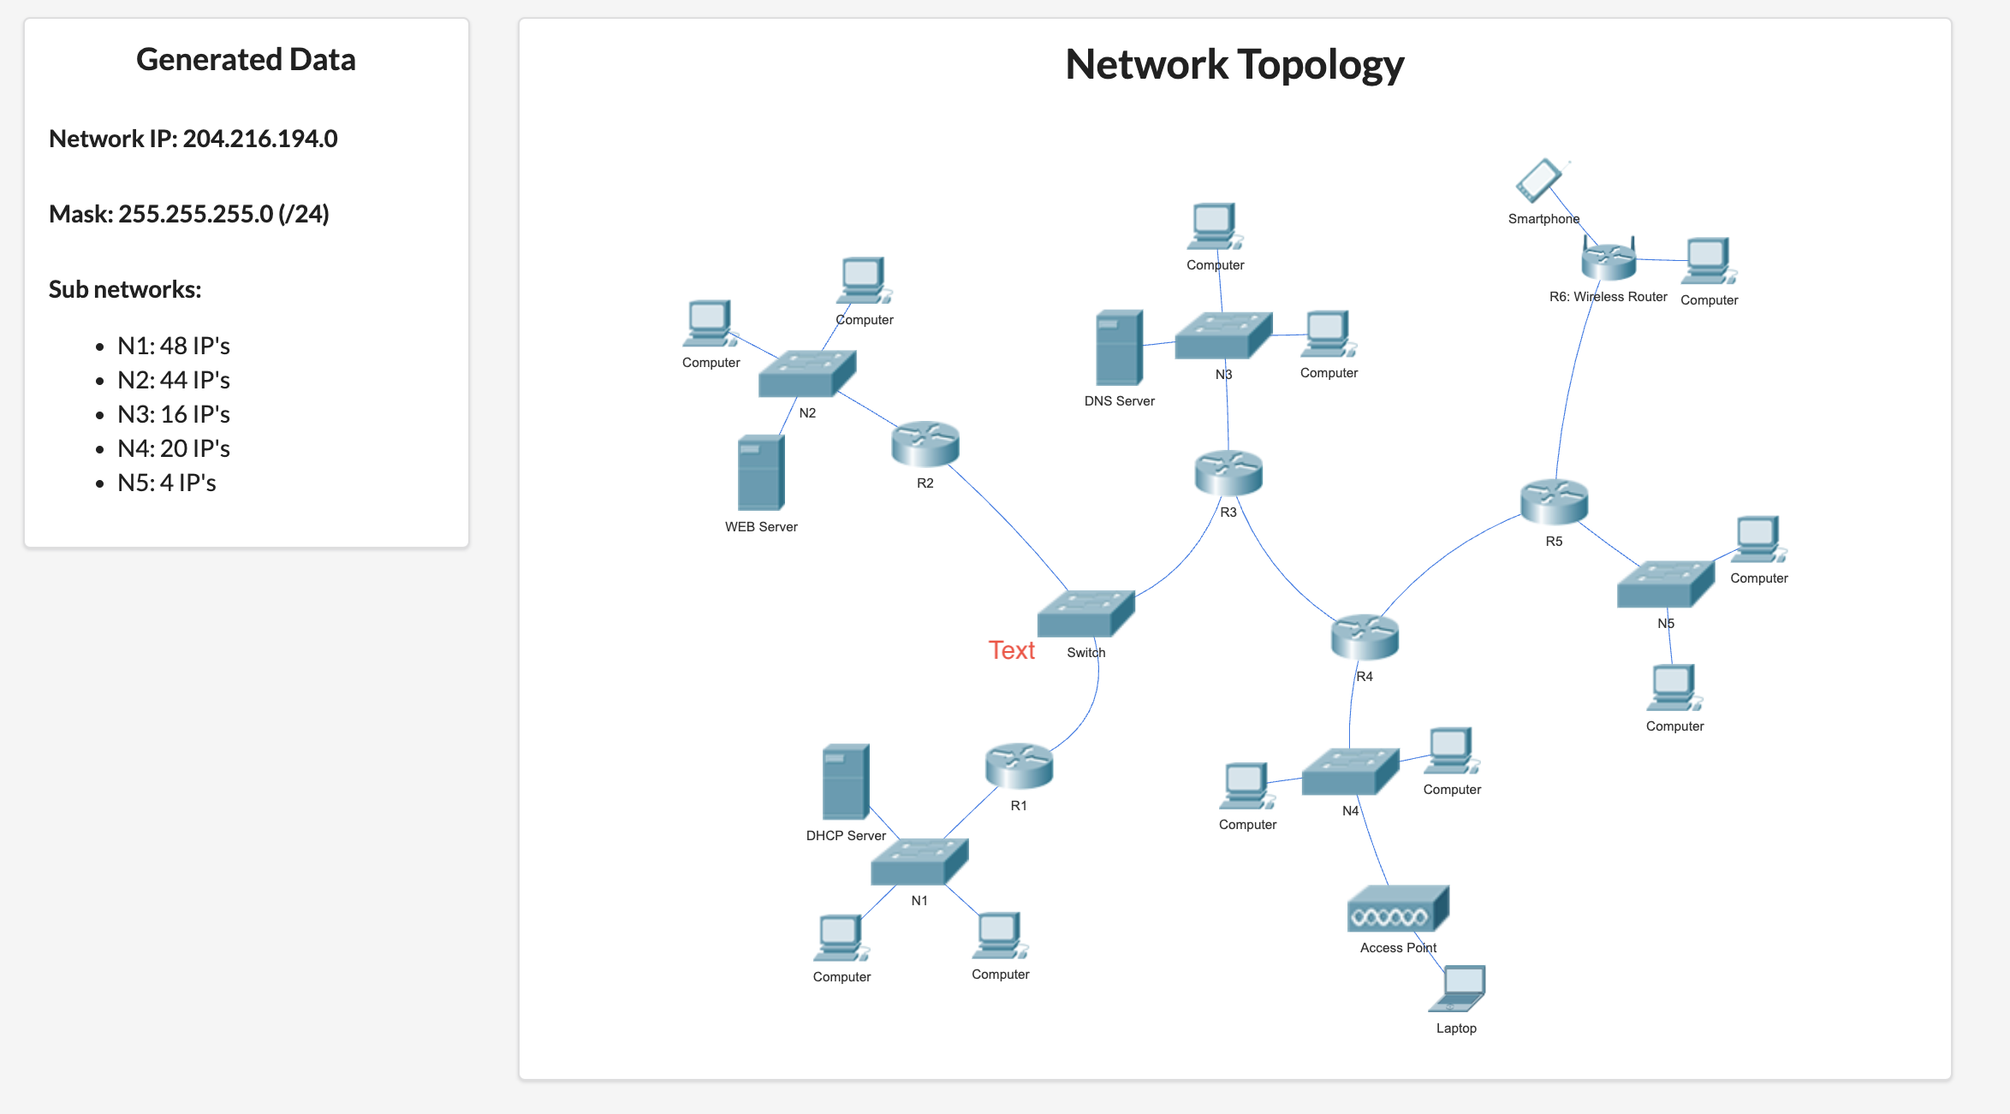
Nwifi
N123
N34
N45

Slide 2
adresa de retea: 204.216.194.0 netmask: 255.255.255.0 (/24) adresa ip inceput: ​204.216.194.0 adresa ip final: 204.216.194.255 IP-uri totale: 256
adrese IP ramanse: 204.216.194.224/27(-204.216.194.255)
Retea | Nr. IP-uri | Dimensiune retea | Adresa de retea | Adresa de broadcast
N1 | 48 + AR + AB + DG | 64 | 204.216.194.0 /26 | 204.216.194.63
N2 | 44 + AR + AB + DG | 64 | 204.216.194.64/26 | 204.216.194.127
N3 | 16 + AR + AB + DG | 32 | 204.216.194.128/27 | 204.216.194.159
N4 | 20 + AR + AB + DG | 32 | 204.216.194.160/27 | 204.216.194.191
N5 | 4 + AR + AB + DG | 8 | 204.216.194.192/29 | 204.216.194.199
N123 | 3 + AR + AB | 8 | 204.216.194.200/29 | 204.216.194.207
Nwifi | 3 + AR + AB + DG | 8 | 204.216.194.208/29 | 204.216.194.215
N45 | 2 + AR + AB | 4 | 204.216.194.216/30 | 204.216.194.219
N34 | 2 + AR + AB | 4 | 204.216.194.220/30 | 204.216.194.223

