Slide 1
NLP Data Augmentation
Andrew Crane-Droesch

Slide 2
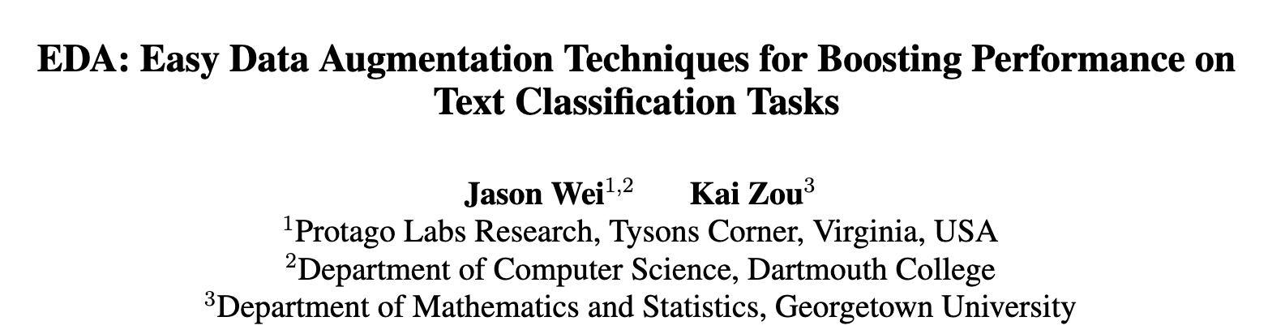
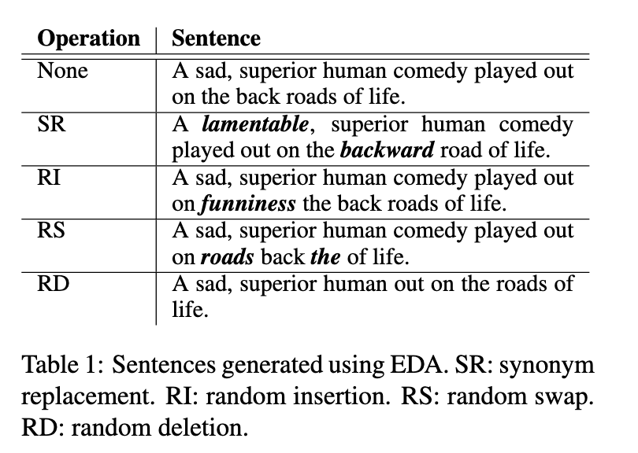
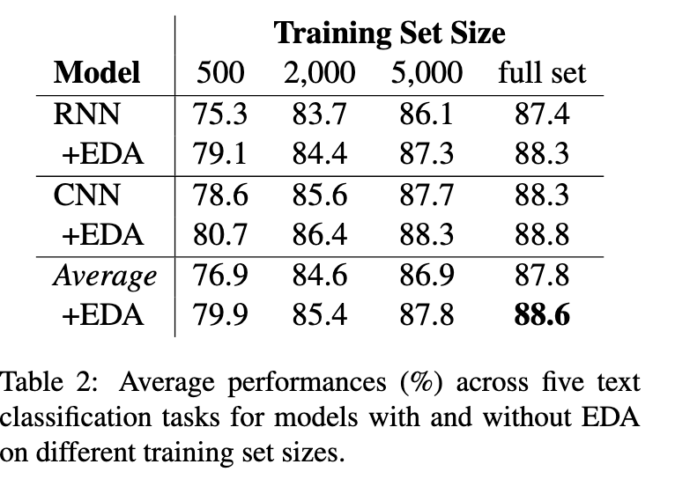
”Easy Data Augmentation” (EDA)
(what the world needs is not another acronym)

Slide 3
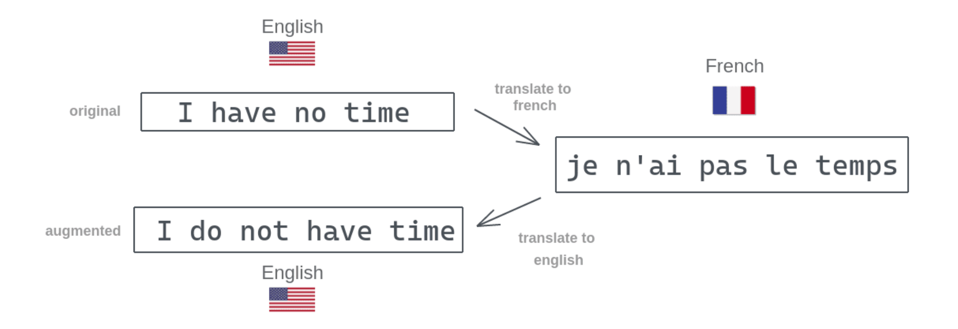
Back translation

Slide 4
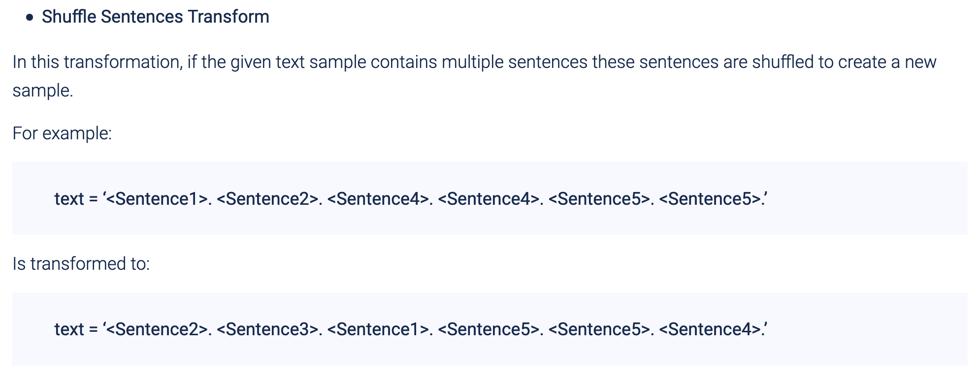
NLP Albumentation
This one might not work so well if the batches are sentences; if there is no inter-sentence dependence

Slide 5

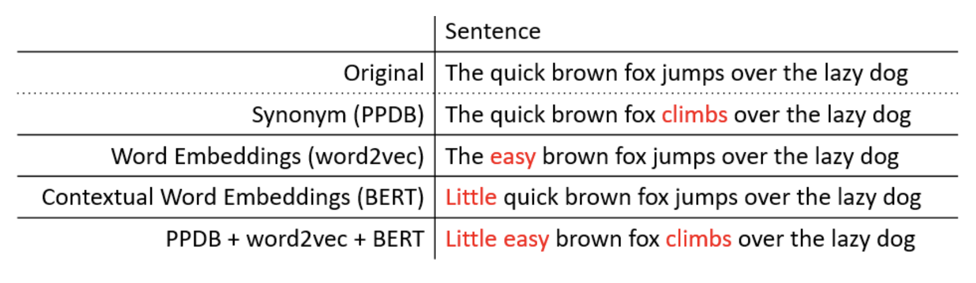
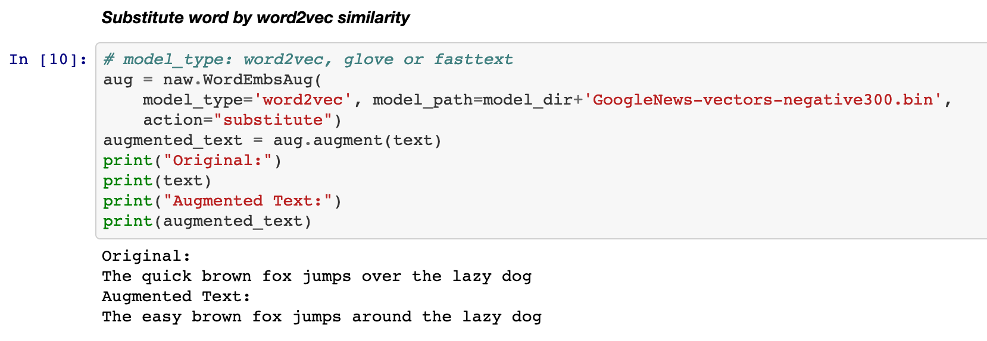
NLPAug
Python package for NLP augmentation

Slide 6
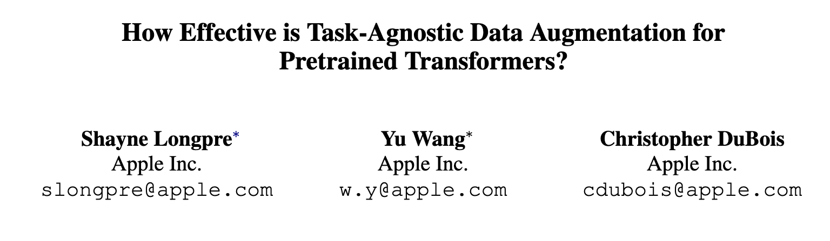
Does it work?

Slide 7
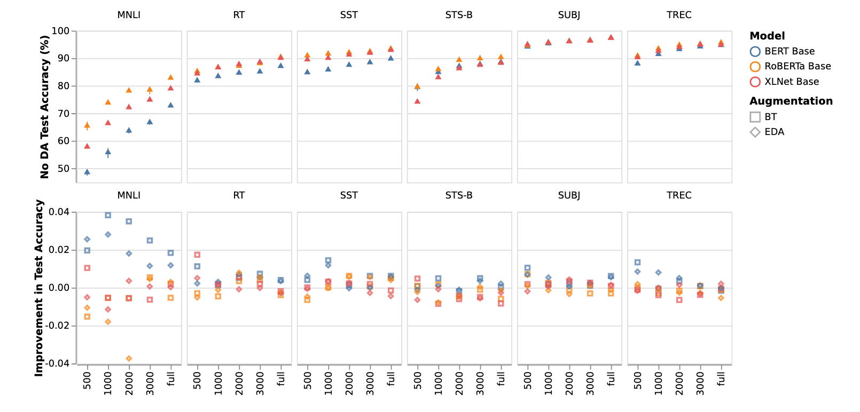
Maybe not so much for pre-trained models

