Slide 1
Frailty Classifier
Active Learning Progress to Date
24 Sep 2020

Slide 2
Overview
We are predicting four aspects of frailty within spans of clinical notes. Aspects:
Fall risk, musculo-skeletal problems, respiratory impairment, nutrition problems
Spans within notes are annotated, annotated notes are embedded, and [labels, embeddings, structured data] used to train neural nets
Labels: [positive, neutral, negative]
100 neural nets trained, each a draw from a distribution of hyperparameters/architectures
Using the net with the best validation loss, we compute entropy across for all notes in our corpus, and surface for subsequent annotation the notes with the highest average entropy in the upper half of within-note entropy values
i.e.: max(E[h(x)|h(x)>E[h(x)]])

Slide 3
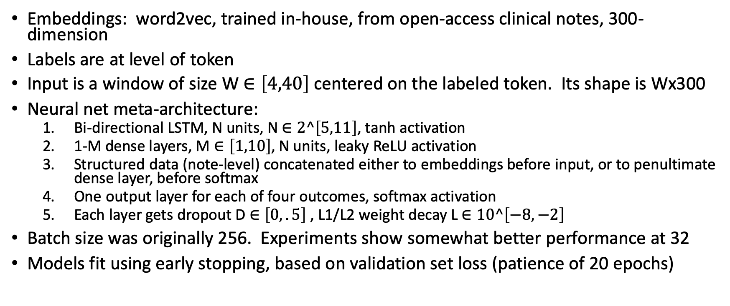
Modelling approach: details
Embeddings: word2vec, trained in-house, from open-access clinical notes, 300-dimension
Labels are at level of token
Input is a window of size W $∈\left[4,40\right]$centered on the labeled token. Its shape is Wx300
Neural net meta-architecture:
Bi-directional LSTM, N units, N $∈2^\left[5,11\right]$, tanh activation
1-M dense layers, M $∈\left[1,10\right]$, N units, leaky ReLU activation
Structured data (note-level) concatenated either to embeddings before input, or to penultimate dense layer, before softmax
One output layer for each of four outcomes, softmax activation
Each layer gets dropout D $∈\left[0,.5\right]$ , L1/L2 weight decay L $∈10^\left[−8,−2\right]$
Batch size was originally 256. Experiments show somewhat better performance at 32
Models fit using early stopping, based on validation set loss (patience of 20 epochs)

Slide 4
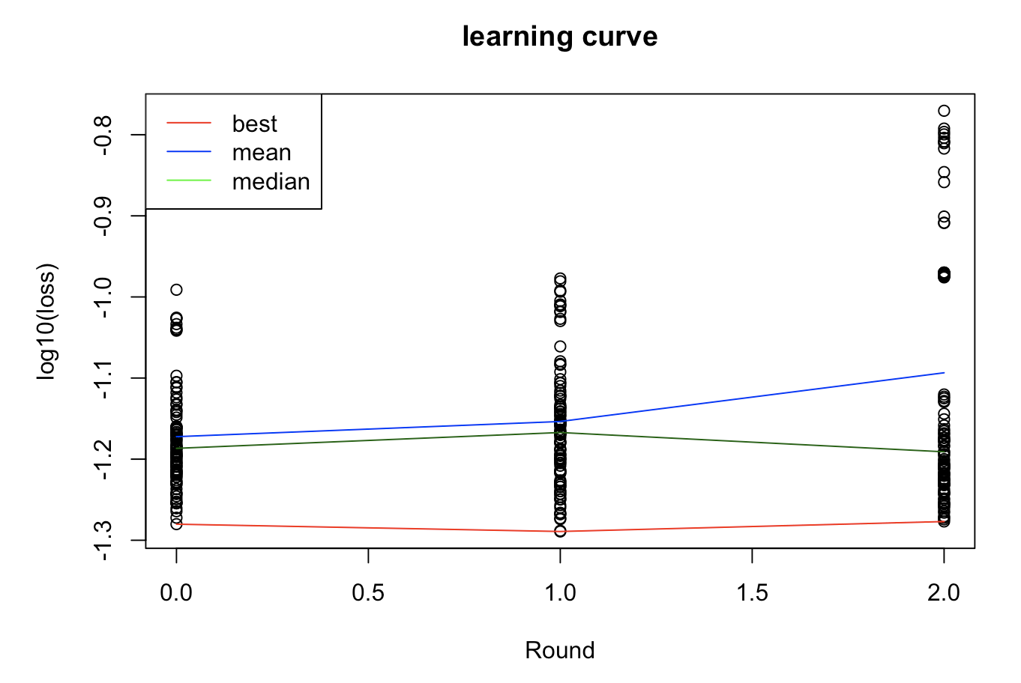
Results to date
No clear signal yet
Sample size went from 50 to 75 to 100 notes
285359 tokens in 100 notes
Label is sparse: 97.5-99.5% of examples are neutral, rather than positive or negative
Case weights are 1/(1-neutral_prevalence)
Different validation set – 1/3rd of notes randomly selected – each round
Lack of signal could be noise

Slide 5
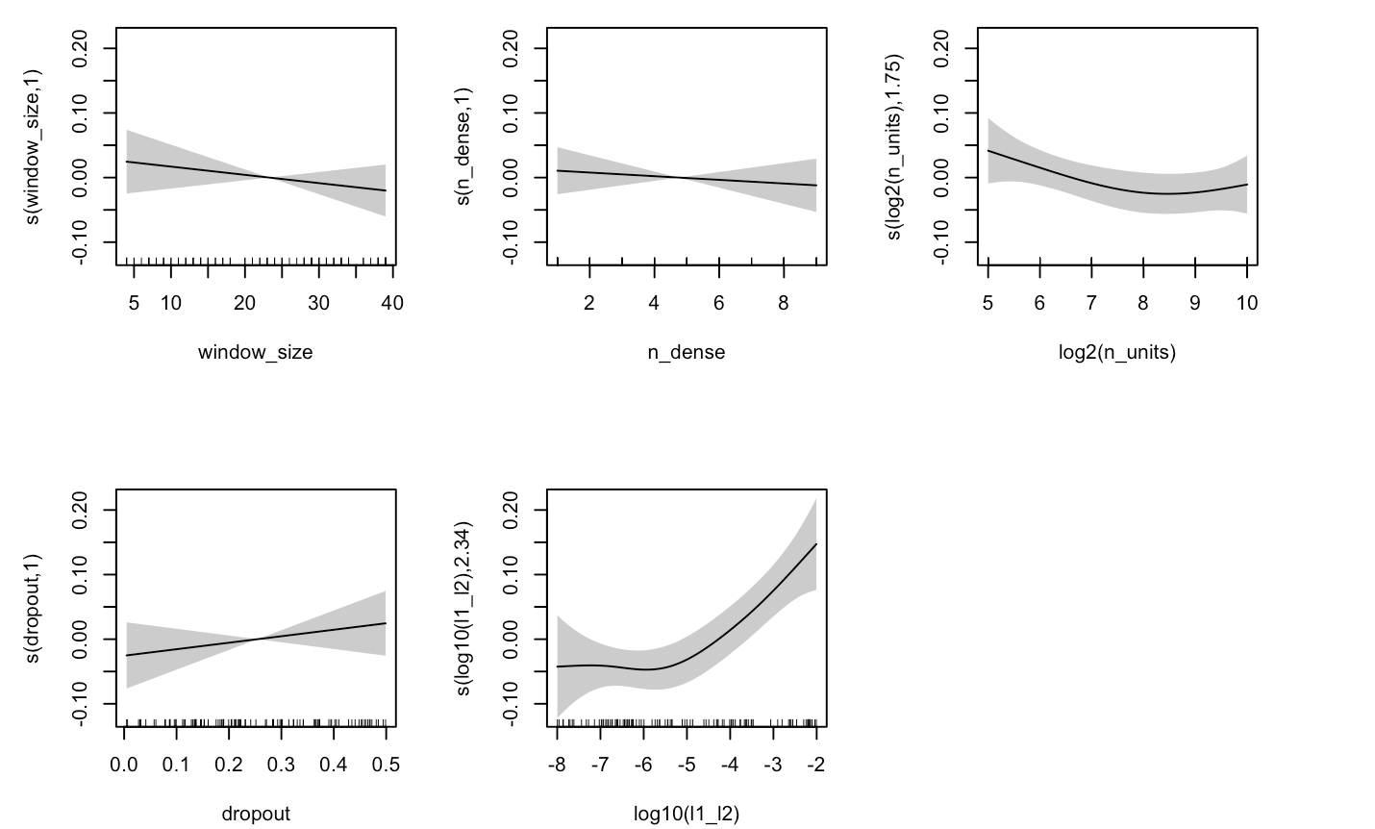
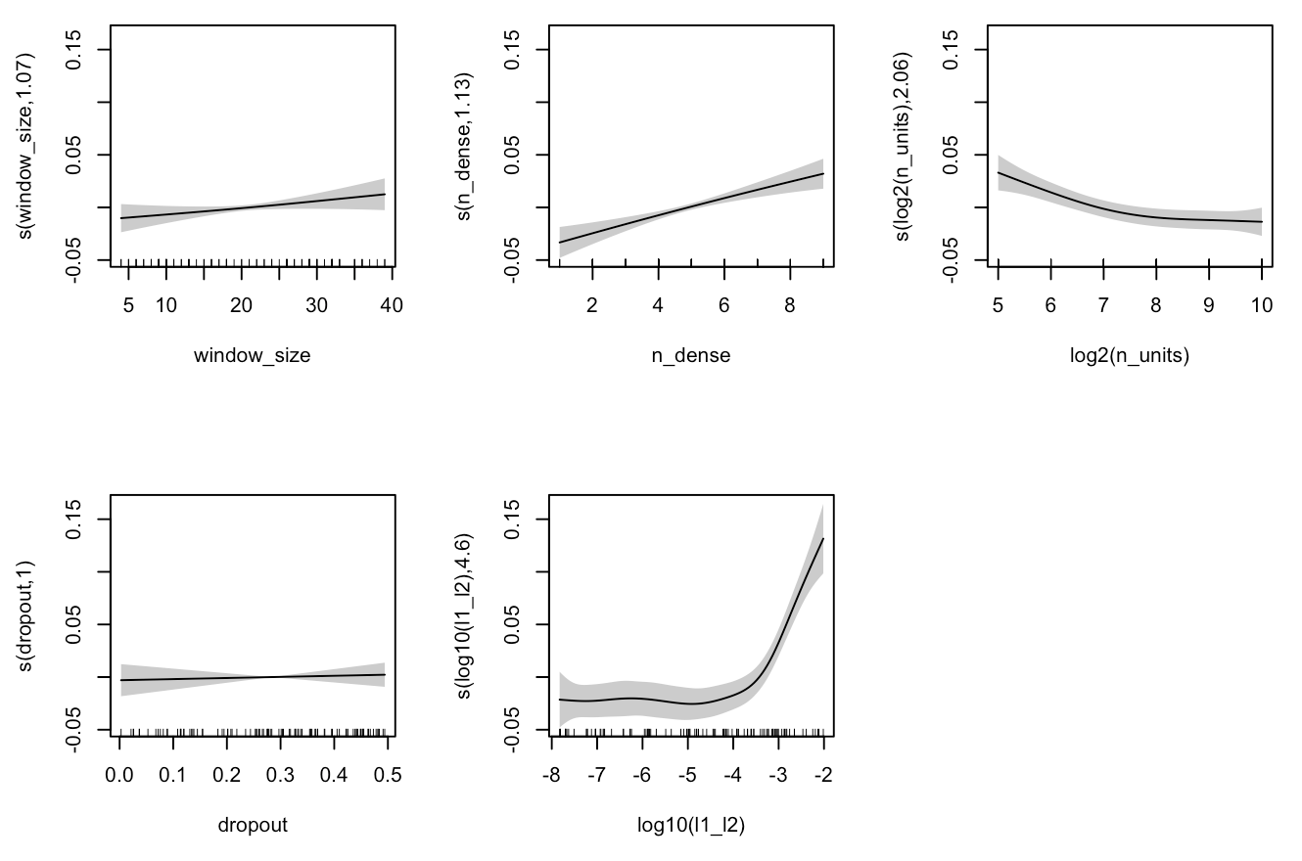
Effects of hyperparameters
Round 3 loss relatively insensitive to hyperparameters:
Only weight decay correlated with loss
Round 2 loss much more sensitive
All hyperparameters except dropout correlated with loss
This may be evidence of importance of variability in sampled notes

Slide 6
Next steps
Proceed a few more rounds to gather more data?
Alter aspects of our process?
Model?
Embeddings?
Active learning?
Hyperparameter selection?
Others?
Training/validation set definition?

