Slide 1

Visa & Permits
Management
Kingdom of Saudi Arabia
Built on SAP BTP · Qiwa, Muqeem and Absher in step
Iqama lifecycle, exit and re-entry tracked to the day, and a live Nitaqat band position, so you know what you can do before Qiwa tells you what you cannot.
Qiwa
Muqeem
Absher
GOSI
Mudad
SCFHS
Enjaz
Saudization · Healthcare licensing · SAP SuccessFactors integrated
An overview for SAP account teams and enterprise customers in the Kingdom
Notes:
Open on the band. Saudi Arabia is the one GCC market where a compliance score decides whether you can hire at all, and that is the hook for both the HR buyer and the SAP account team. Everything else in the deck hangs off it.

Slide 2
THE PROBLEM
Three systems, one employee, nobody joining them up.
Saudi Arabia is the hardest GCC market to govern, and not because the rules are unclear. The rules live in three places, each with its own clock, and one of them can switch the others off.
01
The band gates everything
02
The 90-day clock starts on arrival
03
Exit re-entry is a trap
Drop a Nitaqat band and block visas stop, Iqama renewals stop, transfers stop. Most companies find out after it happens, from a rejection in Qiwa.
An employee lands and a statutory window opens to issue the Iqama. Nobody is counting it for you, and the penalty is not a warning letter.
Someone travels, the visa expires while they are away, the Iqama is cancelled. They cannot come back. The most expensive admin mistake in the Kingdom.
04
The levy is a real number
05
Renewals cluster
06
SuccessFactors does not know
The expat levy per employee per year gets budgeted once and forgotten, then lands as a cost nobody forecast in a month nobody planned for.
Iqamas bunch around hiring dates. One quarter is quiet, the next carries three hundred renewals and the fees that come with them.
Your HR system holds the employee. Qiwa and Muqeem hold the truth about whether they may legally work. Nothing keeps the two in agreement.
What it costs you: a hiring freeze you did not choose, employees stranded outside the Kingdom, levy costs that arrive unplanned, and a compliance position nobody can prove to an inspector.
INK IT Business Solutions · Visa & Permits Management · Kingdom of Saudi Arabia
2
Notes:
Ask the room which of the six they recognise. In Saudi engagements the answer is usually all of them, and number one is the one that gets a CHRO leaning forward.

Slide 3
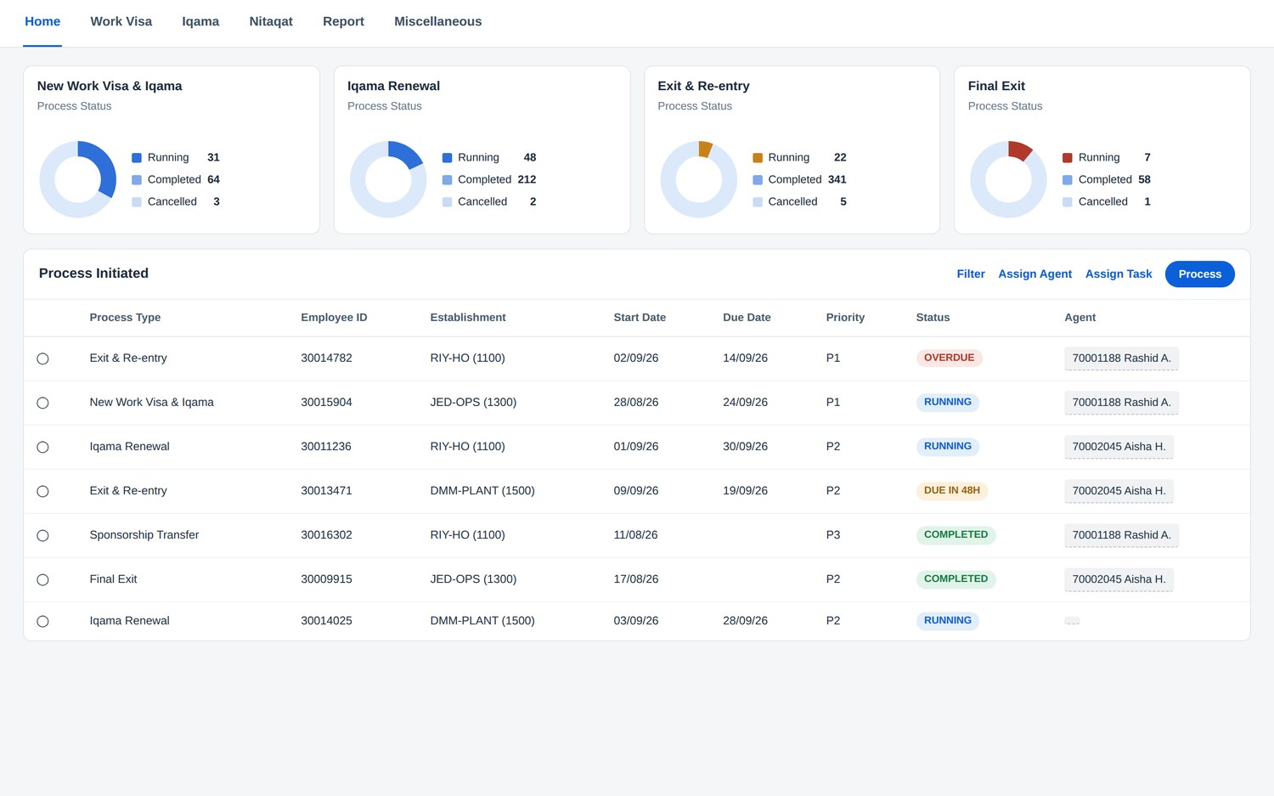
THE SOLUTION
Five Saudi lifecycles on one track.
Pre-built, configured for the Kingdom, and running the authorities as one process instead of three.
New Work Visa & Iqama
12 steps
Block visa through Qiwa contract, arrival, medical, Iqama on Muqeem, GOSI and Mudad.
Iqama Renewal
8 steps
Alert six weeks out, band gate check, levy and fees, Muqeem renewal, write-back.
Exit & Re-entry
9 steps
Request, approval, Muqeem visa, and return-by tracked from actual departure.
Sponsorship Transfer
6 steps
Qiwa status check, Nitaqat impact, transfer, new contract, Iqama moved.
Final Exit
6 steps
The Saudi home dashboard. Four lifecycles with live counts, over a queue where the overdue exit re-entry sits at the top with a name against it.
End of service settled, dues cleared, contract terminated, Iqama cancelled.
INK IT Business Solutions · Visa & Permits Management · Kingdom of Saudi Arabia
3
Notes:
Screens in this deck are the application configured for Saudi Arabia. Say plainly that they are representative KSA screens rather than captures of a live Saudi tenant, and that the engine underneath is the one running in the UAE today.

Slide 4
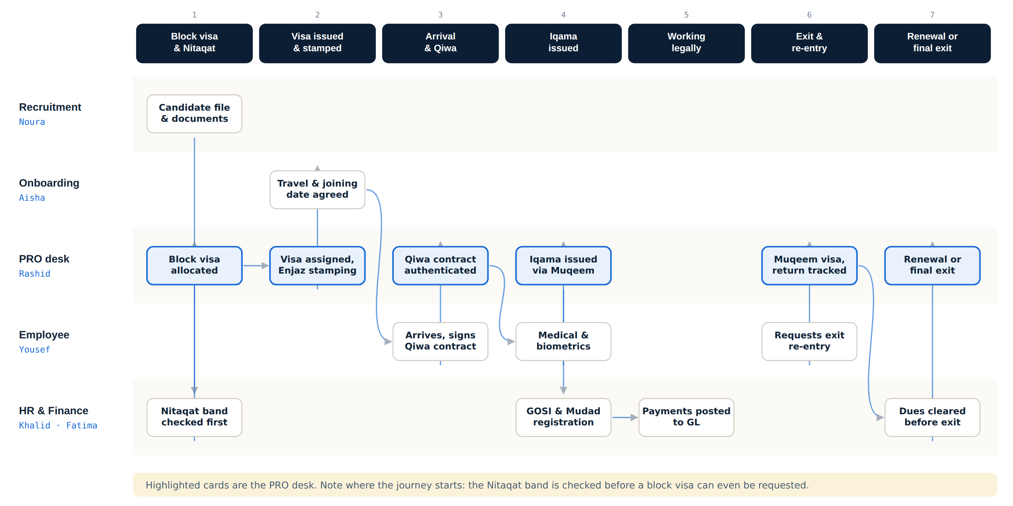
THE JOURNEY MAP
One Iqama, five people, seven stages.
Stages run left to right in the order they happen. Each lane is a person. Every arrow is a hand-off, and every hand-off is where the process stalls today.
Look at stage one. In the UAE a permit starts with a quota check. In Saudi Arabia it starts with a Nitaqat check, because the band decides whether a block visa can be requested at all. That is why a KSA rollout is not a UAE rollout with the names changed.
INK IT Business Solutions · Visa & Permits Management · Kingdom of Saudi Arabia
4
Notes:
This is the slide to slow down on with a mixed audience. Business people read the lanes, technical people read the arrows, and both end up at the same conclusion about where the risk sits.

Slide 5
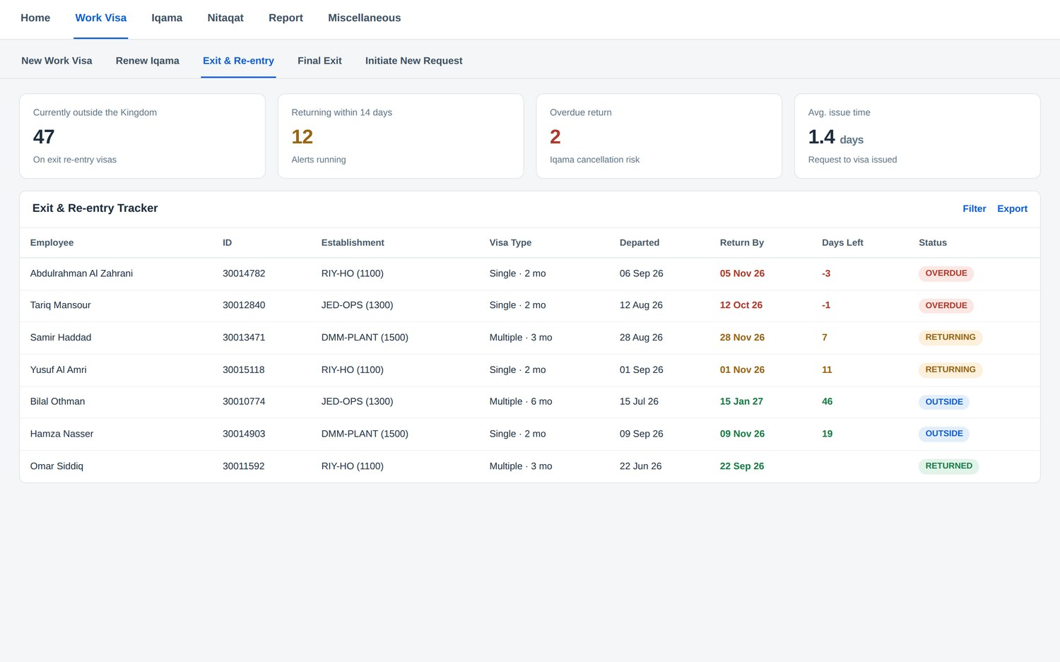
EXIT & RE-ENTRY
The process that costs the most when it goes wrong.
Every expatriate leaving the Kingdom and intending to return needs an exit re-entry visa. Miss the return date and the Iqama is cancelled, and they cannot come back.
1
Employee requests
Travel dates come from the person travelling, in self-service, not second hand.
2
Manager and HR approve
Absence against the leave calendar, then Iqama validity, dues, loans and notice.
3
Muqeem visa issued
Single or multiple, duration recorded, SADAD fee captured with the receipt.
4
Departure recorded
The return-by clock is calculated from the actual departure, not the application.
5
Return monitored
Alerts at 14, 7 and 2 days to employee, line manager and HRBP.
Forty-seven outside the Kingdom. Two already overdue.
6
Re-entry confirmed
Twelve more return inside a fortnight. That is a question your HR director cannot answer today. Here it is one screen, and the overdue rows have already escalated to their line managers.
Arrival recorded, Iqama remains valid, case closes.
INK IT Business Solutions · Visa & Permits Management · Kingdom of Saudi Arabia
5
Notes:
If you only land one slide with a Saudi customer, land this one. Every HR leader in the Kingdom has a story about someone who could not get back, and this is the slide where they tell it to you.

Slide 6
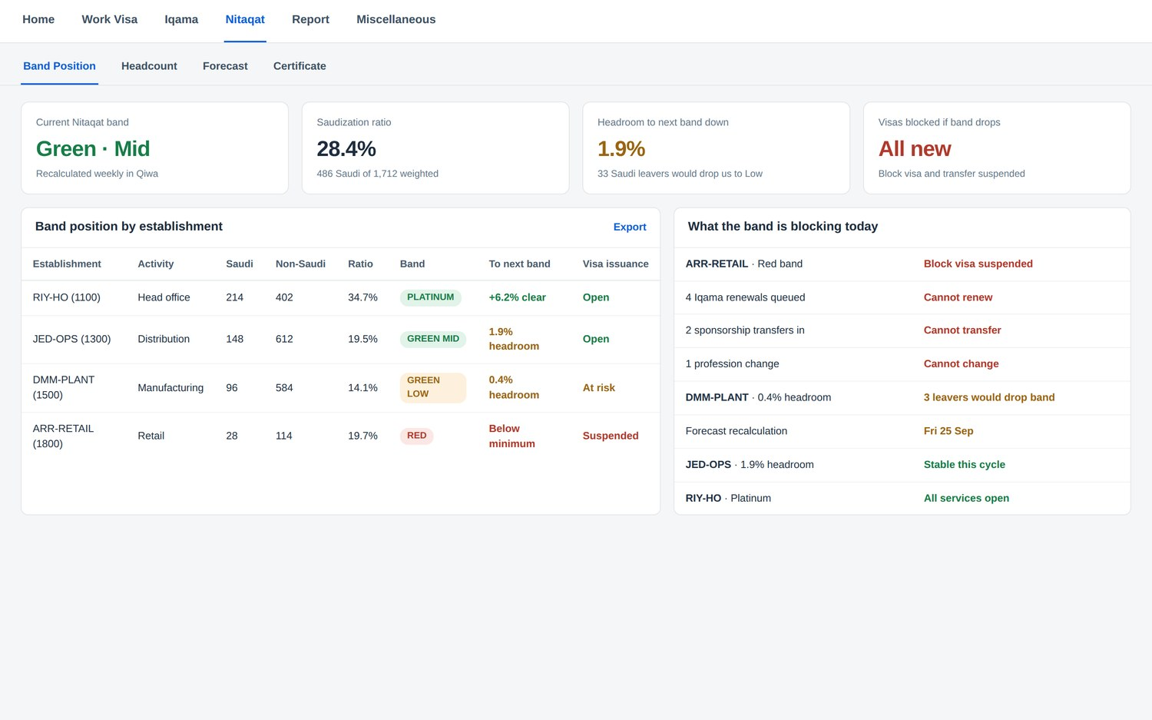
SAUDIZATION & NITAQAT
The number that decides whether you can hire at all.
Nitaqat scores every establishment on the share of Saudi nationals it employs and puts it in a band. The band is not a report card, it is a switch.
PLATINUM
All services open
Block visas, renewals and transfers all available
GREEN
Open, with headroom
Services available while the ratio holds
YELLOW
Restricted
Renewals limited, transfers constrained
RED
Suspended
No block visas, no renewals, no transfers in
What we do that Qiwa does not
Calculate the band continuously, not at the next Qiwa cycle
Show the headroom: how many leavers would drop you
Simulate a restructure or a bulk hire before you commit
Alert before the band moves, with the cause named
The right-hand panel is the point. Not a compliance score, but the four things you cannot do this week because one establishment fell into the red band.
INK IT Business Solutions · Visa & Permits Management · Kingdom of Saudi Arabia
6
Notes:
This is where the deal widens. Visa tracking is a PRO-desk purchase; Nitaqat forecasting is a CHRO and CFO purchase, and it ties straight to Vision 2030 localisation commitments. For an SAP account team this is the slide that justifies the platform conversation.

Slide 7
PERSONA VIEW
Everyone gets their own to-do list.
Each role only sees what is actually theirs, with a due date on it, and the system already knows which Saudi authority each step belongs to.
ROLE
WHAT THEY DO IN THE SYSTEM
WHAT THEY GET
GRO
Government Relations
Requests block visas once the band allows it; authenticates Qiwa contracts; issues Iqamas on Muqeem inside the statutory window; applies for exit re-entry and watches every return-by date.
One queue that already knows which authority each step belongs to.
PRO desk · Riyadh
TA
Recruiter
Checks block visa availability before making an offer; releases candidates from SF Recruiting; agrees the Qiwa profession code with the PRO before submission.
Offers made against visas that actually exist.
Talent acquisition
OB
Onboarding
Records the arrival date that starts the statutory Iqama clock; chases medicals and biometrics; registers Saudi hires with GOSI and Mudad.
Nobody works without the paperwork that makes it legal.
Employee relations
BP
HR Business Partner
Approves exit re-entry against dues and notice; reviews the Nitaqat impact of a resignation before it is actioned; starts final exit once settlement is agreed.
Told before a resignation moves the band, not after.
Employee relations
EM
Employee
Requests exit re-entry with travel dates; confirms medical and biometrics; signs the Qiwa contract; confirms receipt of the renewed Iqama.
Sees their own Iqama expiry and their return-by date.
Self-service
FI
Finance Controller
Reconciles SADAD payments against receipts; posts to GL; forecasts expat levy against the renewal calendar.
The levy stops being a surprise.
Payments and GL
HR
Head of HR
Watches band position per establishment; reviews Saudization against Vision 2030 commitments; signs off the localisation hiring plan.
Nitaqat exposure answerable from one screen.
Governance and risk
INK IT Business Solutions · Visa & Permits Management · Kingdom of Saudi Arabia
7
Notes:
With a mixed audience, let people find their own row. The GRO row is the operational win; the Head of HR row is the one an SAP account executive should point at when the conversation turns to platform value.

Slide 8
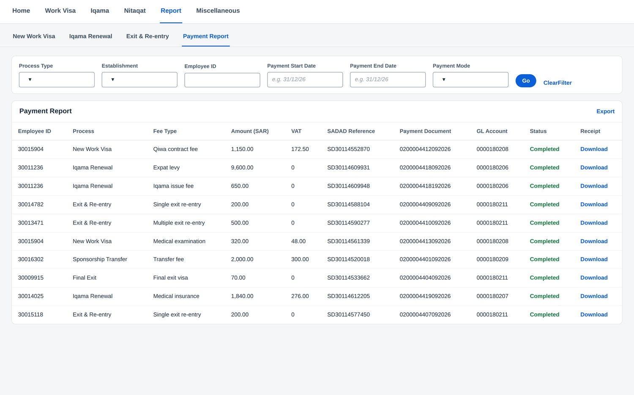
ACCOUNTABILITY & COST CONTROL
Every step owned. Every riyal accounted for.
Statutory deadlines need named owners, and Saudi permit costs are large enough that finance has to see them coming.
1
Assign
Routed to a role, claimed by a named officer. Due dates come from the statutory deadline, not a guess.
2
Nudge
Every 2 days while open. Iqama expiries six weeks out, exit re-entry returns at 14, 7 and 2 days.
3
Escalate
Past the due date it reaches the line manager and HRBP on its own, while something can still be done.
4
Prove
Who had it, when they were reminded, what they uploaded. A Qiwa or GOSI inspection becomes a report.
The Saudi cost line finance actually worries about
The expat levy is charged per employee per year and renewals cluster around hiring dates. We forecast levy and fees against the renewal calendar, so a heavy quarter is budgeted rather than absorbed. Every payment carries a SADAD reference, a receipt and a GL account.
Qiwa contract fee, expat levy, Iqama issue fee, exit re-entry, transfer fee, medical insurance. Each with its own GL account and its own receipt, one click away.
INK IT Business Solutions · Visa & Permits Management · Kingdom of Saudi Arabia
8
Notes:
Two buyers on one slide. The ladder is for the HR operations lead, the levy box is for the CFO. The levy is usually the number that turns this from a nice-to-have into a budgeted project.

Slide 9
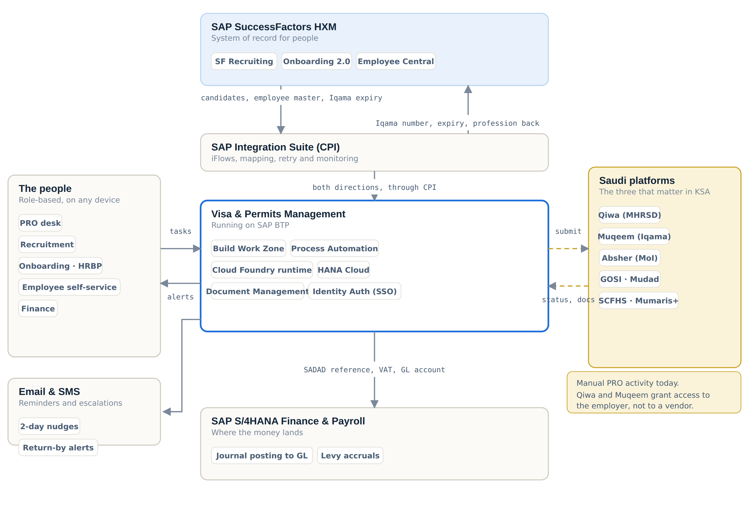
SOLUTION ARCHITECTURE
Every system, and what moves between them.
What flows in
Candidates who accepted an offer, the employee master, separations and the Iqama expiry dates that start a renewal. All through SAP Integration Suite, monitored and retried like any other SAP integration.
What flows back
Iqama number, expiry, profession as registered in Qiwa and work permit status, straight into Employee Central. Nobody re-types anything.
What flows down
Every payment with its amount, VAT, SADAD reference, receipt and GL account, posted to S/4HANA as a journal. Levy accruals included.
The dashed arrows
Qiwa and Muqeem grant API access to the employer under their own establishment registration, never to a software vendor. Those credentials come from you. The connectors are already built.
INK IT Business Solutions · Visa & Permits Management · Kingdom of Saudi Arabia
9
Notes:
The technical slide. Walk the four sides, then land the dashed arrows. Being straight that government API access belongs to the employer is what earns credibility with a Saudi CIO, and it is the question they will ask.

Slide 10
WHAT IT RUNS ON
SAP BTP services, and what it takes to deploy.
CORE — REQUIRED FOR ANY DEPLOYMENT
INTEGRATION & SCALE — AS REQUIRED
Cloud Foundry Runtime
SAP Integration Suite (CPI)
Hosts the application, workflow engine and APIs
Flows to SF Recruiting, Onboarding, EC and S/4HANA
SAP HANA Cloud
Document Management
Iqama records, Nitaqat headcount, payments, audit trail
Qiwa contracts, SADAD receipts, SCFHS certificates
SAP Build Work Zone
Alert Notification / Email
Role-based portal for PRO, HR, finance and employees
Iqama expiry, return-by alerts, escalation mail
SAP Build Process Automation
Job Scheduling
Steps, statutory due dates, reminders, escalation
Nightly expiry and return-by scans, Nitaqat recalculation
SAP Identity Authentication
SAP Analytics Cloud
Single sign-on and directory federation
Nitaqat forecasting, levy budgeting, exec dashboards
Destination & Connectivity
Business Application Studio
Secure outbound to SF, S/4HANA and Saudi endpoints
Localisation, Arabic package, change requests
Data residency
Arabic when you need it
Weeks, not quarters
Deployable in an SAP BTP region that meets Saudi data residency expectations, which is usually the first question a Saudi CIO asks.
The interface ships in English. Arabic and right-to-left layout are a defined localisation package, not a rebuild.
Pre-built and configured rather than written from scratch. Environment and configuration, then integration, then localisation.
Built for the Kingdom.
Qiwa, Muqeem and Absher in step · Nitaqat calculated before it bites · Exit and re-entry tracked to the day
info@inkitsolutions.com
Notes:
Close on provisioning and the three questions a Saudi buyer always asks: where does the data sit, is there Arabic, and how long does it take. Have answers ready rather than promises.

