Slide 1
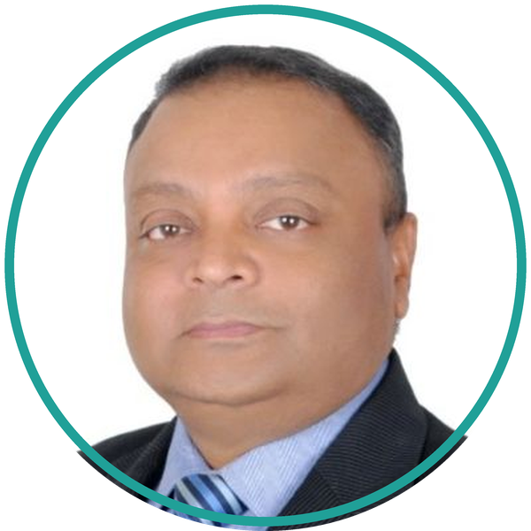
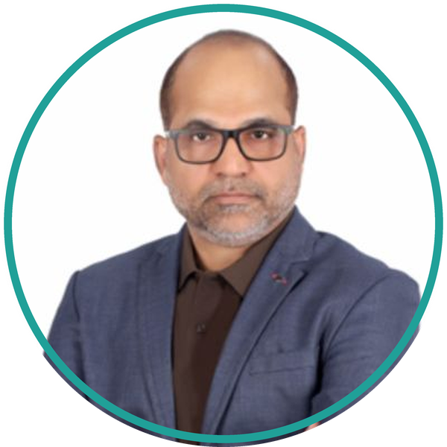
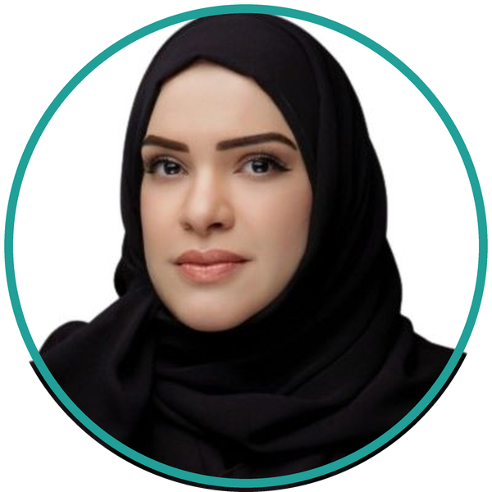
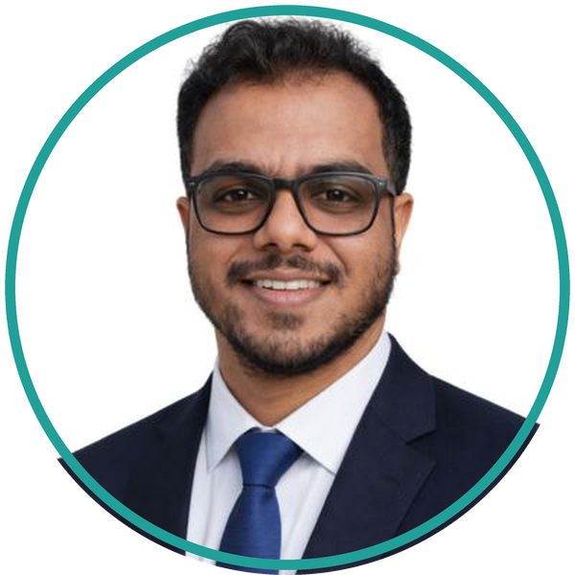
WHO YOU ARE WORKING WITH
The people behind this build.
Four names and one number to call. These are the people you deal with from the first workshop to the day it goes live.
Sekhar Dash
Adeel Ashraf
Rabab Alomani
Sendil Balasubramanian
Senior VP, Sales EMEA
SVP, KSA Country Head & CTO
Director, Sales KSA
Principal Consultant
Owns the commercial relationship across the region.
Runs the Saudi business and signs off the architecture.
Your day-to-day contact on the ground in Riyadh.
Built this application and leads the delivery.
sekhar.dash@inkitsolutions.com
adeel.ashraf@inkitsolutions.com
rabab.alomani@inkitsolutions.com
sendil.balasubramanian@inkitsolutions.com
TALK TO US
RIYADH
DUBAI
info@inkitsolutions.com
Al Malqa D, Anas Bin Malik, 13521
502 Bank Street Building, Bur Dubai
inkitsolutions.com
+966 54 617 7071
+971 50 705 2350
INK IT Business Solutions · Visa & Permits Management on SAP BTP
Notes:
Forty seconds, no more. Name the four people and say which one they will be calling. Adeel is the Saudi country head, so for a Riyadh customer he is the name that matters, and Rabab is on the ground with them. Sendil built the application, which is worth saying out loud in a technical room. Then move on.

