Slide 1

Visa & Permits
Management
Built on SAP BTP · Ready for the GCC
End-to-end governance of work permits, residency and professional licences — with every task owned, every deadline visible, and every government payment matched to a receipt and a GL account.
UAE
KSA
Qatar
Kuwait
Oman
Bahrain
Libya
Healthcare · Industry-grade permits · SAP SuccessFactors integrated
A sales and solution overview for SAP and enterprise customers across the GCC
Notes:
Opening frame. The pitch: a pre-built SAP BTP application covering the work permit, renewal and cancellation lifecycles, with configured country packs across the GCC and Libya. Emphasise three words: owned, visible, reconciled.

Slide 2
THE PROBLEM
One permit. Six teams. No shared clock.
A single work permit crosses recruitment, onboarding, the PRO desk, the employee, HR and finance — and touches a government portal at least five times. Miss one hand-off and it stalls silently, usually until a fine arrives.
01
Tracking lives in a spreadsheet
02
The PRO has no digital desk
03
The money is untraceable
Expiry dates sit in one person’s file. When they are on leave the company is blind — and overstay fines start at the border, not in the system.
Government relations officers run everything from WhatsApp, email and memory. No queue, no due date, no proof of who was asked what.
Typing fees, medicals, insurance and ID charges paid on cards and petty cash. Receipts arrive late, or never. Duplicates surface at audit.
04
Recruitment and PRO are unsynced
05
Compliance is a memory test
06
Nobody can answer "where is it?"
Onboarding promises a joining date. The PRO has not been told the file exists. The candidate waits abroad for a permit nobody started.
Quota, skill classification, profession matching, work-location alignment — rules a human must recall correctly, every time, under pressure.
One employee query takes three calls and a day. Multiply that across thousands of permits and several operating countries.
The cost of getting this wrong: overstay and labour fines, blocked quotas, employees who cannot legally be rostered, and a compliance position no one can evidence to a regulator or an auditor.
INK IT Business Solutions · Visa & Permits Management on SAP BTP
2
Notes:
Let the audience recognise themselves here. Ask which of the six they have. Almost every GCC enterprise has at least four.

Slide 3
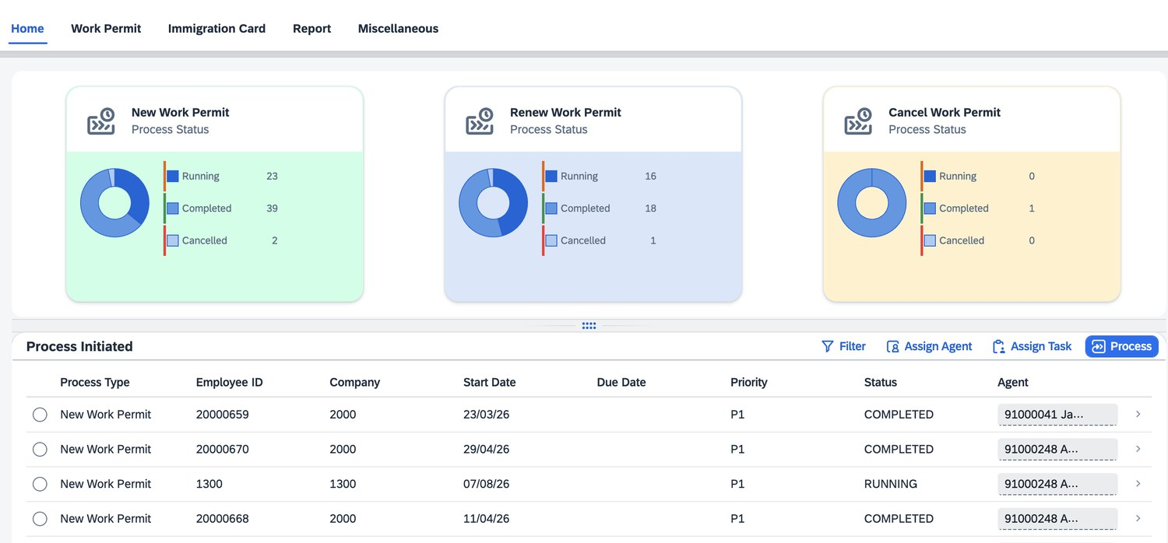
THE SOLUTION
A tracked runway for every permit.
Three governed lifecycles, twenty-two milestones, one task inbox.
New Work Permit
11 milestones
Candidate to legally employed — offer, labour card, entry permit or status change, medical, Emirates ID.
Renew Work Permit
7 milestones
Driven by expiry alerts six weeks ahead — medical, contract, stamping, ID renewal and collection.
Cancel Work Permit
4 milestones
Gated behind end-of-service settlement — cancellation forms, ministry submission, residence cancellation.
The home dashboard — running, completed and cancelled counts across all three lifecycles, over a queue of initiated cases with priority, status and assigned agent.
WORKFLOW
TASKS
DOCUMENTS
PAYMENTS
REPORTING
Configurable milestones per country and permit type
Owner, due date, reminders and escalation per step
Mandatory attachments before a step can close
Amount, VAT, mode, reference, receipt and GL account
Filterable, exportable reports per process and payment
INK IT Business Solutions · Visa & Permits Management on SAP BTP
3
Notes:
Anchor on the screenshot — this is the built application, not a mock-up. The five capability tiles are what makes it a governance tool rather than a tracker.

Slide 4
PERSONA VIEW
Everyone gets their own to-do list.
Each role sees only what is theirs to do, with a due date against it — which is how the PRO desk, recruitment, onboarding and employee relations stay coordinated.
ROLE
WHAT THEY DO IN THE SYSTEM
WHAT THEY GET
GRO
Government Relations
Claims cases from the queue; files MOHRE / Qiwa applications; records every payment and receipt; books medicals and biometrics; tracks stamping to ID collection; maintains quota.
A queue with priorities, due dates and proof of what was done.
PRO desk · GRO
TA
Recruiter
Completes the candidate file and document checklist; releases accepted candidates into the permit process; aligns profession and work-location codes with the PRO.
Joining dates based on real progress, not optimism.
Talent acquisition
OB
Onboarding Coordinator
Initiates the permit; checks quota; chases signed offers, contracts and medical receipts; sends biometric appointments; handles national-hire pension steps.
No joiner arrives without the paperwork that makes them legal.
Employee relations
BP
HR Business Partner
Verifies renewal contracts; approves visa allocation for senior grades; initiates cancellation after end-of-service; reviews fines before payroll deduction.
Escalations arrive before the fine, not after it.
Employee relations
EM
Employee / Candidate
Acknowledges and uploads signed contracts; confirms in-country or out-of-country status; confirms medical completion, insurance enrolment and ID receipt.
Knows exactly what is pending from them, and by when.
Self-service
FI
Finance Controller
Reconciles government fees against receipts; posts permit costs to GL accounts; reviews card-holder spend for reimbursement; approves fine deductions.
One export instead of days of reconciliation.
Payments & GL
HR
Head of HR
Monitors quota utilisation and Saudization or Emiratisation ratios; reviews compliance exposure by entity and country; signs off permit cost budgets.
Compliance risk as a dashboard, not a fire drill.
Governance & risk
INK IT Business Solutions · Visa & Permits Management on SAP BTP
4
Notes:
This is the slide that wins the room — people see their own job. Pause on the GRO row: that is the persona whose working life changes most.

Slide 5
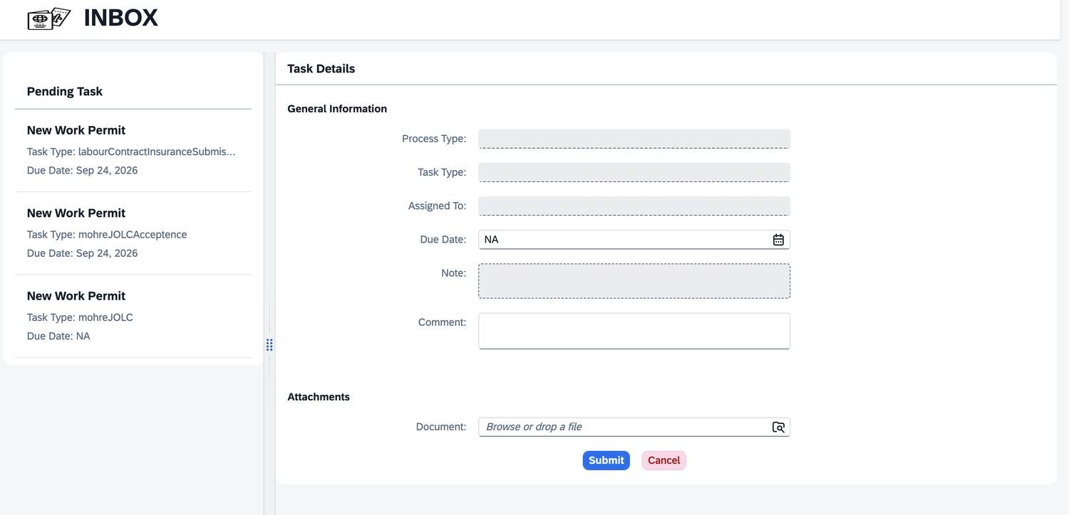
TASK MANAGEMENT & ACCOUNTABILITY
A task with a name on it behaves differently.
Every milestone becomes a real task with an assignee, a due date and an escalation path. Nothing sits in a grey zone where everybody assumes somebody else has it.
1
Assign · The task gets an owner
Routed to a role, then claimed by a named officer with "Assign To Yourself" — or pushed by a supervisor with "Assign Agent". Priority and due date are stamped at that moment.
2
Nudge · Reminder every 2 days
Open tasks re-notify the assignee on a two-day cycle. Document expiries fire six weeks ahead, to the employee, the PRO and the HRBP together.
3
Escalate · The manager is told
At two weeks before expiry, or when a task passes its due date, the line escalates automatically to the HR Manager and the line manager.
The officer’s inbox — pending tasks with type and due date on the left, the task itself on the right: assignee, due date, comment thread and the document that must come back before it can be submitted.
Prove · The trail is permanent
Delays surfaced at source The system shows where the wait actually is — the unsigned contract, the unbooked medical, the government step pending. The bottleneck has an address.
4
Who was assigned, when they were reminded, what they uploaded and when they submitted is written to the record. Audits become a report, not an investigation.
Workload made visible HR admins can see how many assignments each officer has completed, so work is distributed on evidence rather than on who complains loudest.
INK IT Business Solutions · Visa & Permits Management on SAP BTP
5
Notes:
This is the differentiating slide. Other tools track visas; this one manages the people doing the work. Stress the escalation ladder — it is what converts a tracker into accountability.

Slide 6
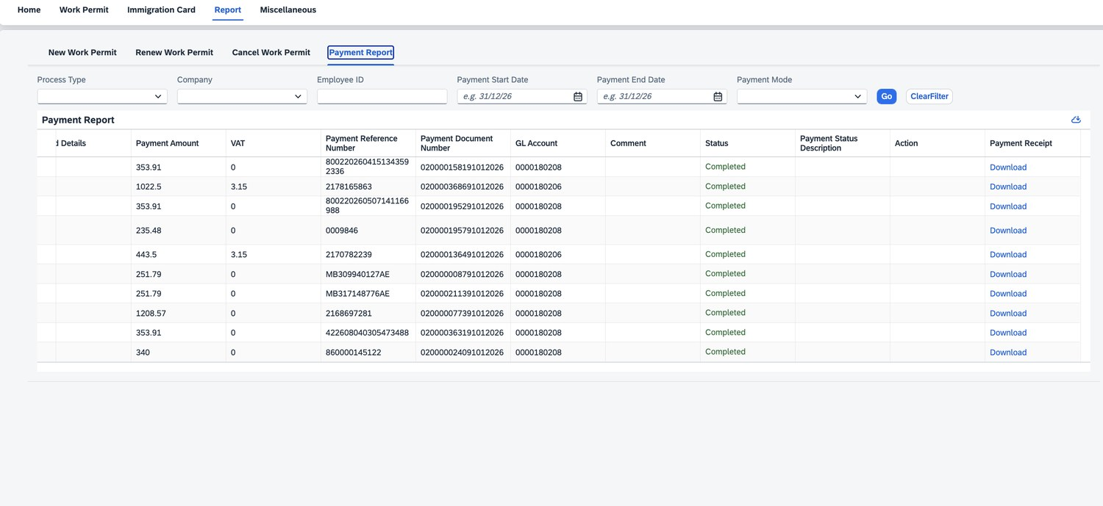
FINANCIAL CONTROL
No payment without a receipt and a GL account.
Government fees are the leakiest part of permit management. Making the payment part of the task means the money cannot move without leaving a record.
01
02
03
04
05
Captured in the step
Receipt attached
Card holder recorded
Posted to finance
Reportable
Amount, VAT, mode, date and reference are mandatory fields on the milestone form itself.
The scanned receipt is a required attachment. No file, no submit — the milestone stays open.
Who paid, on whose card, and whether the company or the employee bears the cost.
Published to the correct GL account with a payment document number for journal posting.
Filterable by process, company, employee, date, mode or card holder — then exported.
✓
No duplicate payments
A reference is captured against a specific milestone of a specific case, so the same fee cannot be recorded twice against the same step.
✓
No unaccounted spend
Every payment leaves with a GL account and a document number. Finance reconciles from the report, not a shoebox of receipts.
✓
Fines have a workflow too
Overstay, traffic, labour and immigration fines are raised by the PRO, routed via the HRBP to payroll, and stored as a deduction.
Every row is auditable: amount, VAT, payment reference, payment document number, GL account and status — with the original receipt one click away under Download.
INK IT Business Solutions · Visa & Permits Management on SAP BTP
6
Notes:
The CFO slide. The line that lands: a payment cannot exist in this system without a receipt and a GL code, so duplicates are prevented at entry rather than discovered at audit.

Slide 7
GCC COVERAGE
One engine. Seven rulebooks.
Labour law is national, so the process must be too. The workflow engine, task model, payment capture and reporting stay identical — what changes per country is the milestone set, the authorities, the document checklist and the alert thresholds.
COUNTRY
AUTHORITIES & PORTALS
PROCESSES IN THE PACK
United Arab Emirates
MOHRE · ICP · GDRFA · Tasheel / Tawjeeh · ILOE
New, renew, cancel, quota, temporary permit, Emiratisation, absconding, company documents
PACK
Kingdom of Saudi Arabia
Qiwa · Muqeem · Absher · GOSI · Mudad
Block visa & quota, work permit, Iqama issue and renewal, exit / re-entry, final exit, profession change, transfer, Nitaqat
PACK
Qatar
ADLSA · MOI · Metrash2 · Qatar Visa Centre
Work visa quota, contract attestation, entry visa, medical and biometrics, RP and Qatar ID, renewal, exit
PACK
Kuwait
PAM (Ashal) · MOI · Sahel · PACI
Article 18 work permit, entry visa, medical and fingerprint, residency stamping, Civil ID, renewal, cancellation
PACK
Oman
Ministry of Labour · ROP · Invest Easy
Labour clearance, employment visa, medical, resident card, renewal, Omanisation monitoring, exit
PACK
Bahrain
LMRA (EMS) · NPRA · SIO / CPR · GOSI
Expatriate work permit, medical, residence permit, CPR card, renewal, flexi permit tracking, cancellation
PACK
Libya
Ministry of Labour · Passport & Nationality Authority
Work permit, entry visa, medical, residency, rotation tracking for expatriate crews, company operating permits
PACK
PACK = the country’s statutory flow expressed as configuration on the shared engine — milestones, authorities, document checklist, mandatory fields, payment types and alert thresholds. Pre-built rather than custom-developed, with a localisation workshop confirming document names, fees and thresholds before go-live.
INK IT Business Solutions · Visa & Permits Management on SAP BTP
7
Notes:
The GCC-ready slide. The message is breadth from one engine: each pack is configuration, not a rebuild, which is why deployment is weeks rather than quarters. For KSA note the three-authority split: Qiwa for labour, Muqeem for the Iqama, Absher as the employee-facing mirror.

Slide 8
HEALTHCARE & INDUSTRY PERMITS
A nurse needs two permissions, not one.
A clinician cannot legally practise until a health regulator has verified their credentials and issued a professional licence — on its own clock, with its own renewal cycle. The application runs that as a parallel lane on the same case.
The professional licensing lane
Why it fails without a system
Credential pack collected at recruitment
Primary-source verification (DataFlow) tracked to result
Professional classification or eligibility assessment
Licensing exam booked, sat and certificate uploaded
Licence issued, activated against the employing facility
Renewal driven by CME hours — 90-day alerts, 15-day escalations
A clinician joins on a valid visa but cannot be rostered
Primary-source verification stalls with nobody watching the queue
A trainee’s 45-day dataflow deadline passes unnoticed
CME hours logged only after the renewal window has closed
Licence and visa expiry drift apart — one lapses, the other is fine
The facility licence expires, exposing every practitioner under it
Health regulators covered by the country packs
Saudi Arabia
UAE — Dubai
UAE — Abu Dhabi
UAE — Northern
SCFHS
DHA
DOH
MOHAP
Mumaris+ · DataFlow · Prometric
Sheryan portal
TAMM / DOH portal
MOHAP licensing
Qatar
Bahrain
Oman
Kuwait
DHP (MOPH)
NHRA
OMSB / MOH
MOH
DHP practitioner portal
NHRA licensing
MOH · Prometric
MOH · Kuwait Prometric
INK IT Business Solutions · Visa & Permits Management on SAP BTP
8
Notes:
For healthcare prospects this is the slide that proves domain depth. Note that the same model handles facility permits — pharmacy and clinic licences, trade licences, civil defence — and any industry-grade permit that expires.

Slide 9
ARCHITECTURE & INTEGRATION
Between the government portal and SuccessFactors.
The application sits exactly where the gap is: it takes candidates from Recruiting, drives the government-facing work, writes permit data back into Employee Central, and posts the money to finance.
SAP SuccessFactors
Government portals
Candidates, employee master, separations and expiry dates flow in
Qiwa · Muqeem · Absher · MOHRE · ICP · GDRFA · LMRA · PAM · ADLSA · SCFHS · DHA · DOH
SF Recruiting
SF Onboarding 2.0
Employee Central
SF Work Zone
Visa & Permits on SAP BTP
The governed layer — where the work is actually managed
API integration — read this carefully
Workflow & milestones
Task inbox & escalation
Documents
Payments
The application is API-ready by design. Every government-facing milestone is an abstracted service call, so a portal integration drops into an existing slot rather than requiring the workflow to be rebuilt.
What the customer must obtain. GCC governments do not publish open APIs, and access is granted to the employer — not to the software vendor. The customer approaches each authority directly (Qiwa and Muqeem in KSA, MOHRE and ICP in the UAE, LMRA in Bahrain) for API credentials, a specification and a sandbox under their own establishment registration. We build the connector from those.
Until then the government step stays a tracked manual PRO activity, with reference number, receipt and status captured in the milestone — which is how the application is designed to operate from day one, with or without a portal connection.
Quota register
Reporting
SAP S/4HANA Finance
Permit costs and approved fine deductions post outward
Payments to GL
Journal posting
Payroll deductions
INK IT Business Solutions · Visa & Permits Management on SAP BTP
9
Notes:
Handle the API question head-on before the customer raises it. The value is not automating the click on the government site — it is knowing the click happened, who made it, when, what it cost and what came back.

Slide 10
WHAT IT RUNS ON
SAP BTP services required.
CORE — REQUIRED FOR ANY DEPLOYMENT
INTEGRATION & SCALE — AS REQUIRED
Cloud Foundry Runtime
SAP Integration Suite (CPI)
Hosts the application, workflow engine and APIs
Integration flows to SF and S/4HANA Finance
SAP HANA Cloud
Document Management Service
Permit records, quotas, payments, audit trail
Passports, contracts, receipts, certificates
SAP Build Work Zone
Alert Notification / Email
Role-based portal and launchpad per persona
Expiry alerts, reminders and escalation mails
SAP Build Process Automation
Job Scheduling Service
Milestones, routing, due dates, escalation
Nightly expiry scans and scheduled reports
SAP Identity Authentication
SAP Analytics Cloud
Single sign-on and directory federation
Executive dashboards and cross-country analytics
Destination & Connectivity
Business Application Studio
Secure outbound to SF, S/4HANA and future APIs
Localisation and change-request development
Two licensing routes
Works without SuccessFactors
Deployable in weeks
You subscribe and operate the runtime and portal — or INK IT manages the subscription and operations entirely, removing separate developer licences.
System-agnostic within BTP. If SF is not live yet, the non-integrated deployment still delivers full governance from day one.
Pre-built and configurable rather than custom-developed — environment and configuration, then integration, then localisation.
Ready for the GCC, today.
Country packs for the UAE, KSA, Qatar, Kuwait, Oman, Bahrain and Libya · Work permits, healthcare licences and any industry-grade permit
info@inkitsolutions.com
Notes:
Close on provisioning and commercials. The core six are non-negotiable; the rest scale with ambition. Two licensing routes matters — INK IT-managed operation is materially cheaper and is often the deciding factor.

