Slide 1

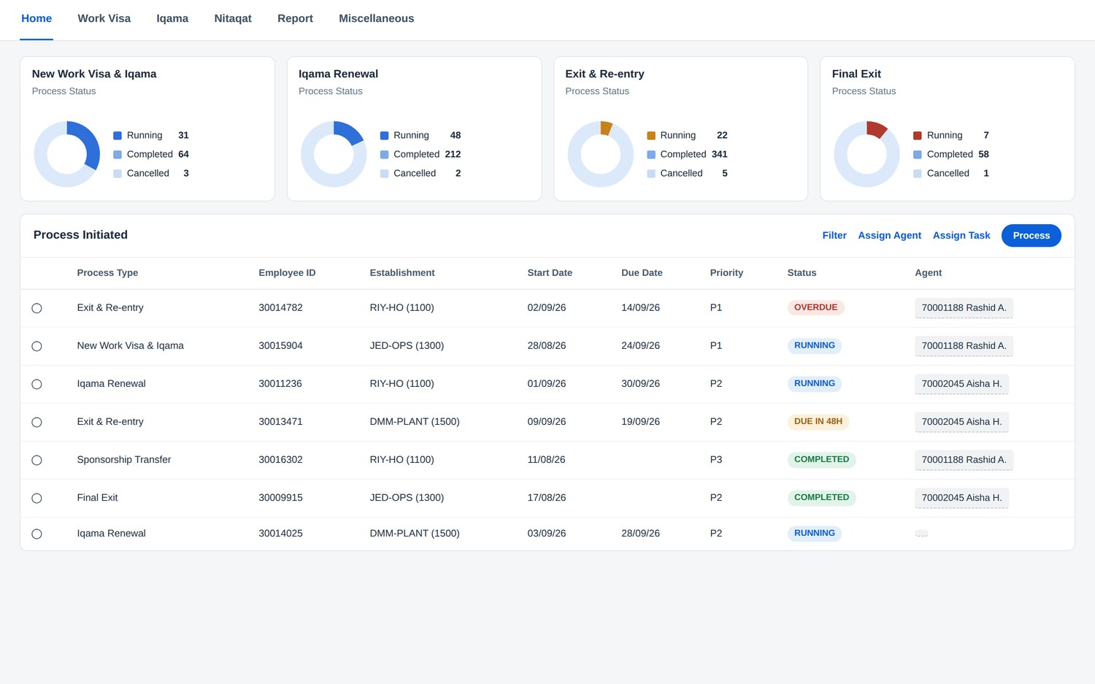
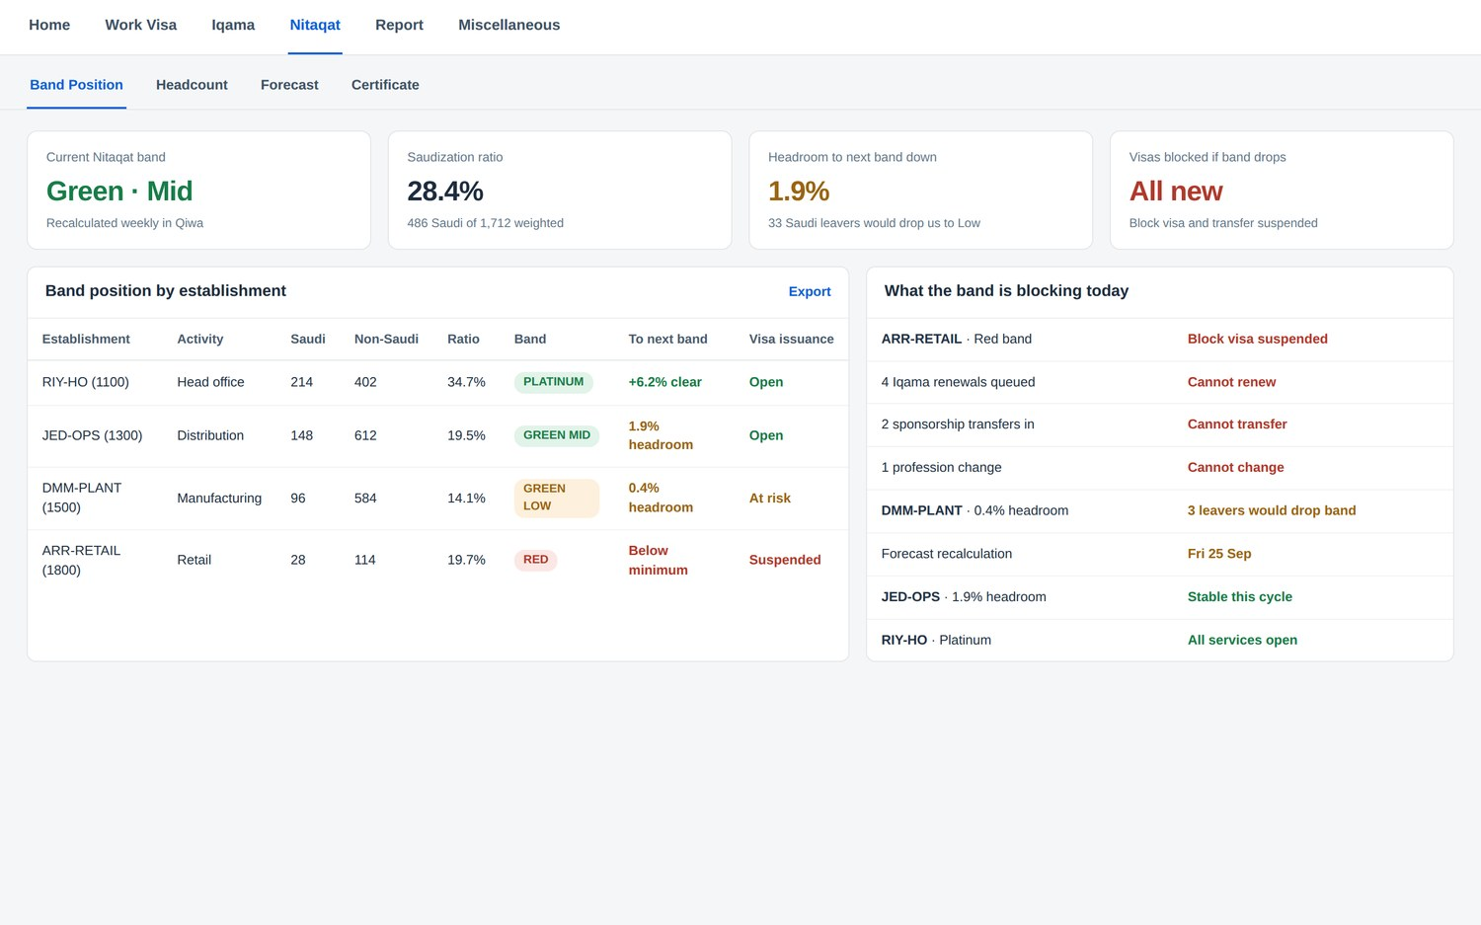
KINGDOM OF SAUDI ARABIA
Visa and Permits
Management
Built on SAP Business Technology Platform
Every work permit, Iqama, exit and re-entry and final exit on one track, between the Saudi government portals and SAP SuccessFactors.
The problem. The Saudi permit lifecycle runs across three government systems and one human resources system, and nothing joins them up. Work sits in inboxes, fees go unreconciled, and a missed date costs a fine.
WHAT IT DOES
Five lifecycles, one queue
Seven authorities, one screen
New work visa, Iqama renewal, exit and re-entry, final exit and transfer. Each step has an owner and a due date.
Qiwa, Muqeem, Absher, Enjaz, GOSI, Mudad and CCHI, with the right one already attached to each step.
Nitaqat before you hire
Every riyal accounted for
Band position per establishment, so a hire is approved against headroom that actually exists.
Each fee carries a receipt, a payment reference and a General Ledger code. No duplicate, no unexplained payment.
The officer dashboard and the Nitaqat band position. Representative of the Saudi configuration.
1,930
23,160
7
6
permit cases a year at 1,000 employees
tracked tasks, each with an owner
Saudi authorities covered
more Gulf countries ready
WHAT IT RUNS ON
SAP BTP, Cloud Foundry runtime · SAP HANA Cloud · SAP Build Work Zone · SAP Build Process Automation
SAP Integration Suite · SAP Document Management service · SAP Alert Notification service · SAP Cloud Identity Services
On government access. Portal access is granted to the employer under its own establishment registration, never to a software vendor. Every connector is built and waits on the credential the customer obtains.
INK IT Business Solutions
adeel.ashraf@inkitsolutions.com · +966 54 617 7071
[ SAP partner
badge ]
Riyadh · Dubai · inkitsolutions.com
rabab.alomani@inkitsolutions.com · info@inkitsolutions.com

