Slide 1

Hand Gesture Recognition using RF-Sensing
By: Tan Jun Hao
Notes:
Good afternoon Professors, I am Jun Hao and I will be presenting on the topic " hand gesture recognition using RF-Sensing"

Slide 2
Overview
Data Collection
Model Development
Model Training
Results
Notes:
I will be going through the data collection phase, development, and training of the model, and the results of this project

Slide 3
Motivation
Camera vs Radar Recognition
Privacy
Illuminated environment
Notes:
Before that, I would like to share the motivation for the project.
This project is slightly different from other projects because it uses radar-based recognition instead of camera-based recognition. This is because camera-based recognition has privacy issues like for example if the device is being hacked, the hacker is able to use the camera as a spying device. Another reason why the camera is not used is that it does not work well in an environment that is not illuminated.

Slide 4
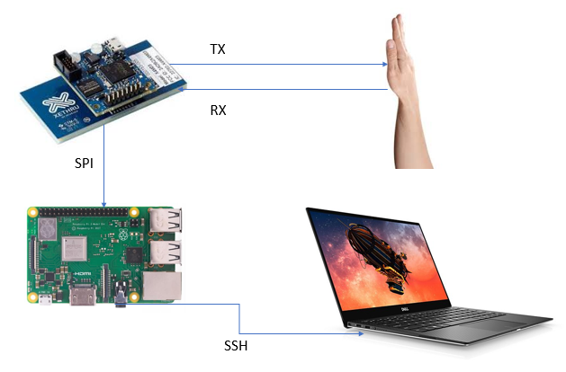
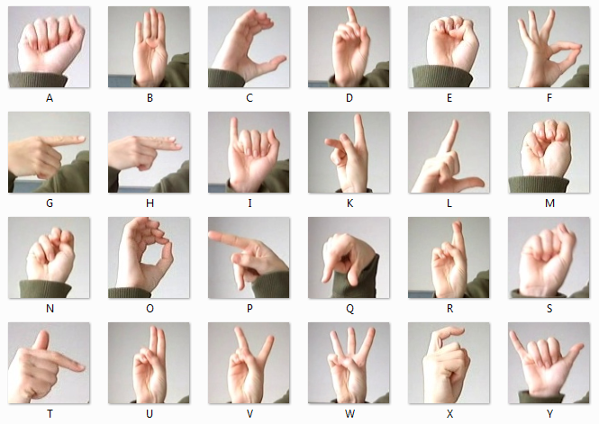
Data Collection
Radar Sensor
Raspberry Pi
Notes:
The data collected are of hand gestures that represent different letters. A radar is being used to capture the movement of the hand to determine the different gestures. The results are being transmitted to the Raspberry Pi before it is passed to the computer for processing.

Slide 5
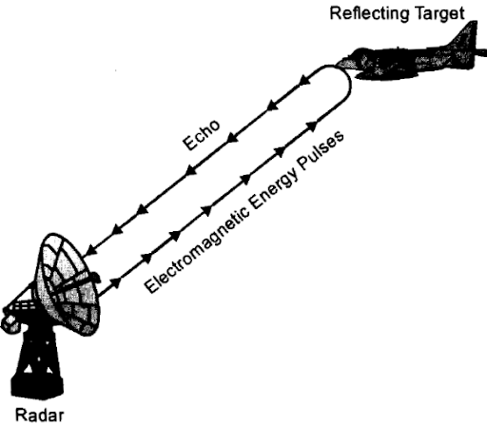
Radar - Radio Detection and Raging - Target detection technology - Transmitter and receiver
Notes:
Now I will share a bit more about the radar and how it is being used in the project. Radar is widely known as a target detection technology used in military. Radar is an acronym for Radio Detection and Raging and as the name suggests, it make use of radio waves to detect objects. The radar sensor consists of transmitter and receiver and to determine parameters such as range and velocity of the object.

Slide 6
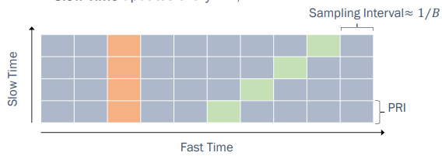
Radar(cont.)
Results come in a matrix
Slow time is the number of pulses receive
Fast time is the measurement of data at each pulse
Notes:
The data is received in a 2D matrix and each time the radar receives a new pulse, the data is recorded and added to a new row of matrix. Fast time is the measurement of data at each pulse and the Slow time is the number of pulses receive. As you can see from the picture on the right, the green box is moving towards the right after each slow time which also means that the object is moving further away from the sensor.

Slide 7
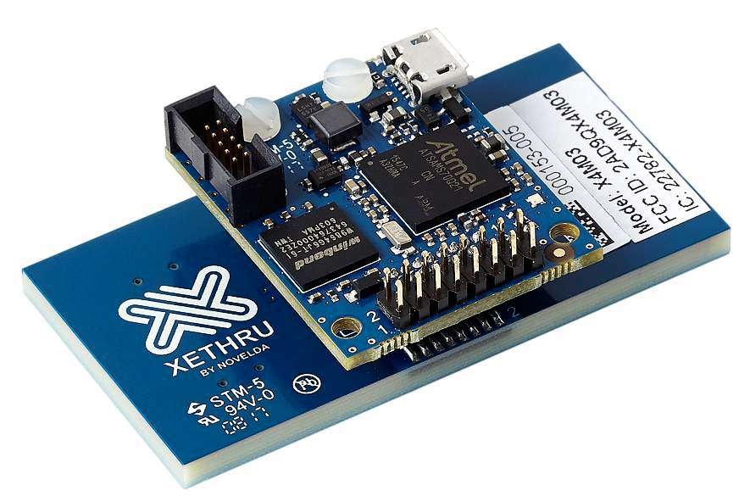
Radar Sensors
Continuous Wave (CW)
Frequency Modulated Continuous Wave (FMCW)
Impulse Radio Ultra-Wide Band (IR-UWB)
Notes:
The three different radar sensors. The different sensors emits different signal. They are the Continuous Wave (CW), the Frequency Modulated Continuous Wave (FMCW) and the Impulse Radio Ultra-Wide Band (IR-UWB). The biggest disadvantage is that CW and FMCW radars are more expensive than IR-UWB radars and slow data acquisition. IR-UWB radars, on the other hand, has a high range resolution, and it is less subjected to outside interference . Hence, the hardware for this project is the Novelda Xethru X4 UWB pulsed radar.

Slide 8
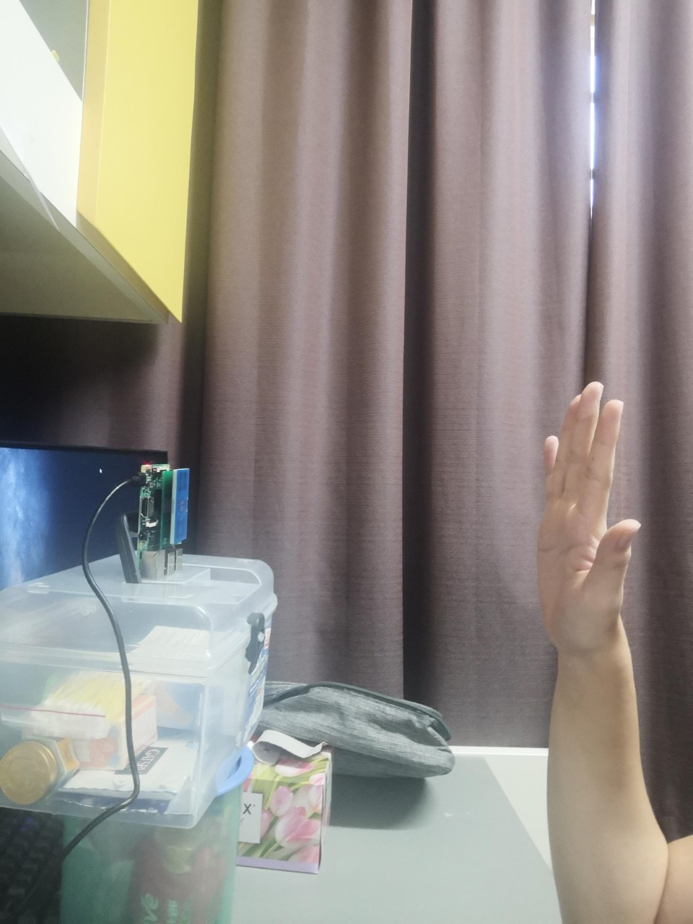
Experiment Setup
30cm
Time | Gesture
0 – 5s | Starting Gesture
5 – 15s | Transition to Gesture X
15 – 20s | Gesture X
Notes:
This is an example of the setup. The hand is positioned 30cm away from the sensor. One cycle of the experiment will take around 20 seconds. First 5 seconds will be stationary starting gesture, next it will be 10s of transitioning to the gesture as required and there will be another stationary final gesture for 5s. One cycle will be one matrix of data and it is repeated for 100 times for each different gestures.

Slide 9
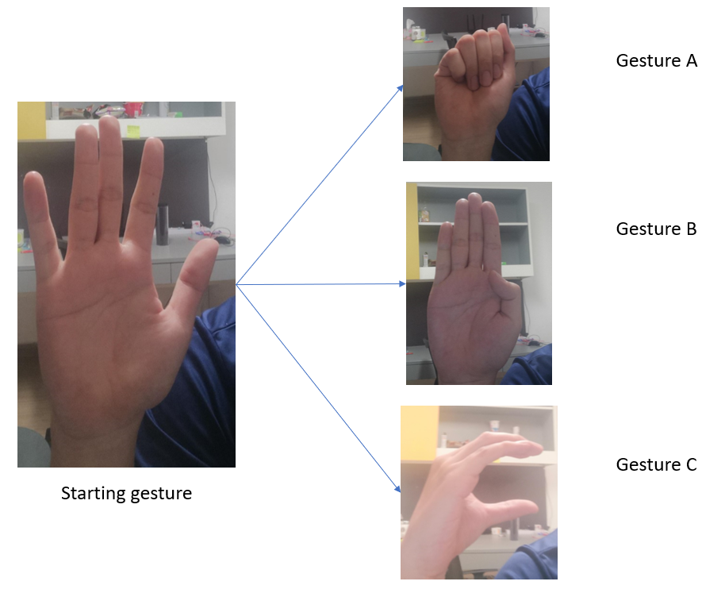
Notes:
This picture shows the starting gesture transiting to different hand gestures.

Slide 10
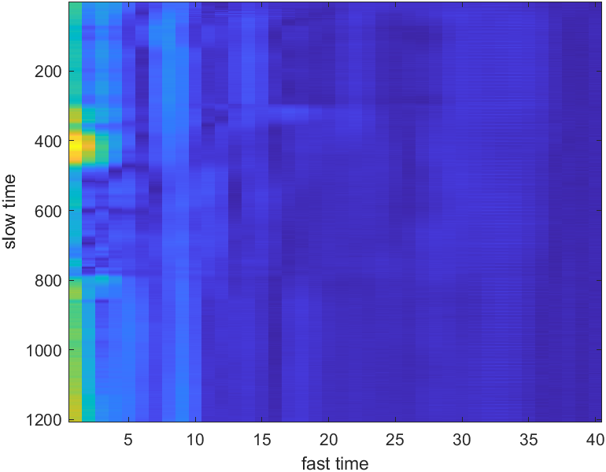
Spectrogram
Step for plotting a spectrogram of the data:
Read CSV file
Split the data into in-phase (real) and quadrature (imaginary) components
Add both components
Plot the spectrum with the absolute value
Gesture A
Notes:
To check the integrity of the data, I used Matlab to plot a spectrogram of the data. I first read the csv, then split it into in-phase and quadrature components before adding them up. After that, I plot the spectrum using the absolute value. This way I can see if I have the similar plots for the same gesture (low intra-class distance) and dissimilar radar images for different gesture (high inter-class distance).

Slide 11
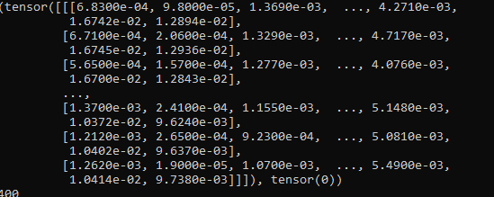
Loading of data
PyTorch Library
Dataset and Dataloader Class
950 X 276 to 1 X 950 X 276
Notes:
To load the data, I make use of the dataset and dataloader class from the pytorch library and also convertered a 950 X 276 to 1 X 950 X 276 because the input for a model requires a 3D input.

Slide 12
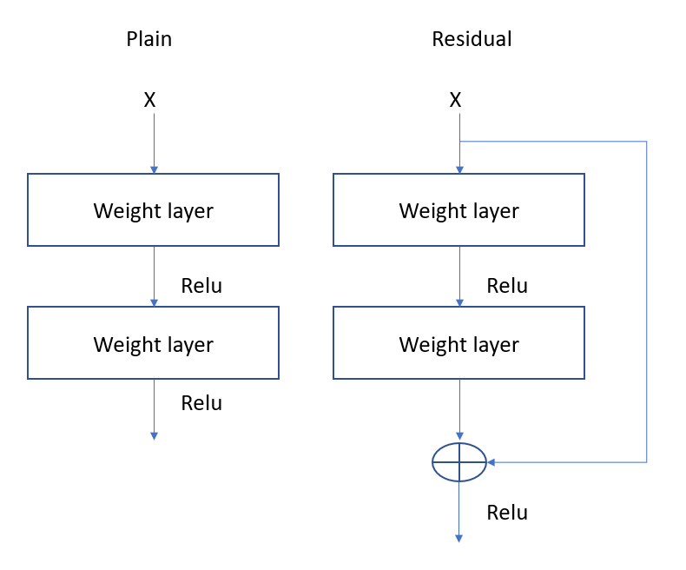
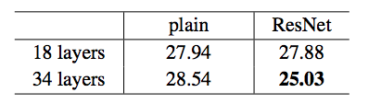
Model Implementation
Residual Network (ResNet)
Take output from the previous layer to the layer ahead
Notes:
For the model, ResNet is being chosen for the base model. ResNet, aka, Residual Network is slightly different from the normal neural network because it consist of taking the output from the previous layer and put it to the layer ahead. It also has a lower error rate for a higher layered model compared to just plain models.

Slide 13
Optimizer and Loss function
Optimizer: Adam (Adaptive Moment Estimation)
Loss: Cross Loss Entropy
Notes:
The optimizer used is Adaptive moment estimation. This is because it can implement adaptive learning rate as compared to stochastic gradient descent that used a fixed learning rate. Cross loss entropy is best suited for a classification problem like this project.

Slide 14
Hyperparameters Tuning
Epoch | Accuracy | Loss
10 | 62.5% | 0.5
20 | 79.2% | 0.4
30 | 85% | 0.29
Learning rate | Accuracy | Loss
0.1 | 52.2% | 0.74
0.01 | 58.3% | 0.76
0.001 | 66.6% | 0.47
Batch size | Accuracy | Loss
5 | 54% | 0.83
15 | 60.8% | 0.66
25 | 62% | 0.74
Notes:
These 3 hyperparameters are being tunes to get better results. For each parameter being changed, the others will be kept constant. For example, to find the optimal number of epoch, the learning rate and batch size is being kept constant. As you can see, the higher the epoch, the better the accuracy but it does not mean that epoch must be high because too high of an epoch results in overfitting. Overfitting occurs when the model fit too nicely to the training samples and not the test samples. As for the learning rate, having to small of a learning rate will also slow down the training by a lot because the weights are being updated by a very small amount so it will need sometime before it reach the optimal value. Having a larger batch size not only provide better accuracy but also slightly faster training time. However, due to memory constraint, the batch size cannot be too big.

Slide 15
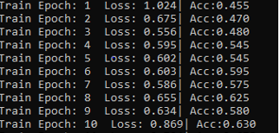
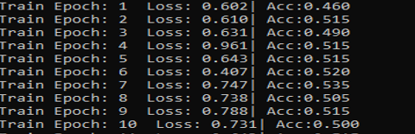
ResNet18 Vs ResNet50
ResNet50
ResNet18
Notes:
This is the comparison between ResNet50 and ResNet18 and you can see that ResNet50 outperform ResNet18. However, the accuracy is still low and this is where I come across data augmentation.

Slide 16
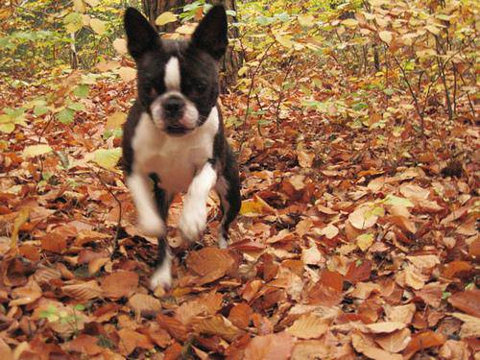
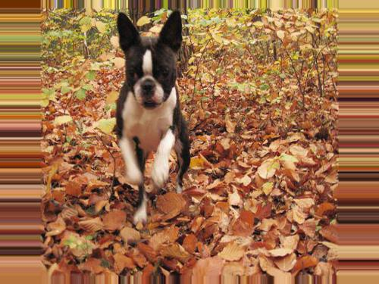
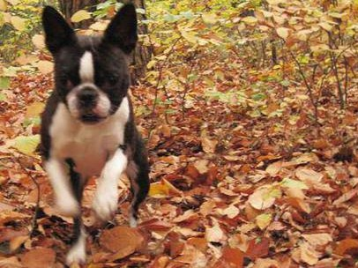
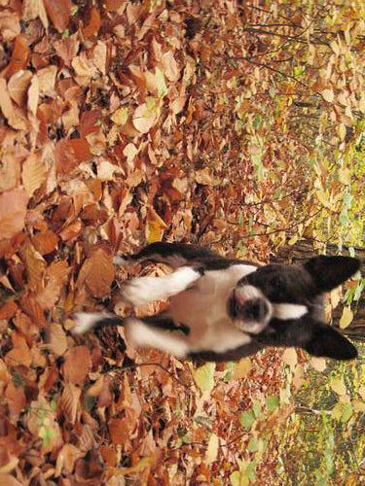
Data Augmentation
“increase” sample size
Notes:
Data Augmentation is a method to increase the diversification of data when there is limited data. The data is being transformed into different formats but while retaining the features. Some techniques are changing the brightness, rotating, and resizing the images. Using the RandomAffine method from PyTorch library, we can do that to the data. The picture can be scaled, shifted and rotated and this provides us with an increase of samples which increase the accuracy

Slide 17
Finalized Hyperparameters
Batch size: 10
Epoch: 20
Learning Rate : 0.0005
Train Accuracy: 87.4%
Test Accuracy: 80.7%
Notes:
Overall, to achieve the optimal values for the hyperparameters, different combinations of values were tried. With batch size = 10, epoch = 20, learning rate = 0.0005, the model can get a training accuracy of 87.4% and a test accuracy of 80.7% with 4 different gestures and 100 samples each. Due to the memory constraint, the batch size cannot be further increased.

Slide 18
Conclusion
Data collection is important
Fine tuning Hyperparameters takes up time
GPU is good to have for fast model training
Notes:
In this project, there were many challenges that were faced. Data collection was the most important and challenging phase because it is a long and tedious process. There are times where the transition of hand gesture was too fast or the remote connection with the Raspberry Pi was lost halfway through and the collection of data must restart. There are a lot of parameter and model architecture to select from and choosing the right values takes multiple testing but however, with the help of a graphic processor unit (GPU), the time taken for each epoch was greatly reduced by more than 50 times as compared to a computer processor unit (CPU). The problems were addressed with trial and errors and extensive research. As a result, hand gesture recognition system with a training accuracy of 87.4% and a test accuracy of 80.7% with 4 different gestures (A, B, C, D) is successfully developed.

