Slide 1
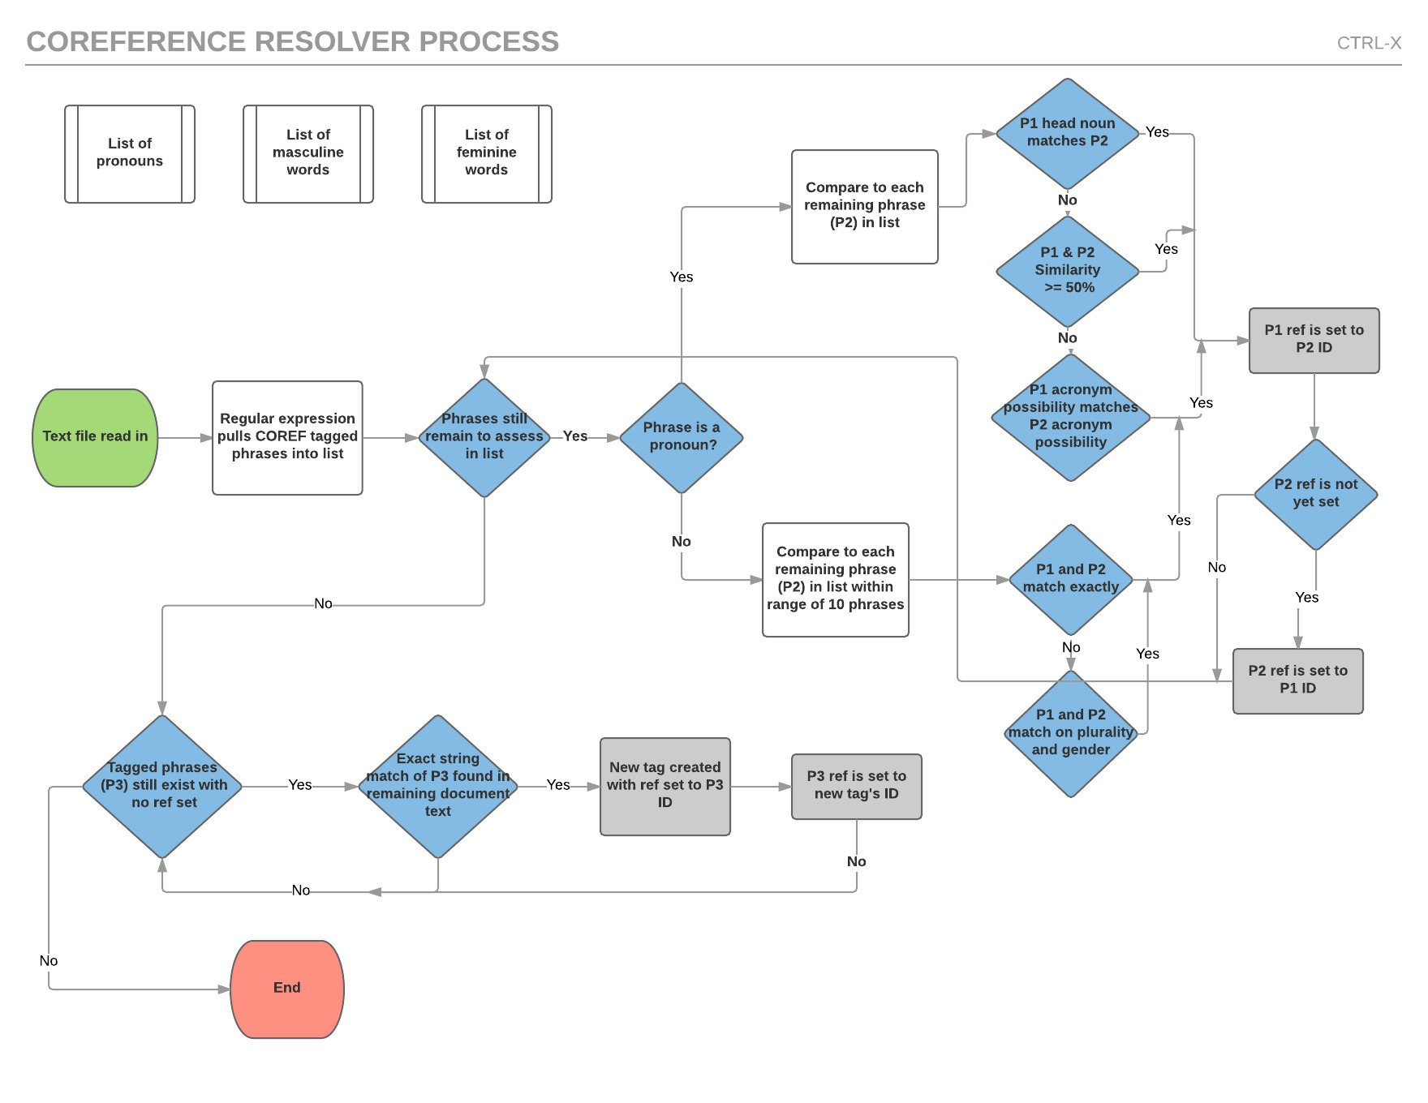
TEAM CTRL-X
Victor Johnson and Camille Rasmussen
Our System
How does your system work?
What tools did you use?
Think about using flowcharts and figures. Examples are great!
Victories
Complications
Exact string matching
Head noun matching
…
Guessing plurality and gender for all noun phrases
…

