Slide 1

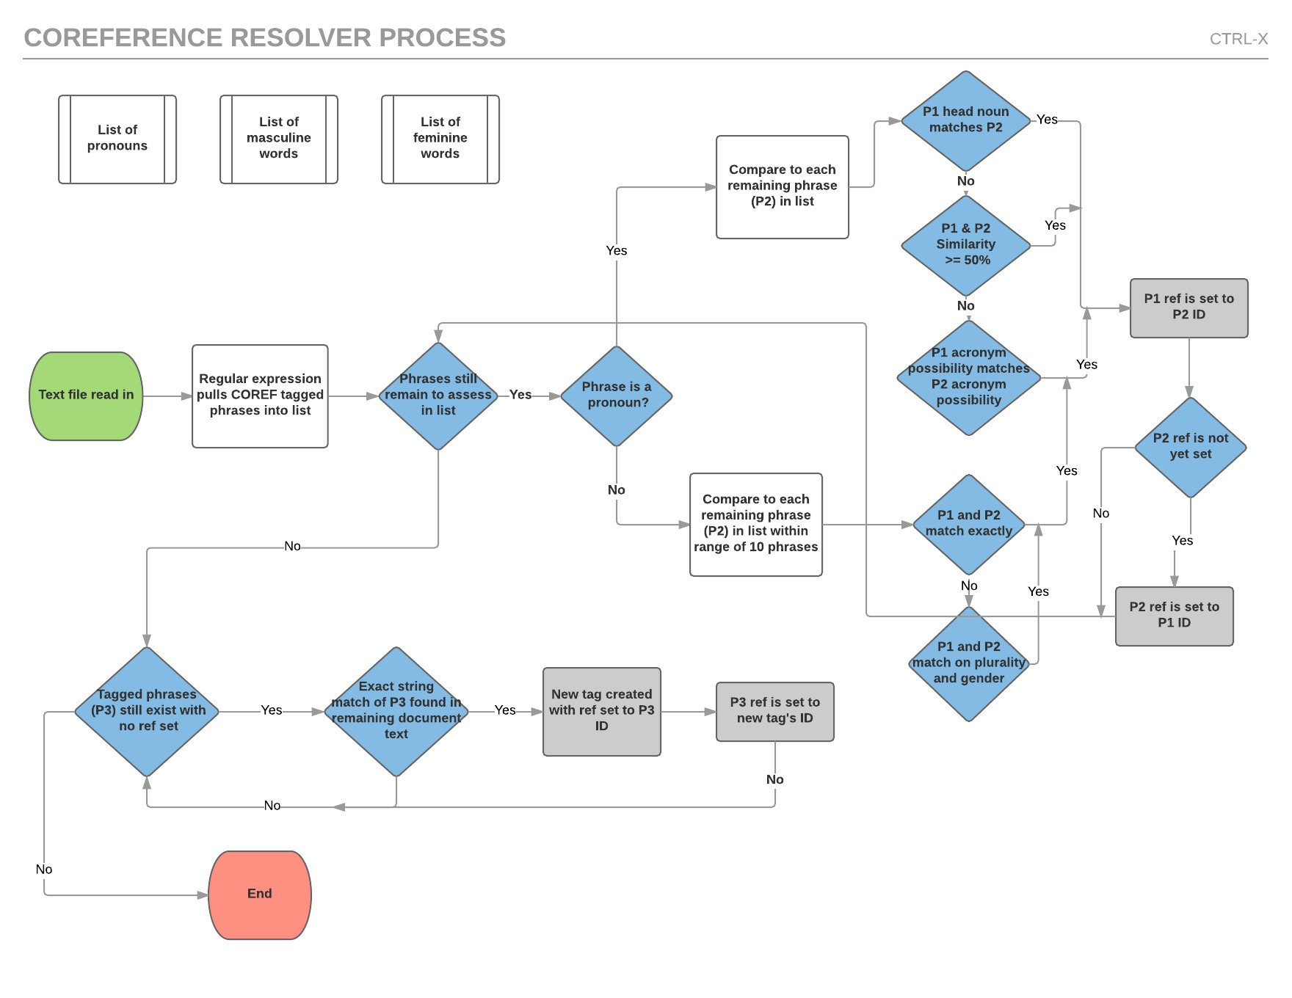
CTRL-X
Victor Johnson & Camille Rasmussen
System design
Performance
Document
Resolver
With 57% accuracy on test set 2 and 63% accuracy on test set 3, our coreference resolver performed quite similarly on both test sets. This similarity can be attributed the general approach that was taken.
Main Contributor: Victor Johnson
Main Contributor: Camille Rasmussen
Extracts noun phrase tags from the file.
Stores updated tag references.
Outputs results to the output file.
Searches tags for references.
Updates the references for each tag in the Document.
Searches for untagged noun phrases referencing tagged noun phrases.
Complications
Successes
Guessing gender and plurality.
Finding untagged antecedents.
String matching head nouns.
Acronym builder for string matching.
We opted to take a simple and general approach to resolving coreferences. The majority of references are found using string matching techniques. The remaining references are resolved by guessing the gender and plurality of noun phrases and using those to match similar noun phrases.
By keeping our approach more general and not relying on the parse tree or other document specific attributes we were able to perform well on all test sets. Because of this plan, the majority of our time was spent tuning the parts of the resolver responsible for string matching and finding pronoun matches.
The Algorithm

