Slide 1
Block-based Adaptive Median Filter
Ravi Sharma (2015165)
Prasoon Jain (2015157)

Slide 2
Content
Adaptive Median Filter
Block Based Adaptive Filter
Results
Conclusion

Slide 3

Adaptive Median Filter
Noise detection
Adjusting window size
Filtering
F(i,j) Pixel Value
C Average value of window
Max max value of window
Min min value of window
Td Threshold value

Slide 4
Block Based Median Filtering
Divide image in 16X16 blocks
Calculate Standard deviation
Noise detection
Adjusting window size
Filtering
F(i,j) Pixel Value
C Average value of window
Max max value of window
Min min value of window
Sd Standard deviation
Td Sd * Threshold value

Slide 5
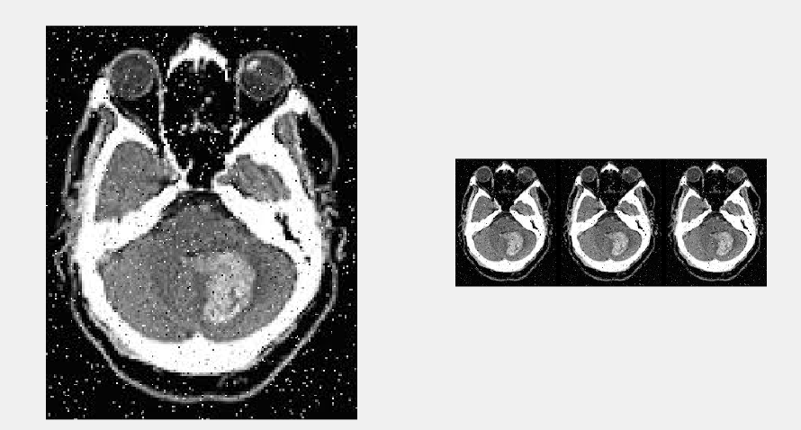
Results
Adaptive Results on Mri Images

Slide 6
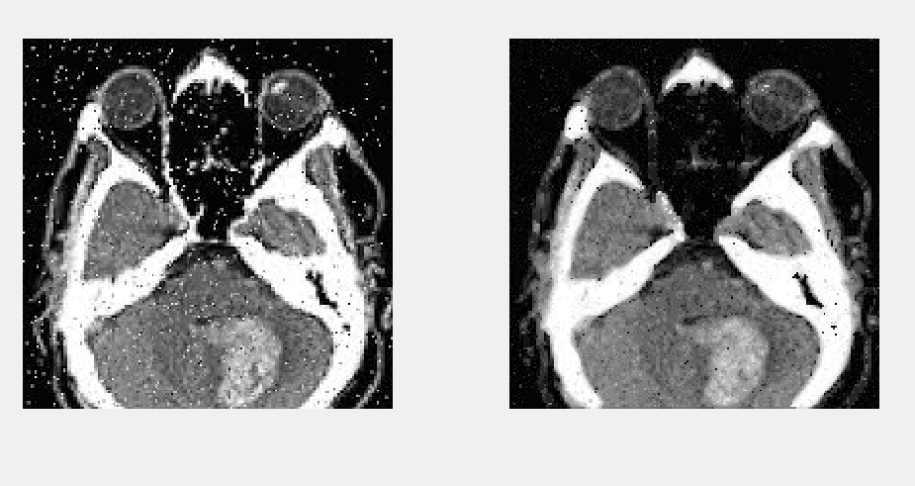
Results
Block Adaptive Results on Mri Images

Slide 7
Conclusion
Correlation between Original and Filtered image
Adaptive corr = 0.94
Block Based corr = 0.96
Block Based filter gives better results.

