Slide 1
Computer Organization II
Advanced rock-paper-scissors
Noah Stinson

Slide 2
Topic & Participants
Rock Paper Scissors – Advanced!
Features 11 different weapons to pick from
Each weapon is weak against 5 other weapons, and strong against 5 other weapons
Participants:
Noah Stinson

Slide 3
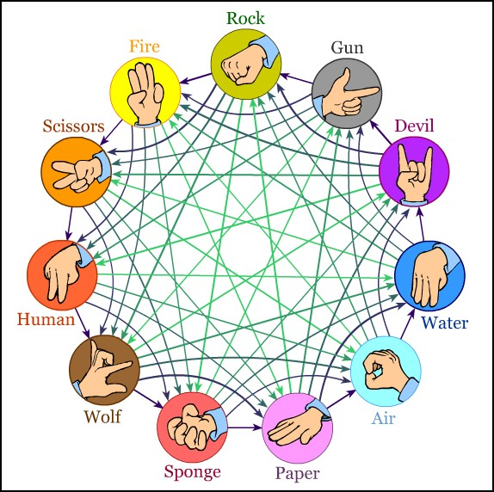
ROCK
PAPER
SCISSORS
FIRE
GUN
HUMAN
WATER
DEVIL
AIR
SPONGE
WOLF

Slide 4
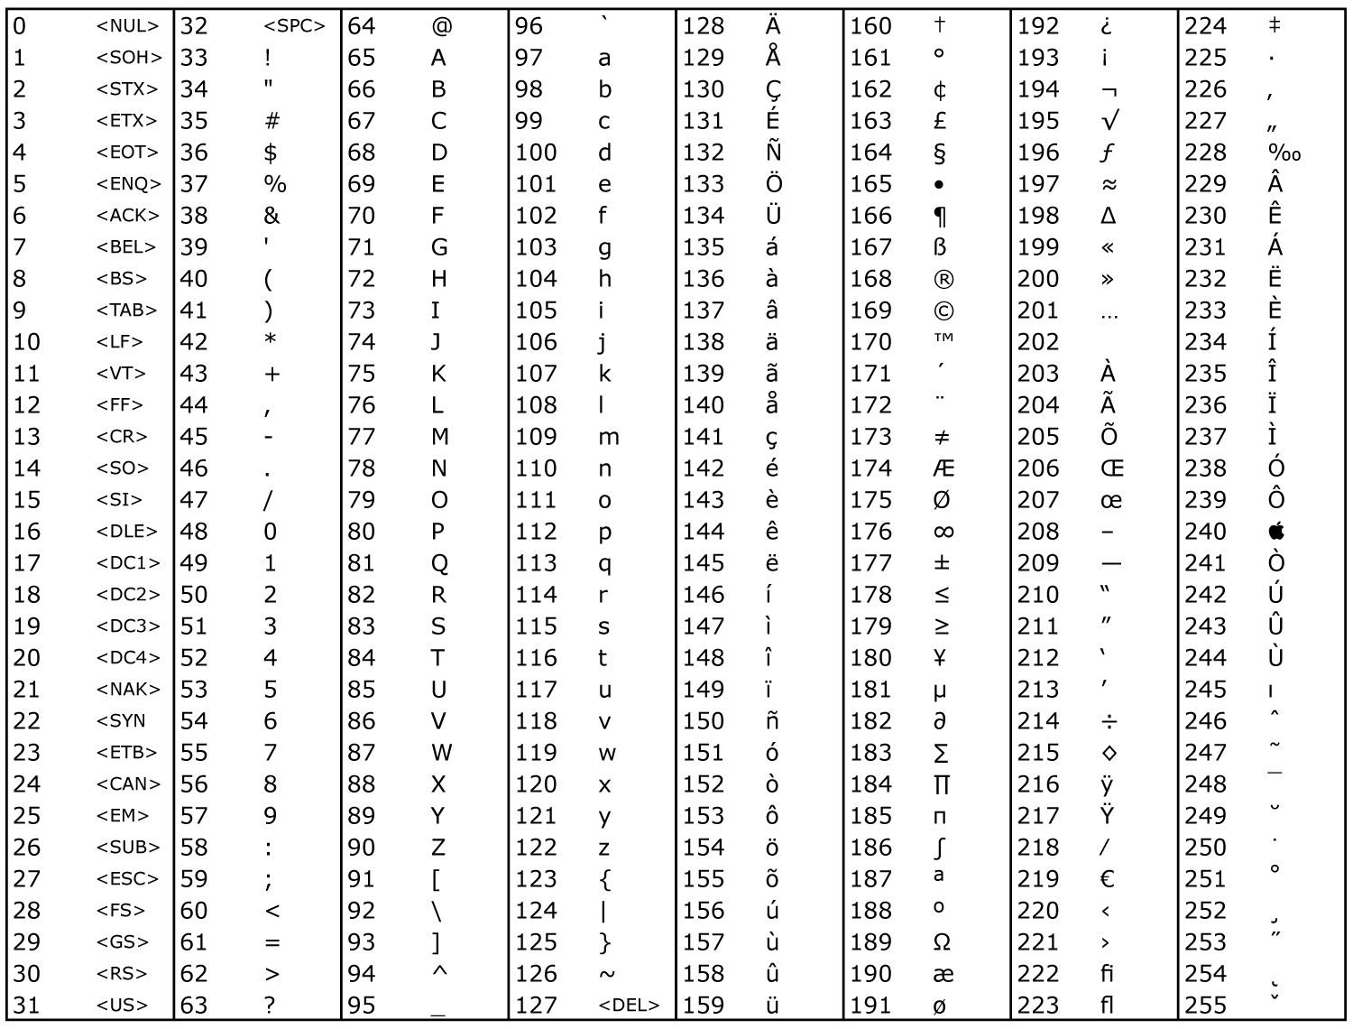
ACSII
Normal Text
Hello World!
ASCII
072 101 108 108 111 032 087 111 114 108 100 033
Normal Text
HELLO WORLD!
ASCII
072 069 076 076 079 032 087 079 082 076 068 033

Slide 5


C-Strings
char rock[] =
R
O
C
K
\0
// R
// o
// c
// k
// [null]
char rock[] =
082
111
099
107
000
Functions as a return value

Slide 6
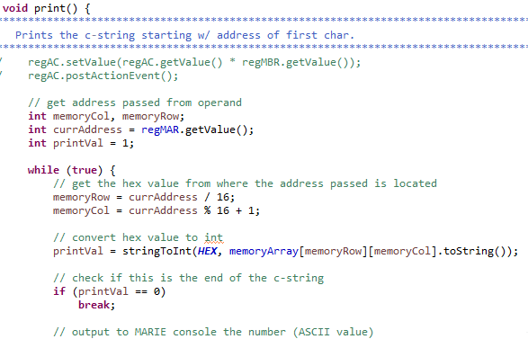
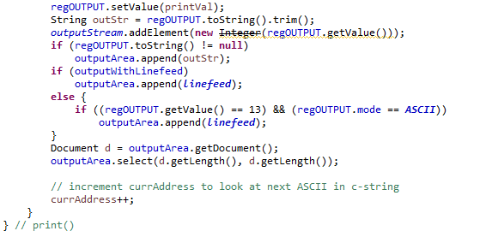
OPCODE F: print() – PRINT [OPERAND]

Slide 7
User Score
The program features repeated play until the players wish to stop. In addition to this, a score is being held that is displayed once the players are done.
The MARIE output window is meant to be used in ASCII mode. All numbers scores are displayed in the corresponding ASCII.
This would cause a score of 1 to be the “NULL” ASCII value.
To remedy this, we need to “shift” the score to it’s corresponding ASCII value.

Slide 8
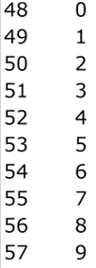

DECIMAL
ASCII
SCORE = 8
// Would not display the number “8” in the MARIE output. It would display the ASCII value corresponding to decimal 8
If we add the ASCII value “0”‘s corresponding DECIMAL value (48) to our score, it will shift it the ASCII value for “8”
SCORE = 8 + 48 = 56

Slide 9
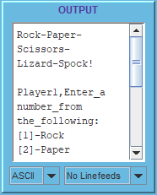
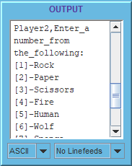
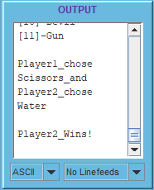
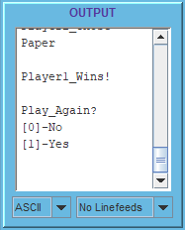
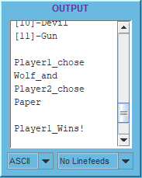
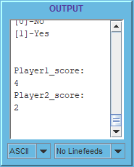
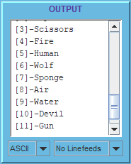
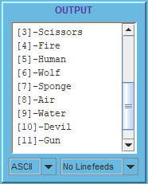
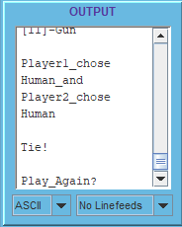
…

Slide 10
Conclusion
Assembly like language is tedious!
Very grateful for high level languages
Making the print function was incredibly useful.
Saved myself time, as well as likely improved execution performance

