Slide 1
Misadventures in Stone and JavaScript

Slide 2
Florida? More like FloriDON'T!

Slide 3
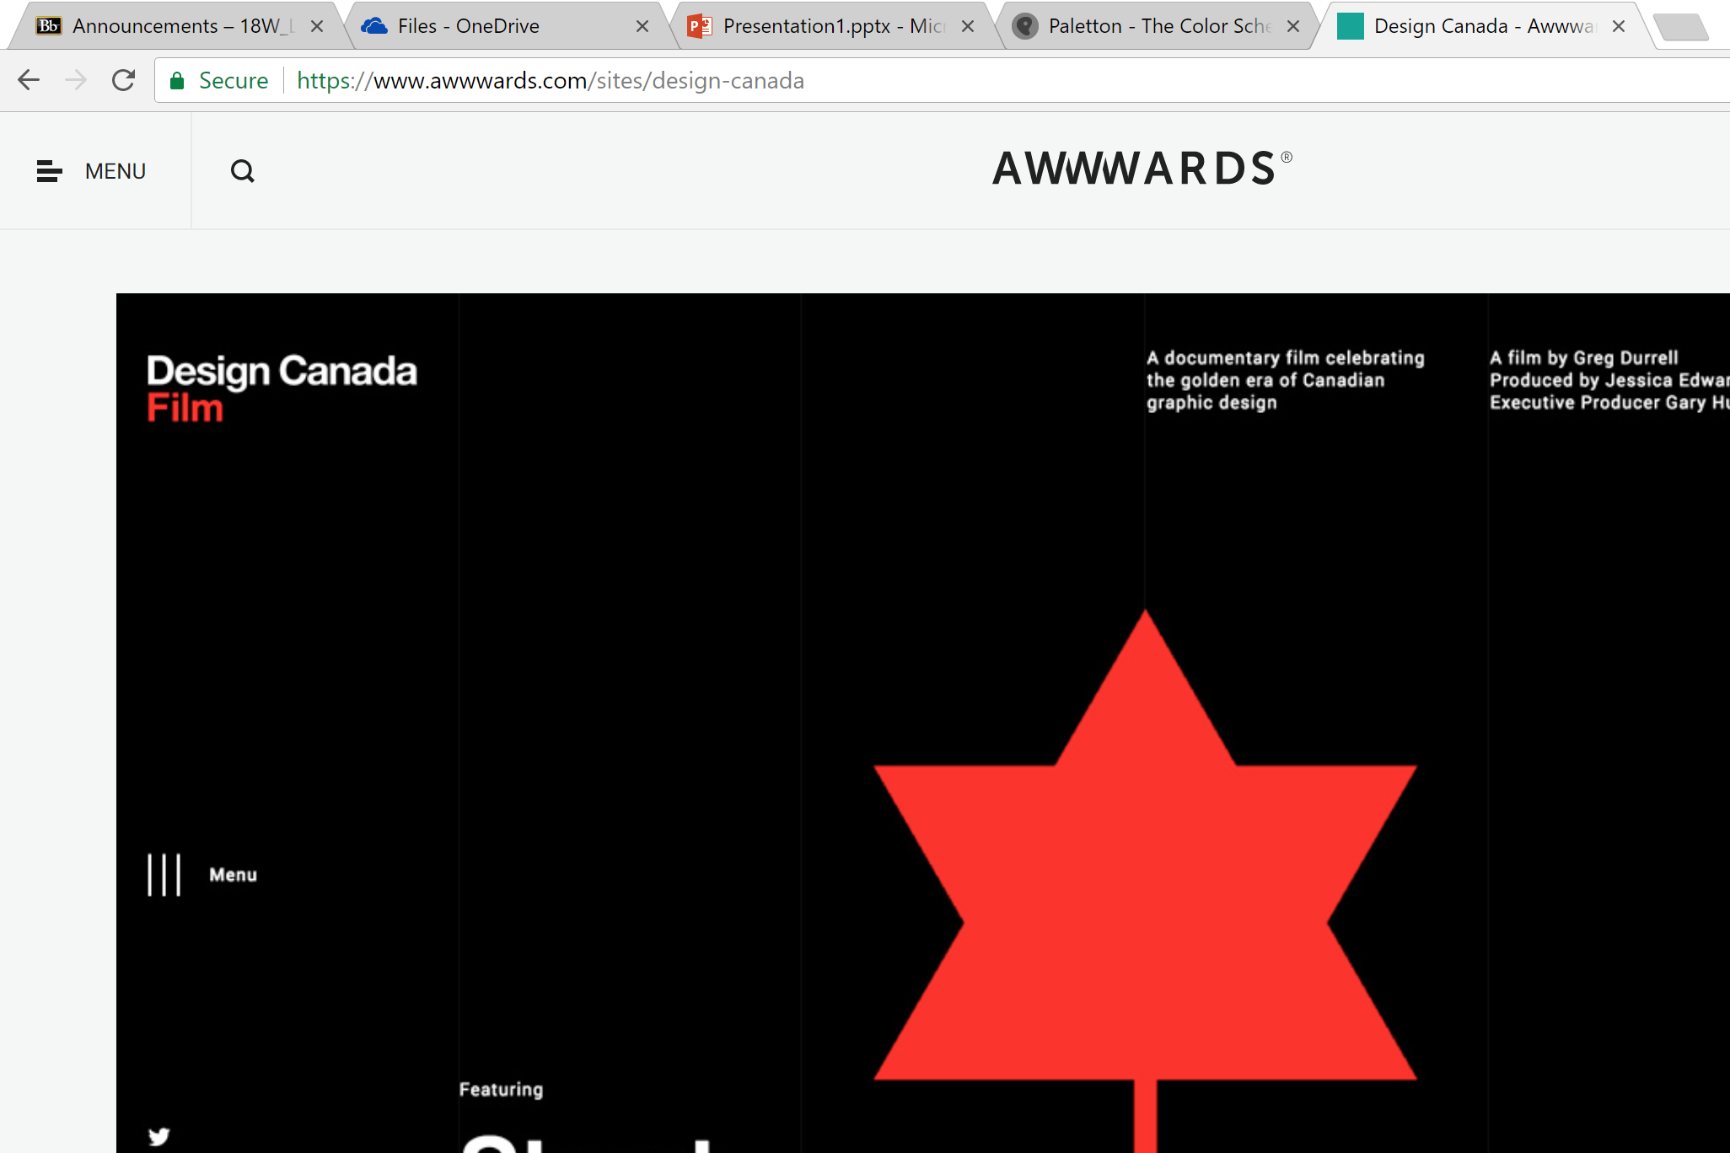

Slide 4
