Slide 1
Aim Of Our Project
1. To crawl the website of a foreign university.
2. To Collect the URL’s Containing the forms.
3. To Classify the forms into various categories.
4. Visit URL’s to fill the forms.
5. Extract info of indian professors.

Slide 2
TOPICS WE WILL COVER
1. Algorithms used for our project.
2. How are our forms classified ?
3. Fetcher() ?
4. Our DataBase.
5. GUI.
6. Naive Bayes Theorem

Slide 3
ALGORITHMS

Slide 4
BFS ALGORITHM
Seed URL
QUEUE
LinkN
.
.
.
.
.
.
Queue Is Empty
Queue Contains some links
.
.
IS LINK . .
.
TERMINATE
.
Link3
Link2
Link1
Already Crawled
A new Link
Collect all hyperlinks
in the new link

Slide 5
Simple Pattern searching Algorithm
Linear searching
Time Complexity is O(N*M)
where :
N = Length of text
M = Length of Pattern

Slide 6
For Faster Pattern searching we used:
Knuth Morris Pratt Algorithm
Time Complexity of KMP Algorithm is:
O(N + M)
where :
N = Length of text
M = Length of Pattern

Slide 7
How we classify forms ?
login_list = ['login', "LOGIN", "LOG IN", "Sign In", "SIGN IN", "SIGNIN", 'Log In']
signup_list = ['Already have an account','REGISTER','register','signup', "SIGN UP", . . . . . . . .]
search_keys = ['search','SEARCH','Search']

Slide 8
Fetching Content
def FETCHER(expression, key):
try:
pos = expression.find(key)
except:
return None
if pos == -1:
return None
pos += len(key)
while expression[pos] == ' ':
pos += 1
pos += 1
while expression[pos] == ' ':
pos += 1
id = ""
while pos < len(expression):
id += expression[pos]
pos += 1
if expression[pos] is '"' or expression[pos] is "'":
break
return id
“id=”
<form id = “gaia_login”
method = “get”
Onclick = “www.mail.google.com” >
<HTML ATTR>
</HTML ATTR>
.
.
.
.
</form>

Slide 9
Where Our Data Is Going ?
We Use 2 Types Of File Currently:
1. .txt File
2. .csv

Slide 10
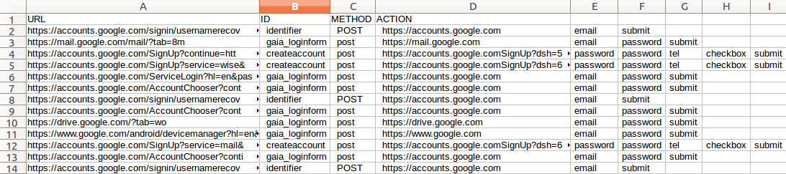
.CSV FILE FOR SIGNIN FORMS
ID
ONCLICK
Fill To Proceed
URL’s
Method

Slide 11
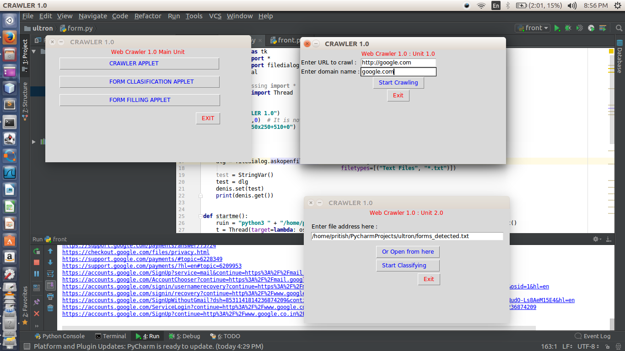
GUI

Slide 12
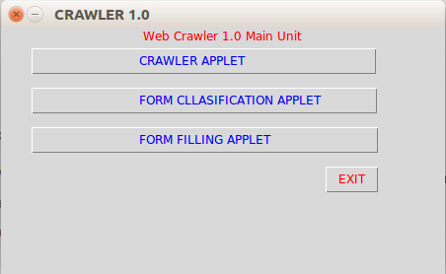
DESKTOP APP GUI : MAIN WINDOW

Slide 13
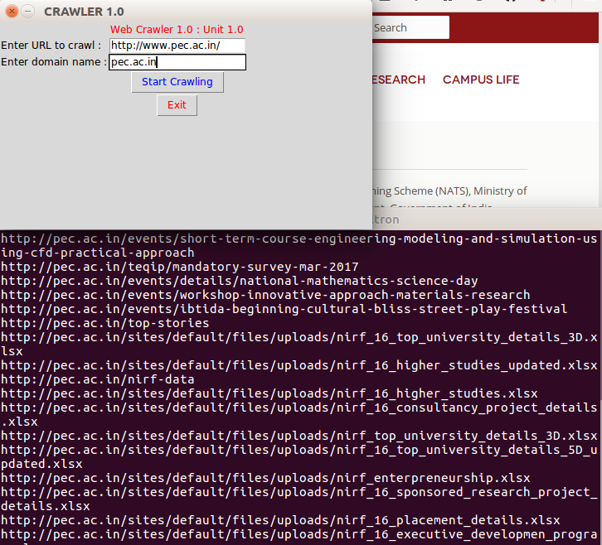
DESKTOP APP GUI : CRAWLING WINDOW

Slide 14
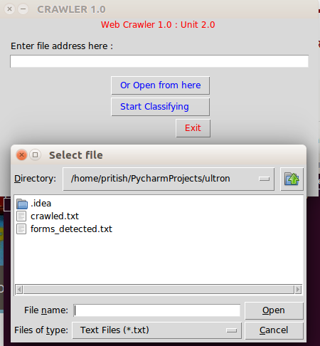
DESKTOP APP GUI : FORM DETECTION AND CLASSIFICATION WINDOW

