Slide 1

TANZANIA WILDLIFE MANAGEMENT AUTHORITY
MODULE;WEAPON TRAINING (WT)
LIKUYU SEKAMAGANGA
PREPARED BY;
1. C I SD GWIMO
2. C II EL NKWAMA
3. C II MS NDEGE
4. CR III DANIEL MD

Slide 2
Introduction
Weapon safety
Safety rules
Procedure and commands to shoot
Safety precaution when handling a weapon
Weapon cleaning
Weapon familiarity
Parts of a weapon
Stages of preparedness
Application shooting
Principle of application shooting

Slide 3
A WEAPON (Rifle/gun)
Weapon is a thing designed or used for inflicting bodily harm or physical damages. It is an important tool in the whole set of wildlife protection
The most used tool in fighting poaching in almost all protected area.
Various types
  Rifles (404, 458, 375,30-06, etc.)
  Assault weapons (SAR, AK 47, MG, LMG, FN, G3 etc.)
  Hand gun
It is very useful for self defense
It is very harmful/dangerous if not properly handled. (It killed his master)

Slide 4
Firearms safety rules/Commandments of handling firearms
Treat every weapon as if it is loaded.
2. Never point your weapon at anything you are not willing to destroy.
3. Keep your finger off the trigger and your weapon on safe until your sights are on the target.
4. Be sure (identify) of your target and its surroundings.
5. . Never handle a weapon under the influence of alcohol or drugs.
6. Never leave a weapon unattended. Make sure weapons are secure at all times, especially in public areas. During operations, have your weapon with you at all times.

Slide 5
Firearms safety rules cont…..
6. Never leave a weapon unattended. Make sure weapons are secure at all times, especially in public areas. During operations, have your weapon with you at all times.
7. Unload firearms when not in use. Never take a loaded weapon into a house, vehicle, armory etc
8. Never load a firearm until you are ready to shoot.
9. ALWAYS clear a weapon pointing at a safe direction. E.g. up at the sky and away from people, buildings etc
10. Store firearms and ammunitions separately and safely

Slide 6
TYPES OF FIREARMS(SMALL ARMS)
Firearms can be divided into three categories;
Rifles
Handgun (pistol)
Shotgun

Slide 7
1. Rifles
A rifle is a firearm with a rifled bore designed to be fired from the shoulder.
Riflings are shallow grooves cut inside barrel surface, which impart spin to the bullet ensuring a steadier and more accurate bullet flight (That is, it causes the projectile to fly straighter).
CLASSIFICATION OF RIFLES ACCORDING TO USE
There are two types
Civilian/Hunting riffles
Military rifles/weapons

Slide 8
Hunting rifles-these are firearms used in hunting and Self Defence. Examples of hunting rifles include:-
Eg; .300, .30-o6, .308, .303, .375, & .378, .600

Slide 9
Military rifles
Military rifles/weapons are rifles which are used by the armies.
Examples
Assault rifles. (AK 47)
Semi-automatic rifles (SKS)

Slide 10
Assault rifles
Assault rifle is a rifle that has the capacity to switch between semiautomatic and fully automatic fire ( selective fire). They are also called selective fire rifles.
Assault rifles are currently the standard service rifles in most modern armies. Examples of assault rifles include the AK-47,G3,M16 rifle etc.
Characteristics
It must be an individual weapon.
It must be capable of selective fire.
Its ammunition must be supplied from a detachable box magazine.
it should have an effective range of at least 300 meters

Slide 11
Firearms parts and accessories- (AK 47)
Modern firearms consist of three basic parts, namely;
Barrel
Action
Stock/Frame

Slide 12
Parts of firearm cont..
Barrel- this is a metal tube through which the projectile (bullet or shot) travels.
The barrel may be rifled or smooth bore
Some guns may have more than one barrel.

Slide 13
The barrel cont….
The barrel consists of the following parts:-
Bore-the inside of the barrel through which the projectile travels when fired. Bore can either be smooth or
Muzzle(front)-the opening at the end of the barrel where the projectile (bullet or shot) exits the firearm.
Breech (rear)-this is the rear end of the barrel, where the cartridge is inserted.
Chamber-the portion at the breech end of the barrel that holds the cartridges or Shotshell ready for firing
Sights –are firearm devices either mechanical or optical on top of a barrel that help the shooter to aim accurately.

Slide 14
SIGHTS
TYPES OF SIGHTS
Firearms’ Sights are categorized into two major types:-
Iron sights-these are sights which are made up of alloy.
Types of iron sights include the following:-
Open sights
Aperture sights (also called peep sights)
Bead sights
2. Optical sights. These include:-
Telescopic sights
Electronic dot sights

Slide 15
Parts of firearms cont..
2. Stock- A frame that holds the barrel and action and allows the gun to be held firmly when firing.
Stocks are made of wood, rubber or plastics and other synthetic materials.
Note: The stock for handgun is called a GRIP. Grip is the portion of a handgun that’s used to hold the firearm

Slide 16
Parts of firearms cont..
The stock of a riffle or shotgun consists of the following parts:-
Butt (butt plate)-the rear end of a riffle or shotgun- that rests against your shoulder when shooting.
Butt stock-the part of the stock which extends from the receiver to the butt.
Fore-end/fore-stock/forearm
Comb-the upper edge of a riffle or shotgun where the holder’s cheek rests

Slide 17
Parts of firearms cont..
3. Action- this is the part of a firearm that loads, fires, extracts and ejects cartridges or shells.
The action comprises of the following parts:-
Trigger guard
Trigger
Frame
Hammer
Firing pin
Sear spring
Bolt carrier group (bolt assembly)

Slide 18
Bolt carrier group parts
7. Bolt carrier group (bolt assembly)- this part comprises of the following parts:-
Bolt (bolt are extractor and firing pin are found in/on the bolt).
Bolt carrier
Charging handle (corking handle)/Bolt handle
The major functions of Bolt carrier group are as follows:-
Chambering a round
Firing - The sear releases the hammer, which strikes the firing pin (located within the bolt carrier group). This fires the cartridge.
Extraction - The bolt, upon unlocking, pulls the cartridge from the chamber.

Slide 19
Parts of firearms cont..
8. Magazine- Is a device or container that holds ammunition (cartridges) before it is loaded into the chamber.
There are two types of magazines:-
Fixed magazine
Detachable magazines
9. Safety –a mechanical device that blocks the trigger or hammer to from accidental firing
When the safety is "on," the gun cannot fire
When the safety is "off," the gun is ready to fire

Slide 20
Parts of firearms cont..
10. RSM (Recoil Spring Mechanism)
11. Piston & piston tube
12. Receiver cover
13. Ejector

Slide 21
SAFETY RULES.........
RIFLE RANGE SAFETY PROCEDURE
NEVER load a weapon on the range until commanded to do so.
NEVER come onto the range or leave firing area with a magazine on your rifle.
The working parts must ALWAYS be back breech (rifle).
Rifle muzzle must ALWAYS be pointed up at the sky;

Slide 22
SAFETY RULES
WAIT for a command to call you to the firing line;
WAIT for a command to tell you to load and cock your weapon;
WAIT for instructions and command to shoot;
IMMEDIATELY clear your weapon and make it SAFE once you have finished firing;

Slide 23
SAFETY RULES..............
WAIT for instructor to check your weapon;
WAIT for the command to leave the firing line;
NEVER fire your weapon on automatic.
If you hear the command cease fire , air horn or whistle; freeze, place your trigger finger straight along the frame, place your weapon on safe and wait for further command

Slide 24
PROCEDURE AND COMMAND TO SHOOT
Command Procedure
Rounds load. Load-rounds into magazine
Magazine load. Load magazine onto weapon.
Cock ready Cock weapon.
Safety catch on; Put safety catch on safe.
Xx Round at your target in your own time; fire !
Listen to instruction on how and where to shoot, Look at your targets, move safe to semi-automatic, complete the exercise

Slide 25
Safety precaution when handling a weapon
Identify safe direction
Safety catch ‘On’ check
Remove magazine
Safety catch ‘off’
Cock release (cock again ) 3 times
Inspect the chamber
Feel at night with small finger
Release springs
Squeeze trigger
Safety catch ‘On’
Declare weapon clear

Slide 26
TOPIC: WEAPON CLEANING
The maintenance and care of weapons
Ensure the up keeping of weapons
Materials Required:
  Weapons, cleaning equipments, rifle oil, Ground sheet (large tarpaulin (3m²))

Slide 27
WEAPON CLEANING
SKILLS
To know how and when to clean weapons and magazines
Explains circumstances which dictate when a weapon must be cleaned:
  Before use
  After firing
  Regular cleaning
  increased frequency during wet conditions

Slide 28
WEAPON FAMILIARITY
stripping and assembling processes
OBJECTIVE:
To promote competent weapon handling
To promote weapon familiarization
MATERIALS REQUIRED:
  Weapons, one large tarpaulin (3m²)

Slide 29
WEAPON FAMILIARITY.............
Ability to strip and assemble any of the issue service weapons
Demonstrates striping and assembling of different weapons
Trainees practice striping and assembling exercises
Striping and assembling of weapons blind folded
Trainees reinforce striping and assembling skills by developing tactile ability in this exercise

Slide 30
PARTS OF WEAPON
Three major parts of a weapon
Butt stock
Body
Barrel
Accessories of the gun/AK47,SMG, RIFLE
Receiver cover
Return spring mechanism
Firing pin
Trigger guard
Harmer
Fore and rear sight

Slide 31
Piston and piston tube/housing
Sling and sling swivel
Cleaning rod
Sliding ruler
Cleaning accessories
Barrel
Muzzle cap
Extractor
Corking handle magazine
PARTS OF WEAPONS/Accessories of the AK47,SMG,RIFLE cont…

Slide 32
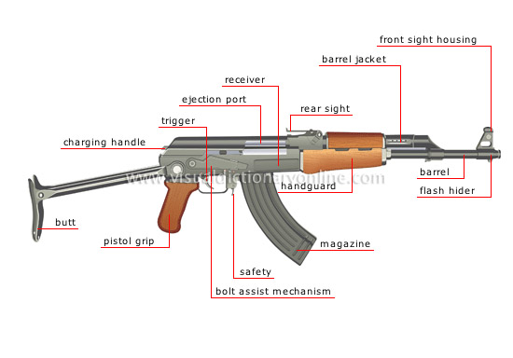
PARTS OF WEAPONS/Accessories of the AK47,SMG,RIFLE cont…

Slide 33
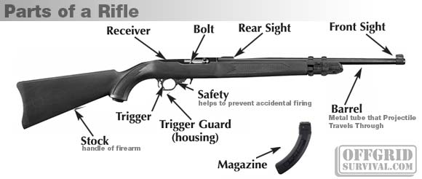
Parts of weapons

Slide 34
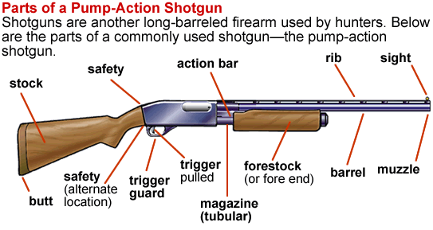
Parts of weapon

Slide 35
STAGES OF PREPAREDNESS
STAGE- 0
No mag on the riffle
No rounds in the chamber
Breach closed
Safety catch On
Fire arm in a safe
USEFULL IN TRAINING

Slide 36
STAGES OF PREPAREDNESS....
STAGE -1
Empty mag on the rifle
No rounds in the chamber
Breach closed
Safety catch on
USEFUL ON TRAINING OR WHEN SO ORDERED

Slide 37
STAGES OF PREAREDNESS...
STAGE II
Full mag on the firearm
No round in chamber
Breach closed
Safety catch on
USEFULL IN NON OPERSTION AREAS/NO DANGER/WHEN SO ORDERED and in guides and sentries

Slide 38
STAGES OF PREPAREDNESS
STAGE III
Full magazine on weapon.
Rounds in the chamber
Safety catch on
USEFUL IN AREA WITH POSIBLE THREATS OR WHEN SO ORDERD

Slide 39
STAGES OF PREPAREDNESS
STAGE IV
Full mag on the firearm
Rounds on the chamber
Safety catch off
USEFUL IN EMMINENT DANGER/AMBUSH and contact situation
STAGE V
Full mag on the firearm
Round in the chamber
Safety catch on ‘A’-L’ (rapid)
USEFUL IN AMBUSH

Slide 40
APPLICATION SHOOTING
Objective:
To teach the correct principles of alignment of sights and targets.
Techniques for aiming a weapon in application shooting and judging distances
Techniques for holding and aiming a weapon in various positions.
Breathing rhythm, breath holding during squeeze trigger, and follow through after pull

Slide 41
APPLICATION SHOOTING
Use of sight eye disk to reinforce alignment of sight as a skill
Weapon cleared, cocked and fired at sight disk
Students work in pairs while instructor checks every individual

Slide 42
LIVE APPLICATION SHOOTING
OBJECTIVE:
To put into practice with live shooting the application shooting methods
Accurate shooting at fixed target
Students shoot in groups of six in an extended line
Instructor imposes rigorous control and uses explicit commands
Introduction of lying, kneeling and standing positions. Students in extended line
Instructor controls range procedures

Slide 43
Principles of Application Shooting
Body position
Alignments
Control breathing
Squeeze the trigger
Follow through

Slide 44
Alexander Kalashnkov operation –AK47
(ANIMATION)

Slide 45
MWISHO
Asante kwa usikivu

