Slide 1
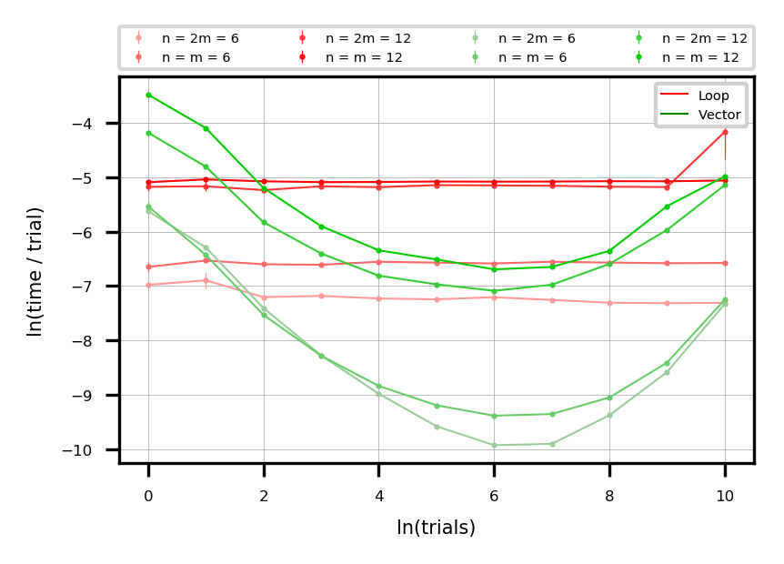
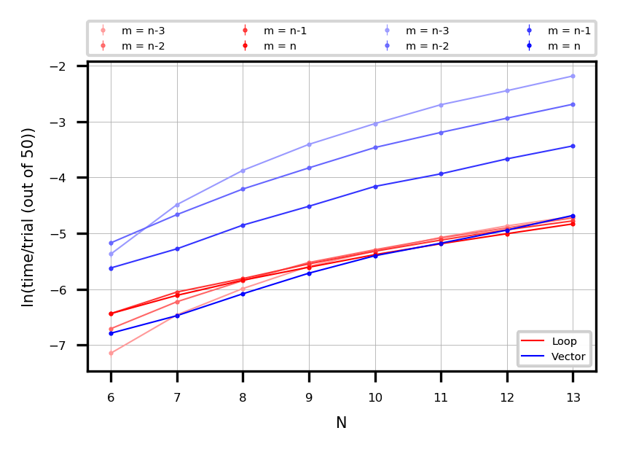
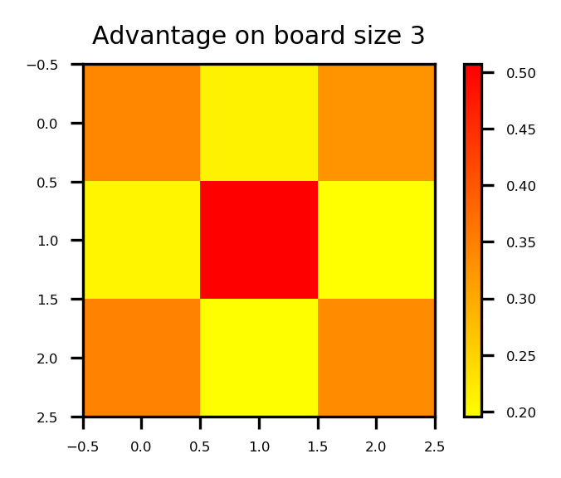
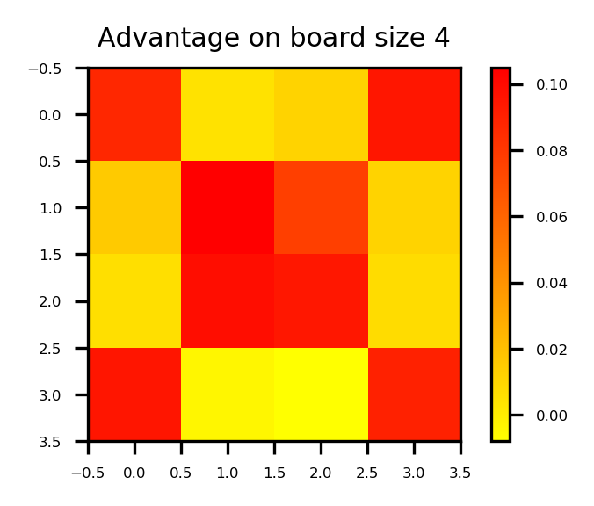
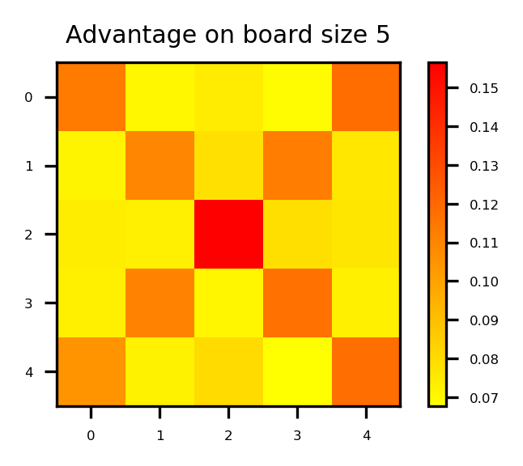
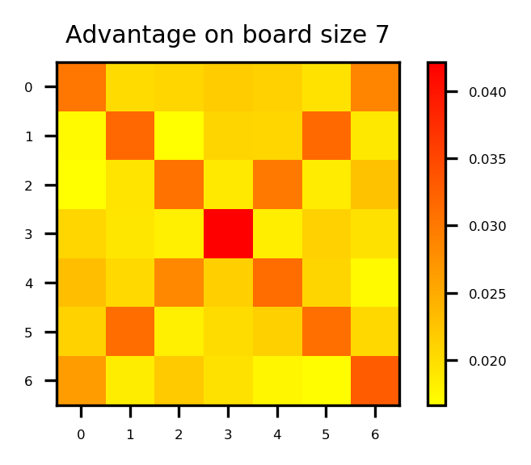
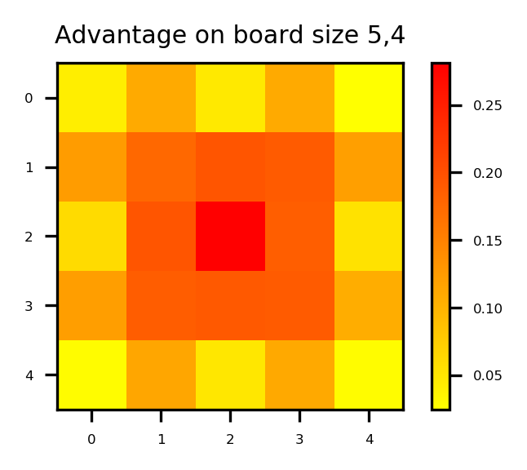
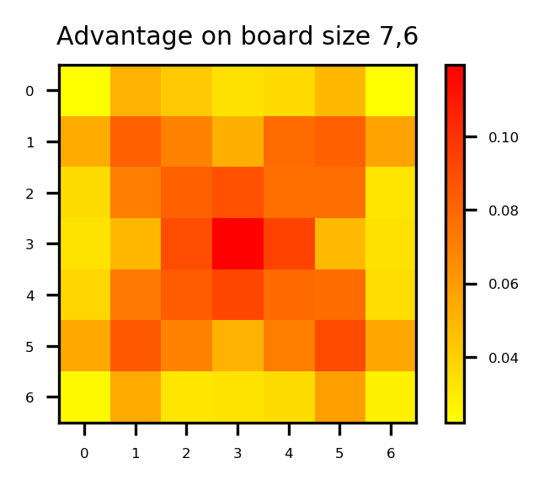
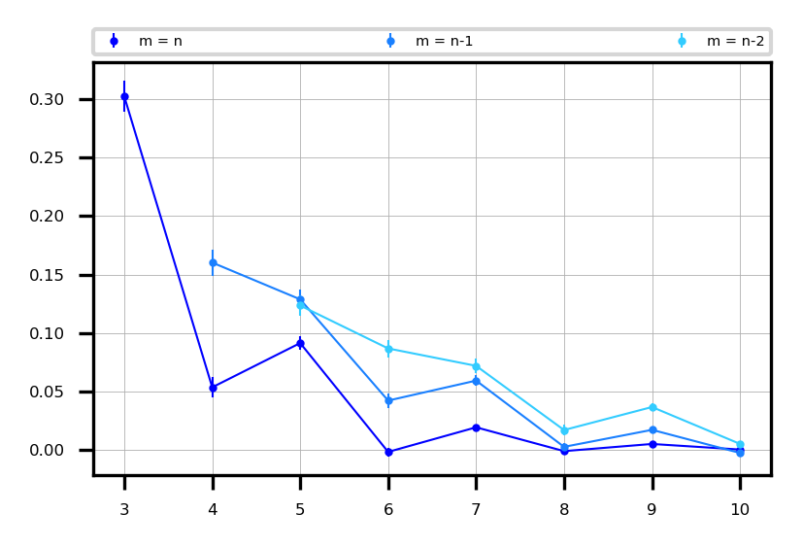
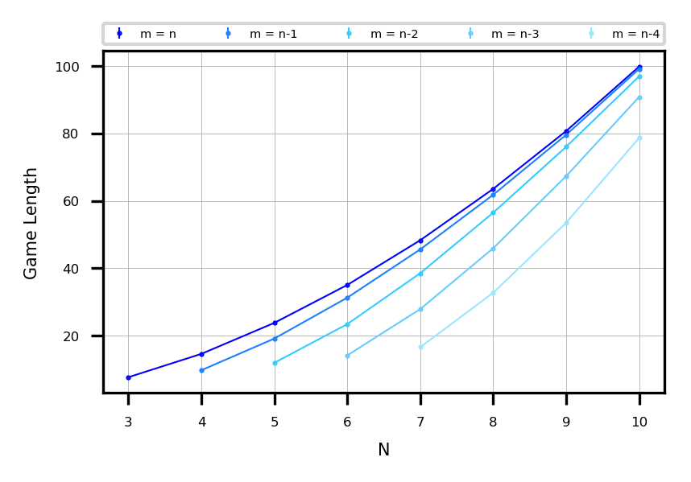
Monte Carlo Noughts & Crosses

Slide 2
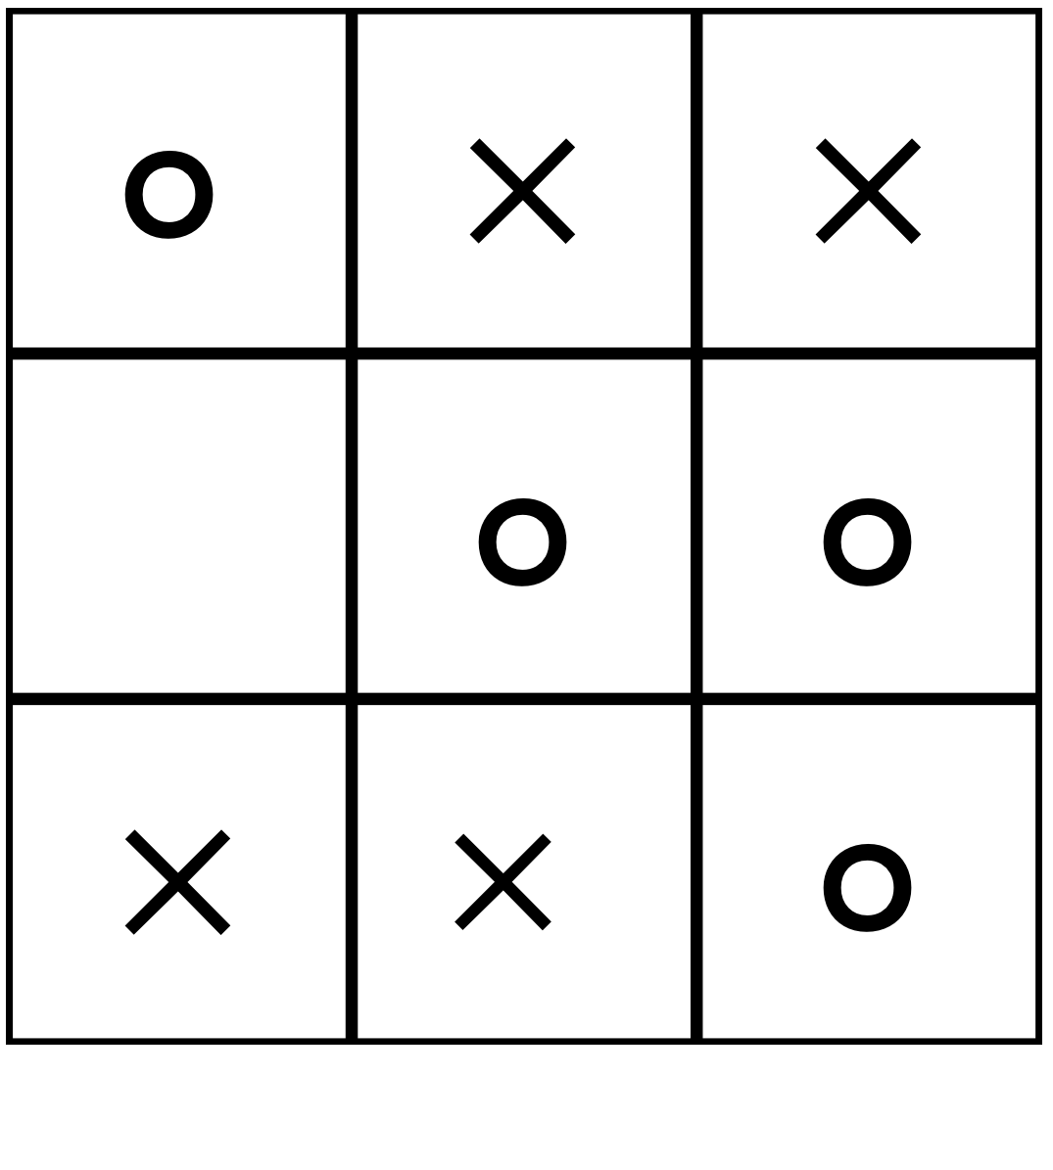
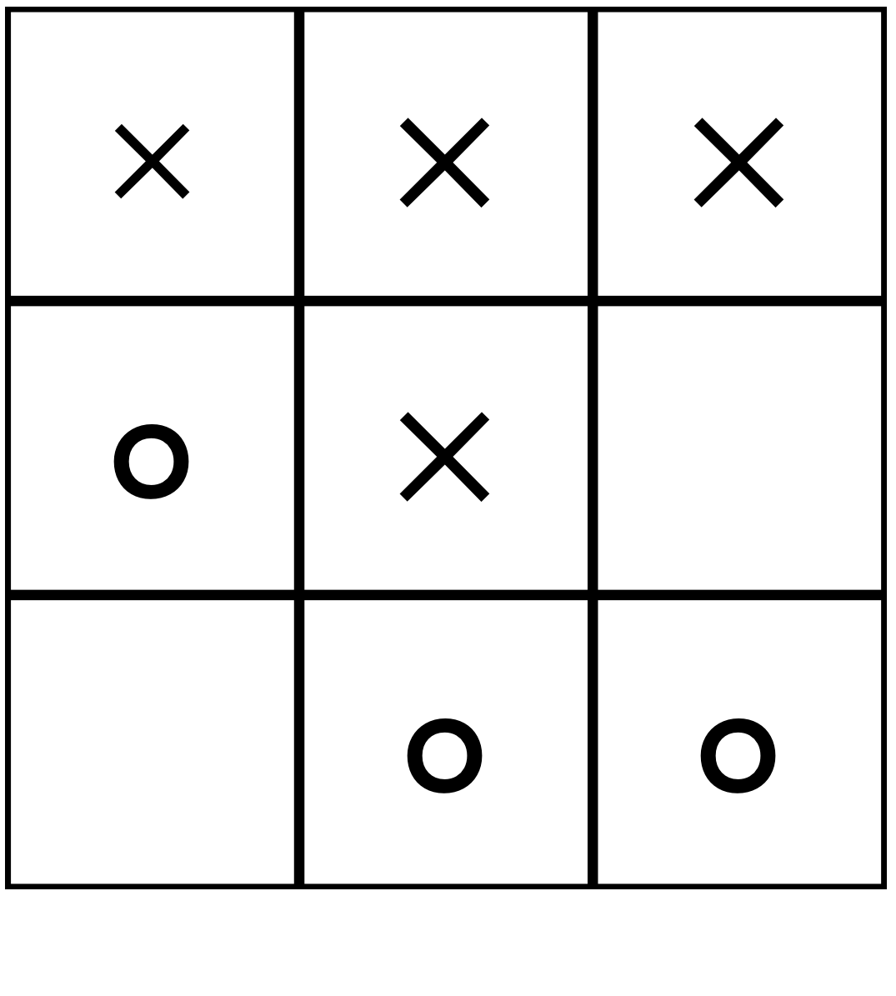
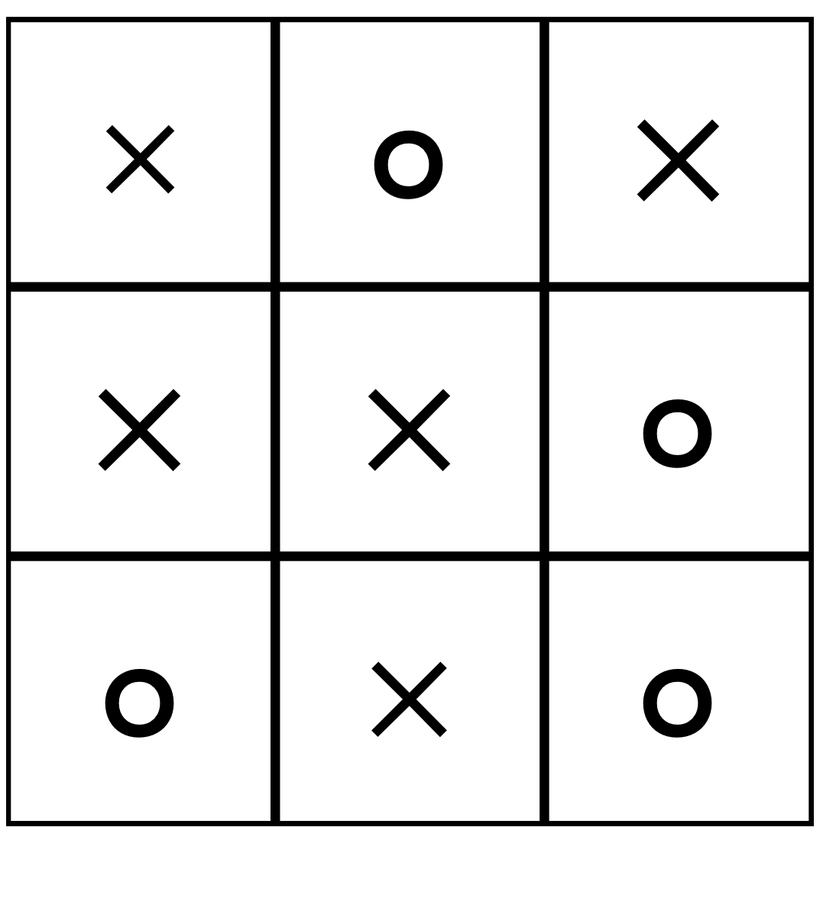
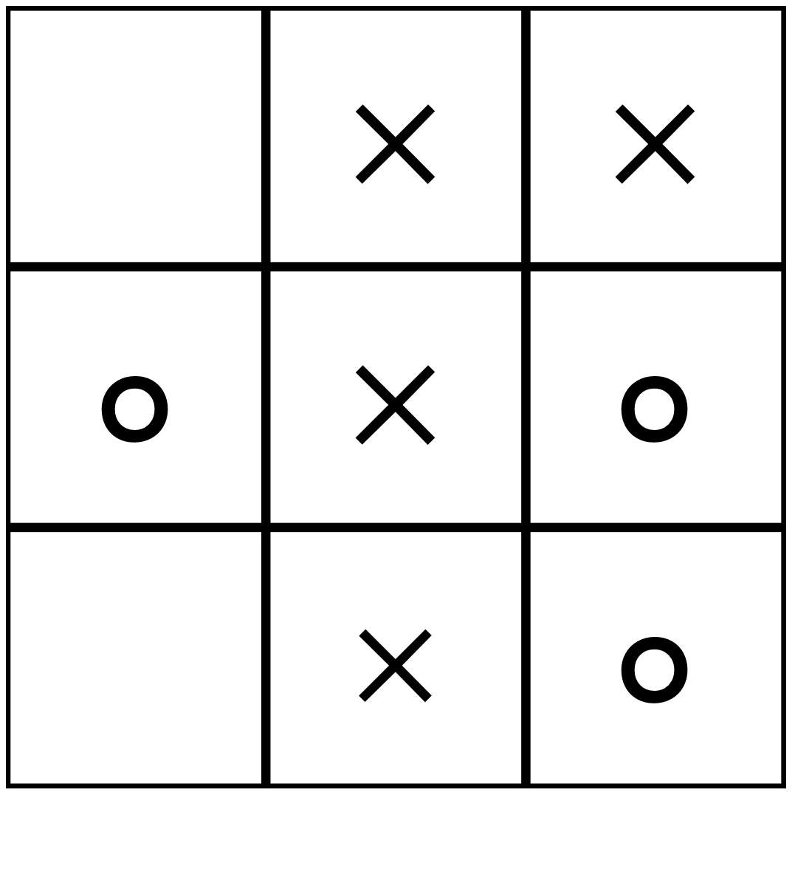
$$×$$ | $$×$$ | $$×$$
$$∘$$ | $$×$$
 | $$∘$$ | $$∘$$
 | $$×$$ | $$×$$
$$∘$$ | $$×$$ | $$∘$$
 | $$×$$ | $$∘$$
$$∘$$ | $$×$$ | $$×$$
 | $$∘$$ | $$∘$$
$$×$$ | $$×$$ | $$∘$$
$$×$$ | $$∘$$ | $$×$$
$$×$$ | $$×$$ | $$∘$$
$$∘$$ | $$×$$ | $$∘$$

Slide 3
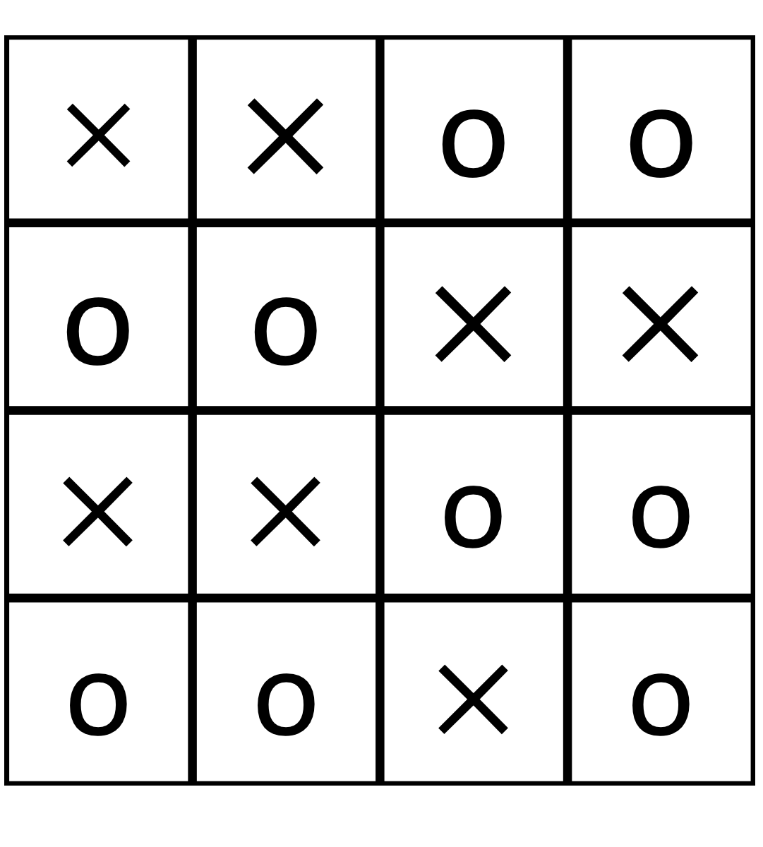
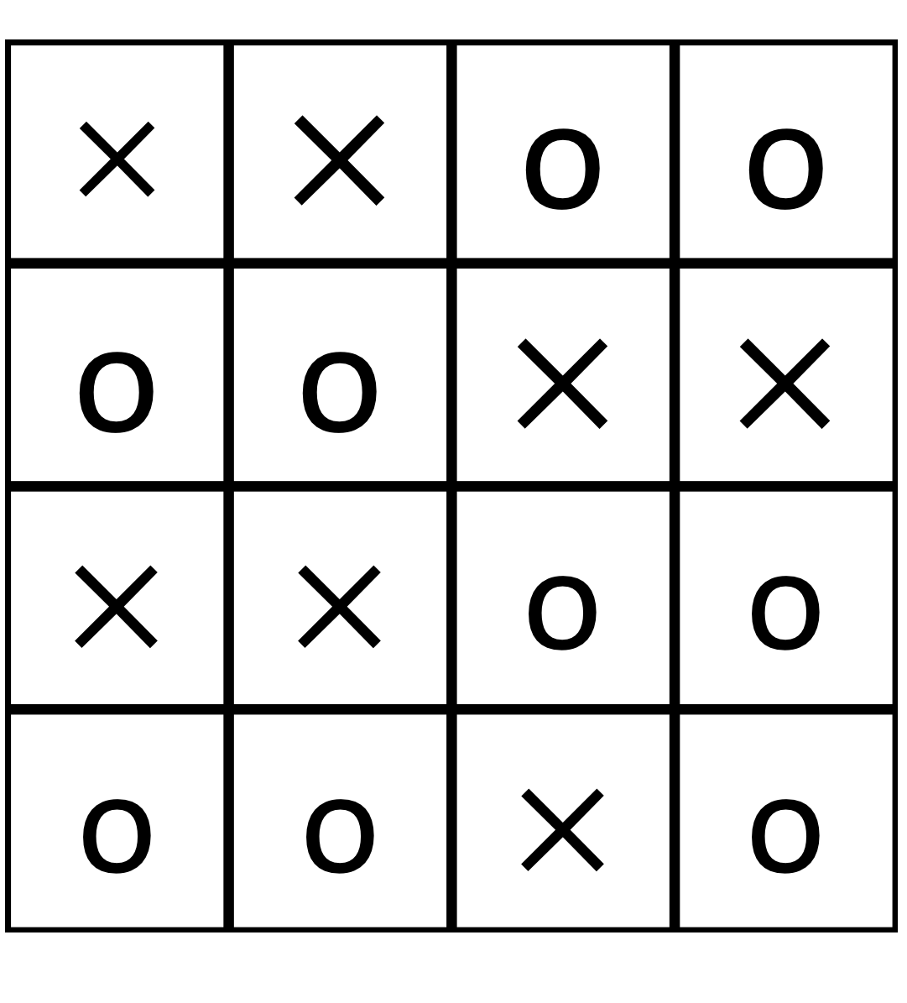
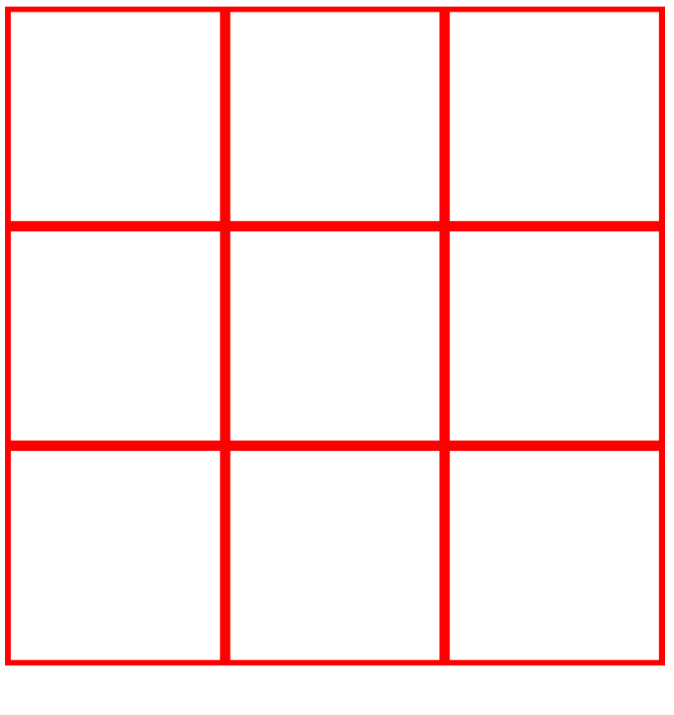
$$×$$ | $$×$$ | o | o
o | o | $$×$$ | $$×$$
$$×$$ | $$×$$ | o | o
o | o | $$×$$ | o
$$×$$ | $$×$$ | o | o
o | o | $$×$$ | $$×$$
$$×$$ | $$×$$ | o | o
o | o | $$×$$ | o
$$×$$ | $$×$$ | o | o
o | o | $$×$$ | $$×$$
$$×$$ | $$×$$ | o | o
o | o | $$×$$ | o
$$×$$ | $$×$$ | o | o
o | o | $$×$$ | $$×$$
$$×$$ | $$×$$ | o | o
o | o | $$×$$ | o

