Slide 1

SORTED!
School of Computer Science and Engineering
Department of Computer Science and Engineering
Submitted By: Shreyansh Rajput
2427030067
Supervised By: Dr Ridhi Arora

Slide 2
Outline
Introduction
Literature Review
Problem Statement
Proposed Solution
Objectives
Upgrades

Slide 3
Introduction
Sorting algorithms form an essential part of Data Structures & Algorithms. However, students often find it difficult to understand the internal working of algorithms using only code or theoretical explanation. To address this challenge, this project introduces a Python + Pygame based Sorting Algorithm Visualizer that displays sorting operations through animated bars.
This project also includes a gamified learning mode called “Guess the Algorithm,” where the system runs an algorithm animation and the user must identify which sorting algorithm it is. This interactive approach improves conceptual clarity, visual pattern recognition, and engagement.

Slide 4
Literature Review
VisuAlgo (2013, NTU Singapore): Excellent visualization platform Lacks gamification
CS50 Sorting Visualizer: Good for teaching fundamentals but no interactive learning or guess-based features
Algorithm Visualizer (Open Source): Supports many algorithms but Does not evaluate user understanding

Slide 5
4. IEEE Paper on Gamification in Computer Science Education (2020), Gamification improves retention by 28–40% also enhances student engagement
5. ACM Study on Visual Learning (2019) Visual tools increase comprehension significantly but Notes lack of interactive algorithm explorers

Slide 6
Problem Statement
“Students struggle to intuitively understand sorting algorithms using traditional static or non-interactive methods.”

Slide 7
Proposed Solution
A Pygame based desktop application that: Animates six sorting algorithms Shows comparisons, swaps, pivots, merges, etc. Includes color-coded visualization Provides a “Guess-the-Algorithm” game with scoring Runs completely offline

Slide 8
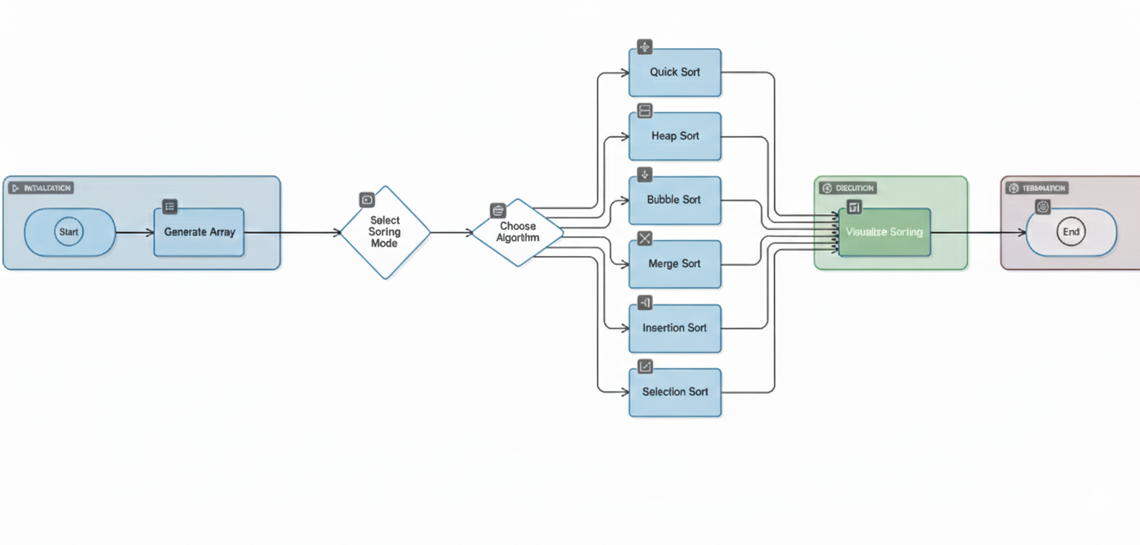
Flow Chart:

Slide 9
Objectives
To visually demonstrate sorting algorithms using animated bars
To enhance intuitive understanding through real-time operations
To introduce gamified learning to test algorithm recognition
To build a Python desktop tool that supports offline learning
To support multiple algorithms: Bubble, Selection, Insertion, Merge, Quick, Heap

Slide 10
Advancements & Enhancements
Modern dark-themed UI with interactive buttons
Added Pause/Resume and real-time speed control
Implemented non-blocking (generator-based) sorting
Supports 6 algorithms (Bubble, Selection, Insertion, Merge, Quick, Heap)
Displays numbers, colors, and live status (Running/Paused)
Improved smoothness and user experience

Slide 11
References
VisuAlgo – Nanyang Technological University
CS50 Visual Sorting
Algorithm Visualizer (Open Source)
IEEE Gamification in Education (2020)
ACM Visual Learning Study (2019)
Pygame Documentation

Slide 12
Thank You

