Slide 1
Python architecture for learning decisions
Group 8 · PySteps · Connecting mistakes to the next learning activity.
Layer | Technical responsibility
LearningEngine | Grading, courses, ranking, review
HTTP + SQLite | JSON endpoints, sessions, revision writes
Diagnosis + Agent | Validated model output and tool loop
Browser Worker | AST validation and task execution
Group 8 · 0:00–0:35
1 / 5
Notes:
0:00–0:35
Introduce the purpose in one sentence, then focus on architecture. Python owns learning decisions and persistence; React handles interaction; Pyodide runs student code in a browser Worker. Name the module boundaries. Lecture03: functions, classes and modularity.
Sources: current project backend/domain.py, agent.py, ai.py, storage.py, server.py; web/src/App.tsx and AssistantWidget.tsx; data/*.json; tests/*.py; local regression dated 29 October 2026; supplied INT6181 Project Requirements v2 section 3.4 and Lecture03–06. Screenshots are current application interfaces, not fabricated live outcomes.

Slide 2
Learning rules as testable Python functions
Lecture03: collections and sorting · Lecture06: explicit expected behaviour
Assessment and progression
Fixed keys; reading + two unhinted course answers.
Ranking
Target unseen → due → other unseen → seen; exclude current item.
Review
Wrong: +10 min; due success: 1/3/7/14/30 days.
Group 8 · 0:35–1:35
2 / 5
Notes:
0:35–1:35
Use boundary_1 to illustrate deterministic grading: 5 > 5 is False. Explain how dictionaries store questions, sets express prerequisites and passed concepts, and a tuple key ranks candidates. A wrong answer schedules ten minutes; independent due-time success advances stage. Connect each rule to a named LearningTests test. This is technical explanation, not a long product tour.
Sources: current project backend/domain.py, agent.py, ai.py, storage.py, server.py; web/src/App.tsx and AssistantWidget.tsx; data/*.json; tests/*.py; local regression dated 29 October 2026; supplied INT6181 Project Requirements v2 section 3.4 and Lecture03–06. Screenshots are current application interfaces, not fabricated live outcomes.

Slide 3
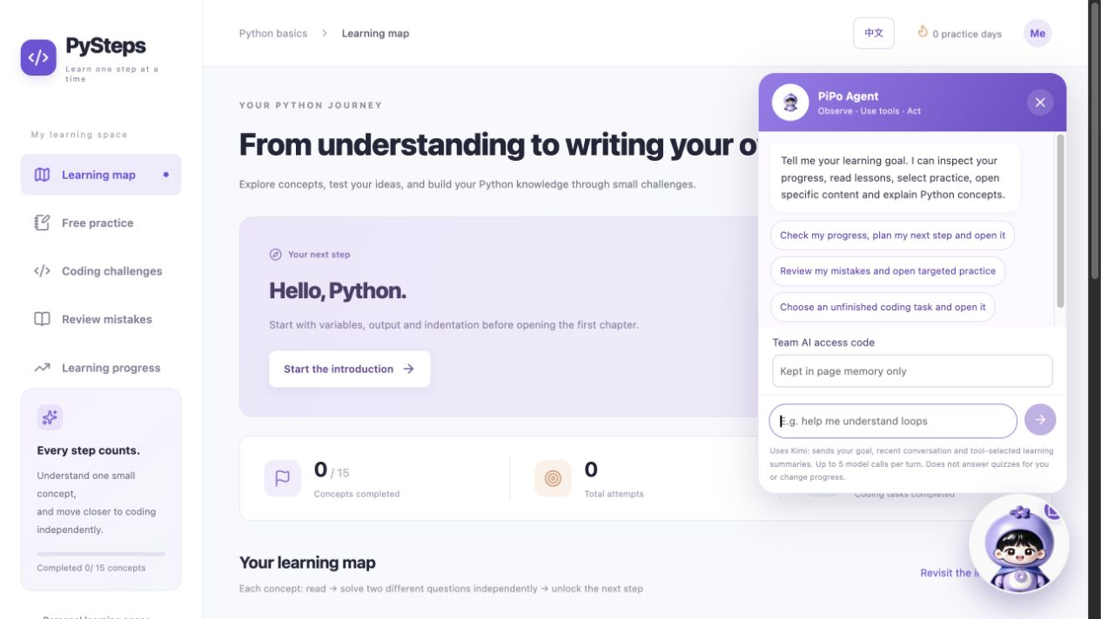
PiPo model/tool/observation loop
Lecture05: model + harness and repeated tool use
Model decision
Select progress, lesson, recommend, coding or open_content.
Python execution
Validate arguments, inspect content and return an observation.
Next decision
Continue the loop, then return one validated opening.
Group 8 · 1:35–2:40
3 / 5
Notes:
1:35–2:40
Explain one concrete goal: “Review my mistake and open related practice.” The model receives tools, selects one, sees Python’s observation and chooses its next step. Highlight that this differs from keyword routing. Python rejects unknown tools, uninspected IDs and locked lessons. State the per-turn limits: up to five model requests, eight tool executions and one opening. Refer to the multi-round and rejected-action-recovery tests. A brief prepared tool trace may be shown within this timing, but do not spend the slot waiting for a network request.
Sources: current project backend/domain.py, agent.py, ai.py, storage.py, server.py; web/src/App.tsx and AssistantWidget.tsx; data/*.json; tests/*.py; local regression dated 29 October 2026; supplied INT6181 Project Requirements v2 section 3.4 and Lecture03–06. Screenshots are current application interfaces, not fabricated live outcomes.

Slide 4
Reliable records and controlled code execution
Transactions and process boundaries protect the learning workflow.
SQLite
BEGIN IMMEDIATE + revision comparison; stale writes return 409.
Browser Python
AST allowlist, disposable Worker and 4-second execution threshold.
Model boundary
Team authorisation, fixed answer keys and shared request allowance.
Group 8 · 2:40–3:40
4 / 5
Notes:
2:40–3:40
Explain the two-tab stale-revision example and why atomic writes avoid silent replacement. Distinguish backend learning Python from browser learner Python. A Worker can be terminated without executing student source in the web server. Explain diagnosis evidence checks and shared 60/hour allowance. Match the claims to SQLite/HTTP/AST/AI tests. These are implemented engineering choices, not claims of production security certification.
Sources: current project backend/domain.py, agent.py, ai.py, storage.py, server.py; web/src/App.tsx and AssistantWidget.tsx; data/*.json; tests/*.py; local regression dated 29 October 2026; supplied INT6181 Project Requirements v2 section 3.4 and Lecture03–06. Screenshots are current application interfaces, not fabricated live outcomes.

Slide 5
Requirements, tests and review evidence
Lecture04: SRS and review · Lecture06: matching verification
Regression
38 passed; 32 project checks + 6 independent examples.
PiPo evidence
10 methods: tools, recovery, boundaries, timeout and budgets.
Quality process
Requirement → test → implementation → regression → code review.
Group 8 · 3:40–4:45
5 / 5
Notes:
3:40–4:45
Show the source of the test count and one SPEC-to-test mapping. Explain that automated model tests are simulated and live teaching quality is a separate evaluation. State how AI assisted implementation, tests and documentation. Describe code review evidence using reviewer, code location, finding, resolution and recheck; show actual records if completed. Conclude that the technical contribution is an inspectable Python learning engine plus a bounded tool-using Agent. Finish at 4:45, preserving 15 seconds within the five-minute slot for transitions. Answer instructor/classmate questions afterwards as directed.
Sources: current project backend/domain.py, agent.py, ai.py, storage.py, server.py; web/src/App.tsx and AssistantWidget.tsx; data/*.json; tests/*.py; local regression dated 29 October 2026; supplied INT6181 Project Requirements v2 section 3.4 and Lecture03–06. Screenshots are current application interfaces, not fabricated live outcomes.

