Slide 1

PySteps
Python learning
with the PiPo agent
Group 8 · A practical learning application for beginners
Introduction · problem · method · live demonstration · conclusion
Video presentation · target 14:30
Notes:
0:00–0:45
Introduce Group 8 and the learner problem. Say: “PySteps connects a wrong answer with an explanation, a related exercise and a coding activity. PiPo can inspect our learning records and select a next step.” State that the video includes live use of the application.
Sources: current project backend/domain.py, agent.py, ai.py, storage.py, server.py; web/src/App.tsx and AssistantWidget.tsx; data/*.json; tests/*.py; local regression dated 29 October 2026; supplied INT6181 Project Requirements v2 section 3.4 and Lecture03–06. Screenshots are current application interfaces, not fabricated live outcomes.

Slide 2
The learner problem
Knowing an answer is wrong does not identify the next useful activity.
After a mistake
Which Python rule did I misunderstand?
During practice
Which question should I try next?
When returning
What have I completed, and what should I review?
Group 8 · 0:45–1:45
2 / 9
Notes:
0:45–1:45
Use one learner throughout the demonstration: a beginner confuses > with >=, practises a comparison, then applies it in gate_status. Explain practical settings: an individual studying independently, a tutor working with a small group, and classroom practice. Each needs concrete feedback, a next task and saved records. These are use scenarios, not reported study outcomes.
Sources: current project backend/domain.py, agent.py, ai.py, storage.py, server.py; web/src/App.tsx and AssistantWidget.tsx; data/*.json; tests/*.py; local regression dated 29 October 2026; supplied INT6181 Project Requirements v2 section 3.4 and Lecture03–06. Screenshots are current application interfaces, not fabricated live outcomes.

Slide 3
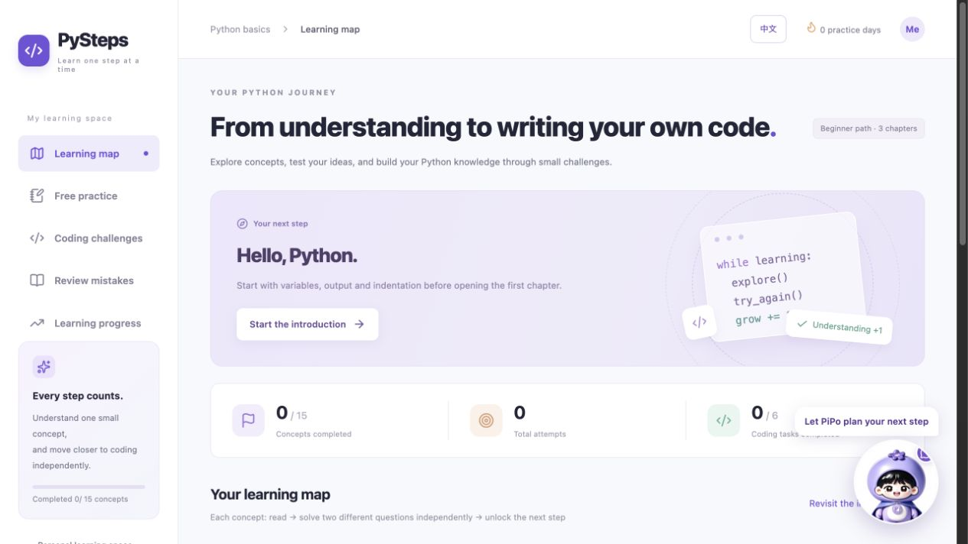
Method: one continuous learning workflow
Fixed Python rules determine progress; model assistance interprets reasons and goals.
Learn and explain
Read a concept, answer a question and state a reason.
Choose the next activity
Rules rank practice; PiPo reads tools and chooses an action.
Apply and retain
Run chapter code, inspect results and save the learning record.
Group 8 · 1:45–3:15
3 / 9
Notes:
1:45–3:15
Explain the method before switching to live use. Python compares answers to the question bank; course completion requires reading and two independent unhinted answers. Recommendation stays in the current chapter and excludes the question just answered. Optional Kimi diagnosis analyses reasons; PiPo uses a separate repeated model/tool/observation loop. SQLite connects the activities through a learning state. Explain simple usability: a local launch command, a visible language switch, saved drafts and meaningful errors.
Sources: current project backend/domain.py, agent.py, ai.py, storage.py, server.py; web/src/App.tsx and AssistantWidget.tsx; data/*.json; tests/*.py; local regression dated 29 October 2026; supplied INT6181 Project Requirements v2 section 3.4 and Lecture03–06. Screenshots are current application interfaces, not fabricated live outcomes.

Slide 4
Live demonstration: mistake feedback
Example: x = 5; print(x > 5)
Student action
Choose B: True and explain why.
Visible feedback
The fixed answer is False; inspect the equality boundary.
Revision
Edit the reason and reanalyse the same attempt.
Group 8 · 3:15–5:30
4 / 9
Notes:
3:15–5:30
SWITCH TO THE RUNNING APPLICATION for this full segment; do not remain on this slide. Open Free practice and select boundary_1 (the first conditionals question). Enter “I thought greater than includes equality”, choose B: True, submit and show the fixed incorrect result. Point to the standard explanation and available hints. With the prechecked configured model, request analysis and show the quoted reason; explain that it does not change the answer key. Revise the reason to “I now distinguish > from >=; equality makes this expression false”, reanalyse and show that the attempt count has not increased. Briefly show the language switch and clear labels. Narrate the expected result only after it is visible.
Sources: current project backend/domain.py, agent.py, ai.py, storage.py, server.py; web/src/App.tsx and AssistantWidget.tsx; data/*.json; tests/*.py; local regression dated 29 October 2026; supplied INT6181 Project Requirements v2 section 3.4 and Lecture03–06. Screenshots are current application interfaces, not fabricated live outcomes.

Slide 5
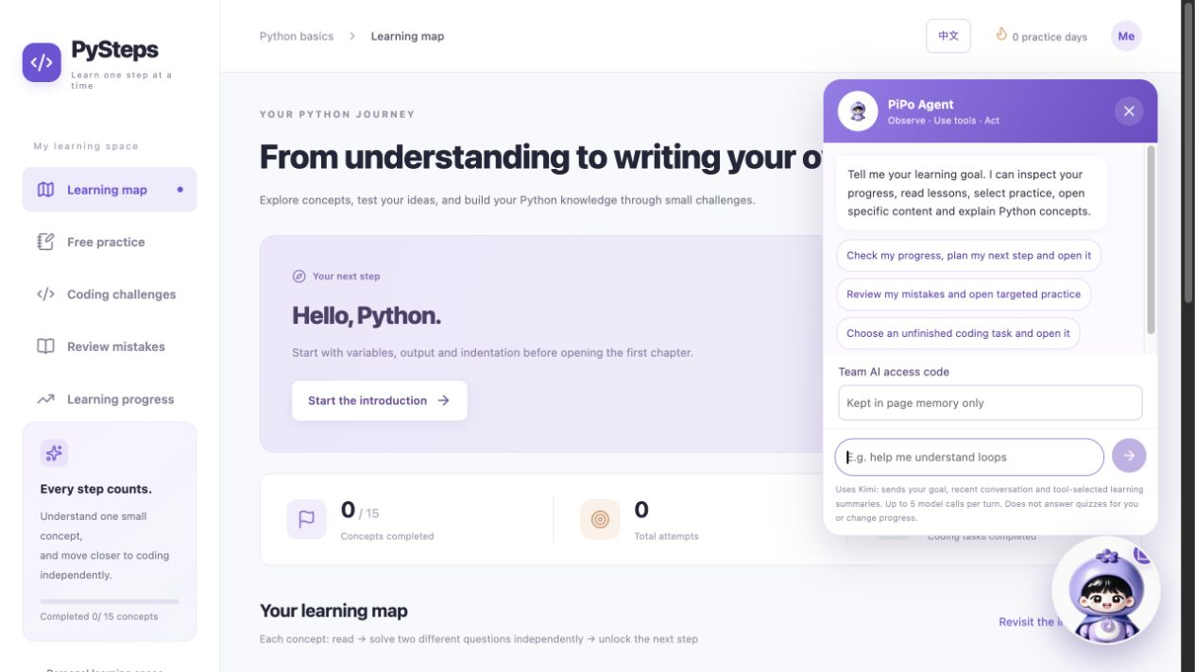
Live demonstration: PiPo chooses practice
Goal: “Review my latest comparison mistake and open related practice.”
Observe
PiPo reads current progress and available content.
Decide
The model chooses its next tool from the observations.
Verify
Expand the actual tool trace and check the opened question.
Group 8 · 5:30–8:00
5 / 9
Notes:
5:30–8:00
STAY IN THE APPLICATION. Open PiPo, enter the team access code without showing the provider key, and send the displayed goal. Wait for the real completed response. Expand the visible tool trace and explain the actual calls rather than reading a predetermined sequence. Confirm that the opened question is a valid inspected item in the relevant chapter and not boundary_1. Ask a short follow-up: “Explain why equality matters here without giving me the answer.” Point out tool decisions and the distinction between model-selected tools and Python-executed actions. If the account model cannot complete the turn, show the actual error and explain the observed state; arrange a functioning account before the final recording. Do not substitute simulated test output for this live segment.
Sources: current project backend/domain.py, agent.py, ai.py, storage.py, server.py; web/src/App.tsx and AssistantWidget.tsx; data/*.json; tests/*.py; local regression dated 29 October 2026; supplied INT6181 Project Requirements v2 section 3.4 and Lecture03–06. Screenshots are current application interfaces, not fabricated live outcomes.

Slide 6
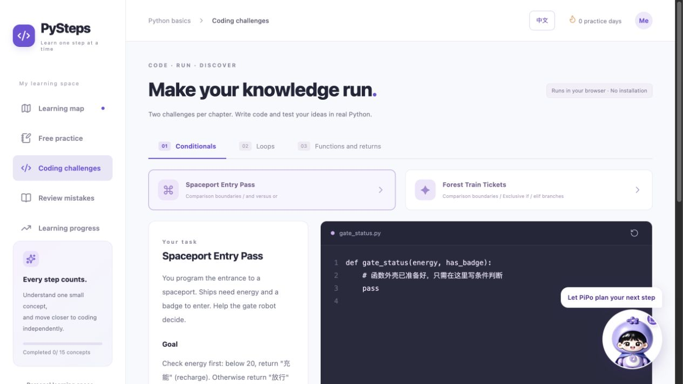
Live demonstration: Python coding
Spaceport Entry Pass · gate_status(energy, has_badge)
Write
Use the prepared function and preserve exact return strings.
Check
Run two examples, then check all seven task cases.
Inspect
Show case results, an error and the saved submission.
Group 8 · 8:00–10:30
6 / 9
Notes:
8:00–10:30
STAY IN THE APPLICATION. Open Coding challenges → Spaceport Entry Pass. Explain the rule: energy below 20 returns the required recharge string; otherwise a badge permits entry. First run the starter pass body to show useful failing case results, then paste the prepared reference function from the recording guide. Run examples (first two cases), then Check answer (all seven cases for this task). Highlight the 19/20 boundary, all visible passing results and the saved submission. Briefly introduce a syntax error and show its location, then restore the correct source. Explain that the Worker executes browser Python, while the backend stores progress.
Sources: current project backend/domain.py, agent.py, ai.py, storage.py, server.py; web/src/App.tsx and AssistantWidget.tsx; data/*.json; tests/*.py; local regression dated 29 October 2026; supplied INT6181 Project Requirements v2 section 3.4 and Lecture03–06. Screenshots are current application interfaces, not fabricated live outcomes.

Slide 7
Live demonstration: returning to saved learning
Progress and backups support a continuing learning session.
Review
Show the wrong attempt, reason and coding history.
Resume
Refresh and verify that the same learning space retains records.
Transfer
Export a JSON backup for explicit record transfer.
Group 8 · 10:30–11:30
7 / 9
Notes:
10:30–11:30
STAY IN THE APPLICATION. Open Review mistakes and identify the comparison attempt and revised reason. Open Learning progress and show the coding completion/attempt counts. Refresh and confirm records remain in the same browser space. Export a JSON backup and explain that import is a confirmed replacement. These actions establish practical continuity for self-study and tutor-led sessions. Do not clear cookies or import a backup into a real learner space during the recording.
Sources: current project backend/domain.py, agent.py, ai.py, storage.py, server.py; web/src/App.tsx and AssistantWidget.tsx; data/*.json; tests/*.py; local regression dated 29 October 2026; supplied INT6181 Project Requirements v2 section 3.4 and Lecture03–06. Screenshots are current application interfaces, not fabricated live outcomes.

Slide 8
Engineering method and verification
Python modularity, explicit requirements and reproducible tests
Implementation
LearningEngine, SQLite transactions, JSON APIs and tool execution.
Verification
38 methods passed: 32 project checks and 6 independent examples.
Engineering evidence
SRS-to-test mapping, README, CI configuration and review criteria.
Group 8 · 11:30–13:30
8 / 9
Notes:
11:30–13:30
Return to the slides. Show domain.py, agent.py and storage.py briefly using prepared windows. Explain functions/classes/collections (Lecture03), prompt contracts and SRS (Lecture04), model plus harness (Lecture05), and requirement/test matching (Lecture06). Show the current saved regression result dated 29 October 2026: 38 passed, including 10 PiPo methods. Explain that model responses in the automated tests are simulated; the live application segment is a separate demonstration. Show one requirement in SPEC and the named test. Describe the review record fields—reviewer, code location, finding, resolution and recheck—and show actual completed records if available. Identify CI as a configured multi-platform pipeline, not an invented successful run. State that AI assisted implementation, tests and documentation.
Sources: current project backend/domain.py, agent.py, ai.py, storage.py, server.py; web/src/App.tsx and AssistantWidget.tsx; data/*.json; tests/*.py; local regression dated 29 October 2026; supplied INT6181 Project Requirements v2 section 3.4 and Lecture03–06. Screenshots are current application interfaces, not fabricated live outcomes.

Slide 9
Conclusion: feedback connected to a next step
The live learner journey combines explanation, practice and working code.
Practical use
Self-study, classroom exercises and small teaching groups.
Ease of use
One launch command, bilingual controls and retained records.
Contribution
PiPo and Python rules connect learning decisions to specific activities.
Group 8 · 13:30–14:30
9 / 9
Notes:
13:30–14:30
Summarise only what the audience has just seen: incorrect answer and explanation, revised reason, PiPo-selected practice, task cases and persistent records. State the practical contribution without asserting measured learning gains. Thank the audience. Finish by 14:30, leaving 30 seconds before the 15-minute cap for transitions or variable model latency.
Sources: current project backend/domain.py, agent.py, ai.py, storage.py, server.py; web/src/App.tsx and AssistantWidget.tsx; data/*.json; tests/*.py; local regression dated 29 October 2026; supplied INT6181 Project Requirements v2 section 3.4 and Lecture03–06. Screenshots are current application interfaces, not fabricated live outcomes.

