Slide 1
A Peek Behind the Curtains:
How Django Auto-Generates the Initial Setup

Slide 2
Who Am I?
Name: Marcus Willock
Handle: crazcalm (Github and Twitter)
About Me: I am a python dev that dreams of getting more sleep #WorksInTheCityButLivesInJersey

Slide 3
Few Assumptions
I assume you all know what Django is?
I assume that at some point in time you have gone through a Django tutorial.
Note: If you do not fall under these assumptions, you will still understand the talk just fine.

Slide 4
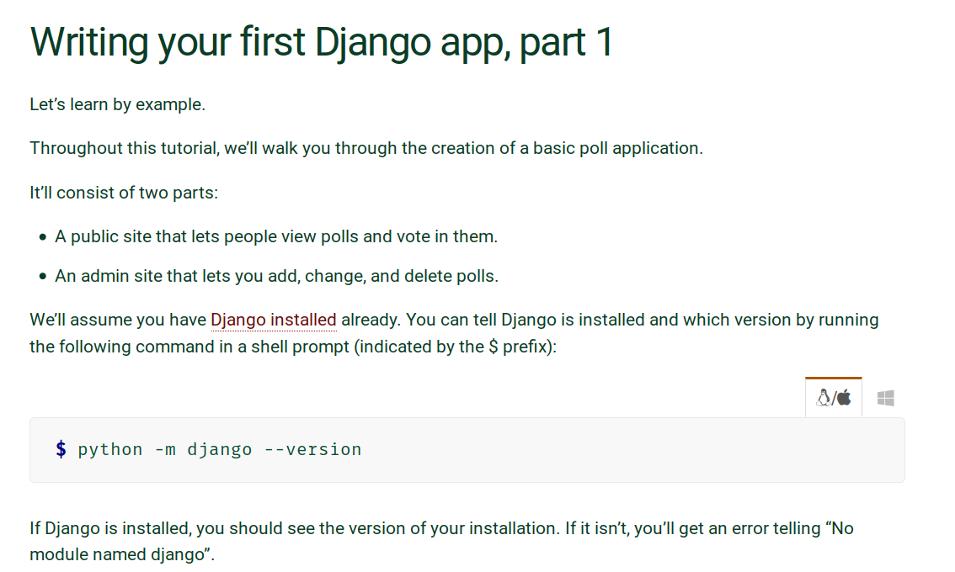
Django: The Beginning

Slide 5
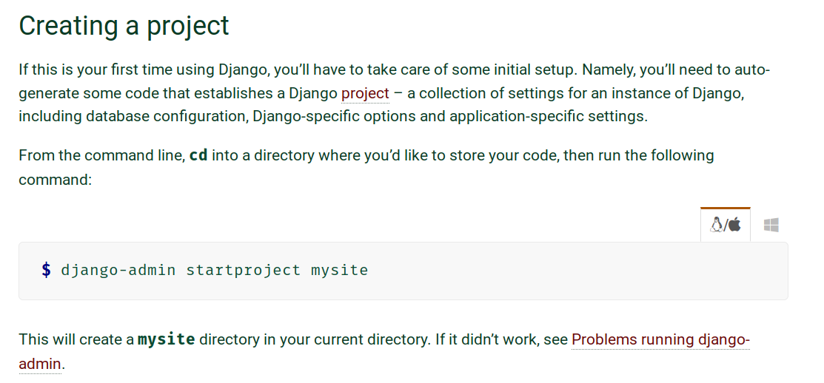

Slide 6
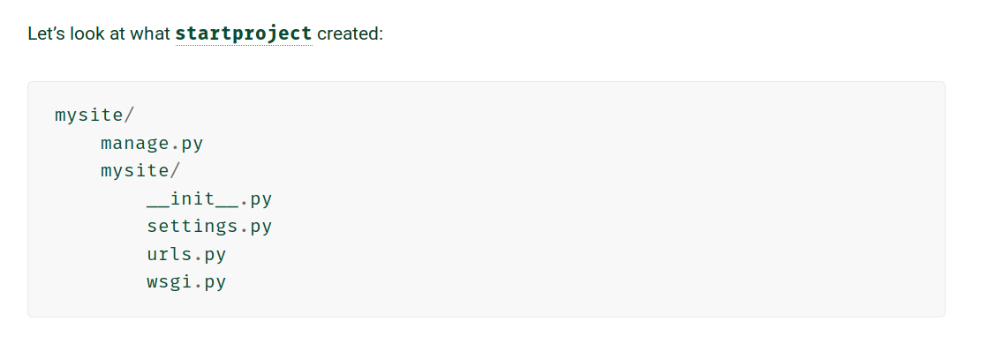

Slide 7
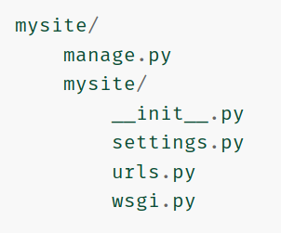
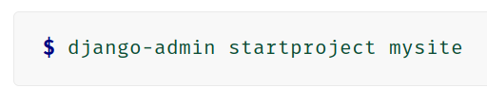
Quick Review:

Slide 8
In this talk, we are going to figure out how the django-admin command creates that directory and those files.

Slide 9

But First!

Slide 10
Back to the matter at hand

Slide 11
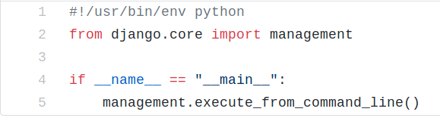
Django Admin Source Code:

Slide 12
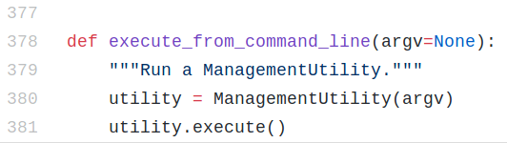
django.core.management.__init__.py

Slide 13
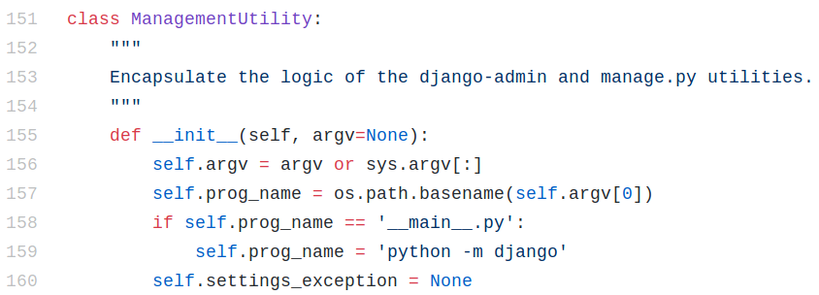
Same file...

Slide 14
Variable Values:
sys.argv = [path to django-admin, startproject, mysite]
self.prog_name = django-admin

Slide 15
django.core.management.__init__.py

Slide 16
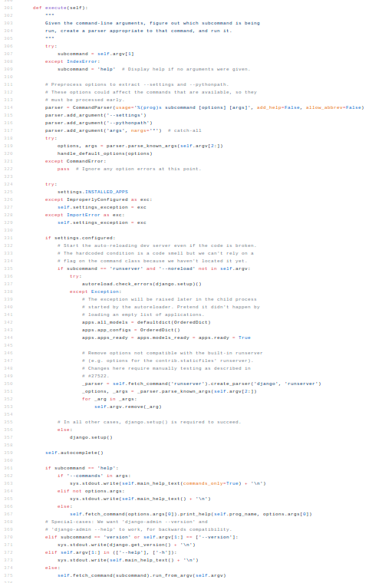
Execute Method:
75 Lines of code
But… Most of it does not apply to us!

Slide 17
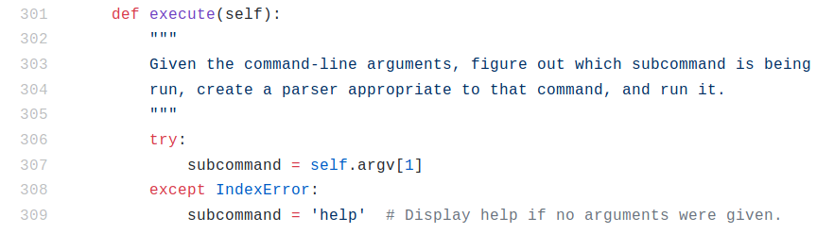
Continued.
subcommand = “startproject”

Slide 18
Last line of execute method
Subcommand = “startproject”
Self.argv = [path to django-admin, startproject, mysite]

Slide 19
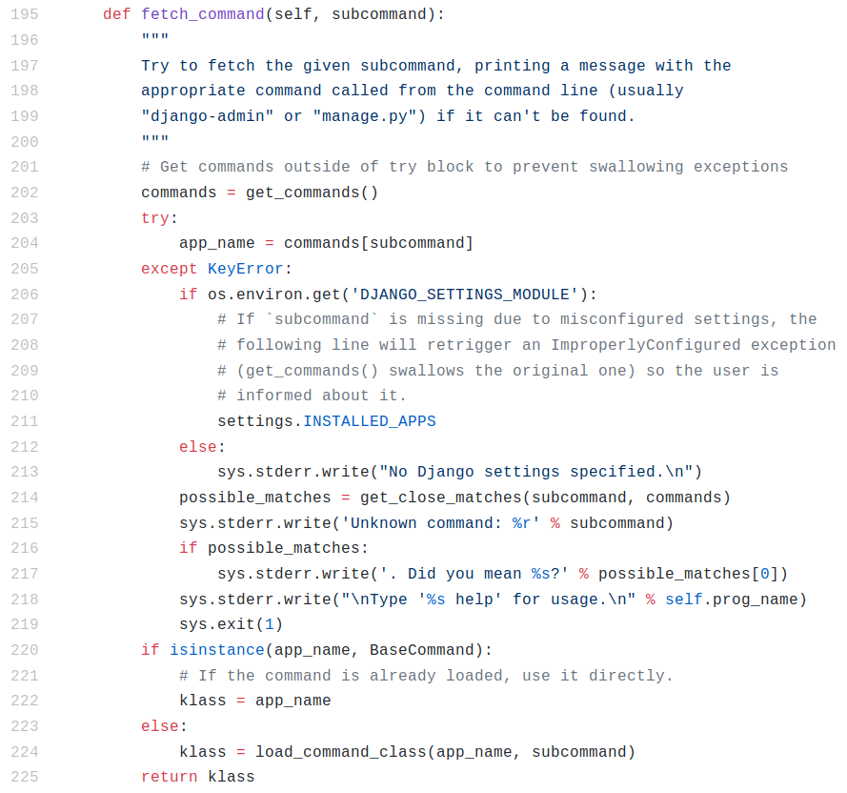
fetch_command Method
About 30 lines
We do not care about most of theses lines, but here is where it gets interesting!

Slide 20
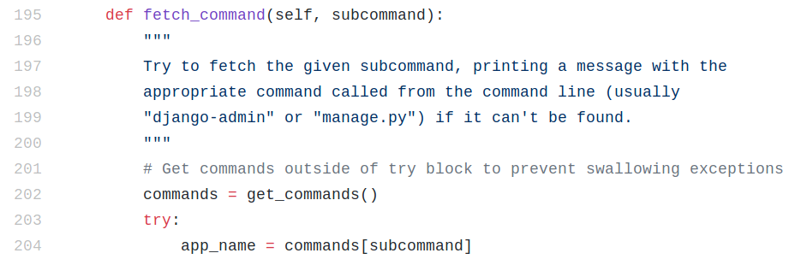
get_commands?
commands[subcommand]?
What is this MAGIC?!

Slide 21
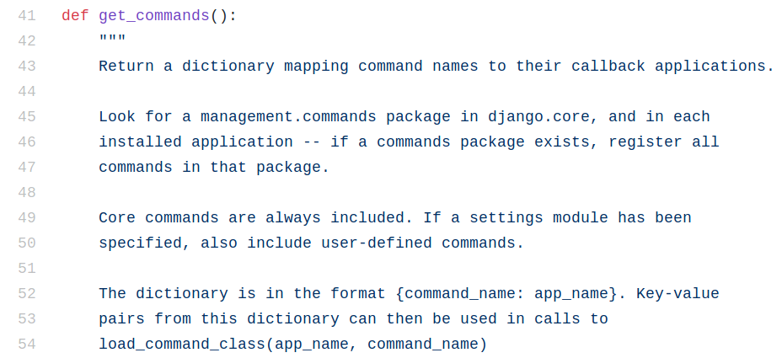

Slide 22
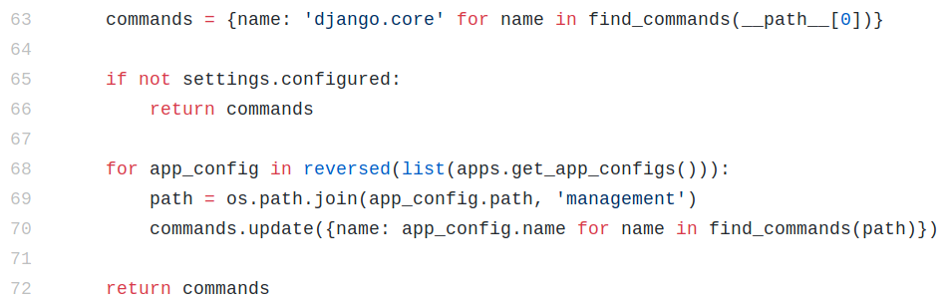
get_commands Source code
===> find_commands(__path__[0]) <===

Slide 23
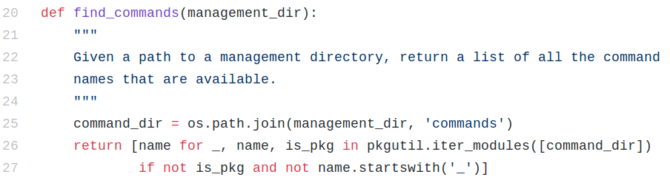
We have struck GOLD!
command_dir = python_path/site-packages/django/core/management/commands

Slide 24
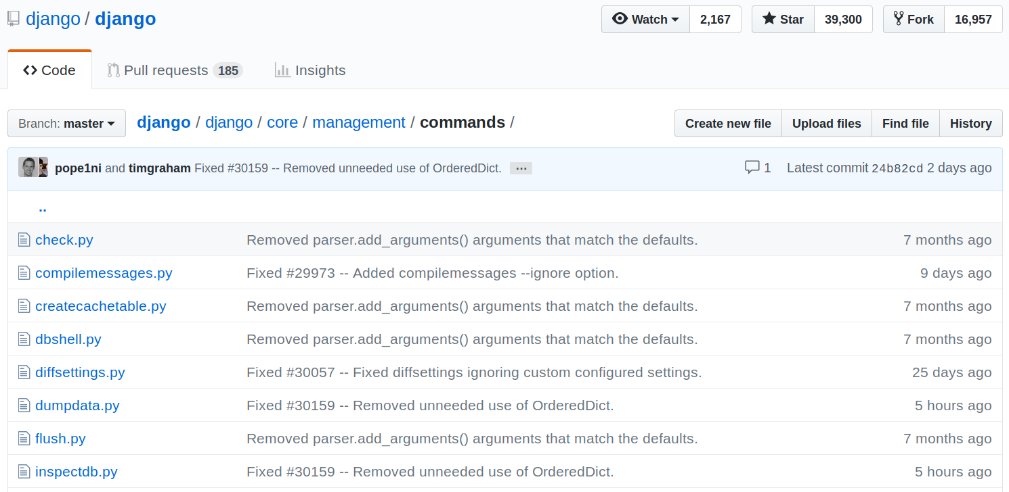

Slide 25
Ready to see the startproject.py source code?!

Slide 26
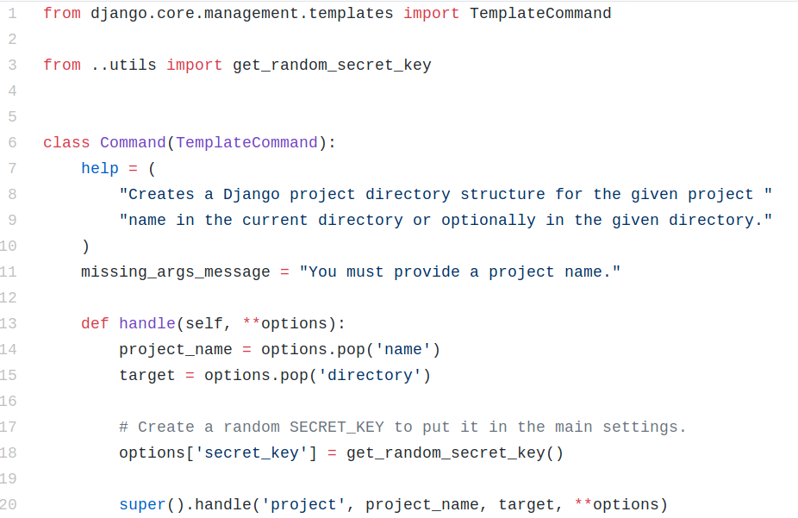

Slide 27

The Inheritance Tree:
This inheritance tree seems to lead to something much bigger than we were searching for...

Slide 28
The BaseCommand Class
The BaseCommand class is located in django/core/management/base/py
For us, the most important part of this class is the doc string where is explains the work flow.

Slide 29
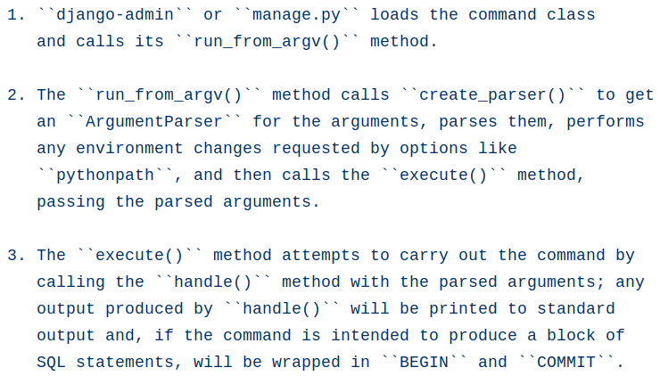
Work Flow:

Slide 30
Lets take a few steps back to the fetch_command function
fetch_command found the command that we wanted and returned it.

Slide 31
One More Step Back

Slide 32
Last line of execute method
Subcommand = “startproject”
Self.argv = [path to django-admin, startproject, mysite]
We have now made it full circle!

Slide 33
According to the BaseCommand
fetch_command(subcommand).run_from_argv(self.argv)
Which will call an `execute()` Method
Which will call an `handle()` Method
And bring us to startproject.py::Command::handle()
  See Source Code in the following slide

Slide 34
==> “mysite”
==> None

Slide 35
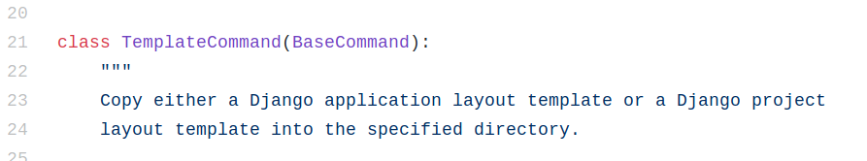
This is where the work is done
The handle method copies template files from django/conf/project_template, fills in the needed information with the project name and writes all those files to disk.

Slide 36
In Summary
`django-admin startproject mysite` looks up the subcommand (“startproject”) from a directory filled with subcommand files.
It then calls a handle method which loads up all the template files and passes in “mysite” as the project name.
Then it writes everything to disk.

Slide 37
The End

