Slide 1
Predicting Used-Car Prices in Sri Lanka
12.6%
Tuned boosting and stacking ensembles, explained with SHAP and LIME
average price error on unseen cars
Lakshan B.D. · Index 269136C · Applied Machine Learning
github.com/crazy-diya/ML_Assignment-269136C
Live demo: https://crazy-diya-ml-assignment-269136c-app-8yzt7l.streamlit.app/
Notes:
Hello, I'm Lakshan. I built a model that estimates the asking price of a car in Sri Lanka. The headline result: on cars the model never saw, the average error is about 12.6 percent.

Slide 2
A local problem: nobody knows what a used car is worth
Imports restricted since 2020
THE GOAL
1
Prices jumped and became opaque, so buyers cannot judge a fair price.
Estimate a car's asking price in LKR from its specification
Reconditioned Japanese imports
2
A category found almost nowhere else, priced between Used and Brand New.
Regression
Tabular data, local Sri Lankan dataset
Hybrids and EVs are growing
3
Fuel-price shocks changed what a fair price looks like.
Notes:
This is a local problem. Since imports were restricted in 2020, used-car prices rose sharply and became hard to judge. Many cars are reconditioned Japanese imports, and hybrids and EVs are growing. The goal is a regression model that estimates the asking price in rupees.

Slide 3
Data: 3,000 live ads collected from ikman.lk
3,000
10
351
163
car advertisements
features per car
distinct car models
locations
How it was collected
What is predicted
Own Python scraper, so the data is new and local
robots.txt respected, 1.5 s delay between requests
Resumable, with retries on timeouts
Target: asking price in LKR
Inputs: brand, model, year, condition, fuel, transmission, body, engine, mileage, location
Limit: asking price, not final sale price
Notes:
I collected my own data from ikman.lk, Sri Lanka's biggest classifieds site, using a polite scraper that respects robots.txt. The target is the asking price, which is higher than the final sale price - I state that as a limitation.

Slide 4
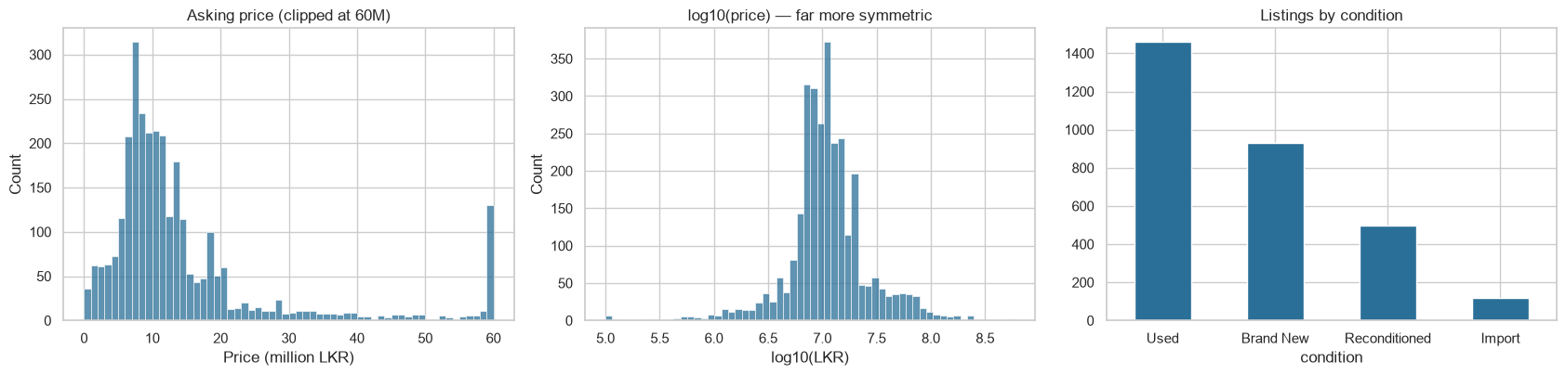
What the data looked like
Skewed price
Condition and age
High-cardinality models
A few LKR 200M+ cars dominate raw rupees, so the models train on log(price).
Brand New and Import sit above Reconditioned, which sits above Used. Depreciation is non-linear.
351 car models make this a categorical problem, which suits CatBoost.
Notes:
Price is extremely skewed - a few luxury cars cost over 200 million rupees - so I train on log price, which also means the model optimises percentage error. Condition is the biggest divider, a uniquely Sri Lankan feature. And with 351 car models this is a high-cardinality categorical problem.

Slide 5
Cleaning real, messy data with local knowledge
Issue found | Examples | Decision
Impossible prices | LKR 0, 106, 123456; a 595M BMW with a 1 cc "electric" engine | Drop 14 rows: a target cannot be imputed honestly
Impossible inputs | Year 2027; engine under 300 cc; mileage 1, 10, 123456 | Set to missing, then impute: engine from the same model, mileage from the same condition
EV engine is kW, not cc | Electric cars list a kW rating as the engine | Set to 0; fuel type carries the information
Real but unusual | 1970s Nissan Sunny, VW Beetle; Porsche, Bentley | Keep: genuine local market segments
Also: age and km-per-year engineered · rare models and locations grouped as "Other" · ordinal, one-hot and native categorical encoding · numeric scaling · all steps fitted on training data only
Notes:
Not all errors are nulls. I found placeholder prices, a 595 million rupee BMW with a 1 cc electric engine, future model years and fake mileages. I used domain knowledge to decide what to drop, what to impute and what to keep - vintage Sunnys and luxury Porsches are real parts of the Sri Lankan market.

Slide 6
Models and tuning: no default parameters
Baselines
Tuned single models
Ensembles
existing approaches
5-fold randomised search
combine the boosters
Ridge regression
Decision tree
Random Forest
XGBoost
LightGBM
CatBoost
Gradient Boosting
Voting (average)
Stacking (Ridge meta-learner on out-of-fold predictions)
Ranges designed from how each algorithm works and from ~2,400 training rows
Boosters: shallow trees (depth 3–8), small learning rates (0.02–0.15), row and column subsampling, L2 penalty 0.5–10. Random Forest: deep trees (8–30), 300–900 trees.
Notes:
I compared two baselines, five tuned single models and two ensembles. The lecturer's rule was no defaults, so I designed each search space from how the algorithm works. Boosters use shallow trees and small learning rates because 2,400 noisy rows overfit easily; Random Forest can use deep trees because bagging reduces variance.

Slide 7
Ensembles cut error from 23.5% to about 13%
Average % error on 600 unseen cars (lower is better)
0.914
R² of the stacked model on the test set
CatBoost
best single model, thanks to native categorical handling
0.76 / 0.74
R² of the Ridge and Decision Tree baselines
Notes:
Ensembles beat the baselines by a wide margin: average error falls from 23.5 percent for a single tree to about 13 percent for the boosters, and R-squared in rupees rises from 0.74 to 0.91. CatBoost is the best single model. Stacking and CatBoost are almost tied on log error, so I don't oversell the stack - its gain shows in R-squared and rupee error.

Slide 8
Each model has trade-offs
Model | Strength | Limitation seen in this project
Ridge / linear | Fast and transparent | Cannot capture non-linear depreciation; poor in rupees (R² 0.76)
Random Forest | Robust, little tuning | Cannot extrapolate: luxury cars come out too cheap
XGBoost / LightGBM | Accurate, regularised, fast | Needs careful tuning; categories must be encoded by hand
CatBoost | Native categorical handling: best single model | Slowest to train
Voting / Stacking | Combine different error patterns; best R² | Most complex; small gain over CatBoost
Notes:
Each model has trade-offs. Ridge is transparent but too simple for depreciation curves. Random Forest cannot predict beyond the price range it saw, so luxury cars are under-priced. CatBoost handles the many categories natively, which is why it won among single models. Stacking is the most complex for a small gain.

Slide 9
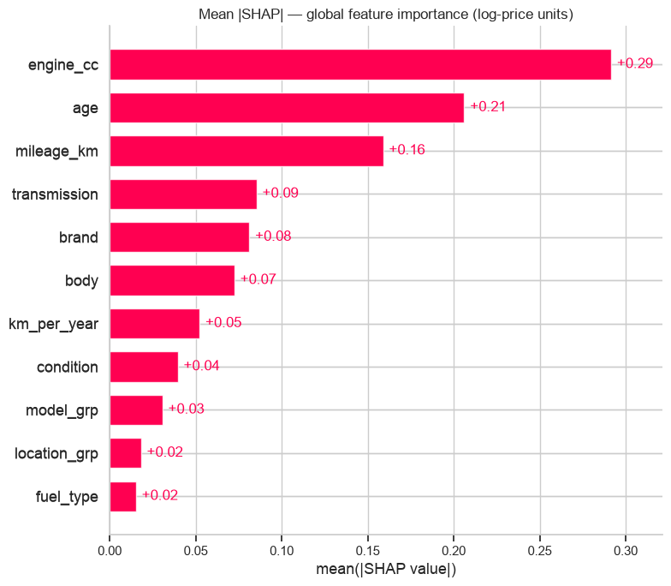
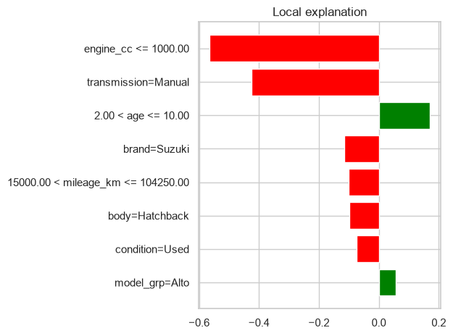
SHAP and LIME show why a car gets its price
SHAP: engine size, age and mileage matter most
LIME: this Alto is cheaper because of its small engine and manual gearbox
LIME also flagged an implausible mileage on a 2007 Hyundai Santa Fe, so explanations double as a data-quality check
Notes:
SHAP explains the whole model: engine size, age and mileage matter most, and the directions make sense - newer, lower-mileage and bigger-engine cars cost more. LIME explains one car: this Suzuki Alto is cheaper because of its small engine and manual gearbox. LIME on a 2007 Santa Fe revealed a mileage under 15,000 km - almost certainly a typo - so the explanation also works as a data-quality check.

Slide 10
MLOps: tested, monitored and redeployed automatically
Push or PR
CI
Image
Deploy
GitHub
>
9 tests + quality gate + Docker health check
>
GitHub Container Registry
>
Azure Container Apps + Streamlit Cloud
Weekly monitor
Drift?
Quality gate
Pull request
fresh ads vs training data: PSI, KS test, live MAPE
>
if yes, retrain a challenger on old + fresh data
>
challenger vs champion on ads neither has seen
>
a human approves, merge redeploys
On 200 fresh ads the live model scored MAPE 9.4% with no drift. In a retrain test the challenger beat the champion (log-RMSE 0.1285 vs 0.1305) and was promoted. Azure runs at about zero cost thanks to scale-to-zero.
Notes:
For the bonus I built an MLOps loop. Every push runs nine automated tests and a Docker health check. The image is published and runs on Azure Container Apps, and also on Streamlit Cloud. Every week the pipeline collects fresh ads, checks for drift with PSI and KS tests and measures live accuracy. If drift appears, it retrains a challenger and only promotes it if it is no worse than the current model on ads neither has seen, then opens a pull request for a human to approve.

Slide 11
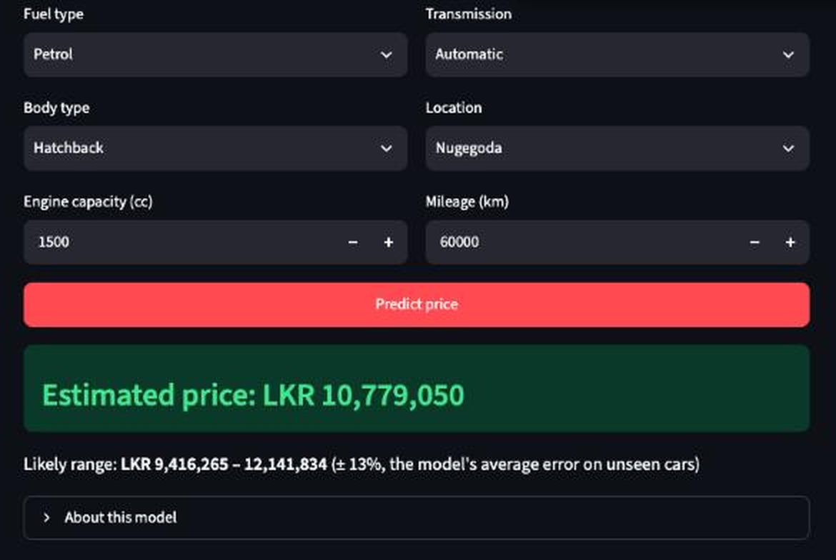
Live demo, limits and next steps
Held-out test car: Daihatsu Mira 2026
−0.6% error
Predicted LKR 7.43M vs actual LKR 7.48M
Limits
Asking prices, one website, 3,000 ads, few comparables for rare cars
Next steps
Add time-series for market drift, more data sources, and prediction logging on Azure
Live demo (Azure): https://car-price-app.bluemeadow-a6e43a1f.malaysiawest.azurecontainerapps.io
Notes:
Here is the Streamlit app: pick the car's details, press Predict, and it returns an estimated price with a plus-or-minus 13 percent range. One car was kept out of all training; the model predicted 7.43 million against an actual 7.48 million - 0.6 percent off. Limits: asking prices, one website, 3,000 ads. Next: add a time-series component for market drift, more data sources, and MLOps deployment.

