Slide 1


BANK LOAN CASE STUDY
Report By- Siva Sanakri H
Jan 9th, 2025

Slide 2

OBJECTIVE
Identify patterns that indicate if a customer will have difficulty paying their instalments
Make decisions such as denying the loan, reducing the amount of loan, or lending at a higher interest rate to risky applicants.
Understand the key factors behind loan default so it can make better decisions about loan approval.

Slide 3
Pre Read
What happens when a customer applies for loan?
When a customer applies for a loan, there are four possible outcomes:
a) Approved: The company has approved the loan application.
b) Cancelled: The customer cancelled the application during the approval process.
c) Refused: The company rejected the loan.
d) Unused Offer: The loan was approved but the customer did not use it.
Analysing the applications received is very important because –
a) If the applicant can repay the loan but is not approved, the company loses business - Risk Assessment
b) If the applicant cannot repay the loan and is approved, the company faces a financial loss - Credit Decisioning

Slide 4
Data Set Description
File a) – previous_application.csv: Contains information about previous loan applications.
File b) – application_data.csv: Provides details about the current loan applications.
File c)– columns_description.csv: Describes the columns present in the other datasets, explaining what each column represents.
We will be working with File b) for our data analysis tasks. This file has 39 columns with 50000 entries. This file contains important information about our client like their contact info etc.

Slide 5
Data Analytics Tasks
Task A. Identify Missing Data and Deal with it Appropriately
Task B. Identify Outliers in the Dataset
Task C. Analyze Data Imbalance
Task D. Perform Univariate, Segmented Univariate, and Bivariate Analysis
Task E. Identify Top Correlations for Different Scenarios

Slide 6
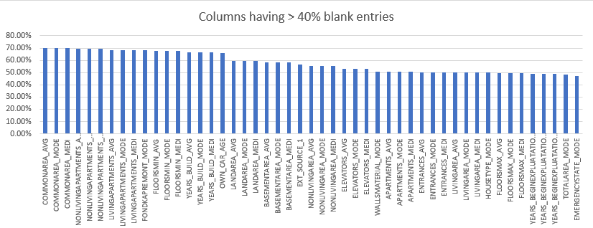
1. Identify Missing Data and Deal with it Appropriately
Task: Identify the missing data in the dataset and decide on an appropriate method to deal with it using Excel built-in functions and features.

Slide 7
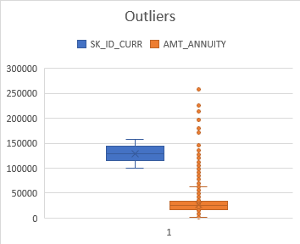
2. Identify Outliers in the Dataset
Task: Detect and identify outliers in the dataset using Excel statistical functions and features, focusing on numerical variables.
Outliers are data points that differ significantly from the rest of the data in a dataset. They are values that are much higher or lower than most of the other observations and can distort statistical analyses, such as averages or trends.
We have used QUARTILE (ARRAY, VALUE) function to measure the outliers.
Types of Outliers -
1. Univariate outliers
2. Multivariate outliers

Slide 8
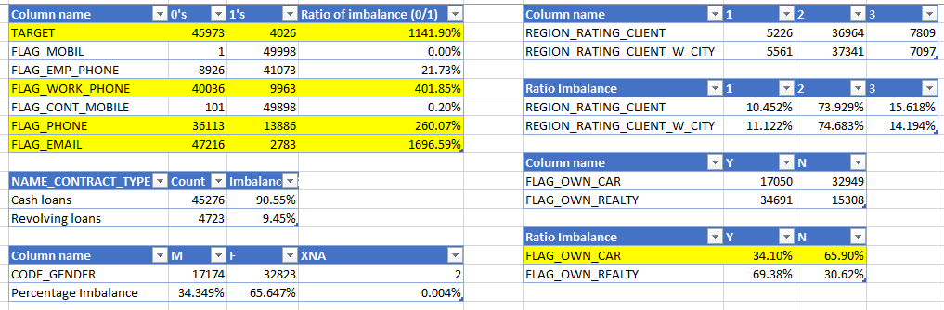
3. Analyze Data Imbalance
Task: Determine if there is data imbalance in the loan application dataset and calculate the ratio of data imbalance using Excel functions.

Slide 9
4. Perform Univariate, Segmented Univariate, and Bivariate Analysis
Task: Perform univariate analysis to understand the distribution of individual variables, segmented univariate analysis to compare variable distributions for different scenarios, and bivariate analysis to explore relationships between variables and the target variable using Excel functions and features.

Slide 10
Univariate Analysis
Examination of a single variable in a dataset to summarize and find patterns.
It involves calculating basic statistics such as mean, median, mode, range, and standard deviation, as well as visualizing the data using charts like histograms, boxplots, and bar graphs.
This type of analysis helps understand the distribution and central tendencies of a variable..

Slide 11
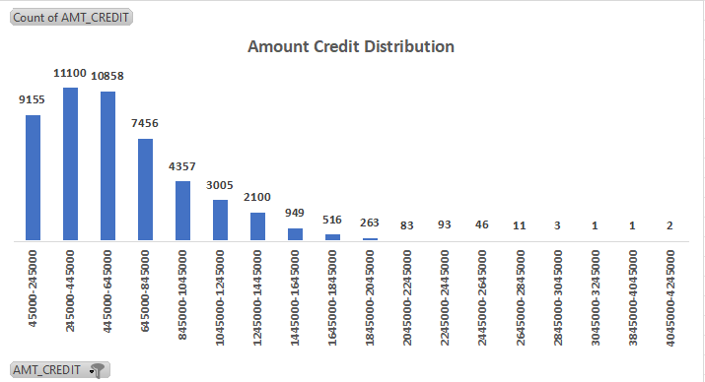
1. Amount Credit Column – we have come to a conclusion that the maximum loan amount credited falls within the range of ₹ 2,45,000 - ₹ 44,5,000 INR.
2. Applicants are more likely to receive easier loan approval when the requested loan amount falls within the range of ₹ 45,000 to ₹ 12,45,000.

Slide 12
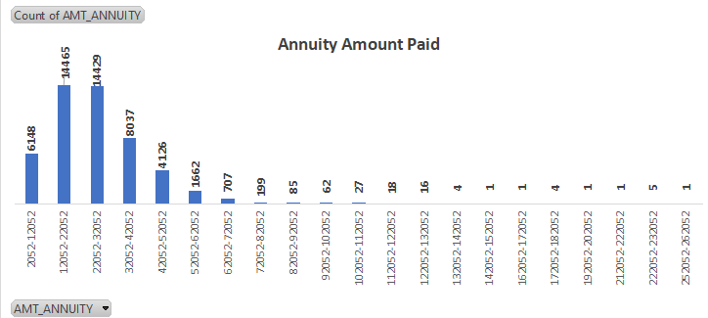
3. Annuity Amount – it can be seen that maximum annuity paid by a borrower falls in the range ₹ 12,052 - ₹ 22,052. Annuity refers to the payments (usually of equal amounts) made to a bank over a specified period of time.
4. The bank calculates the annuity payments based on the principal loan amount, interest rate, and loan term. These fixed payments help ensure that the borrower can repay the loan in manageable amounts.

Slide 13
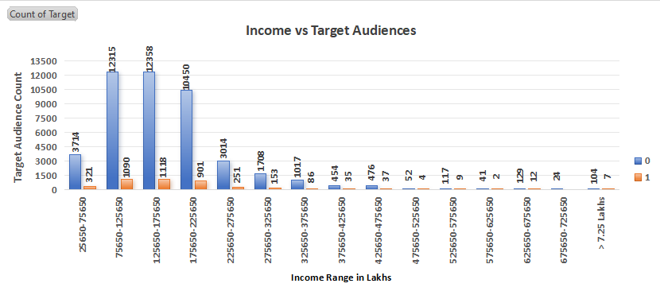
Bivariate Analysis
Explores the relationship of two variables as well as the depth of this relationship to figure out if there are any discrepancies between two variables and any causes of this difference. Some of the examples are percentage table, scatter plot, etc.

Slide 14
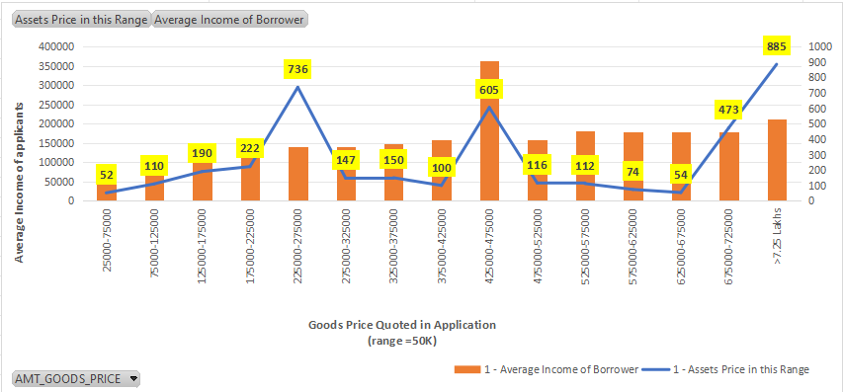
.+--+
1. The primary axis – x indicates the goods price quoted in the loan applications and the y axis indicates average income of the applicants falling under this price range.
2. Secondary axis– indicates the number of assets falling under this income range. This means – we have 52 assets falling in price range ₹ 25,000 – ₹ 75,000.
3. The average income in this category is near ₹ 50,000. Which mean, 52 applicants having average salary in ₹ 50000 margin have quoted for goods of price close to ₹ 75,000.

Slide 15
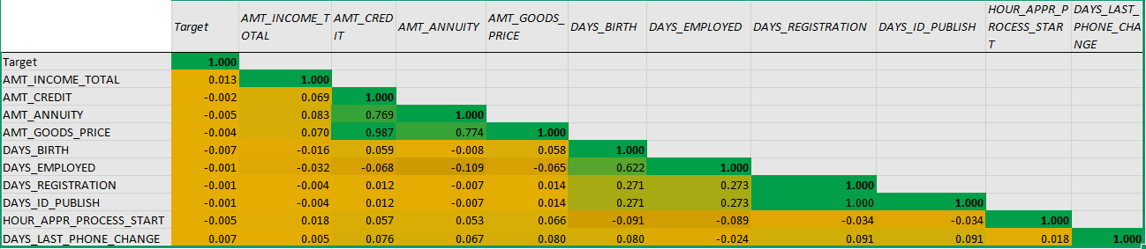
5. Identify Top Correlations for Different Scenarios
1. Green highlighted cells indicate positive correlation.
2. Yellow indicates negative correlation.
3. Light shaded region indicates values closer to 0 - means no correlation.

Slide 16

Drive Links -
Bank Loan DataSet_ Solutions
Thank You !!!

