Slide 1

Student Placement Management System
Mini Project Presentation
Name: Vedic Varma
Reg.No: 229302083

Slide 2
Introduction
The Placement Management System is a web-based application developed using React.js for the front-end and PHP for the back-end. The system is designed to manage and streamline the process of student placements in an educational institution.
The system provides a user-friendly interface for managing student data. It allows users to add new students, view a list of all students, and filter students based on various criteria. The system is designed with a focus on simplicity and ease of use, making it accessible to users with varying levels of technical expertise.

Slide 3

Motivation
The motivation behind this project was to simplify the process of managing student placements. Traditionally, this process involves a lot of manual work, including maintaining and updating spreadsheets, which can be time-consuming and error-prone. The Placement Management System automates these tasks, reducing the potential for errors and freeing up time for staff to focus on other important tasks.

Slide 4
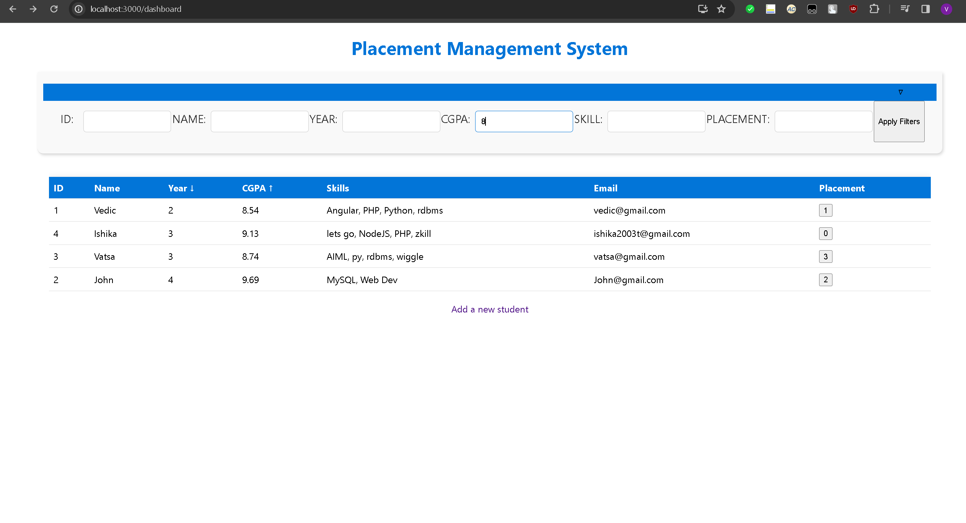
Dashboard

Slide 5
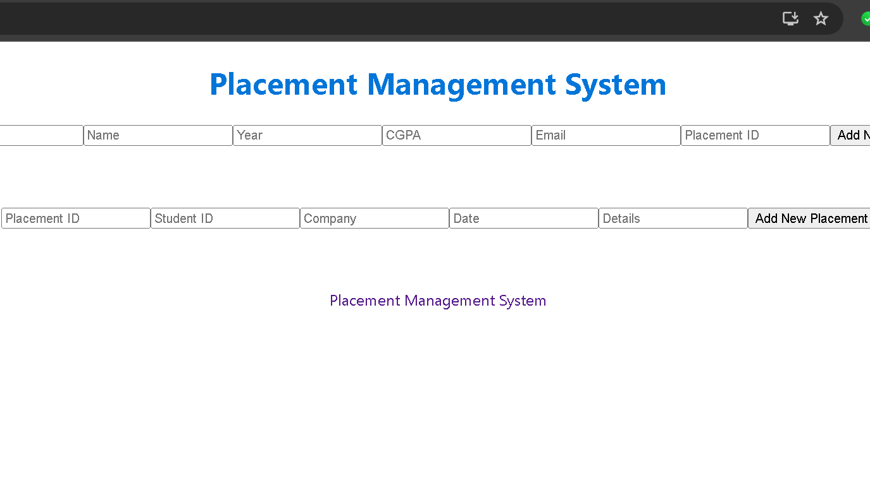
Add Data

Slide 6
Design
Frontend made in React-JS
Backend written in PHP-MySQL with XAMPP
Skills
Dashboard
Student ID
Students
Add Students / Placements
Placements

Slide 7

Future Work
Adding a feature to track the status of each student's placement process.
Implementing a user authentication system to ensure data security.
Integrating with an email system to automatically send notifications to students about their placement status.
Expanding the filtering options to allow for more specific searches.
Optimizing the system for mobile devices to allow users to access it on the go.

