Slide 1
3D reconstruction from SINGLE 2D IMAGE
DONG Juncheng / syaoran@stu.hitedu.con

Slide 2
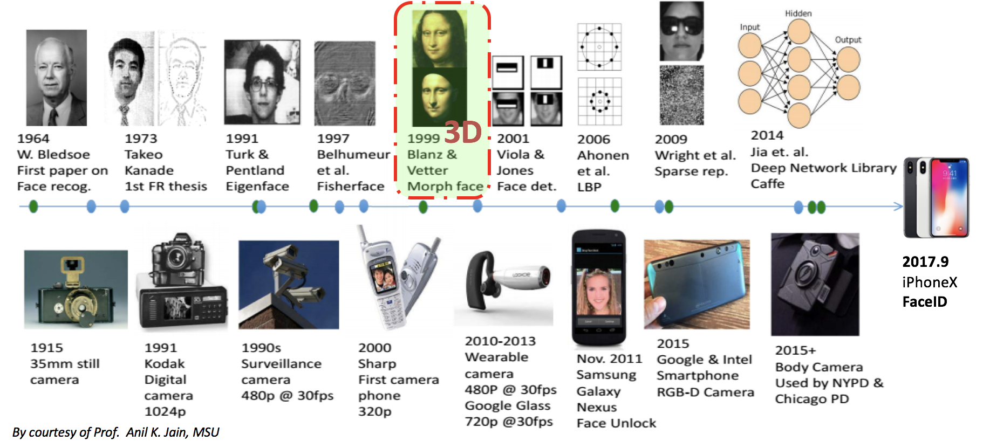

Slide 3
Optimization-based Approach / Parametric Face Models
Learning-based Approach
Corrective Basis and Subspace Learning
Deep Integration of Generative Model
…

Slide 4
Realization & Improvement
High-dimensional Reconstruction
Personalized Editing

Slide 5
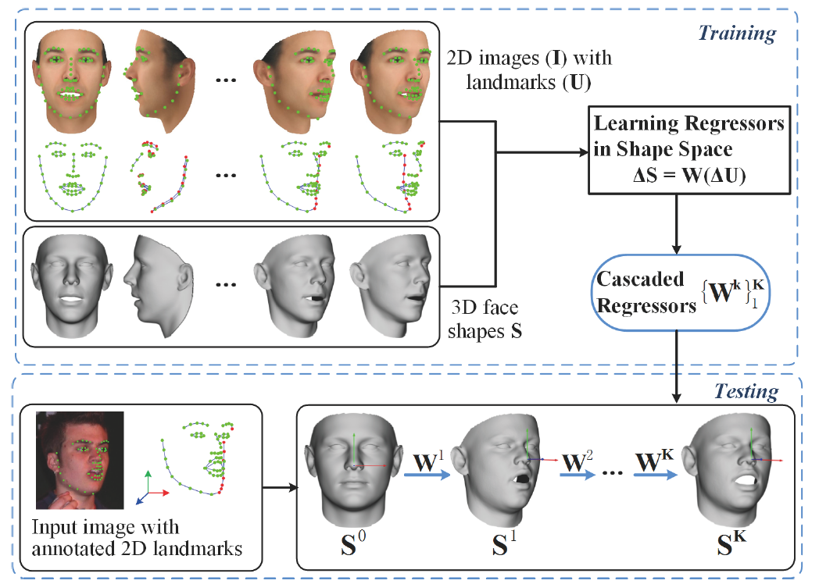
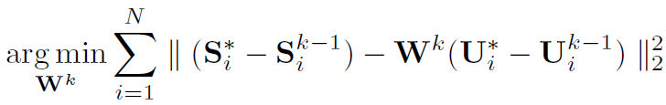
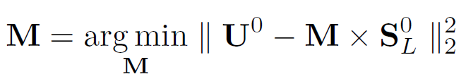

METHOD:
Optimization-based Approach / Parametric Face Models
1. Reconstruction process
2. Learning cascaded repressors
3. Estimating 3D-to-2D mapping and landmark visibility
F. Liu, D. Zeng, J. Li, Q. Zhao, “On 3D face reconstruction via cascaded regression in shape space,” Frontiers of Information Technology & Electronic Engineering, 2017, in press

Slide 6
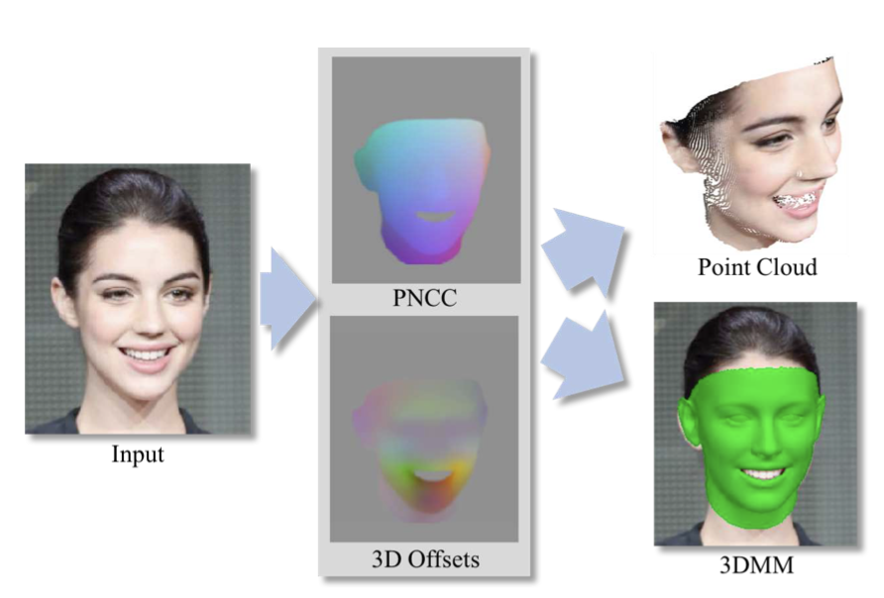
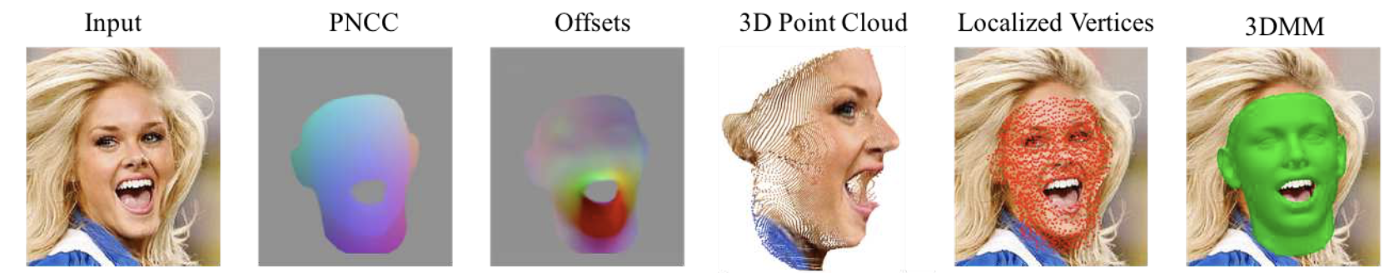
Notes:
Projected Normalized Coordinate Code (PNCC)

Slide 7
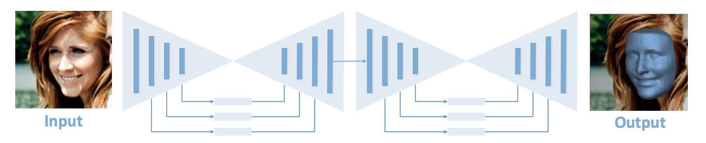
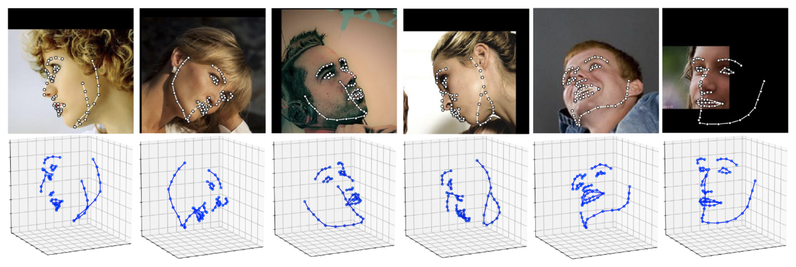
METHOD: Learning-based Approach

Slide 8
Data Set
300W (300 Faces In-the-Wild Challenge) Dataset
300W-LP (300W under Large Poses) Dataset
BU-3DFE (Binghamton University 3D Facial Expression) Dataset
AFLW2000-3D/AFLW Dataset

Slide 9
THANK You

