Slide 1
Natural Language Processing Introduction
Executive Session

Slide 2
NLP Concepts – Level 1
Objective:
Learning Outcomes:
Topics Covered:
Target Audience:
Duration:
1 Hour webinar session

Slide 3
Natural Language Processing
Level 2

Slide 4
NLP Concepts – Level 2
Objective:
Introduction to NLP and hands-on exercises for text mining, information extraction
Duration:
8 hours workshop (4+4, 2 Days)
Learning Outcomes:
Introduction to NLP, major tasks and applications
Typical NLP pipeline and technology stack for Java, Python
Hands-on exercises on text clustering, classification and information extraction using
Java : Mallet, UIMA
Python : scikit-learn, NLTK 3, Spacy
Target Audience:
Technical leads / Architects
Senior Developers
Software Required:
Anaconda 4+
Python 2.7, 3.5
Spyder / IDLE python editors
Eclipse + UIMA Plugin
Maven
Spacy, NLTK
UIMA, Cleartk

Slide 5
NLP Concepts – Level 2 (cont..)
Topics Covered: Day 1 (4 hours)
Text Mining (90 Minutes)
Introduction to text processing, analytics and mining
Text normalization, feature extraction, BOW
Clustering and classification
Hands-on Session (150 Minutes)
Text pre-processing, BOW
K-Means clustering
Naïve Bayes classification
Prerequisites:
Java / Python basics
Regex
Machine Learning
Evaluation metrics (Precision, Recall, ROC)
Topics Covered: Day 2 (4 hours)
Information Extraction (90 Minutes)
Typical NLP pipeline
Default entity extraction models
Custom entity extraction using Regex, POS, Dependency Relations
Hands-on Session (150 Minutes)
Setup
Default, Regex entity extraction
Custom entity extraction exercise
Prerequisites:
Java / Python basics
Regex
Machine Learning
Evaluation metrics (Precision, Recall, ROC)

Slide 6
NLP pipeline
A pipeline in NLP is a chain of independent modules
pipeline isn't a technique only featured in NLP

Slide 7
Classical NLP pipeline
Break text into sentences and words
lemmatize Part of speech (POS) tagging, stemming
NER Constituency/dependency parsing
Co-reference resolution
Word-sense disambiguation Task-dependent (sentiment, …)
Raw Text
Tokenization
Morphology
Syntax
Semantics
Discourse

Slide 8
Often relies on language banks
WordNet (ontology, semantic similarity tree)
Penn Treebank (POS, grammar rules)
PropBank (semantic propositions)
…Dozens of them!

Slide 9
NLP pipeline to extract semantic roles from a sentence
Raw text
Tokenization
Lemmatization
Pos-tagging
dependency parsing
Role labelling

Slide 10
Quick vocabulary
Corpus - Body of text, singular. Corpora is the plural of this.
Example: A collection of medical journals.
Lexicon - Words and their meanings.
Example: English dictionary. Consider, however, that various fields will have different lexicons
Token - Each "entity" that is a part of whatever was split up based on rules

Slide 11
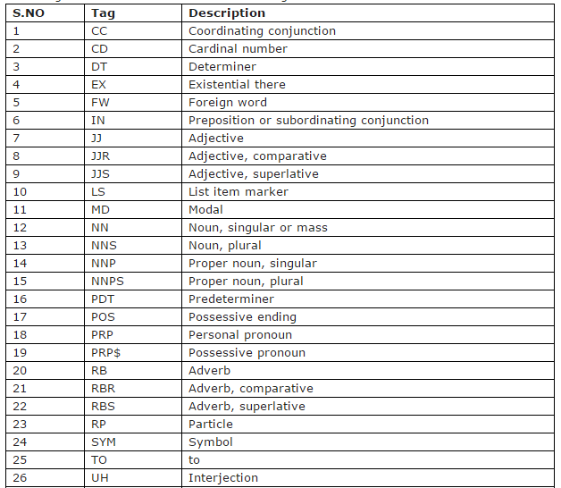
POS Tag List

Slide 12
NLP pipeline process
Let’s see how to use Apache OpenNLP through a set of simple examples.
1. Sentence Detector
2. Tokenizer
3. Name Finder
4. POS Tagger
5. Chunker
6. Parser

Slide 13

Sentence detection
Sentence detector is for detecting sentence boundaries. Given the following paragraph
Output

Slide 14
Sentence detection (cont..)
Example Code
//code snippet

Slide 15
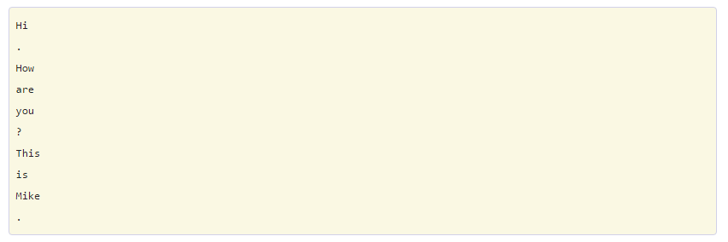
Tokenizer
There are exceptions while tokenizing .
For example, "isn't" gets split into "is" and "n't, since it is a brief format of "is not".
In our case tokenized sentence be like

Slide 16
Tokenizer (cont..)
Example Code
//code snippet

Slide 17
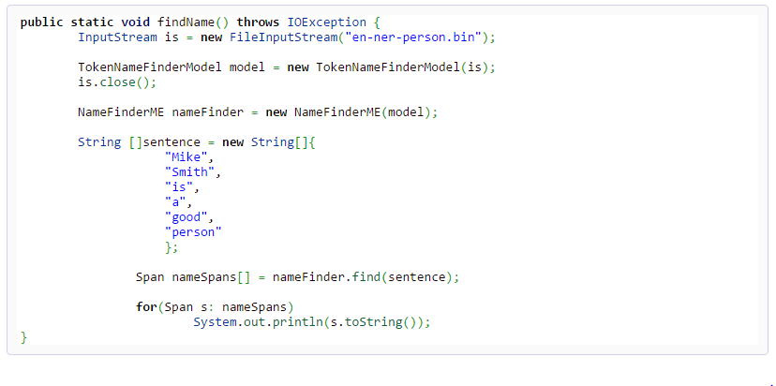
Name Finder
Name finder just finds names in the context
It accepts an array of strings, and find the names inside
Example Code

Slide 18
POS Tagger
Labeling words in a sentence as nouns, adjectives, verbs...etc
For example “Hi how are you ? This is Mike.” will tagged as
“Pierre , 27 years old, is a software Engineer joined xyz organization.Mr . Vinken is the project manager, team size 10”

Slide 19
Pos tagger (cont..)
Example Code
// code snippet

Slide 20
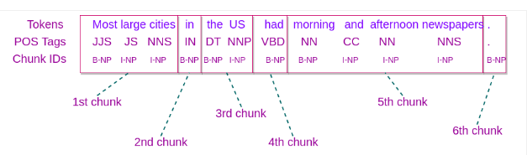
Chunker
partition a sentence to a set of chunks by using the tokens generated by tokenizer
Breaks sentences into groups ( of words) containing sequential words of sentence that belong to a noun group, verb group etc.

Slide 21
Chunker (cont..)
Example Code
//code snippet

Slide 22

Parser
Given this sentence: "The sky is blue.", parser can return the following:
where S is Sentence, NP is Noun-phrase, and VP is Verb- phrase
A parenthesized string like –
S(NP(The sky) VP(is blue.))

Slide 23
Thank you

