Slide 1
Information Extraction and Named Entity Recognition
Introducing the tasks:
Getting simple structured information out of text

Slide 2
Information Extraction
Information extraction (IE) systems
Find and understand limited relevant parts of texts
Gather information from many pieces of text
Produce a structured representation of relevant information:
relations (in the database sense), a.k.a.,
a knowledge base
Goals:
Organize information so that it is useful to people
Put information in a semantically precise form that allows further inferences to be made by computer algorithms
Notes:
Now let's define information extraction! a more general task
Goal: get semantic information out of documents, esp. web pages
Defined as a dumbing-down of more lofty goal of Natural Language Understanding -- more technologically manageable
we're often interested in learning about particular relations (in DB sense)
e.g. scouring financial news for movements of executives
e.g. [person] [assumes/loses] [role] at [company]
I want to scour through text, find relation instances, suck out, put in DB
you're allowed to do domain- and problem-specific customization
lots of potential applications
- business/financial context
- biomedical context, clinical medicine
there's all this unstructured text data about research and patients -- you'd like to be able to get structured information out of it
could lead to other automated information finding: trends, correlations, drug interactions, impact of some protein on expression of a gene, ...

Slide 3
Information Extraction (IE)
IE systems extract clear, factual information
Roughly: Who did what to whom when?
E.g.,
Gathering earnings, profits, board members, headquarters, etc. from company reports
The headquarters of BHP Billiton Limited, and the global headquarters of the combined BHP Billiton Group, are located in Melbourne, Australia.
headquarters(“BHP Biliton Limited”, “Melbourne, Australia”)
Learn drug-gene product interactions from medical research literature
Notes:
Now let's define information extraction! a more general task
Goal: get semantic information out of documents, esp. web pages
Defined as a dumbing-down of more lofty goal of Natural Language Understanding -- more technologically manageable
we're often interested in learning about particular relations (in DB sense)
e.g. scouring financial news for movements of executives
e.g. [person] [assumes/loses] [role] at [company]
I want to scour through text, find relation instances, suck out, put in DB
you're allowed to do domain- and problem-specific customization
lots of potential applications
- business/financial context
- biomedical context, clinical medicine
there's all this unstructured text data about research and patients -- you'd like to be able to get structured information out of it
could lead to other automated information finding: trends, correlations, drug interactions, impact of some protein on expression of a gene, ...

Slide 4
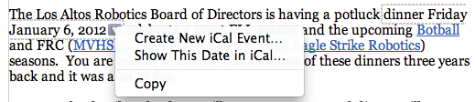
Low-level information extraction
Is now available – and I think popular – in applications like Apple or Google mail, and web indexing
Often seems to be based on regular expressions and name lists
Notes:
low-level information extraction:
mail programs extracting times, dates, phone numbers, events
these are specialized kinds of relations
done using regular expressions

Slide 5
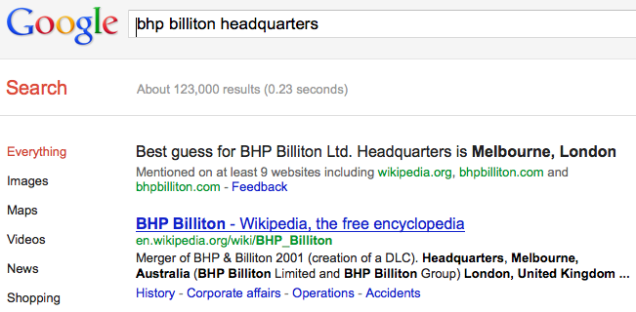
Low-level information extraction
Notes:
low-level information extraction:
mail programs extracting times, dates, phone numbers, events
these are specialized kinds of relations
done using regular expressions

Slide 6
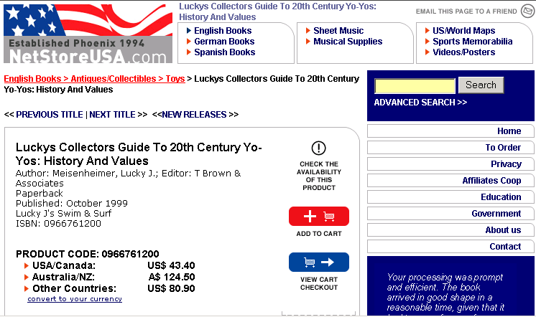
Why is IE hard on the web?
A book,
Not a toy
Title
Need this
price
Notes:
this task is actually a surprisingly difficult task
you might think, how hard can it be: you look at the web page, find out how much, … but there's actually a lot of subtlety in getting it right
here's a product web page -- it's probably pretty obvious to you guys that this is a book, right? but for the computer, it's sort of subtle to tell this
because although the top-level category is "English Books” it's inside subcategory "Toys" -- you might think it's a toy
that's what's more common on shopping sites: if you're on a site that sells home furnishings, and you're in a subcategory "flatware", you assume that a product you see there is an instance of flatware
the title isn't labeled as a title, it's just bold and big font
and then prices -- very typically you see multiple prices
here, prices for different countries
also: list price vs. our price, or previously vs. marked down
somehow you need to figure out that this is the price you want
so to do this with accuracy over different websites is quite tough

Slide 7
How is IE useful? Classified Advertisements (Real Estate)
Background:
Plain text advertisements
Lowest common denominator: only thing that 70+ newspapers using many different publishing systems can all handle
<ADNUM>2067206v1</ADNUM>
<DATE>March 02, 1998</DATE>
<ADTITLE>MADDINGTON $89,000</ADTITLE>
<ADTEXT>
OPEN 1.00 - 1.45<BR>
U 11 / 10 BERTRAM ST<BR>
NEW TO MARKET Beautiful<BR>
3 brm freestanding<BR>
villa, close to shops & bus<BR>
Owner moved to Melbourne<BR>
ideally suit 1st home buyer,<BR>
investor & 55 and over.<BR>
Brian Hazelden 0418 958 996<BR>
R WHITE LEEMING 9332 3477
</ADTEXT>
Notes:
classified ads (real estate): first IE system Chris worked on, 1997, early years of web, in Australia
working for Rupert Murdoch, president of News Corp, which owns many newspapers in Australia
classified ads were starting to move onto web
they wanted a system for putting ads from all their 70+ newspapers onto web
what technology was available to get stuff out?
there were 20+ backends with different structures, ontologies, so they decided the only way they could get data out was to go to plain text
so they had text of all these classifieds, wanted unified web front end
they already had a system, but it was plain old text web search
good example of how IE can give higher-level value
ads include both for sale and for rent (note how low prices are!)
Maddington is town
there's a price, an address
note street address is separate from the town!
there's an open house time
it's a 3BR house
lots of useful relational information
IE aims to get all this information out, to deliver higher-level services

Slide 8
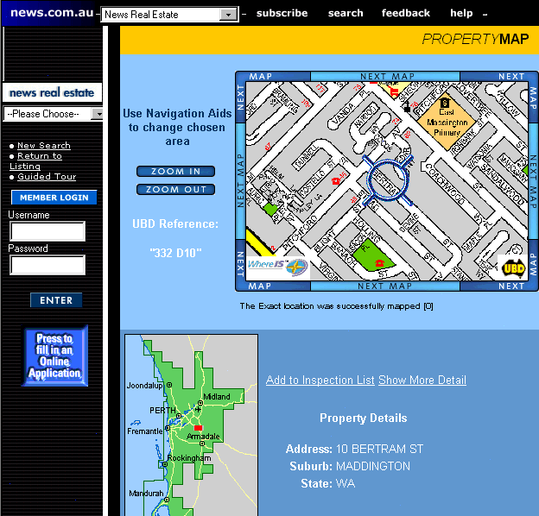
Notes:
for example: get out address, plot on map
get out time of open house, 45m only, plan schedule of visits
delivering this functionality depends on understanding the text!
this is what IE is meant to let you do

Slide 9
Why doesn’t text search (IR) work?
What you search for in real estate advertisements:
Town/suburb. You might think easy, but:
Real estate agents: Coldwell Banker, Mosman
Phrases: Only 45 minutes from Parramatta
Multiple property ads have different suburbs in one ad
Money: want a range not a textual match
Multiple amounts: was $155K, now $145K
Variations: offers in the high 700s [but not rents for $270]
Bedrooms: similar issues: br, bdr, beds, B/R
Notes:
why did the text search engine work so badly?
not only does it not give you geocoding, open house planning
couldn't even successfully deliver basic functionality of search
if you want to search for property, what do you care about?
you probably care about size (# bedrooms), price range, location
none of those are well supported by basic text search
you might think town or suburb would work OK -- and it is the one that comes closest
but still lots of problems:
mention location of real estate office
45 minuts from Parramatta
multiple locations in a single ad
prices -- people want to search for price range, and text search doesn't do that
multiple prices: was X, now Y
rent vs buy

Slide 10
Named Entity Recognition (NER)
A very important sub-task: find and classify names in text, for example:
The decision by the independent MP Andrew Wilkie to withdraw his support for the minority Labor government sounded dramatic but it should not further threaten its stability. When, after the 2010 election, Wilkie, Rob Oakeshott, Tony Windsor and the Greens agreed to support Labor, they gave just two guarantees: confidence and supply.
Notes:
so let's talk a bit more about NER and how it's evaluated, and then we'll talk about two approaches for doing it
so I already defined NER. you have a piece of text, and you want to:
1. find things that are names: European Commission, John Lloyd Jones, etc.
2. give them labels: ORG, PERS, etc.
note that in this particular example "Thursday" was not labeled

Slide 11
Named Entity Recognition (NER)
A very important sub-task: find and classify names in text, for example:
The decision by the independent MP Andrew Wilkie to withdraw his support for the minority Labor government sounded dramatic but it should not further threaten its stability. When, after the 2010 election, Wilkie, Rob Oakeshott, Tony Windsor and the Greens agreed to support Labor, they gave just two guarantees: confidence and supply.
Notes:
An entity is a discrete thing like “IBM Corporation”
But often extended in practice to things like dates, instances of products and chemical/biological substances that aren’t really entities…
“Named” means called “IBM” or “Big Blue” not “it” or “the company”
But also used for times, dates, proteins, etc., which aren’t entities – easy to recognize semantic classes
so let's talk a bit more about NER and how it's evaluated, and then we'll talk about two approaches for doing it
so I already defined NER. you have a piece of text, and you want to:
1. find things that are names: European Commission, John Lloyd Jones, etc.
2. give them labels: ORG, PERS, etc.
note that in this particular example "Thursday" was not labeled

Slide 12
Named Entity Recognition (NER)
A very important sub-task: find and classify names in text, for example:
The decision by the independent MP Andrew Wilkie to withdraw his support for the minority Labor government sounded dramatic but it should not further threaten its stability. When, after the 2010 election, Wilkie, Rob Oakeshott, Tony Windsor and the Greens agreed to support Labor, they gave just two guarantees: confidence and supply.
Person
Date
Location
Organi-
zation
Notes:
Say how this is often a very large part of IE – knowing entity types takes you a long way in IE. Biomedical example.
so let's talk a bit more about NER and how it's evaluated, and then we'll talk about two approaches for doing it
so I already defined NER. you have a piece of text, and you want to:
1. find things that are names: European Commission, John Lloyd Jones, etc.
2. give them labels: ORG, PERS, etc.
note that in this particular example "Thursday" was not labeled

Slide 13
Named Entity Recognition (NER)
The uses:
Named entities can be indexed, linked off, etc.
Sentiment can be attributed to companies or products
A lot of IE relations are associations between named entities
For question answering, answers are often named entities.
Concretely:
Many web pages tag various entities, with links to bio or topic pages, etc.
Reuters’ OpenCalais, Evri, AlchemyAPI, Yahoo’s Term Extraction, …
Apple/Google/Microsoft/… smart recognizers for document content
Notes:
First, let's define NER!
go through pages, recognize the names of things: "Bill MacCartney", "Stanford University"
the people who came up with this task had a rather precise, philosophically motivated meaning in mind
entity: a discrete, actual thing: Bill MacCartney, but not calcium carbonate or Tuesday or Viagra
named entity: an entity with a name, in a philosophical, Kripke-like sense
(this water bottle is an entity, but not a NAMED entity)
but in practice the definition has been expanded quite a bit in later work
we routinely include dates & times, proteins, drug names
but still, loosely, things that have a name
but NOT references to entities which are not names: "this university", "it”
first task in NER: identifying occurrences of named entities
looking for capital letters is a really good clue! at least in English! but not so much in Hebrew, Chinese, ... non-Latinate alphabets also doesn't really work in German -- all nouns are capitalized!
so that's a pretty useful base-level task -- widely deployed and used
you've probably seen web pages that do this
e.g. financial web sites often mark up stock symbols, names of companies
Microsoft has done work with this, smart tags, entities tagged with metadata
Reuters has web service OpenCalais, you send them docs, they send back NER markup

Slide 14
Information Extraction and Named Entity Recognition
Introducing the tasks:
Getting simple structured information out of text

Slide 15
Evaluation of Named Entity Recognition
Precision, Recall, and the F measure;
their extension to sequences

Slide 16
The 2-by-2 contingency table
 | correct | not correct
selected | tp | fp
not selected | fn | tn
Notes:
precision, recall, f-measure [many have seen before]
there are two sets: CORRECT entities and SELECTED entities
2x2 contingency table, four possible outcomes
for precision & recall, you're ignoring bottom corner (where you get O right)
precision: what proportion of your guesses are correct?
note that correctness means (a) correct boundaries, and (b) correct label
recall: what proportion of true entities did you get right?
ASK STUDENTS HERE ABOUT WHY NOT TO USE ACCURACY
[note that there is typically a trade-off between precision and recall!]
[to get high precision, be very reluctant to make guesses – but then you may have poor recall]
[to get high recall, be very promiscuous in making guesses – but then you may have poor precision]

Slide 17
Precision and recall
Precision: % of selected items that are correct Recall: % of correct items that are selected
 | correct | not correct
selected | tp | fp
not selected | fn | tn
Notes:
Precision P = tp/(tp + fp)
Recall R = tp/(tp + fn)
Mention precision recall tradeoff.
precision, recall, f-measure [many have seen before]
there are two sets: CORRECT entities and SELECTED entities
2x2 contingency table, four possible outcomes
for precision & recall, you're ignoring bottom corner (where you get O right)
precision: what proportion of your guesses are correct?
note that correctness means (a) correct boundaries, and (b) correct label
recall: what proportion of true entities did you get right?
ASK STUDENTS HERE ABOUT WHY NOT TO USE ACCURACY
[note that there is typically a trade-off between precision and recall!]
[to get high precision, be very reluctant to make guesses – but then you may have poor recall]
[to get high recall, be very promiscuous in making guesses – but then you may have poor precision]

Slide 18
A combined measure: F
A combined measure that assesses the P/R tradeoff is F measure (weighted harmonic mean):
The harmonic mean is a very conservative average; see IIR § 8.3
People usually use balanced F1 measure
i.e., with β = 1 (that is, α = ½): F = 2PR/(P+R)
Notes:
a combined measure: F-measure: weighted harmonic mean between precision and recall
[why weighted? in some applications you may care more about P or R]
[why harmonic? it's conservative -- lower than arith or geo mean]
[if P and R are far apart, F tends to be near lower value]
[in order to do well on F1, need to do well on BOTH P and R]
[this way, can't beat the system by being either too reluctant or too promiscuous]
Comment: when ppl say f-measure w/o specifying beta, they mean balanced, and this is by far the most common way of doing it

Slide 19
Quiz question
What is the F₁?
P = 40% R = 40% F₁ =
Notes:
Which of the following combinations of precision and recall yields the highest F₁?
P = 35% R = 100%
P = 45% R = 80%
P = 55% R = 55%
P = 65% R = 50%
P = 75% R = 45%

Slide 20
Quiz question
What is the F₁?
P = 75% R = 25% F₁ =
Notes:
Which of the following combinations of precision and recall yields the highest F₁?
P = 35% R = 100%
P = 45% R = 80%
P = 55% R = 55%
P = 65% R = 50%
P = 75% R = 45%

Slide 21
The Named Entity Recognition Task
Task: Predict entities in a text
Foreign ORG
Ministry ORG
spokesman O
Shen PER
Guofang PER
told O
Reuters ORG
: :
Standard evaluation
is per entity, not per token
}
Notes:
one way to think of task: sequence labeling, label each token with ORG/PER/.../O
one way you could eval is per-token, but that's not satisfactory
any user wants complete entity names
also, it's possible (though rare) to have adjacent entities "showed Sue Bill 's book"
standard eval is, you have subsequences of tokens and assess whether those are right
also, usually most tokens are O (other) -- this example not typical
so it doesn't seem like you should get points for getting O right
so we use the same eval metrics that are typical in IR: precision and recall

Slide 22
Precision/Recall/F1 for IE/NER
Recall and precision are straightforward for tasks like IR and text categorization, where there is only one grain size (documents)
The measure behaves a bit funnily for IE/NER when there are boundary errors (which are common):
First Bank of Chicago announced earnings …
This counts as both a fp and a fn
Selecting nothing would have been better
Some other metrics (e.g., MUC scorer) give partial credit (according to complex rules)
Notes:
if you're familiar with P & R from IR, it actually works differently & weirdly for IE
in IR, there's only one unit of scale: documents
but here we're dealing with subsequences
in NER/IE, most common mistake is getting boundaries wrong
"First [Bank of Chicago] ..." -- this is an easy mistake to make, because "First" is also regular word, and many banks are "Bank of X"
but this mistake counts as BOTH FP and FN! two demerits!
would have been better to guess nothing -- would have been just FN
there have been attempts to devise systems for partial credit

Slide 23
Evaluation of Named Entity Recognition
Precision, Recall, and the F measure;
their extension to sequences

Slide 24
Methods for doing NER and IE
The space;
hand-written patterns

Slide 25
Three standard approaches to NER (and IE)
Hand-written regular expressions
Perhaps stacked
Using classifiers
Generative: Naïve Bayes
Discriminative: Maxent models
Sequence models
HMMs
CMMs/MEMMs
CRFs
Notes:
Approaches to NER -- three standard approaches
1. hand-written regular expressions aka FSA
work in IE started here, still used today, e.g. for dates, phone numbers
2. classifiers: Naive Bayes, maxent
this can sometimes work -- I'll show you an example which will illustrate both the possibilities and the limitations
3. sequence models -- next time

Slide 26
Hand-written Patterns for Information Extraction
If extracting from automatically generated web pages, simple regex patterns usually work.
Amazon page
<div class="buying"><h1 class="parseasinTitle"><span id="btAsinTitle" style="">(.*?)</span></h1>
For certain restricted, common types of entities in unstructured text, simple regex patterns also usually work.
Finding (US) phone numbers
(?:\(?[0-9]{3}\)?[ -.])?[0-9]{3}[ -.]?[0-9]{4}
Notes:
IE using hand-written regexps
work in "wrapper induction" or "wrapper generation" for snarfing data from web pages
humans (or sometimes ML algorithms) construct regexps describing context
e.g. this pattern for snarfing the title of a book
this will work, but there are some catches
first & foremost, it breaks whenever they change their page! -- and they break regularly -- per some studies, 10% per month
well, this can keep a regexp writer employed long term
note difference between two examples
in the first, I define regexp for context, but target content is undefined
you could never write a regexp for book titles!
in the second, I define a regexp for the target content itself
the content is very rigidly defined -- doesn't depend on context
also UPS, FedEx tracking numbers, phone numbers, ...
but this will just never work for person names, book titles, ...
Can push the idea up the stack

Slide 27
MUC: the NLP genesis of IE
DARPA funded significant efforts in IE in the early to mid 1990s
Message Understanding Conference (MUC) was an annual event/competition where results were presented.
Focused on extracting information from news articles:
Terrorist events
Industrial joint ventures
Company management changes
Starting off, all rule-based, gradually moved to ML
Notes:
IE as name and field owes genesis to DARPA
provided much early funding, in 90s, to MUC conference
DARPA is interested in terrorists events, but also company mgmt changes
this was the work in the pre-web days

Slide 28
MUC Information Extraction Example
Bridgestone Sports Co. said Friday it had set up a joint venture in Taiwan with a local concern and a Japanese trading house to produce golf clubs to be supplied to Japan. The joint venture, Bridgestone Sports Taiwan Co., capitalized at 20 million new Taiwan dollars, will start production in January 1990 with production of 20,000 iron and “metal wood” clubs a month.
JOINT-VENTURE-1
Relationship: TIE-UP
Entities: “Bridgestone Sport Co.” , “a local concern”, “a Japanese trading house”
Joint Ent: “Bridgestone Sports Taiwan Co.”
Activity: ACTIVITY-1
Amount: NT$20 000 000
ACTIVITY-1
Activity: PRODUCTION
Company: “Bridgestone Sports Taiwan Co.”
Product: “iron and ‘metal wood’ clubs”
Start date: DURING: January 1990
Notes:
much of the early MUC work used fancy regexps
example over real natural language: Bridgestone
want to extract these highly structured events based on templates

Slide 29
Natural Language Processing-based Hand-written Information Extraction
For unstructured human-written text, some NLP may help
Part-of-speech (POS) tagging
Mark each word as a noun, verb, preposition, etc.
Syntactic parsing
Identify phrases: NP, VP, PP
Semantic word categories (e.g. from WordNet)
KILL: kill, murder, assassinate, strangle, suffocate
Notes:
If extracting from more natural, unstructured, human-written text, some NLP may help.
but you can push regexps further
some early work in IE which was much more NLPish was based on CASCADED regexps
if we do POS tagging, we can write regexps over POS tags

Slide 30
Grep++ = Cascaded grepping
1
PN
’s
Art
0
2
ADJ
N
Finite Automaton for
Noun groups:
John’s interesting
book with a nice cover
3
’s
Art
P
4
PN
Notes:
FASTUS at SRI
the kind of NLP it did was almost like parsing sentence structures
but done in terms of base-level units from lexicons: currencies, companies
and then build higher-level syntactic ones in terms of POS
here's an FSA for NPs
...
later in the course we'll talk about methods of doing full parsing
you probably know you can parse CFGs
so why try to do it with FSAs? efficiency -- linear time
esp. appealing for working a web scale

Slide 31
Natural Language Processing-based Hand-written Information Extraction
We use a cascaded regular expressions to match relations
Higher-level regular expressions can use categories matched by lower-level expressions
E.g. the CRIME-VICTIM pattern can use things matching NOUN-GROUP
This was the basis of the SRI FASTUS system in later MUCs
Example extraction pattern
Crime victim:
Prefiller: [POS: V, Hypernym: KILL]
Filler: [Phrase: NOUN-GROUP]
Notes:
If extracting from more natural, unstructured, human-written text, some NLP may help.
but you can push regexps further
some early work in IE which was much more NLPish was based on CASCADED regexps
if we do POS tagging, we can write regexps over POS tags

Slide 32
Rule-based Extraction Examples
Determining which person holds what office in what organization
[person] , [office] of [org]
Vuk Draskovic, leader of the Serbian Renewal Movement
[org] (named, appointed, etc.) [person] Prep [office]
NATO appointed Wesley Clark as Commander in Chief
Determining where an organization is located
[org] in [loc]
NATO headquarters in Brussels
[org] [loc] (division, branch, headquarters, etc.)
KFOR Kosovo headquarters
Notes:
FASTUS at SRI
if you can identify named entities, you can write patterns (FSAs) that work over them
if you can recognize persons, organizations, etc., you can write relation extraction patterns
use regexps, build up more complex things by layering regexps on top of them

Slide 33
Methods for doing NER and IE
The space;
hand-written patterns

Slide 34
Information extraction as text classification

Slide 35
Naïve use of text classification for IE
Use conventional classification algorithms to classify substrings of document as “to be extracted” or not.
In some simple but compelling domains, this naive technique is remarkably effective.
But do think about when it would and wouldn’t work!
Notes:
so a NB model lets us classify a piece of text into one of k classes
text categorization: sports, business, science, entertainment
if you've seen classifiers before, you might think of IE as classification problem
look at this sequence of words and ask, ORG or PER or LOC?
so it is like a classification problem
can we just treat IE as classification problem
well, often it doesn't work so well -- but sometimes it does!

Slide 36
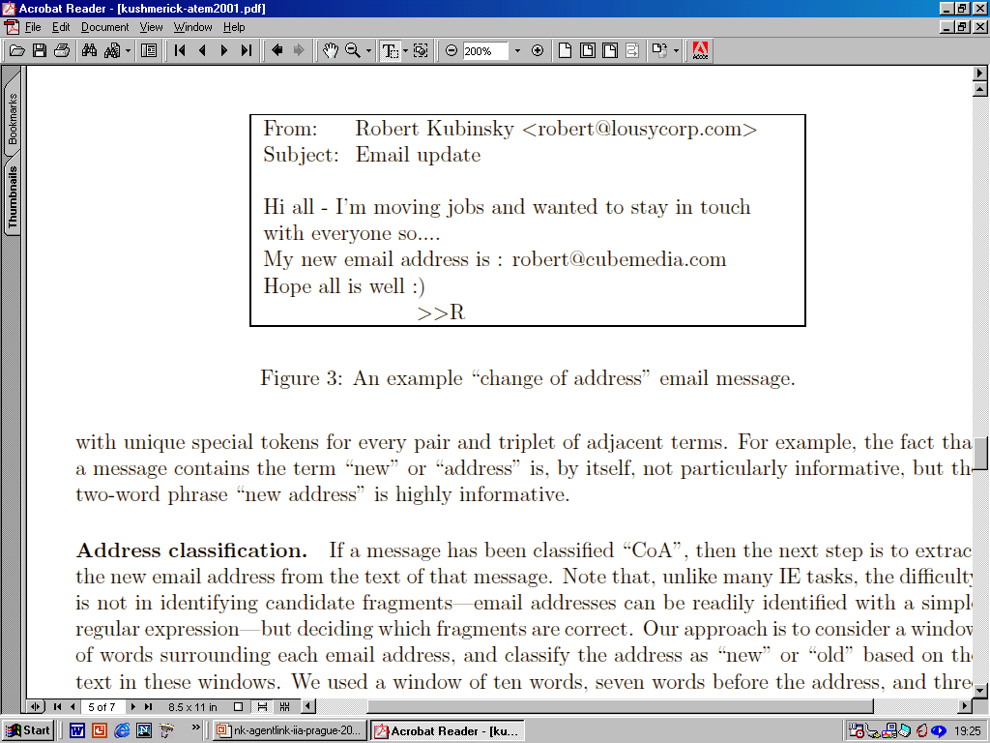
‘Change of Address’ email
Notes:
example from Nick Kushmerick, Irish guy, done lots of work in web IE
wrote a system to automatically handle COA emails
when someone sends you a COA email, rather than updating your address book manually, it should update it automatically

Slide 37
Change-of-Address detection [Kushmerick et al., ATEM 2001]
1. Classification
“message” naïve Bayes model
not CoA
Yes
everyone so.... My new email address is: robert@cubemedia.com Hope all is well :) >
From: Robert Kubinsky <robert@lousycorp.com> Subject: Email update Hi all - I’m
2. Extraction
“address” naïve-Bayes model
P[robert@lousycorp.com] = 0.28 P[robert@cubemedia.com] = 0.72
Notes:
so the system worked like this: two NB text classifiers
1. global text classifier: is this email a COA email? binary (like spam)
2. if so, which part is the new address?
ID email addresses using regexp
then apply NB classifier to each one to decide if new address
but can't feed whole doc into each NB prediction -- always same answer
so, make mini-doc using window around email address
hand-labeled data to train classifiers

Slide 38
Change-of-Address detection results [Kushmerick et al., ATEM 2001]
Corpus of 36 CoA emails and 5720 non-CoA emails
Results from 2-fold cross validations (train on half, test on other half)
Very skewed distribution intended to be realistic
Note very limited training data: only 18 training CoA messages per fold
36 CoA messages have 86 email addresses; old, new, and miscellaneous
 | P | R | F₁
Message classification | 98% | 97% | 98%
Address classification | 98% | 68% | 80%
Notes:
results: worked pretty nicely
two versions: one had only word features, others had phrase-based feature
98% F-measure is pretty awesome
on address classification, performance is unbalanced: very high P, so-so R
that was deliberate: automatic additions to address book need to be high precision
but overall, the performance is quite good!
nice example of how you can build a good IE system using a simple classifier
but: IMPORTANT: only works because of a very special property of this domain -- namely, you can write regexp for email addresses! so you can define windows
this is NOT the case with picking out person names, book titles, etc.
so this leads to the more general problem: we want to find subsequences of some category no matter where they are, and we can't easily identify candidates
so that leads to the kind of sequence model approaches we'll discuss next time

Slide 39
Information extraction as text classification

Slide 40
Sequence Models for Named Entity Recognition

Slide 41
The ML sequence model approach to NER
Training
Collect a set of representative training documents
Label each token for its entity class or other (O)
Design feature extractors appropriate to the text and classes
Train a sequence classifier to predict the labels from the data
Testing
Receive a set of testing documents
Run sequence model inference to label each token
Appropriately output the recognized entities

Slide 42
Encoding classes for sequence labeling
IO encoding IOB encoding
Fred PER B-PER
showed O O
Sue PER B-PER
Mengqiu PER B-PER
Huang PER I-PER
‘s O O
new O O
painting O O
Notes:
c classes: c + 1 labels vs. 2c + 1 labels. Stanford NER uses IO encoding
one way to think of task: sequence labeling, label each token with ORG/PER/.../O
one way you could eval is per-token, but that's not satisfactory
any user wants complete entity names
also, it's possible (though rare) to have adjacent entities "showed Sue Bill 's book"
standard eval is, you have subsequences of tokens and assess whether those are right
also, usually most tokens are O (other) -- this example not typical
so it doesn't seem like you should get points for getting O right
so we use the same eval metrics that are typical in IR: precision and recall

Slide 43
Features for sequence labeling
Words
Current word (essentially like a learned dictionary)
Previous/next word (context)
Other kinds of inferred linguistic classification
Part-of-speech tags
Label context
Previous (and perhaps next) label

Slide 44
Features: Word substrings
oxa
:
field
Cotrimoxazole
Wethersfield
Alien Fury: Countdown to Invasion

Slide 45
Features: Word shapes
Word Shapes
Map words to simplified representation that encodes attributes such as length, capitalization, numerals, Greek letters, internal punctuation, etc.
Varicella-zoster | Xx-xxx
mRNA | xXXX
CPA1 | XXXd

Slide 46
Sequence Models for Named Entity Recognition

Slide 47
Maximum entropy sequence models
Maximum entropy Markov models (MEMMs) or Conditional Markov models

Slide 48
Sequence problems
Many problems in NLP have data which is a sequence of characters, words, phrases, lines, or sentences …
We can think of our task as one of labeling each item
VBG | NN | IN | DT | NN | IN | NN
Chasing | opportunity | in | an | age | of | upheaval
B | B | I | I | B | I | B | I | B | B
而 | 相 | 对 | 于 | 这 | 些 | 品 | 牌 | 的 | 价
POS tagging
Word segmentation
Q
A
Q
A
A
A
Q
A
PERS | O | O | O | ORG | ORG
Murdoch | discusses | future | of | News | Corp.
Text segmen-tation
Named entity recognition

Slide 49
MEMM inference in systems
For a Conditional Markov Model (CMM) a.k.a. a Maximum Entropy Markov Model (MEMM), the classifier makes a single decision at a time, conditioned on evidence from observations and previous decisions
A larger space of sequences is usually explored via search
Features
Decision Point
Local Context
W₀ | 22.6
W₊₁ | %
W₋₁ | fell
T₋₁ | VBD
T₋₁-T₋₂ | NNP-VBD
hasDigit? | true
… | …
-3 | -2 | -1 | 0 | +1
DT | NNP | VBD | ??? | ???
The | Dow | fell | 22.6 | %
(Ratnaparkhi 1996; Toutanova et al. 2003, etc.)

Slide 50
Example: POS Tagging
Scoring individual labeling decisions is no more complex than standard classification decisions
We have some assumed labels to use for prior positions
We use features of those and the observed data (which can include current, previous, and next words) to predict the current label
Features
Decision Point
Local Context
W₀ | 22.6
W₊₁ | %
W₋₁ | fell
T₋₁ | VBD
T₋₁-T₋₂ | NNP-VBD
hasDigit? | true
… | …
-3 | -2 | -1 | 0 | +1
DT | NNP | VBD | ??? | ???
The | Dow | fell | 22.6 | %
(Ratnaparkhi 1996; Toutanova et al. 2003, etc.)

Slide 51
Example: POS Tagging
POS tagging Features can include:
Current, previous, next words in isolation or together.
Previous one, two, three tags.
Word-internal features: word types, suffixes, dashes, etc.
Features
Decision Point
Local Context
W₀ | 22.6
W₊₁ | %
W₋₁ | fell
T₋₁ | VBD
T₋₁-T₋₂ | NNP-VBD
hasDigit? | true
… | …
-3 | -2 | -1 | 0 | +1
DT | NNP | VBD | ??? | ???
The | Dow | fell | 22.6 | %
(Ratnaparkhi 1996; Toutanova et al. 2003, etc.)

Slide 52
Inference in Systems
Sequence
Data
Sequence Level
Sequence Model
Inference
Local Level
Label
Classifier Type
Label
Local
Data
Feature
Extraction
Local
Data
Local
Data
Optimization
Features
Smoothing
Features
Maximum Entropy Models
Conjugate
Gradient
Quadratic
Penalties

Slide 53
Greedy Inference
Sequence Model
Best Sequence
Inference
Greedy inference:
We just start at the left, and use our classifier at each position to assign a label
The classifier can depend on previous labeling decisions as well as observed data
Advantages:
Fast, no extra memory requirements
Very easy to implement
With rich features including observations to the right, it may perform quite well
Disadvantage:
Greedy. We make commit errors we cannot recover from

Slide 54
Beam Inference
Sequence Model
Best Sequence
Inference
Beam inference:
At each position keep the top k complete sequences.
Extend each sequence in each local way.
The extensions compete for the k slots at the next position.
Advantages:
Fast; beam sizes of 3–5 are almost as good as exact inference in many cases.
Easy to implement (no dynamic programming required).
Disadvantage:
Inexact: the globally best sequence can fall off the beam.

Slide 55
Viterbi Inference
Sequence Model
Best Sequence
Inference
Viterbi inference:
Dynamic programming or memoization.
Requires small window of state influence (e.g., past two states are relevant).
Advantage:
Exact: the global best sequence is returned.
Disadvantage:
Harder to implement long-distance state-state interactions (but beam inference tends not to allow long-distance resurrection of sequences anyway).

Slide 56
Viterbi Inference: J&M Ch. 6
I’m punting on this … read J&M Ch. 5/6.
I’ll do dynamic programming for parsing
Basically, providing you only look at neighboring states, you can dynamic program a search for the optimal state sequence

Slide 57
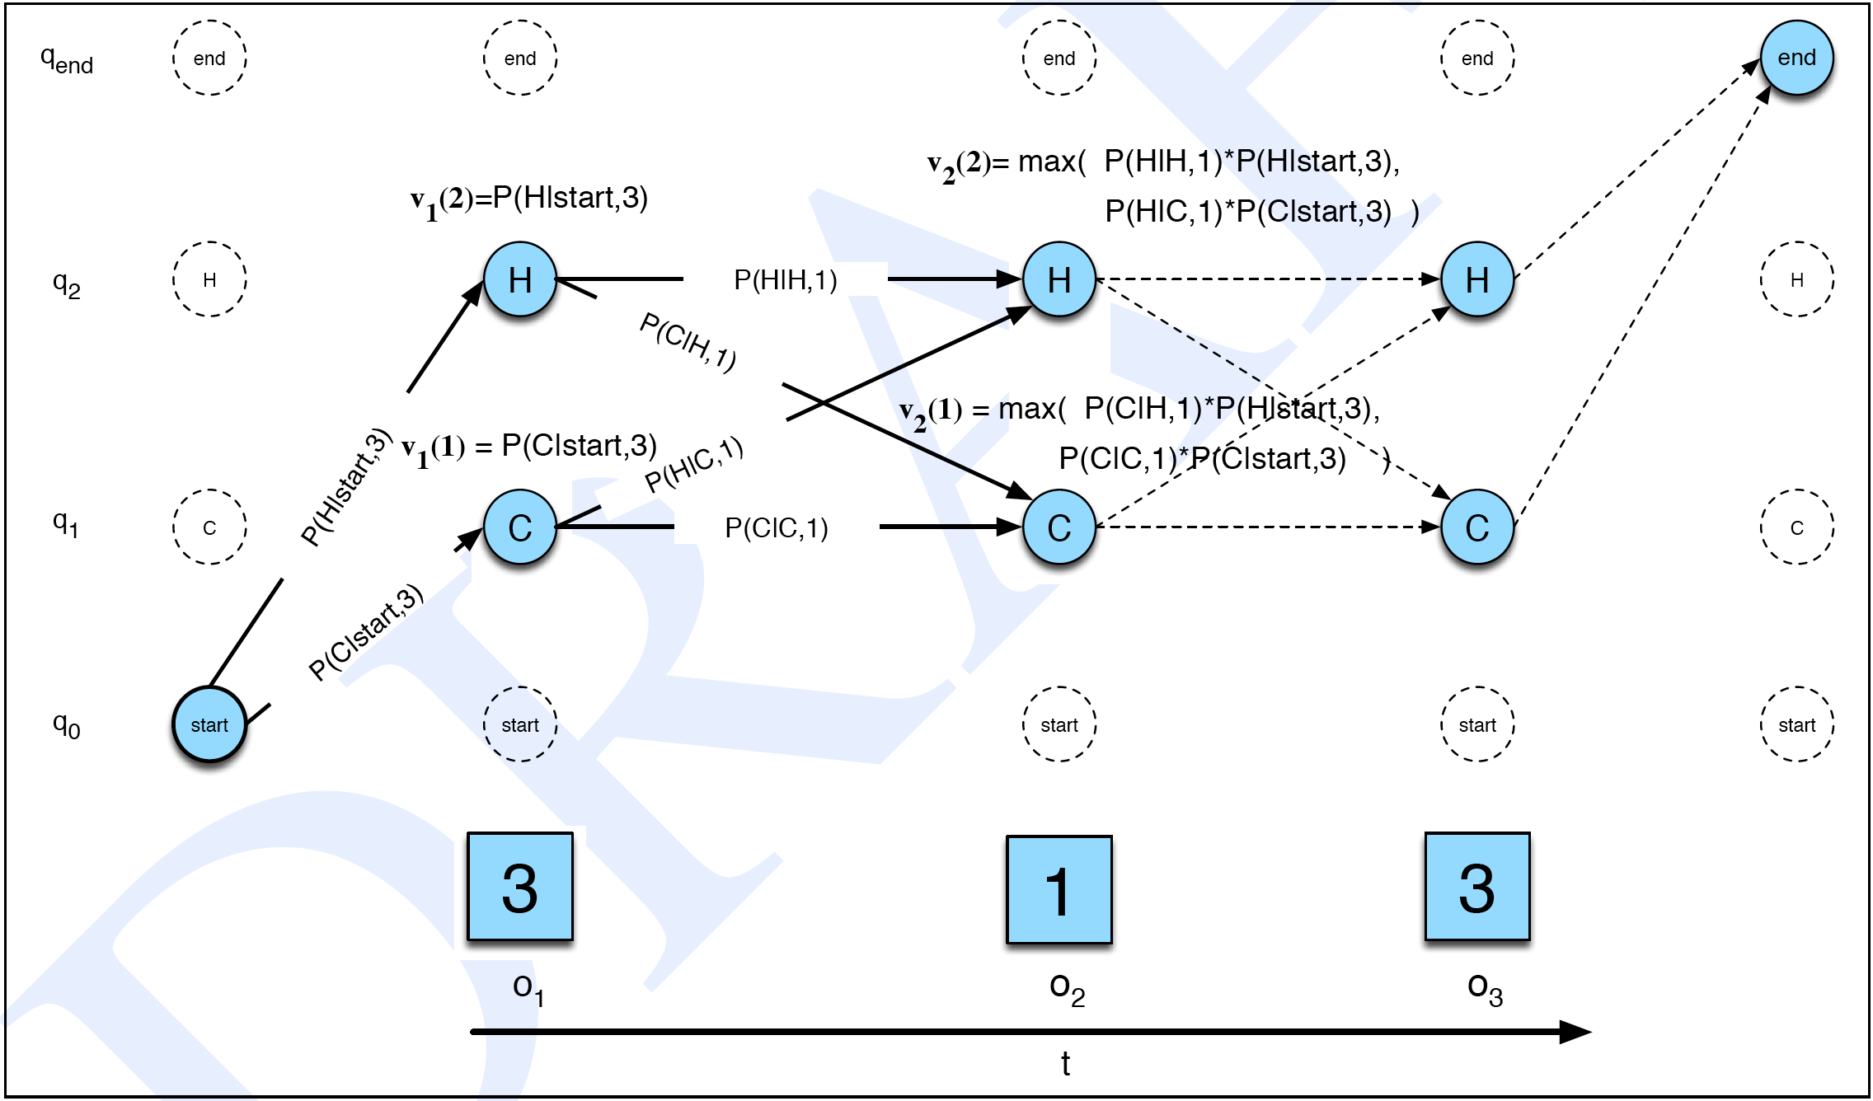
Viterbi Inference: J&M Ch. 5/6

Slide 58
CRFs [Lafferty, Pereira, and McCallum 2001]
Another sequence model: Conditional Random Fields (CRFs)
A whole-sequence conditional model rather than a chaining of local models.
The space of c’s is now the space of sequences
But if the features f_{i} remain local, the conditional sequence likelihood can be calculated exactly using dynamic programming
Training is slower, but CRFs avoid causal-competition biases
These (or a variant using a max margin criterion) are seen as the state-of-the-art these days … but in practice usually work much the same as MEMMs.

Slide 59
Maximum entropy sequence models
Maximum entropy Markov models (MEMMs) or Conditional Markov models

Slide 60
The Full Task of Information Extraction

Slide 61
The Full Task of Information Extraction
As a family of techniques:
Information Extraction =
segmentation + classification + association + clustering
For years, Microsoft Corporation CEO Bill Gates railed against the economic philosophy of open-source software with Orwellian fervor, denouncing its communal licensing as a "cancer" that stifled technological innovation.
Now Gates himself says Microsoft will gladly disclose its crown jewels--the coveted code behind the Windows operating system--to select customers.
"We can be open source. We love the concept of shared source," said Bill Veghte, a Microsoft VP. "That's a super-important shift for us in terms of code access.“
Richard Stallman, founder of the Free Software Foundation, countered saying…
Microsoft Corporation
CEO
Bill Gates
Gates
Microsoft
Bill Veghte
Microsoft
VP
Richard Stallman
founder
Free Software Foundation
Free Soft..
Microsoft
Microsoft
TITLE ORGANIZATION
founder
CEO
VP
Stallman
Veghte
NAME
Bill Gates
Richard
Bill
Slide by Andrew McCallum. Used with permission.
Notes:
what we've been talking about so far is really only part of IE
1. segmentation -- finding NE spans
2. classification -- assigning NEs to PERS/ORG/LOC
3. association -- grouping NEs into tuples which are relation instances
4. clustering -- merging duplicate instances, "Bill Gates" and "Gates"
we're only really talked about 1 and 2, which are done jointly by sequence model
we haven't talked much about 3 and 4

Slide 62
An Even Broader View
Create ontology
Spider
Filter by relevance
IE
Segment
Classify
Associate
Cluster
Database
Load DB
Document collection
Train extraction models
Query,
Search
Label training data
Data mine
Slide by Andrew McCallum. Used with permission.
Notes:
Up to now we have been focused on ML methods for segmentation and classification

Slide 63
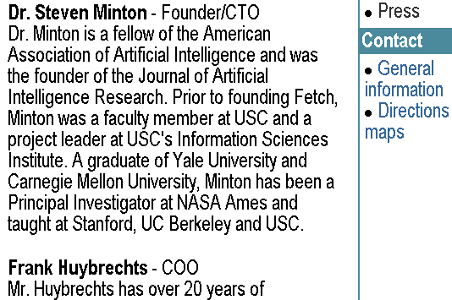
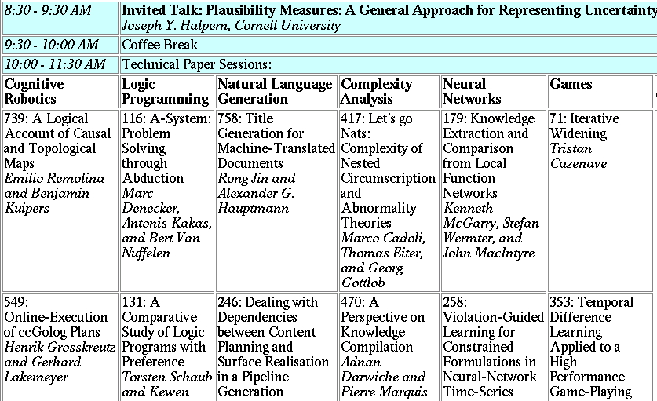
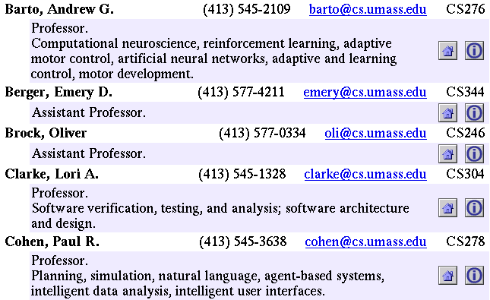
Landscape of IE Tasks: Document Formatting
Text paragraphs
without formatting
Grammatical sentences and some formatting & links
Astro Teller is the CEO and co-founder of BodyMedia. Astro holds a Ph.D. in Artificial Intelligence from Carnegie Mellon University, where he was inducted as a national Hertz fellow. His M.S. in symbolic and heuristic computation and B.S. in computer science are from Stanford University.
Non-grammatical snippets, rich formatting & links
Tables
Slide by Andrew McCallum. Used with permission.
Notes:
Different families of features may be more or less useful in different data sets.

Slide 64
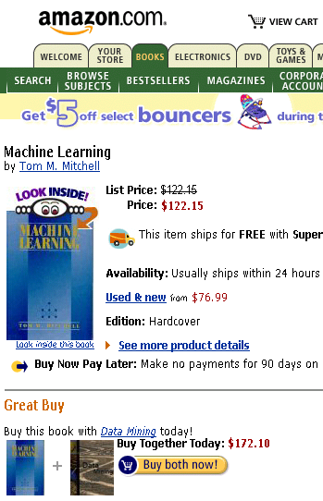


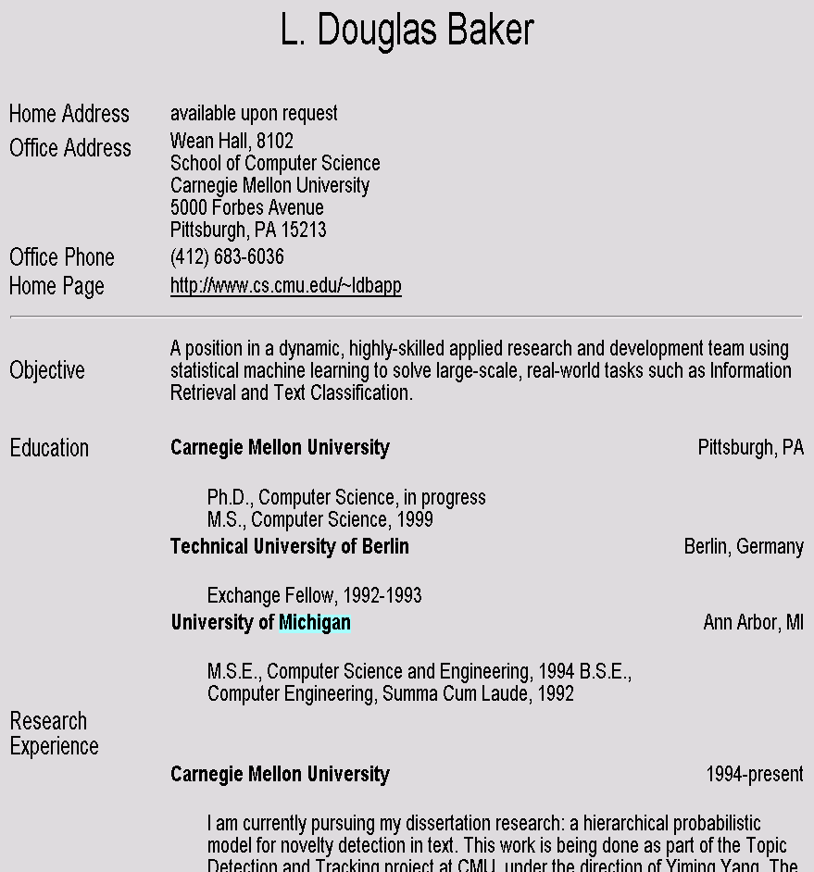
Landscape of IE Tasks Intended Breadth of Coverage
Web site specific
Genre specific
Wide, non-specific
Formatting
Layout
Language
Amazon.com Book Pages
Resumes
University Names
Slide by Andrew McCallum. Used with permission.
Notes:
If you were going to use formatting to do extraction, how often (with what granularity) would you have to re-train your models?

Slide 65
Landscape of IE Tasks : Complexity of entities/relations
Closed set
Regular set
U.S. states
U.S. phone numbers
He was born in Alabama…
Phone: (413) 545-1323
The big Wyoming sky…
The CALD main office is 412-268-1299
Ambiguous patterns, needing context and many sources of evidence
Complex pattern
U.S. postal addresses
Person names
University of Arkansas
P.O. Box 140
Hope, AR 71802
…was among the six houses sold by Hope Feldman that year.
Headquarters:
1128 Main Street, 4th Floor
Cincinnati, Ohio 45210
Pawel Opalinski, Software Engineer at WhizBang Labs.
Slide by Andrew McCallum. Used with permission.
Notes:
How complicated a modeling technique will you have to use?

Slide 66
Landscape of IE Tasks: Arity of relation
Jack Welch will retire as CEO of General Electric tomorrow. The top role at the Connecticut company will be filled by Jeffrey Immelt.
Single entity
Binary relationship
N-ary record
Person: Jack Welch
Relation: Person-Title
Person: Jack Welch
Title: CEO
Relation: Succession
Company: General Electric
Title: CEO
Out: Jack Welsh
In: Jeffrey Immelt
Person: Jeffrey Immelt
Location: Connecticut
Relation: Company-Location
Company: General Electric
Location: Connecticut
“Named entity” extraction
Slide by Andrew McCallum. Used with permission.
Notes:
How many components of the output of your system? Single entity…
It is more difficult to get high accuracy on the right than on the left, because each consituent has to be right, and errors compound. 90%^5=60%

Slide 67
Association task = Relation Extraction
Checking if groupings of entities are instances of a relation
Manually engineered rules
Rules defined over words/entites: “<company> located in <location>”
Rules defined over parsed text:
“((Obj <company>) (Verb located) (*) (Subj <location>))”
Machine Learning-based
Supervised: Learn relation classifier from examples
Partially-supervised: bootstrap rules/patterns from “seed” examples

Slide 68
Relation Extraction: Disease Outbreaks
May 19 1995, Atlanta -- The Centers for Disease Control and Prevention, which is in the front line of the world's response to the deadly Ebola epidemic in Zaire , is finding itself hard pressed to cope with the crisis…
Date | Disease Name | Location
Jan. 1995 | Malaria | Ethiopia
July 1995 | Mad Cow Disease | U.K.
Feb. 1995 | Pneumonia | U.S.
May 1995 | Ebola | Zaire
Information Extraction System

Slide 69
Relation Extraction: Protein Interactions
“We show that CBF-A and CBF-C interact
with each other to form a CBF-A-CBF-C complex
and that CBF-B does not interact with CBF-A or
CBF-C individually but that it associates with the
CBF-A-CBF-C complex.“
interact
complex
CBF-A CBF-C
CBF-B CBF-A-CBF-C complex
associates

Slide 70
Binary Relation Association as Binary Classification
Christos Faloutsos conferred with Ted Senator, the KDD 2003 General Chair.
Person
Person
Role
Person-Role (Christos Faloutsos, KDD 2003 General Chair) → NO
Person-Role ( Ted Senator, KDD 2003 General Chair) → YES

Slide 71
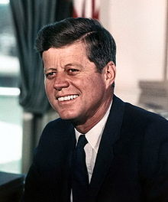
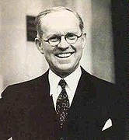
Resolving coreference (both within and across documents)
John Fitzgerald Kennedy was born at 83 Beals Street in Brookline, Massachusetts on Tuesday, May 29, 1917, at 3:00 pm,[7] the second son of Joseph P. Kennedy, Sr., and Rose Fitzgerald; Rose, in turn, was the eldest child of John "Honey Fitz" Fitzgerald, a prominent Boston political figure who was the city's mayor and a three-term member of Congress. Kennedy lived in Brookline for ten years and attended Edward Devotion School, Noble and Greenough Lower School, and the Dexter School, through 4th grade. In 1927, the family moved to 5040 Independence Avenue in Riverdale, Bronx, New York City; two years later, they moved to 294 Pondfield Road in Bronxville, New York, where Kennedy was a member of Scout Troop 2 (and was the first Boy Scout to become President).[8] Kennedy spent summers with his family at their home in Hyannisport, Massachusetts, and Christmas and Easter holidays with his family at their winter home in Palm Beach, Florida. For the 5th through 7th grade, Kennedy attended Riverdale Country School, a private school for boys. For 8th grade in September 1930, the 13-year old Kennedy attended Canterbury School in New Milford, Connecticut.
Notes:
Text and photos from wikipedia
Important problem
Appears in numerous real-world contexts
Plagues many applications
Citeseer, DBLife, AliBaba, Rexa, etc.

Slide 72
Rough Accuracy of Information Extraction
Information type | Accuracy
Entities | 90-98%
Attributes | 80%
Relations | 60-70%
Events | 50-60%
Errors cascade (error in entity tag → error in relation extraction)
These are very rough, actually optimistic, numbers
Hold for well-established tasks, but lower for many specific/novel IE tasks

Slide 73
The Full Task of Information Extraction

