Slide 1
Using R for Analysis

Slide 2
Jake Tolbert
Director of Data Services
Alumni & Development

Slide 3
R & R Studio
R - programming language with a focus on statistical analysis
R Studio - an IDE for R

Slide 4
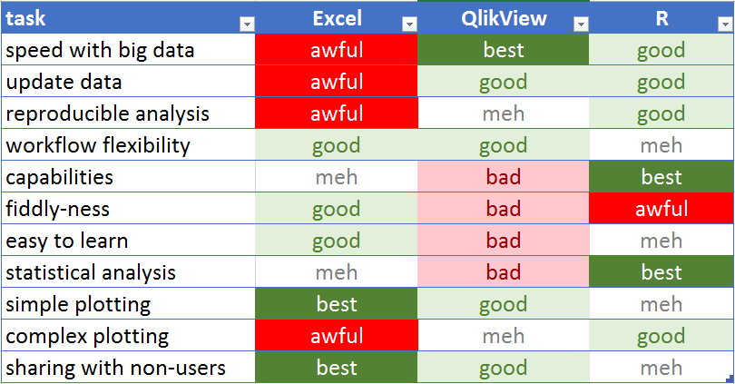
Tool Comparison

Slide 5
Complex Mailing Lists
Use R (or SQL or SAS or some such).
Data can change underneath, but criteria can be saved.
QV has no way to do complex filtering eg:
T&D majors around Decatur OR $1000 lifetime gifts to T&D Building

Slide 6
Pulling A List
# imagine I'm connected to a database with databases: # - majors_tbl with pidm, major # - regions_tbl with pidm, region # - donors_tbl with pidm, td_gifts, athletics_gifts, uc_gifts, scholarship_gifts # - demographic_tbl with pidm, mailing address, and more ... # get a list of all Theatre & Dance majors tdmajors <- majors_tbl %>% filter( major == 'TD' ) # get a list of everybody around Decatur arounddecatur <- regions_tbl %>% filter( region == 'DECATUR' ) # get T&D majors around Decatur td_around_decatur <- tdmajors %>% semi_join(arounddecatur, by = 'pidm') %>% distinct(pidm)

Slide 7
Pulling A List (cont.)
# get donors who've given $1000+ to Theatre & Dance building td_donors <- donors_tbl %>% filter(td_gifts >= 1000 ) %>% distinct(pidm) #combine both lists then add mailing data my_mailing <- bind_rows( td_around_decatur, td_donors) %>% left_join( demographic_tbl %>% select(pidm, name, address, city, st, zip) , by = 'pidm', copy = T ) %>% collect()

Slide 8
Exploratory Analysis
Use QV
load data
set up list boxes and charts
click around

Slide 9
Statisical Analysis
Use R for complex statistical analysis.

Slide 10
Quick Summary Data
summary(airlinedata$DEP_DELAY)
## Min. 1st Qu. Median Mean 3rd Qu. Max. NA's ## -151.00 -5.00 -1.00 11.55 9.00 1341.00 5135

Slide 11
Quick Summary Data
hist(airlinedata$ARR_DELAY)

Slide 12
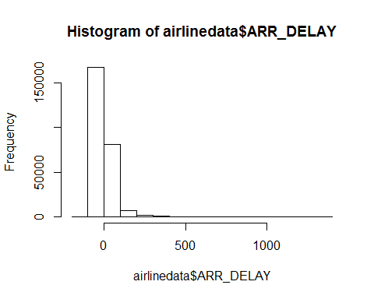

Slide 13
Quick Summary Data
boxplot(airlinedata$ARR_DELAY ~ airlinedata$UNIQUE_CARRIER, ylim = c(-20,50))

Slide 14
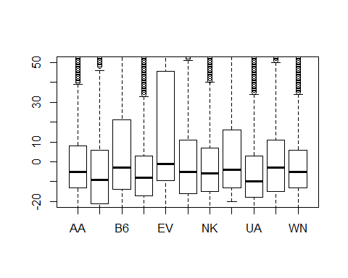

Slide 15
More Complex Analytical Tasks
cor.test(as.numeric(airlinedata$UNIQUE_CARRIER), airlinedata$ARR_DELAY)
## ## Pearson's product-moment correlation ## ## data: as.numeric(airlinedata$UNIQUE_CARRIER) and airlinedata$ARR_DELAY ## t = -24.003, df = 258120, p-value < 2.2e-16 ## alternative hypothesis: true correlation is not equal to 0 ## 95 percent confidence interval: ## -0.05104196 -0.04334354 ## sample estimates: ## cor ## -0.04719345

Slide 16
More Complex Analytical Tasks
t.test( airlinedata %>% filter(ORIGIN == 'ORD') %>% extract2('ARR_DELAY') , airlinedata %>% filter(ORIGIN == 'CLT') %>% extract2('ARR_DELAY') )
## ## Welch Two Sample t-test ## ## data: airlinedata %>% filter(ORIGIN == "ORD") %>% extract2("ARR_DELAY") and airlinedata %>% filter(ORIGIN == "CLT") %>% extract2("ARR_DELAY") ## t = -6.0808, df = 7862.8, p-value = 1.252e-09 ## alternative hypothesis: true difference in means is not equal to 0 ## 95 percent confidence interval: ## -6.674303 -3.420147 ## sample estimates: ## mean of x mean of y ## 1.953069 7.000294

Slide 17
Creating a Report for Others
Build with R Markdown
integrate Markdown + R into generated html/pdf.
Use QV for dashboards, etc.

Slide 18
Building Statistical Models
lm_model <- lm(ARR_DELAY ~ DAY_OF_WEEK + DEP_DELAY, data = mydata) rf_model <- randomForest( x = mydata %>% select(DAY_OF_WEEK , UNIQUE_CARRIER) , y = mydata$ARR_DELAY ) caret_model <- train( x = mydata %>% select(DAY_OF_WEEK , UNIQUE_CARRIER) , y = mydata$ARR_DELAY , trControl = trainControl(number = 3) )

Slide 19
Linear Model
tidy(lm_model)
## # A tibble: 3 x 5 ## term estimate std.error statistic p.value ## <chr> <dbl> <dbl> <dbl> <dbl> ## 1 (Intercept) -5.83 0.428 -13.6 1.80e-41 ## 2 DAY_OF_WEEK -0.0470 0.0943 -0.499 6.18e- 1 ## 3 DEP_DELAY 1.02 0.00480 212. 0.

Slide 20
Random Forest Model
rf_model
## ## Call: ## randomForest(x = mydata %>% select(DAY_OF_WEEK, UNIQUE_CARRIER), y = mydata$ARR_DELAY) ## Type of random forest: regression ## Number of trees: 500 ## No. of variables tried at each split: 1 ## ## Mean of squared residuals: 1732.185 ## % Var explained: 0.81

Slide 21
Caret Model
caret_model
## Random Forest ## ## 5000 samples ## 2 predictor ## ## No pre-processing ## Resampling: Bootstrapped (3 reps) ## Summary of sample sizes: 5000, 5000, 5000 ## Resampling results: ## ## RMSE Rsquared MAE ## 42.499 0.006168087 24.07448 ## ## Tuning parameter 'mtry' was held constant at a value of 2

Slide 22
Predict New Cases
newdata <- data_frame( DAY_OF_WEEK = c(1L,2L,3L,4L,5L) , UNIQUE_CARRIER = factor( c("AA", "AS", "EV", "WN", "OO") , levels = levels(mydata$UNIQUE_CARRIER) ) ) predictions <- predict(caret_model, newdata) newdata$predictedDelay <- predictions newdata
## # A tibble: 5 x 3 ## DAY_OF_WEEK UNIQUE_CARRIER predictedDelay ## <int> <fct> <dbl> ## 1 1 AA 2.23 ## 2 2 AS -6.77 ## 3 3 EV 3.23 ## 4 4 WN 5.86 ## 5 5 OO 4.52

Slide 23
Use the Tidyverse
a series of packages creating a new grammar for R

Slide 24
Base R - Use Nested Functions
bop( scoop( hop(foo_foo, through = forest), up = field_mice ), on = head )

Slide 25
Lots of Little Steps, Saving New Objects
foo_foo_1 <- hop( foo_foo , through = forest) foo_foo_2 <- scoop(foo_foo_1, up = field_mice) foo_foo_3 <- bop( foo_foo_2, on = head)

Slide 26
Lots of Little Steps, Overwriting Each Time
foo_foo <- hop( foo_foo, through = forest) foo_foo <- scoop(foo_foo, up = field_mice) foo_foo <- bop( foo_foo, on = head)

Slide 27
Use the Pipe
foo_foo %>% hop(through = forest) %>% scoop(up = field_mouse) %>% bop(on = head)

Slide 28
Dplyr’s Verbs
airlinedata %>% mutate( DepTime = as.numeric(str_remove(DEP_TIME_BLK, "-.*")) , DepMorning = ifelse(DepTime < 12, "morning", "evening") ) %>% filter(ORIGIN == 'ORD' | ORIGIN == 'MIA') %>% select(ORIGIN, DAY_OF_WEEK, FL_DATE, ARR_DELAY, DEP_DELAY, UNIQUE_CARRIER) %>% arrange(DEP_DELAY)
## # A tibble: 7,844 x 6 ## ORIGIN DAY_OF_WEEK FL_DATE ARR_DELAY DEP_DELAY UNIQUE_CARRIER ## <fct> <int> <date> <int> <int> <fct> ## 1 MIA 2 2017-08-29 -25 -21 DL ## 2 MIA 3 2017-08-30 -31 -19 DL ## 3 ORD 1 2017-01-30 -36 -18 F9 ## 4 ORD 6 2017-02-04 -37 -18 NK ## 5 ORD 1 2017-04-17 -16 -18 NK ## 6 ORD 4 2017-09-21 -5 -18 NK ## 7 ORD 5 2017-11-24 -20 -18 UA ## 8 ORD 2 2017-01-17 -29 -17 NK ## 9 ORD 6 2017-03-11 13 -17 NK ## 10 ORD 1 2017-04-17 -29 -17 F9 ## # ... with 7,834 more rows

Slide 29
Pivot Table Verbs
airlinedata %>% group_by(UNIQUE_CARRIER) %>% summarize( n_flights = n() , mean_delay = mean(ARR_DELAY, na.rm = T) , median_delay = median(ARR_DELAY, na.rm = T) )
## # A tibble: 11 x 4 ## UNIQUE_CARRIER n_flights mean_delay median_delay ## <fct> <int> <dbl> <dbl> ## 1 AA 35860 5.40 -5 ## 2 AS 2315 -3.31 -9 ## 3 B6 40608 14.9 -3 ## 4 DL 35708 1.33 -8 ## 5 EV 79 46.4 -1 ## 6 F9 20827 8.67 -5 ## 7 NK 20747 5.50 -6 ## 8 OO 22 5.77 -4 ## 9 UA 23809 1.41 -10 ## 10 VX 1132 3.48 -3 ## 11 WN 82852 3.02 -5

Slide 30
Fancy Plotting - Dates vs. Arrival Delay
ggplot(mydata, aes(x = FL_DATE, y = ARR_DELAY)) + geom_point(aes(color = UNIQUE_CARRIER)) + geom_smooth()

Slide 31
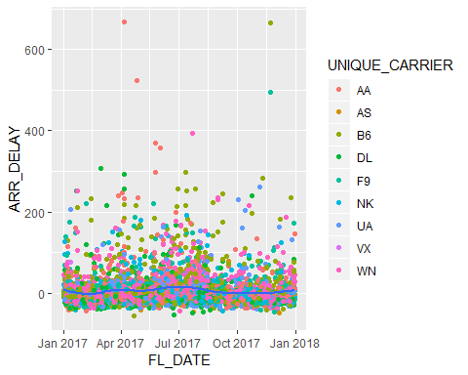

Slide 32
Fancy Plotting - Dates vs. Arrival Delay
ggplot(mydata, aes(x = FL_DATE, y = ARR_DELAY)) + geom_jitter(alpha = .5, aes(color = UNIQUE_CARRIER)) + geom_smooth() + coord_cartesian(ylim = c(0,100))

Slide 33
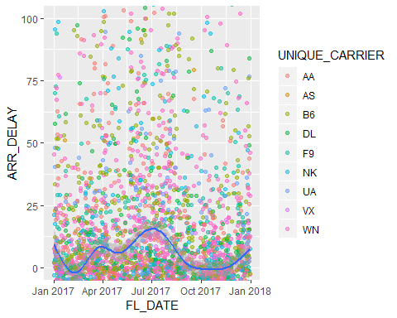

Slide 34
Fancy Plotting- Dates vs. Arrival Delay
ggplot(mydata, aes(x = FL_DATE, y = ARR_DELAY)) + geom_jitter(alpha = .5, aes(color = UNIQUE_CARRIER)) + geom_smooth() + coord_cartesian(ylim = c(0,100)) + facet_wrap(~UNIQUE_CARRIER)

Slide 35
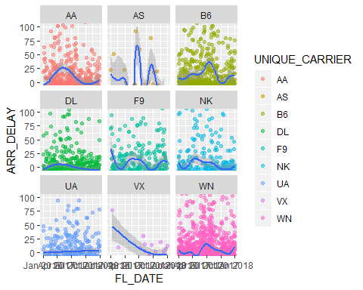

Slide 36
Lots More Code Examples on Github
https://github.com/crazybilly/airline-is470-class
clone the repo to your desktop and open airline-project.Rproj
documentation in Rmd/html files
code examples in R files

