Slide 1
Learning Day : Design Patterns Factories
22/08/14

Slide 2
Agenda
What Are Factories
The Simple Factory (Not a Pattern)
The Factory Method Pattern
The Abstract Factory Pattern
Comparison of the Factory Patterns

Slide 3
01. What Are Factories?
Factories provide a way of decoupling object instantiation code away from client classes. This means that a factory can have several clients that all rely on the Factory to provide object instantiation. Factories makes sense if you have sets of related concrete classes.
Typically, Factories are classes that have a method of the form,
InterfaceType* createObject(arg)
The arg is used to define which particular object we would like created.
Factories rely heavily on polymorphism. All concrete class are subclasses of an interface/abstract class. As shown in the method signature above, the method will return any class that is a subclass of the interface/abstract class.

Slide 4
02. What Are Factories?
Typical Code to Instantiate Related Concrete Classes…
Duck* duck;
If(picnic)
{
duck = new MallardDuck();
}
else if(hunting)
{
duck = new DecoyDuck();
}
else if(bathTub)
{
duck = new RubberDuck();
}

Slide 5
03. What Are Factories?
Creating a Factory Class…
Duck* duck;
Duck* DuckFactory::createDuck(std::string arg_duckType)
{
If(arg_ducktype == “picnic”)
{
duck = new MallardDuck();
}
else if(arg_ducktype == “ hunting”)
{
duck = new DecoyDuck();
}
else if(arg_ducktype == “ bathTub”)
{
duck = new RubberDuck();
}
return duck;

Slide 6
04. What Are Factories?
What’s the Advantage of Putting this Code into a Factory Class…
Supports multiple clients that require object instantiation.
By encapsulating this code in a single class will mean there is only one place to make modifications in the future.
We can sub class our Factory Class to make other factories that will inherit all the behaviour of the parent class, with the benefit of being able to modified that behaviour. This is an important feature of the Factory Patterns.

Slide 7
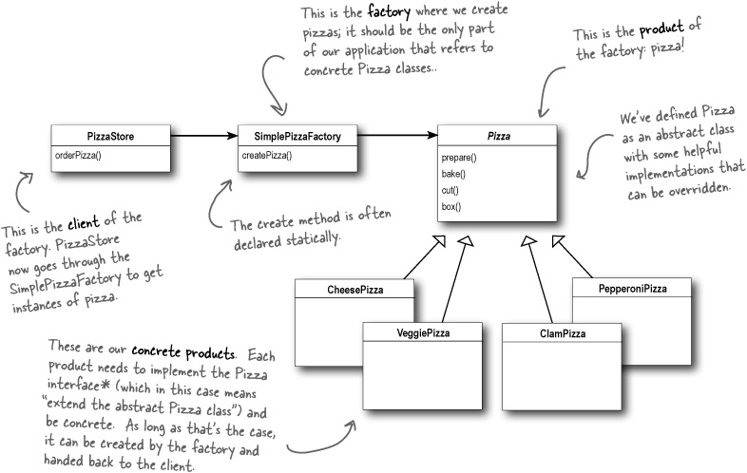
The Simple Factory (Not a Pattern)
Head First : Design Patterns

