Slide 1


Ravi Jannu

Slide 2

AGENDA
What do we have?
Where are we spending more?
Analyze spending patterns
Strategies for saving costs in GCP
Revamp access controls & monitoring.
Increase alert system & reporting.

Slide 3
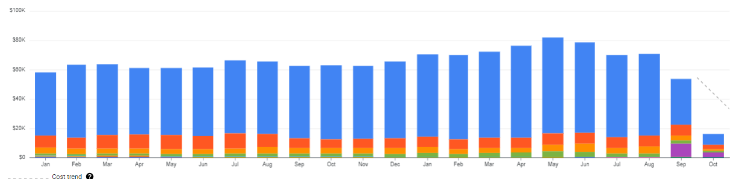
How much we pay now?
Targeting here!!! Further, bring down the cost
Overall Cost By Service Billing Trend from Jan’22 to Current

Slide 4
What do we have?
In our current GCP environment, we're managing a substantial portfolio, consisting of:
74 Projects(54 active projects)
347 GCS Buckets
591 BigQuery Datasets
28,228 BigQuery Tables
24 active VM instances out of a total of 51
3 Composer environments (ETL)
Additionally, there are miscellaneous resources in our GCP environment.
BigQuery
Compute Engine
Cloud Storage
Cloud Composer
Others
591 Datasets
28K Table
1K Shard Obj
40 PB data
51 VM’s total
21 notebooks
3 GKE clusters
Total 347 buckets
1 composer2(M)
1 composer2(S)
1 compser1(M)
Cloud SQL
Cloud Logging
N/w
GKE
Notebooks
Slots(New)

Slide 5
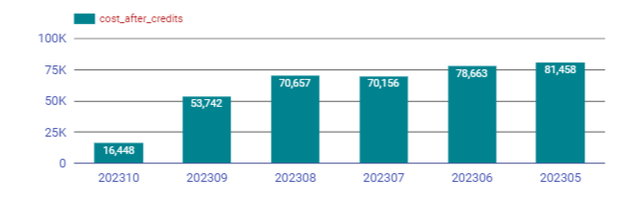
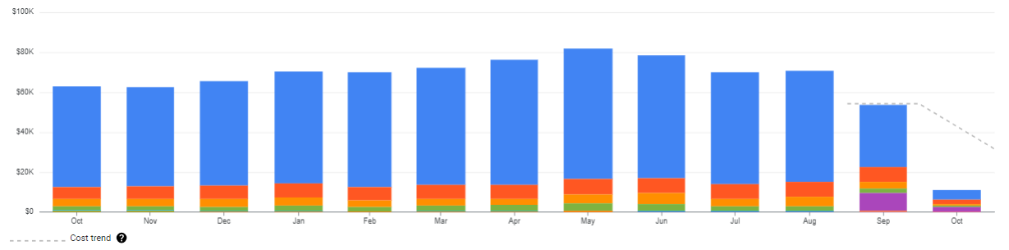
What do we have?
Overall & Cost By Service from May’23 to Oct’23
BigQuery
Compute Engine
Cloud Storage
Cloud Composer
Others
80% usage
50k avg/mon
Query cost
Storage cost
10% usage
10k avg/mon
VM’s cost
Storage cost
6% usage
5k avg/mon
Storage cost
2% usage
3k avg/mon
Service cost
Cloud SQL
Cloud Logging
N/w
GKE
Notebooks
Slots(New)

Slide 6
Where are we spending more?
Deep Dive BQ Service- 80% of cost goes under BQ Query Cost and Storage
BigQuery
70+ active user accounts,80+ service accounts, and around 35K jobs submitted per day, we process around 150 TB of data.
Analysis
Slots
We switched to BQ Editions, Capacity-based pricing for some of the projects from on-demand pricing model.
BI Engine
Recently enabled BI engine for survey reporting under LLD project.
Compute Engine
Logical Storage
Active storage of 279 TB ($20 per TB)
Long-term storage of 1.1 PB ($10 per TB)
Active storage of 65 TB ($40 per TB)-Compressed
Long-term storage of 131 TB($20 per TB)
Started leverage BQ physical model.
Physical Storage
Streaming Insert
we have some applications that stream data to BQ.

Slide 7
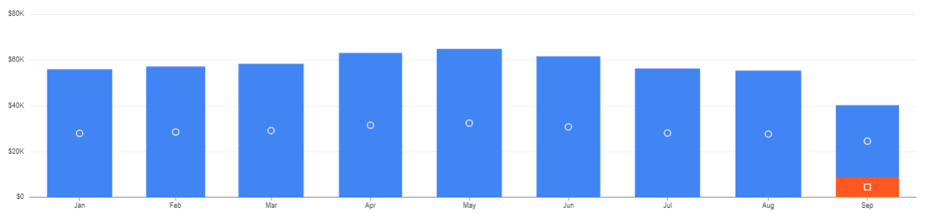
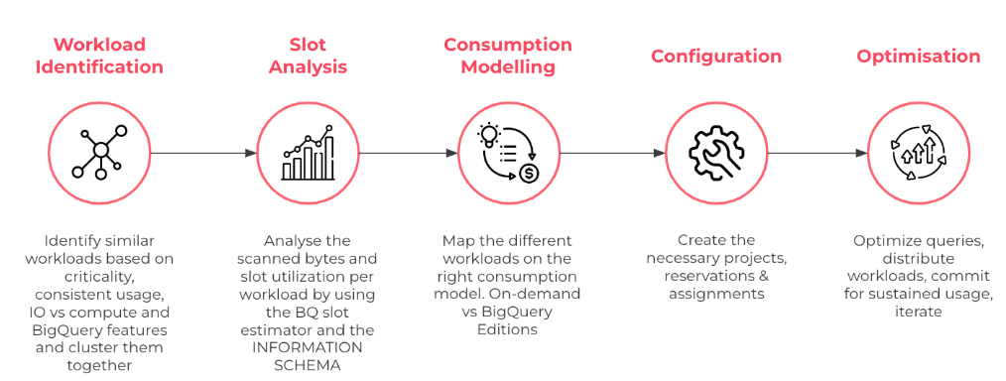
Analyze spending patterns-BQ Analysis
BQ Service Cost from Jan’23 to Sept’23
We started leveraging the BigQuery Editions, which Google has announced recently, this allowed us to get charged based on BigQuery Slots, so we started analyzing our BQ usage and mapped different projects based on the right consumption model without any impact on performance.

Slide 8
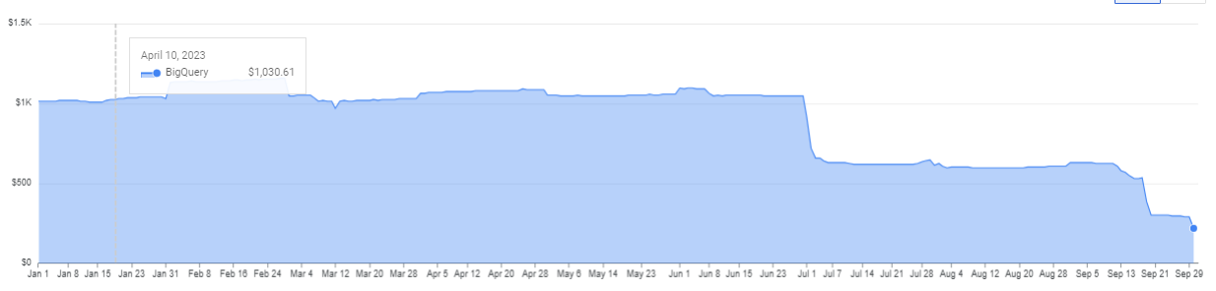
Analyze spending patterns-BQ Storage
BQ Storage Service Cost from Jan’23 to Sept’23
Also, we started leveraging the BigQuery Dataset Physical Storage Model, which Google has announced recently, this allowed us to get pay based on compressed storage instead of raw data storage which google default earlier, so we started analyzing our BQ Datasets and switched larger datasets where the compression ratio is higher.
OVERALL BQ KEY OPTIMIZATION STRATEGIES:
BQ
Switched to the Capacity(slot) pricing model for some projects.
Dropped serval objects as part of compliance cleanup and applied retention policy for some of the large subject areas.
Identifying and migrating non-critical and batch jobs to a slots-based model will save another 2 -5 k per month.
STORAGE-
Reduced the overall long-term storage cost by 44% by dropping the older data as part of compliance and applying the new feature of physical storage on some of the larger datasets.
Currently, the team working on it to further bring down the logical storage billing.

Slide 9
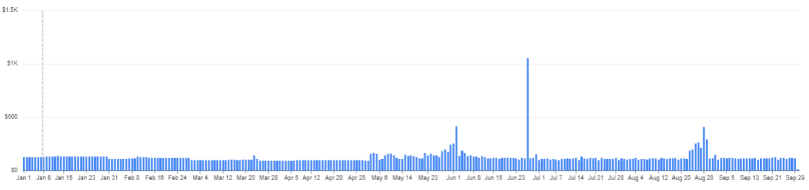
Analyze spending patterns-GCS Storage
GCS Storage Service Cost from Jan’23 to Sept’23
We are consistent, keeping only the data required and moving the data to the different storage tiers like cold line and archive by using bucket lifecycle management, reviewing the use of each bucket comprising the service, and optimizing the specifications like setting proper bucket lifecycle or auto class policy on each bucket as per the usage patterns and data storage.
OVERALL GCS KEY OPTIMIZATION POINTS:
Applied bucket lifecycle rules to all the standard storage class buckets.
Dropped serval objects as part of compliance cleanup and applied retention policy for some of the large subject areas.
Added more monitoring and budgeting alerts.
Planning to cut another $20-30 per day from the current 115 avg per day bill, so we could save around 20 to 25% from here.

Slide 10
Cost Optimization for Compute Engines
Compute Engines
Optimizations
Getting rid of idle Cloud resources by listing unnecessary/unused/costly services and asking teams about the opportunities to cut costs.
Releasing unused disks attached to VMs.
Asking users to enable the VM scheduler to shut off the machines especially notebooks when they are not in use.
For the development team, we planned to have shared resources instead of separate env., for each team.
VMs account for 10% of the entire bill
51 VMs total
21 notebooks
3 GKE clusters(will be part of the Composer Environment)
Avg 7K monthly cost-(mainly cost comes from analytics workloads)
Scope to save 1 to 2k here, if users follow proper guideline from GCPAdmin Teams

Slide 11
Chargeback Process
As we increase our GCP footprint, it’s critical to ensure costs are being managed effectively and follow the process of mapping cloud consumption to internal consumer teams within our Org, this will ensure that each individual team is responsible for their cloud consumption, aligns resource usage, and provides transparency.
CHARGEBACK PROCESS:
We have two main groups data producers and data consumers.
We are in the process of mapping user groups to teams based on the nature of usage and resources they need.
Currently, we are doing chargebacks only 35 to 40% of the total bill, but going forward we need to increase this by aligning teams.
Setting up the host project for each individual team will help in the design and implementation of an effective chargeback process, and also allow internal teams to be proactively aware of the cost of the resources they use.

Slide 12
Teams Mapping– Roles, Responsibilities & Privileges
Below Roles Applied to Team Level
Different Teams
TN-
Admin
Data Producers
BD Team
CDA Team
Segmentation Team
DiServices Team
PCHMedia
Data Consumers
Analytics
Bi Reporting
Credit Collections
App Team-CS
App Team- Frontend Services
App Team –Prize Machine
Marketing Grp1
QA Team
DB2 Team
Super Admin Control over services etc.
Roles Applied
Across Team
TN-DS
Global
Roles
GCP-Admin Teams
TN-Service Accnts
TN-SS
ROOT
[pch.com]
SUPER
ADMIN
TN-DD
TN-QA
TN-DM
TN-QA-Viewer
TN-Auditors
Others..
TN-Viewers

Slide 13
Compiling additional lists of resources for further optimization |  | Best practice
1 | BQ | We have a plan to remove outdated items from our list of older projects. Switch more datasets to physical storage from logical, based on the compression ratio report. Need to opt for 1-year slot commitments to further lower our bill by 20% on based slots only. Migrate non-critical/batch jobs to leverage slots-based billing model instead of on-demand. Reviewing and refining access control policies to ensure that only authorized users or services have access to the resources requested. Adopting data exchange platform Analytics Hub to share data across different projects, now users can discover, and access data library shared by various data provider teams.
2 | Monitoring & Reporting | Referring to built-in reports, cost breakdown by service/SKU, and enhancing custom reports. Identifying the sudden spikes in cloud cost by using custom triggers and alerting features. Adding more dashboard reports to monitor slot usage for optimum allocation.
3 | Taking Charge Of VM’s. | Sending notifications to teams to stop the instances when not in use. Releasing the unused disks attached to VMs.
4 | GCS Storage | Consider archiving rarely accessed data to Coldline or Archival storage classes. Continuously, identifying and removing outdated or unused data to free up storage space. Setting up reports and alerts to notify unusual data storage activity, and sudden spikes in usage. Implementing object lifecycle policies to automatically delete or archive objects when they are no longer needed.
5 | Misc., | Creating user groups, associating host projects with their respective groups, and then implementing access controls, slot reservation, allocation, and implement charge-back to various host project teams based on the actual usage of the services.

Slide 14
Key Milestones
Some keys points in our plan:
Planning to hold monthly working sessions with consumer groups and the engineering teams to communicate usage and expenditures while engaging in discussions.
Increase monitoring and alerting process regularly to identify potential opportunities for improvements, take out unnecessary and underutilized resources, and handle version upgrade issues down the road.
Recommend a new list of features applicable to different use cases, so that the data teams can make an informed decisions.
Estimate and Stabilize Slots Usage as per workloads
Slots Commitment
Storage, Compute Optimizations
Leverage
On-Prem
HDL Cluster
for adhoc spark jobs
Composer1 Migration
Analytics Hub
& Mapping User Groups to Teams
Apply Chargeback Process
Streamline Access Request Process
Custom Monitoring &
Alerts
Many more to come….
Overall, our objective is to reduce expenses by an additional 5-6K per month.

Slide 15


