Slide 1

DECENTRALIZED VOTING SYSTEM

Slide 2
Problem Statement
Current voting systems like ballot box voting or electronic voting suffer from various security threats such as DDoS attacks, polling booth capturing, vote alteration and manipulation, malware attacks, etc, and also require huge amounts of paperwork, human resources, and time. This creates a sense of distrust among existing systems.

Slide 3
Decentralized Voting System using Blockchain
Why do we need it?
Long Queues during elections
Security Breaches like data leaks, vote tampering.
Lot of paperwork involved, hence less eco-friendly and time-consuming.
Difficult for differently-abled voters to reach polling booth.
Cost of expenditure on elections is high.

Slide 4
Solution
Using blockchain, voting process can be made more secure, transparent, immutable, and reliable.

Slide 5
Blockchain Technology
Blockchain is a technology that is rapidly gaining momentum in era of industry 4.0. With high security and transparency provisions, it is being widely used in supply chain management systems, healthcare, payments, business, IOT, voting systems, etc.

Slide 6
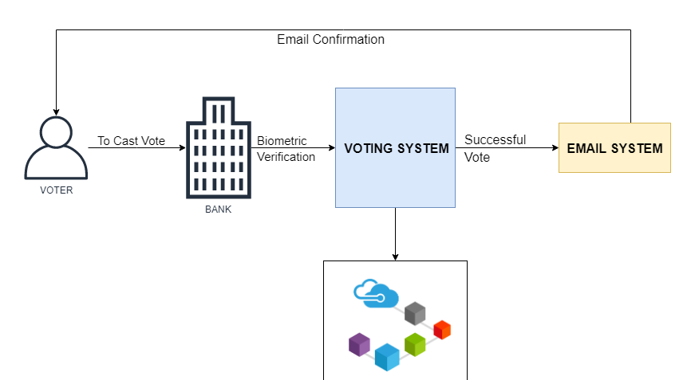
Let’s visualize process
server

Slide 7
Advantages
You can vote anytime/anywhere (During Pandemics like COVID-19 where it’s impossible to hold elections physically
Secure
Immutable
Faster
Transparent

Slide 8
“Q & A Session”

Slide 9
Thank you

