Slide 1
SMART
SPACE

Slide 2


Charleston Digital Corridor
Park Now
Park Later

Slide 3

Malfunction. Need Input.

Slide 4
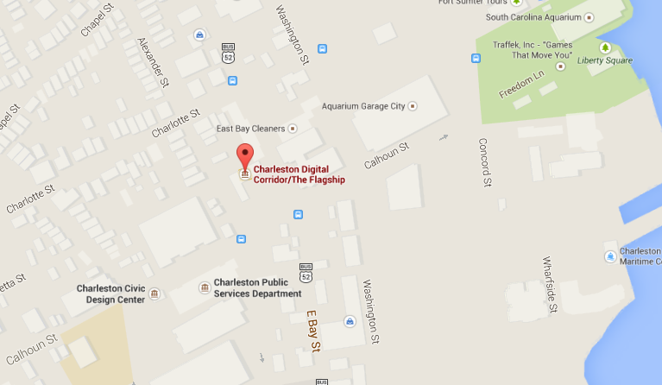

Sort by:
$

Slide 5
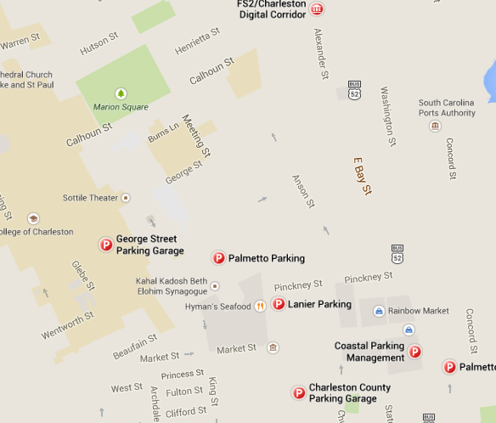
Results:
1.George Street Parking Garage
2.Palmetto Parking
3.Lanier Parking
4.Coastal Parking Management
5.Charleston County Parking Garage
6. Palmett Park
1
2
3
4
6
5

Slide 6
Location/Venue
MM/DD/YYYY

Slide 7

Reserve now:
Rate info:
$$$
$$$
$$$
Blah blah blah
Back to results

Slide 8
No Parking available.
Back to results

