Slide 1
University Grade and Attendance Tracker
Java Project
Team Members:
Faizan Shaik – 2620040127
Swadhin behera – 2620040149
Class:
Section 8
Faculty:
V Gopi Krishna

Slide 2




PROJECT OVERVIEW
Project Overview
CO1 – CO6 Coverage
Input Collection
Demonstrates six Java course outcomes — from data types to streams — in one integrated tracker.
Collects student name, subject count, marks, and attendance in a structured Java workflow.
Grade & Attendance
Processes marks and attendance to assign a grade and check exam eligibility through Average → Grade → Eligibility stages.
Academic Workflow
Capture inputs, calculate totals and averages, assign grades, check eligibility, and report results.

Slide 3


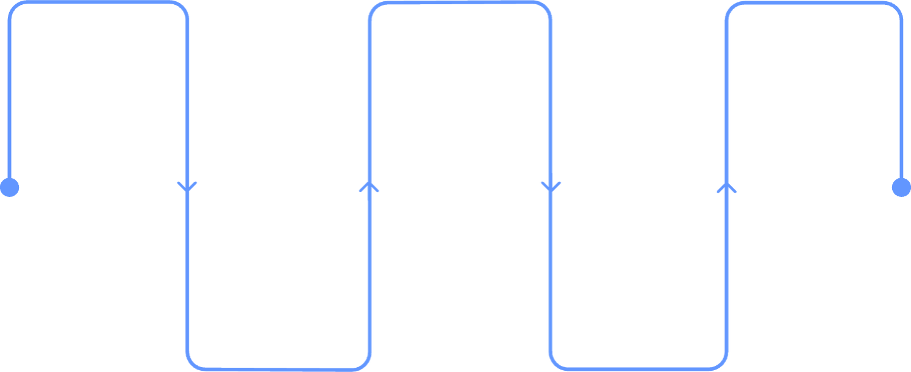
FINAL PROJECT
Academic Status Workflow
Tracker Workflow
Accept Inputs
Enter student name, subject count, marks, and attendance
Processing Flow
Calculate Marks
Compute total and average marks
Input Collection
Attendance Check
Academic Status
Report grade and eligibility
Read student and subject data
Apply the 75% attendance rule
Assign Grade & Eligibility
A–D grade; attendance ≥ 75% → Eligible
Marks Calculation
Report Status
Total and average marks
Grade Assignment
Map average to grade A–D
Present the final student academic report
Final Output
Show the final academic status: Eligible or Not Eligible

Slide 4

CO1
Data Types and Variables
How Java data types and variables store every student record:
Code Snippet
int
String
Subject count and marks — e.g., 5, 86
Average marks and attendance percentage
int subjects = 5;
double attendance = 82.5;
String grade = "A";
String studentName = "Anita";
String
String
Student name, grade, eligibility status
Named variables keep the tracker readable
Variables act as named boxes that hold student data throughout the program's lifetime.

Slide 5
CO2
Selection and Iteration
Code Snippet
How it works in the Tracker
1
if-else Checks Attendance
if (attendance >= 75) {
eligible = true;
} else {
eligible = false;
}
for (int i = 0; i < subjects; i++) {
total += marks[i];
}
Checks whether a courier is at least 75%, eligible, or not eligible and reports exam eligibility.
2
for Loop Totals Marks
Reads each subject mark and adds it to the total.

Slide 6

CO3
Methods and Arrays
1
Code Snippet
readMarks()
int[] marks = new int[subjects];
double average = calculateAverage(marks);
String assignGrade(double average) {
if (average >= 75) return "A";
return "B";
}
// Arrays store marks before processing
int[] marks = new int[subjects];
}
Collects subject marks into an array.
2
calculateAverage()
Returns total divided by subject count.
3
Arrays
Converts the average into grade A, B, C, or D.

Slide 7



CO4
Objects, Classes, Inheritance, Interfaces & Exceptions
Class Structure & Code
class Student {
String name;
int[] marks;
double attendance;
String grade;
}
class HonoursStudent extends Student {
// Reusable student specialization
}
interface Reportable {
void generateReport();
}
try {
if (attendance < 0 || attendance > 100)
throw new Exception("Invalid attendance");
} catch (Exception e) {
System.out.println(e.getMessage());
}
Class & Object
Student is the blueprint; each record added is an object — an instance with its own data.
Inheritance
HonoursStudent extends Student to inherit all base fields with extra speed features.
Exception Handling
try-catch catches invalid subject counts, marks, or attendance values.

Slide 8


CO5
Strings, Library Files, and Data Engineering
Code Snippet
String Methods Used
Scanner Input
Reads student name, subject count, marks, and attendance at runtime.
Scanner sc = new Scanner(System.in);
String studentName = sc.nextLine();
FileWriter fw = new FileWriter("student-reports.txt");
fw.write(studentName + "," + grade);
fw.close();
if (studentName.contains("A")) {
System.out.println("Formatted student report");
}
equals() · contains() · toUpperCase() — used to format and compare student report values.
File Handling
FileWriter saves student reports to student-reports.txt for persistent storage and retrieval.

Slide 9

CO6
Collections, Streams, and Student Data Pipeline
Code Snippet
Data Pipeline Flow
ArrayList<Student> students
= new ArrayList<>();
students.add(
new Student("Anita", 82.5, 5));
students.stream()
.filter(c ->
s.attendance >= 75)
.forEach(c ->
System.out.println(s.name));
Collect Student Data
Filter Eligible Students
Store Student Records
ArrayList stores records dynamically; Streams filter eligible students with clean, readable operations.

Slide 10
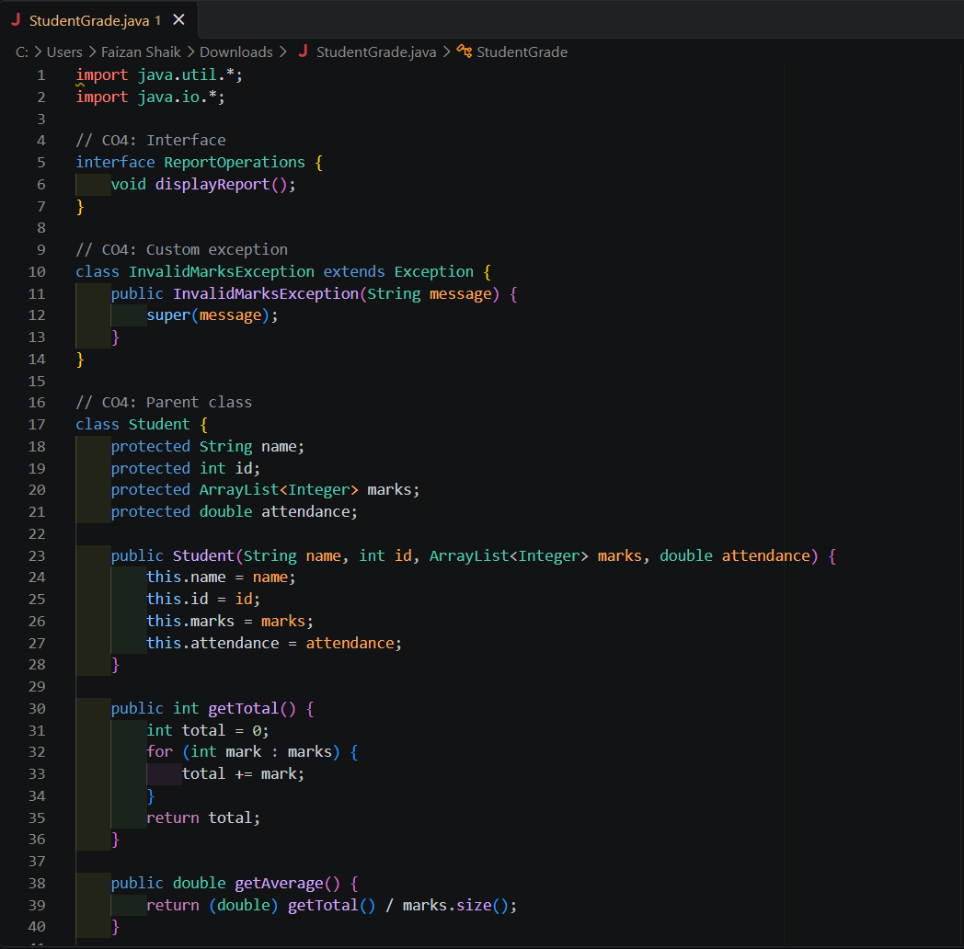
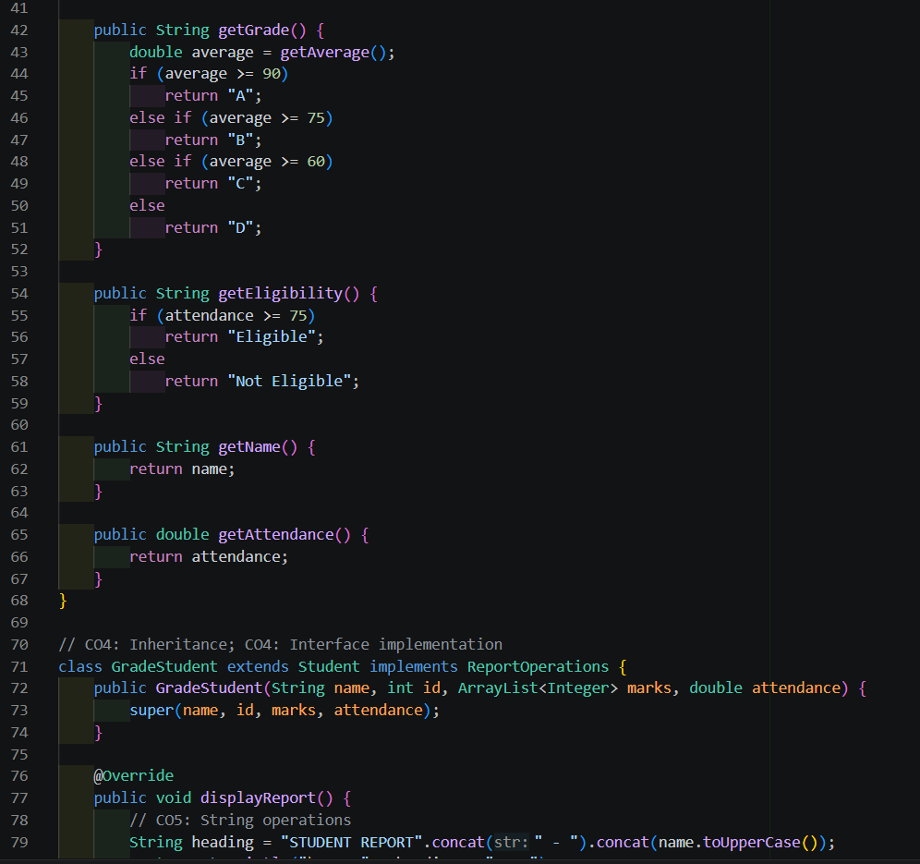
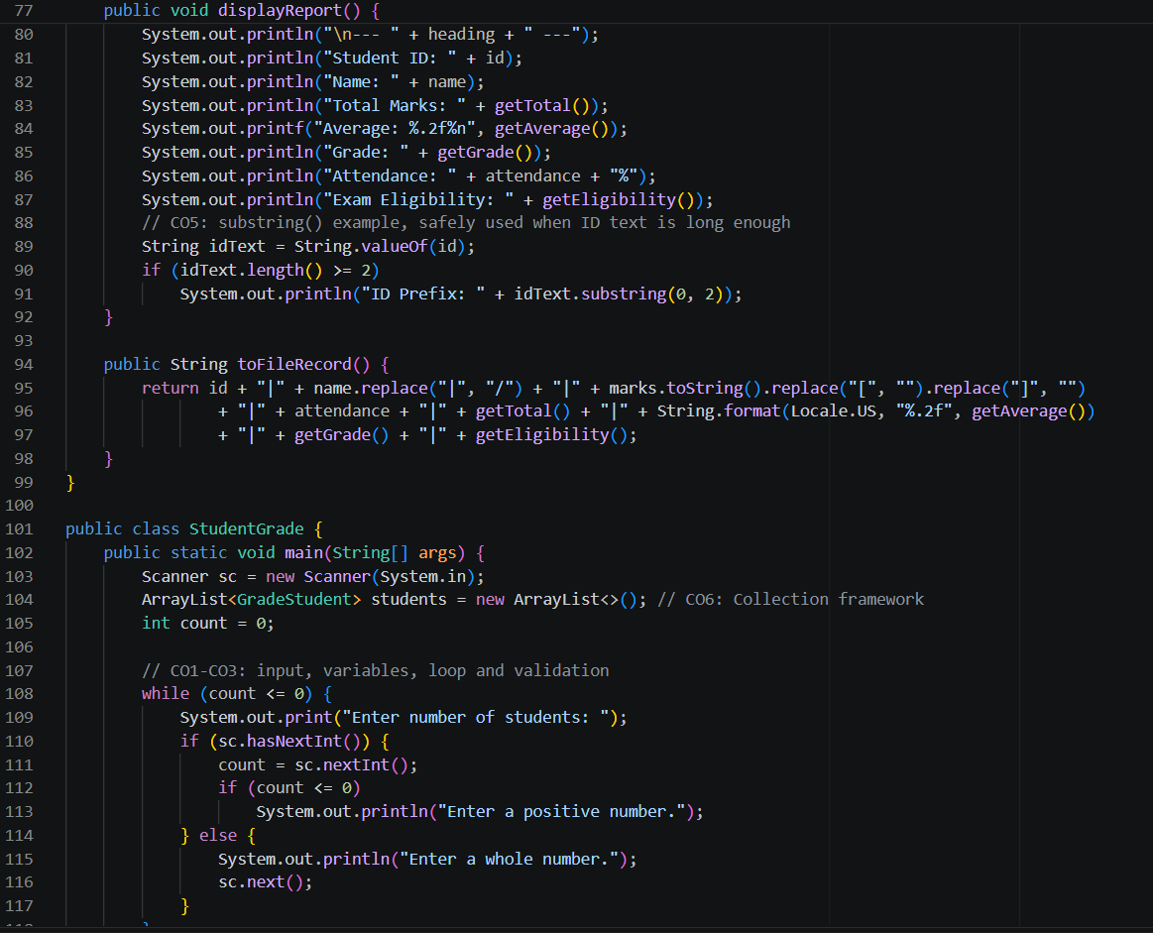
CODE

Slide 11
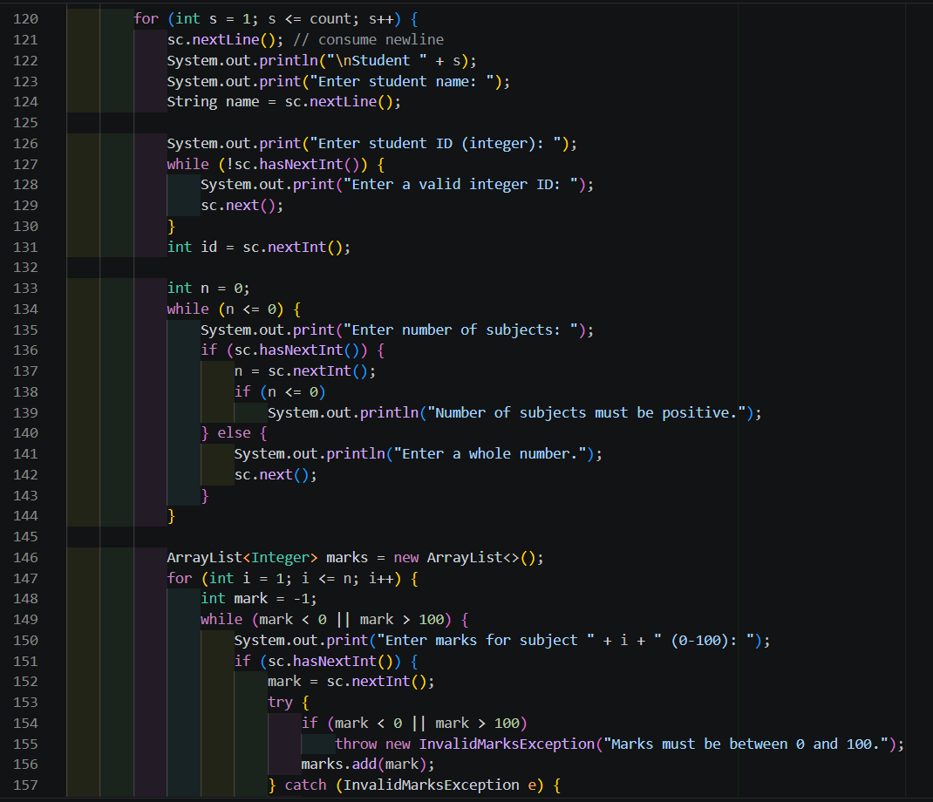
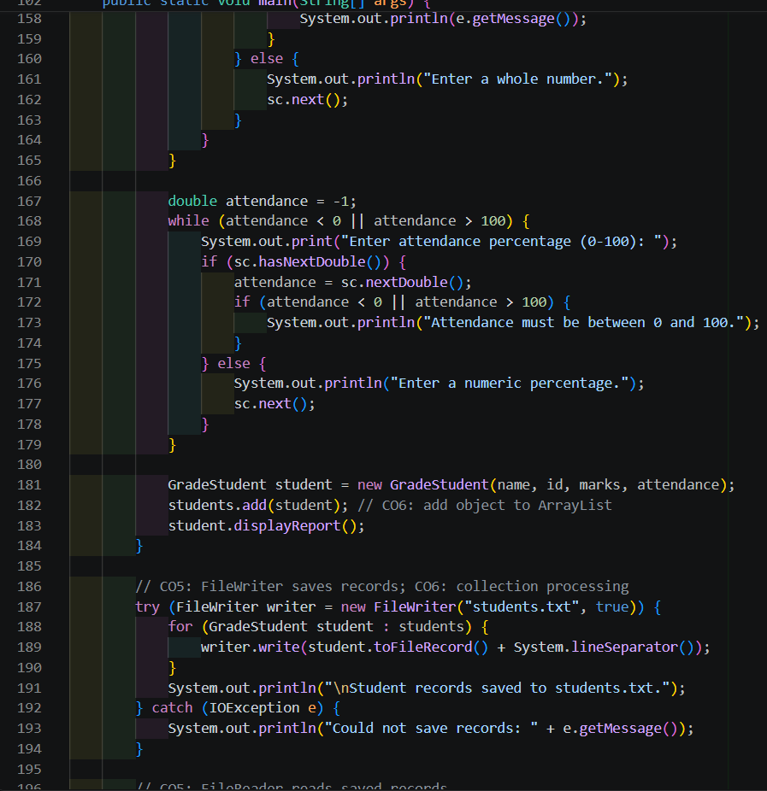
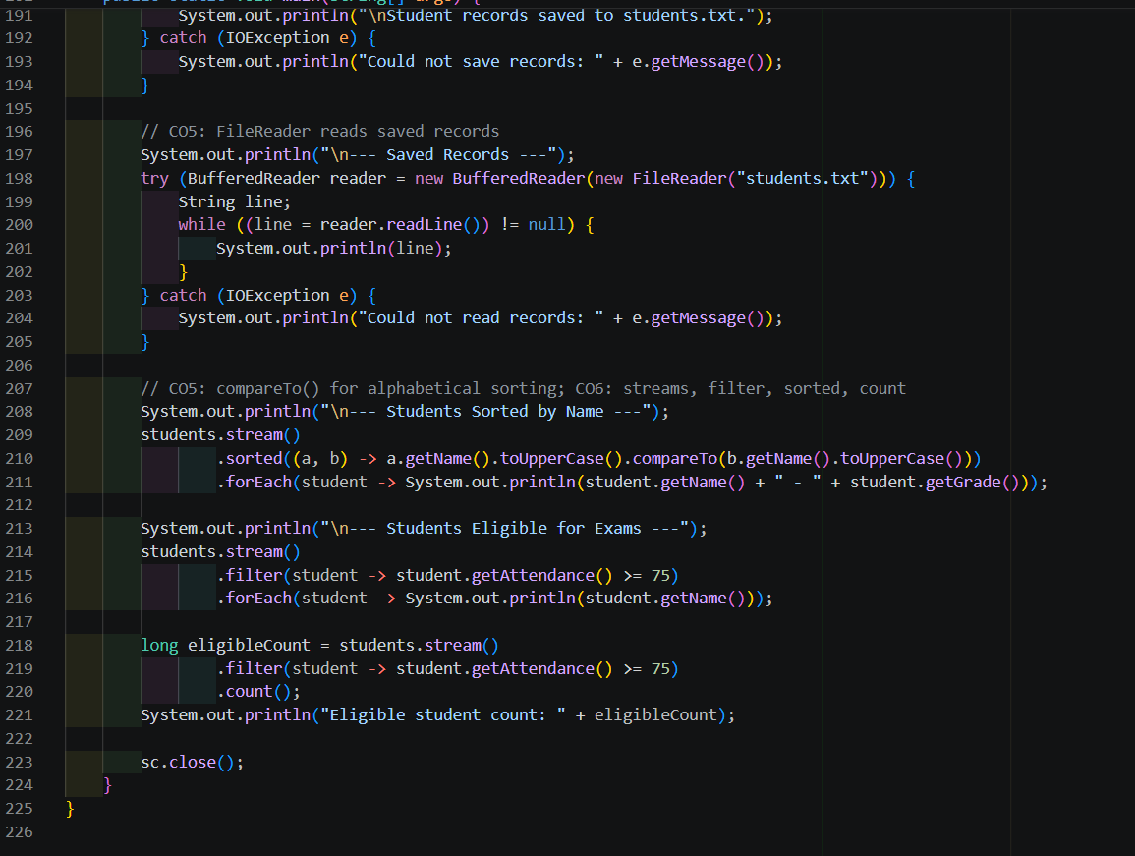
CODE

Slide 12
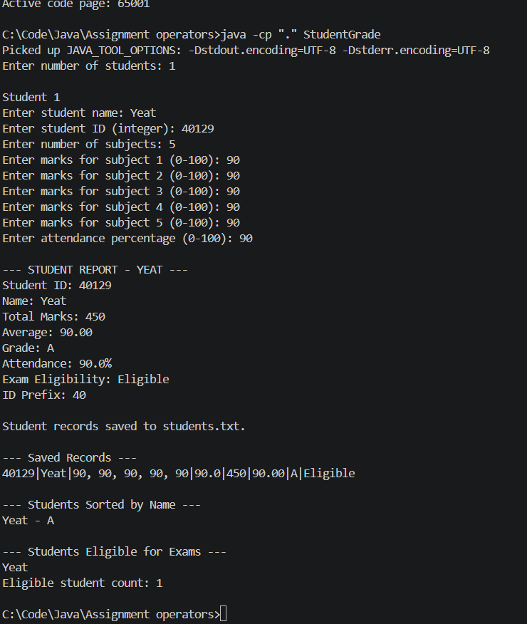
OUTPUT

Slide 13

SAMPLE OUTPUT
Final Academic Status Report
Student Summary
Academic Status
===== STUDENT STATUS REPORT =====
Student Name: Anita
Subjects: 5
Total Marks: 412
Average Marks: 82.4
Grade: A
Attendance: 82.5%
Exam Eligibility: Eligible
Status: Academic report generated
Future scope: database, course-wise tracking, analytics, downloadable reports
Report fields:
Name · Subjects · Total · Average · Grade · Attendance · Eligibility
Student report generated successfully!
Grade: A
Attendance: 82.5%
Student Name : Anita
Subjects : 5
Average Marks : 82.4
Total Marks : 412
Grade : A
Eligibility : Eligible
Academic status generated
successfully

