Slide 1

UNIVERSITY GRADE AND ATTENDANCE TRACKER
KLH/PSPJAVA / Section-8 /Batch-27
Faizan Shaik
Swadhin Behera
2620040127
2620040149

Slide 2


1. Introduction
A simple Java console application for student performance tracking
PURPOSE
INPUTS
OUTPUTS
Collect student details, process marks, calculate average and grade, then check exam eligibility from attendance.
Student name, number of subjects, marks for each subject, and attendance percentage.
Total marks, average marks, grade, and exam eligibility in a final student report.
INPUT → PROCESS → DECISION → REPORT
Student data
Calculations
Grade + attendance
Final report

Slide 3
2. Problem Statement
The project brings the core student tracking steps into one Java workflow
THE PROBLEM
1 — INPUT HANDLING
Student marks and attendance are separate pieces of information, but the final academic status depends on processing both. The project therefore needs a single program that accepts the required inputs, validates them, calculates performance, and reports eligibility consistently.
Accept the required student and subject data.
2 — PERFORMANCE
Convert subject marks into total and average values.
3 — DECISION
Assign a grade and apply the 75% attendance rule.
4 — REPORTING
Present the processed result in one final report.

Slide 4
3. Objectives
What the project is designed to accomplish
Collect input
Validate marks
Calculate performance
Read student name, subject count, subject marks, and attendance using Scanner.
Allow marks only in the 0–100 range and reject invalid values.
Compute total marks and average across all subjects.
Assign grade
Check eligibility
Generate report
Use an else-if ladder with A, B, C, and D thresholds.
Use attendance ≥ 75% as the exam-eligibility condition.
Display all important academic details in one final output.

Slide 5
4. Existing System
Baseline approach before the proposed single-program workflow
SEPARATE STEPS
LIMITATION OF A SEPARATE PROCESS
Enter marks
REPEATED MANUAL PROCESS
Subject values handled individually
Without a single workflow, the calculations and eligibility check must be coordinated step by step. The proposed program combines these operations in one executable flow.
Calculate average
Total divided by subject count
PROJECT BASELINE
Assign grade
The current project source is a console-based Java program, so the “existing system” here is the baseline process that the program consolidates rather than a separate software product.
Compare average against grade bands
Check attendance
Compare attendance with 75% threshold

Slide 6
5. Proposed System
A console-based Java solution using Scanner, loops, validation, and conditional logic
01
02
03
04
05
06
07
Scanner input
→
Validate subject count
→
Validate marks
→
Calculate total + average
→
Assign grade
→
Check 75% attendance
→
Display report
WHY THIS DESIGN?
CORE JAVA CONCEPTS
Simple control flow, clear validation, and direct console output make the project easy to trace.
Scanner, while loop, for loop, arithmetic, if-else, else-if ladder, and String output.

Slide 7
6. System Architecture
Data flows from user input to the final student report
INPUT
VALIDATION
PROCESSING
DECISION
USER
→
Scanner
Name • Subjects • Marks • Attendance
→
Input checks
Subjects > 0
Marks 0–100
→
Total + Average
Grade classification
→
Attendance ≥ 75%?
Student / operator
REPORT
Final
Student Report
Grade + eligibility are combined in the final output.

Slide 8
7. Functionalities
Core features implemented in the Java source
Input collection
Subject loop
Reads name, number of subjects, marks, and attendance.
Processes each subject using a for loop.
Validation
Performance calculation
Subjects must be positive; marks must be 0–100.
Computes total and average marks.
Grade classification
Attendance eligibility
A ≥ 90; B ≥ 75; C ≥ 60; otherwise D.
75% or above = Eligible; below 75% = Not Eligible.
Final report
Prints name, total, average, grade, and exam eligibility.

Slide 9
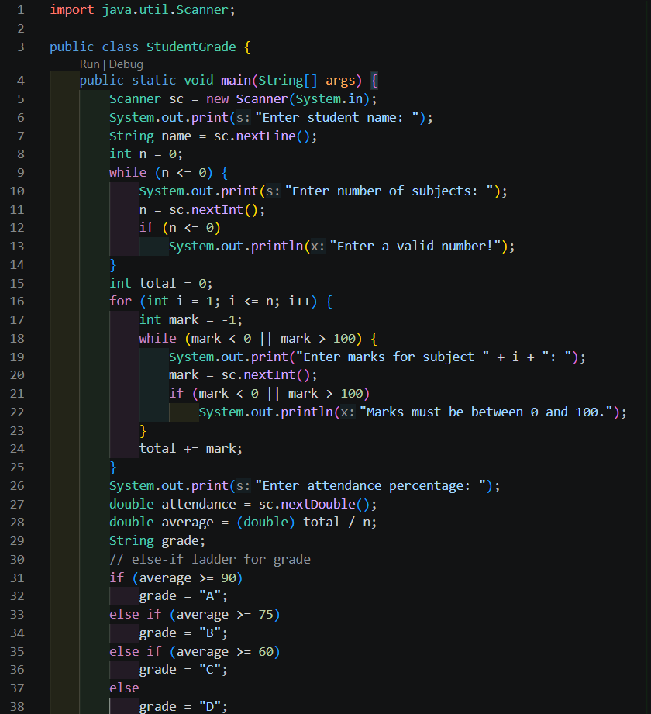
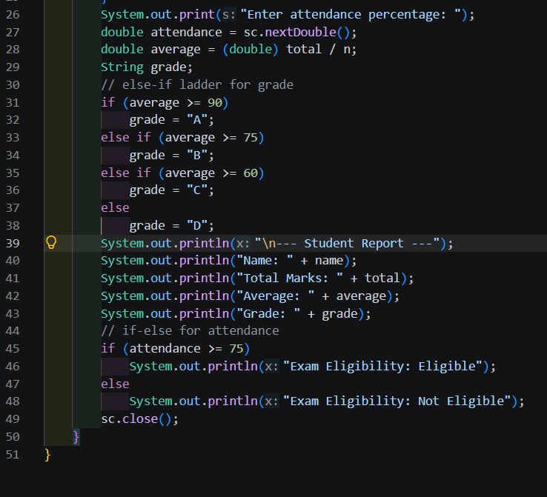
8. Implementation – Java Code Screenshots
Key sections of StudentGrade.java
JAVA SOURCE: StudentGrade.java

Slide 10
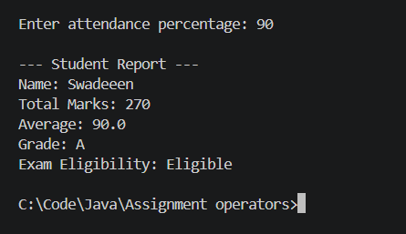
9. Output Screenshots
Sample console result based on the project report format
Sample run shown from the project’s documented output format.

Slide 11
10. Future Scope
10/13
Ways the current console tracker could be extended
Persistent records
Course-wise tracking
Store multiple students and retain their results using files or a database.
Track marks and attendance separately for each course or semester.
Weighted grading
User interface
Support assignments, labs, internals, and end-semester components.
Add a graphical interface or web interface instead of console-only input.
Analytics
Automated reporting
Provide class averages, attendance summaries, and performance trends.
Generate downloadable student report cards or summary files.

Slide 12
11. Conclusion
What the completed project demonstrates
ONE COMPLETE STUDENT TRACKING FLOW
Input
Process
Decide
Report
Collects required student data.
Calculates total and average.
Assigns grade and checks attendance.
Displays the final student status.
The project applies basic Java control structures to automate academic calculations and attendance-based exam eligibility.

Slide 13
THANK YOU
University Grade and Attendance Tracker
Faizan Shaik • Swadhin Behera
2620040127 • 2620040149
Faculty Guide: Gopi Krishna

