Slide 1
A Genetic Algorithm for Task Scheduling
Sean Strickland, Theisen Sanders

Slide 2
Introduction
Goals
Apply a genetic algorithm to a well-known problem
Provide a mechanism to help others understand how genetic algorithms work

Slide 3
Task Scheduling (I)
Problem: An optimization problem in which tasks T₁, T₂, …, T_{n} are allocated to any number of processors.
Goal: To reduce the total time it takes to complete all the tasks and to minimize the prioritized flow time.
Notes:
Total Time - the total time it takes for the last task to complete
Prioritized flow time - based on task priority, minimize the sum of the completion time of all jobs.

Slide 4
Task Scheduling (II)
Constraints:
Procedural
Temporal
This is a NP-Complete problem so no optimal solution can be found in polynomial time when there are 3+ processors.
Notes:
Procedural - Task dependencies
Temporal - Tasks must finish before a specified time

Slide 5
Genetic Algorithms
Genetic algorithms are local search algorithms in which a population of solutions is evolved over generations to produce better solutions.
Main Components:
Solution Encoding
Fitness Function
Crossover Function

Slide 6
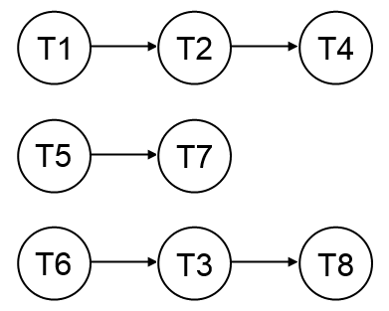
Our Algorithm (I)
Initialization - Use minimum completion time to generate initial population
Fitness - Weighted sum of total time and prioritized flow time
Selection - Roulette selection based on fitness values

Slide 7
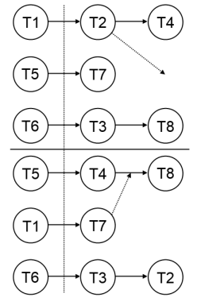
Our Algorithm (II)
Crossover - Randomly select crossover index to split each parent into two sections. Combine diagonally adjacent sections to produce two children.
Mutation- Randomly choose a task and move it to a random (dependency obeying) position in the schedule.

Slide 8
Implementation (t)
Frontend:
The constraints and tasks are created on the frontend using an AngularJS framework.
Backend:
The tasks/constraints are submitted to the algorithm written in Python and results are returned to the frontend for display.

Slide 9

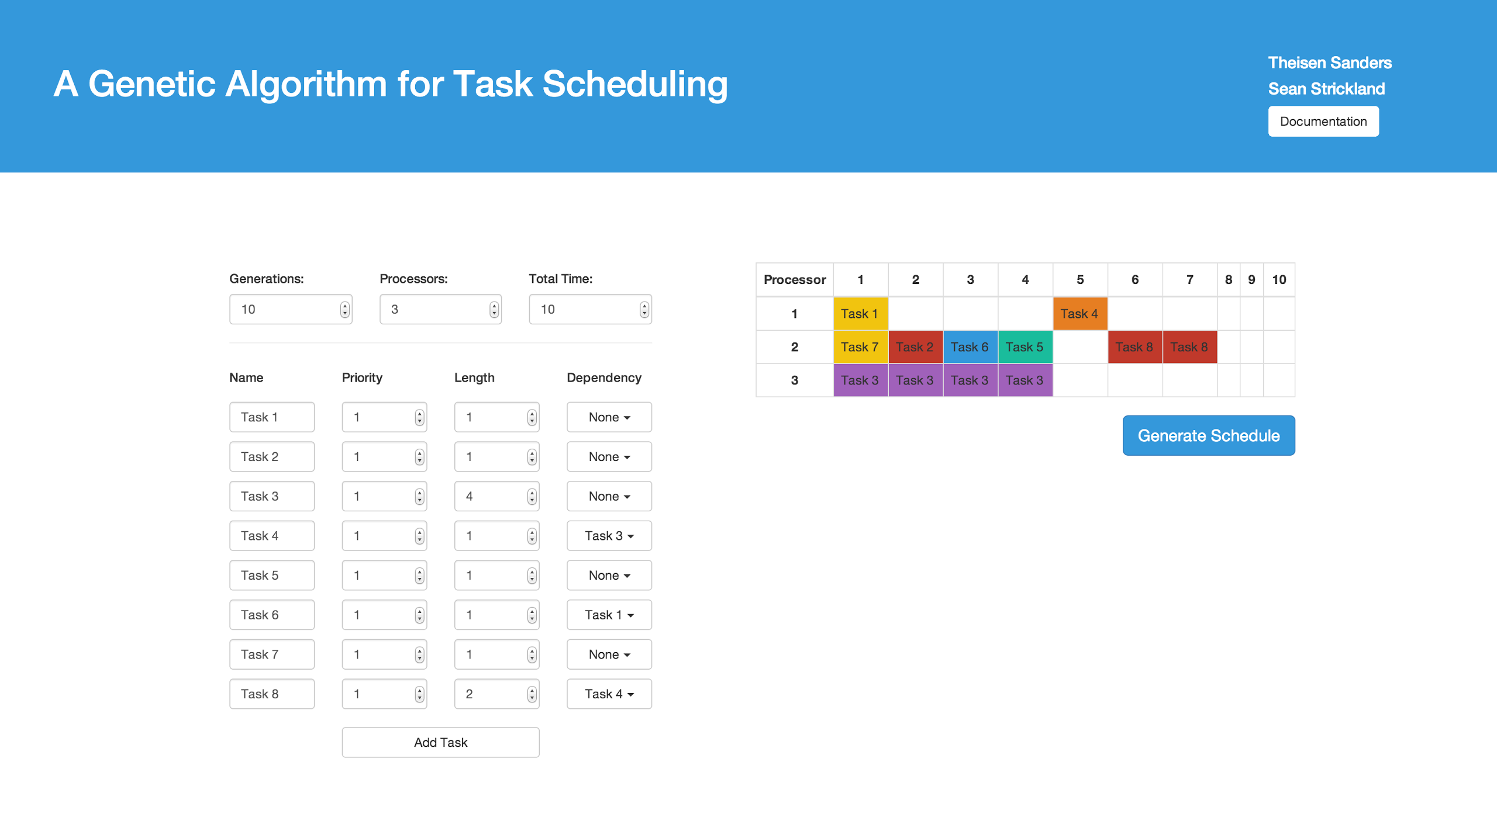
Demo

Slide 10
Results
Test # | Tasks | Dependencies | Processors | MCT Total Time | MCT Flowtime | GEN* Total Time | GEN* Flowtime
1 | 3 | 0 | 2 | 5 | 25 | 4 | 23
2 | 6 | 3 | 2 | 16 | 211 | 15 | 201
3 | 10 | 5 | 3 | 16 | 433 | 14 | 417
4 | 15 | 8 | 3 | 17 | 495 | 15 | 455
* Run for 10 generations

Slide 11
Conclusion
Genetic algorithms can improve the solution obtained from basic task scheduling heuristics while having a minimal effect on performance.
As with all genetic algorithms, performance and optimality of results are in the fine-tuning.

Slide 12
References
Garey, M. R., D. S. Johnson, and R. Sethi. "The Complexity of Flowshop and Jobshop Scheduling." Mathematics of Operations Research 1.2 (1976): 117-29. Print.
Kaur, Kamaljit, Amit Chhabra, and Gurvinder Singh. "Heuristics Based Genetic Algorithm for Scheduling Static Tasks in Homogeneous Parallel System." International Journal of Computer Science and Security 4.2 (2010): n. pag. Print.

Slide 13
Questions?

